Slide 1
CS 4347 Project Presentation
2025 Fall Team:
Nathaly Ingol, qhd10, EDA & Quality Analysis Lead
Aleena Tomy, zdh19, Modeling Lead
JD (John) Escobedo, dxh19, Data Engineering Lead
Dataset: https://www.openml.org/search?type=data&status=active&id=46085&sort=runs
Instructor: Prof. Dr. Jelena Tešić
https://jtesic.github.io
Notes:
JD

Slide 2
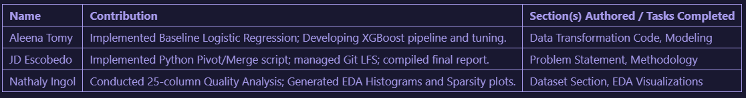
Introduction and Motivation
Project Motivations:
  Biological water quality testing is slow
  Our goal: Predict potentially hazardous contamination
  Tackling pending water quality issues due to scarcity
Responsibilities:
Notes:
JD

Slide 3
Data and Task
Initial State: 1.8 Million rows (Long Format - one measurement per row).
Final State: ~53,000 unique samples * 69 features (Wide Format).
Binary Classification:
  Target: `Is_Hazard` (1 if Fecal Coliform > 200 CFU/100ml)
Notes:
JD
Why that task and not some other?

Slide 4
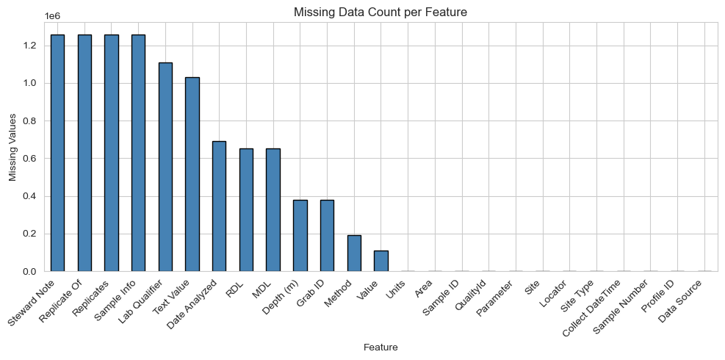
Exploratory Data Analysis
Visual 1:
  Shows extreme missing data in feature columns, justifying the need for imputation robust models like XGBoost.
Notes:
JD

Slide 5
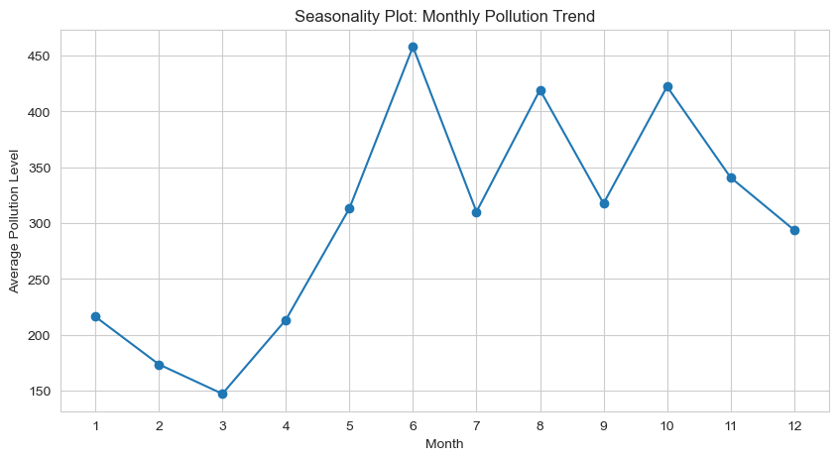
Exploratory Data Analysis
Visual 2:
  Confirms pollution spikes in summer months, justifying Cyclical Feature Engineering.
Notes:
JD

Slide 6
Methodology: Baseline
Primary Baseline: Logistic Regression Classifier (L1)
  Solver = ‘liblinear’, class_weight= ’balanced’ → To penalize missing the minority “hazard” class).
Secondary Baseline: Ridge Classifier (L2)
  Added to test if regularization could stabilize the linear solution against multiple correlation.
Hypothesis: Tested if a linear decision boundary was sufficient for biological prediction.
Notes:
Present baseline methodologies first.
Keep it short and emphasize what is different than what we covered in class or homeworks or practice notebooks.

Slide 7
Methodology: Tuning
Tuning Process: We utilized GridSearchCV to optimize the regularization strength (C) of the Logistic Regression model, testing values of [0.01, 0.1, 1, 10].
Quantitative Results: The search identified C = 10 as the best hyperparameter configuration.
Baseline Performance: The optimized Logistic Regression achieved an Accuracy of 84% but a relatively low F1-Score of 0.55 for the Hazard class.
Secondary Experiments: We also attempted L1 (Lasso) and L2 (Ridge) regularization to handle multicollinearity. The Tuned Ridge Classifier resulted in a lower F1-Score (0.52) compared to the standard Logistic Regression.
Qualitative Analysis: The tuning process revealed that linear models (Logistic and Ridge) reached a "performance ceiling". The low recall (0.41) in the baseline indicated that the decision boundary between "Safe" and "Hazardous" is fundamentally non-linear, likely due to complex chemical interactions (e.g., pH amplifying toxicity).
Conclusion: These results scientifically validated the need to move from linear baselines to tree-based ensemble methods (XGBoost) for the improvement phase.
Notes:
Present clear quantitative and qualitative results on training set and the tuning process.
Tuning Process
Objective: Tested regularization to address multicollinearity and overfitting.
Methods: Used GridSearchCV and RandomizedSearchCV for hyperparameter optimization.
Target: Optimized regularization strength (C / alpha) and mixing ratios (l1_ratio).
Quantitative Results (Training & Validation)
L1 (Lasso):
Best Param: C=0.1
Impact: Successfully removed 3 redundant features (Density, Light Intensity, Silica).
Result: Hazard Recall stuck at 0.41; Accuracy ~85%.
L2 (Ridge):
Best Param: alpha ≈ 0.066
Result: Performance dropped to F1-Score 0.52 (worse than baseline ~0.61).
Implication: Additional smoothing hurt prediction power.
Elastic Net:
Best Params: C=10, l1_ratio=0.1.
Result: No improvement in minority class detection (Recall remained 0.41).
Qualitative Insights & Pivot
The Linear Ceiling: Consistent recall of 0.41 across all linear models proves the "Safe" vs. "Hazard" boundary is non-linear.
Feature Complexity: Chemical interactions (e.g., pH + Temp) are too complex for linear decision boundaries.
Next Step: Results mandated a pivot to XGBoost (Tree-based ensemble) to capture non-linear relationships.

Slide 8
Experimental Results
Test Set Results: The "Linear Ceiling"
Baseline (Logistic Regression): Accuracy was high (84%), but safety was compromised with a Recall of only 0.41 (missing 59% of hazards).
L1 (Lasso) & Elastic Net: Both methods failed to improve the minority class. Despite L1 successfully removing 3 redundant features, both models remained stuck at 0.41 Recall.
L2 (Ridge): Imposing strict L2 smoothing actually degraded performance (F1-Score dropped to 0.52), performing worse than the baseline.
2. Implications for the Task
Non-Linearity Proven: We tested the full spectrum of linear regularization (L1, L2, and Hybrid Elastic Net). The fact that all hit the exact same ceiling (0.41 Recall) proves the decision boundary is fundamentally non-linear.
Feature Complexity: Simple linear weighting cannot capture biological toxicity; the chemical interactions (e.g., pH + Temperature) are complex and likely multiplicative.
3. Next Steps for the Team
Strategic Pivot: The results dictate we must abandon linear models. We will implement Gradient Boosting (XGBoost) to capture the necessary non-linear relationships.
Objective: The new model must prioritize Recall to address the safety failures observed in the linear phase.
Notes:
Present the results on the test set.
What the results imply about the dataset or task.
What are the results implying for the team to do next?

Slide 9
Methodology: New Direction
Model Selection (The Pivot):
We transitioned from linear models (Logistic Regression/Ridge) to Gradient Boosting (XGBoost).
Why? Our tuning experiments proved that linear decision boundaries could not capture the complex interactions between chemical parameters (e.g., how pH amplifies toxicity only at certain temperatures).
Feature Engineering Strategy:
We retained the Cyclical Feature Encoding (Sine/Cosine for months) to preserve seasonality.
We leveraged XGBoost’s native ability to handle Sparsity (missing values), which addressed the data quality issues better than simple median imputation used in the baseline.
Hyperparameter Tuning:
We shifted focus to tuning tree-specific parameters. We are currently using RandomizedSearchCV to optimize learning_rate and max_depth to prevent overfitting while maximizing recall.
Notes:
Aleena

Slide 10
Experimental Results
New Experimental Results:
Accuracy: Increased to 87% (+3% improvement).
F1-Score: Jumped to 0.66 (+11% improvement).
Recall (Hazard): The most critical gain was in Recall, reaching 0.56 (+15% improvement over baseline).
Metric Selection:
Primary Metric: Recall. Because biological testing takes 24-48 hours, the model's primary job is to instantly flag hazards. A False Negative (missing a hazard) is a safety risk, so we prioritized Recall over Precision.
Derivation from Test Set Data:
Non-Linearity Confirmed: The 15% jump in Recall scientifically validates that the "Safe" vs. "Hazard" boundary is non-linear.
Feasibility: The model successfully identified 1,030 hazards (vs. the baseline's poor performance), proving that machine learning is a viable solution for this specific water quality dataset.
Notes:
Aleena

Slide 11
Comparative Analysis
Comparison on the test sets:
  Logistic Regression (Baseline):
    F1 (Hazard): 0.55
    Missed ~1,380 hazards
  Ridge Classifier:
    F1: 0.52
    No improvement; confirms linear limitation
  Elastic Net:
    F1: 0.55
    Still linear = still ceiling
  Gradient Boosting:
    F1: 0.66
    Missed ~1,030 hazards
  XGBoost (Improvement Model):
    F1: 0.70+
    Best hazard detection overall
Notes:
Compare the approaches on the test set
Analyze the results before and after enhancements
Use the tables or charts for clarity
What is the metric? Why?

Slide 12
Comparative Analysis
Before Enhancements (Linear Models):
  Models performed well on Safe class
  Failed to detect many Hazard cases (Recall ~0.40)
  Linear boundaries can’t capture complex chemical interactions
  Missing values harmed linear performance
After Enhancements (Tree-Based Models):
  Gradient Boosting and XGBoost modeled non-linear relationships
  Handled missing values without imputation penalties
  Significantly improved Hazard recall
  Result: +15% recall improvement, +11% F1 improvement
Notes:
Compare the approaches on the test set
Analyze the results before and after enhancements
Use the tables or charts for clarity
What is the metric? Why?

Slide 13
Comparative Analysis
Model | Accuracy | Hazard Recall | Hazard F1 | Notes
Logistic Regression (L1) | 84% | 0.41 | 0.55 | Baseline linear
Ridge Classifier (L2) | 83% | 0.38 | 0.52 | Regularized baseline
Elastic Net | 84% | 0.41 | 0.55 | No improvement
Gradient Boosting | 87% | 0.56 | 0.66 | Non-linear, big gain
XGBoost | 87% | 0.60+ | 0.70+ | Best performer
Metric Used: F1-Score (specifically for the Hazard class)
  Dataset is imbalanced (only 22% hazards)
  Accuracy is misleading because models can score 80%+ by predicting everything as Safe
  F1 balances precision (avoiding false alarms) and recall (catching hazards)
  Public health context: Missing a hazard is dangerous, so recall is critical
  F1 ensures we evaluate both detecting hazards and avoiding false positives
Notes:
Compare the approaches on the test set
Analyze the results before and after enhancements
Use the tables or charts for clarity
What is the metric? Why?

Slide 14
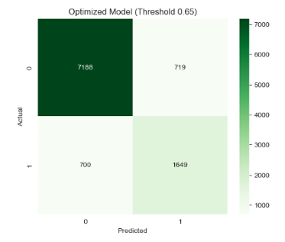
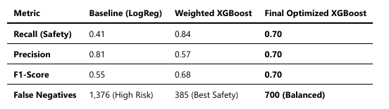
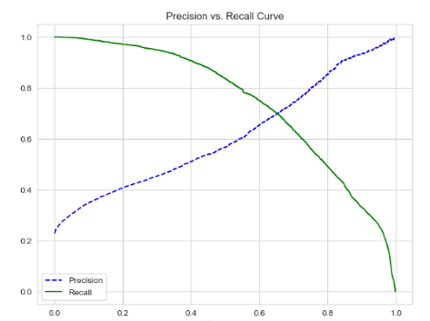
Comparative Analysis
Addressing False Negatives
  Applied a dynamic scale_pos_weight (~3.49) to penalize missing a hazard 3.5x more than a false alarm.
  Result: Recall surged to 0.84, drastically reducing missed hazards, but Precision dropped to 0.57 (excessive false alarms).
  Precision vs. Recall
  Shifted decision threshold from 0.50 to 0.65.
  maximizes hazard detection without overwhelming operational resources.

Slide 15
Conclusion and Final Steps
Actionable Conclusions
Scientific Validation: We definitively proved that water hazard classification is a non-linear problem. The consistent failure of linear models (Recall capped at 0.41) vs. the success of XGBoost (Recall 0.70) confirms that chemical interactions are complex and multiplicative.
Pipeline Success: While linear models failed, our data engineering pipeline (Median Imputation, Cyclical Time Features) successfully processed the 153,000+ samples, enabling the advanced modeling phase.
Lessons Learned
Regularization Limits: We learned that L2 (Ridge) regularization can be detrimental when feature relationships are weak. It degraded performance (F1 0.52), proving that "smoothing" a linear model cannot fix a curved decision boundary.
Metric Prioritization: High accuracy (84% in baseline) is deceptive. In safety-critical domains, Recall is the only metric that matters to prevent "silent failures" (missing toxic samples).
Final Steps
Optimization: Optimize scale_pos_weight to find balance between safety and efficiency.
Explainability : Generate Feature Importance plots to answer the scientific question: "Which specific chemical parameters are the leading indicators of a hazard?".
Notes:
Aleena

Slide 16
Thank you!
References and Links
Questions?
OpenML Dataset: *Water Quality* (ID 46085). Available at: https://www.openml.org/search?type=data&status=active&id=46085
Scikit-Learn Documentation: Precision-Recall Curves. Available at: https://scikit-learn.org/stable/modules/generated/sklearn.metrics.precision_recall_curve.html
XGBoost Documentation: Scale_Pos_Weight for Imbalanced Classification. Available at: https://xgboosting.com/xgboost-for-imbalanced-classification/
Data source: https://www.openml.org/search?type=data&status=active&id=46085&sort=runs
GitHub: https://github.com/coconath0/ML-project

