Slide 1

Notes:
This Scout clipart is my JAM
https://openclipart.org/user-detail/Scout

Slide 2

Version control systems (like Git) allow you to retain your
science karma (!) over the course of a project

Slide 3

Goals for today:
Understand what these tools are for
Create a repository (“repo”) online
Create a repo from your desktop
Push a commit
Fork a repo
Push an edit to a forked repo
Done!

Slide 4
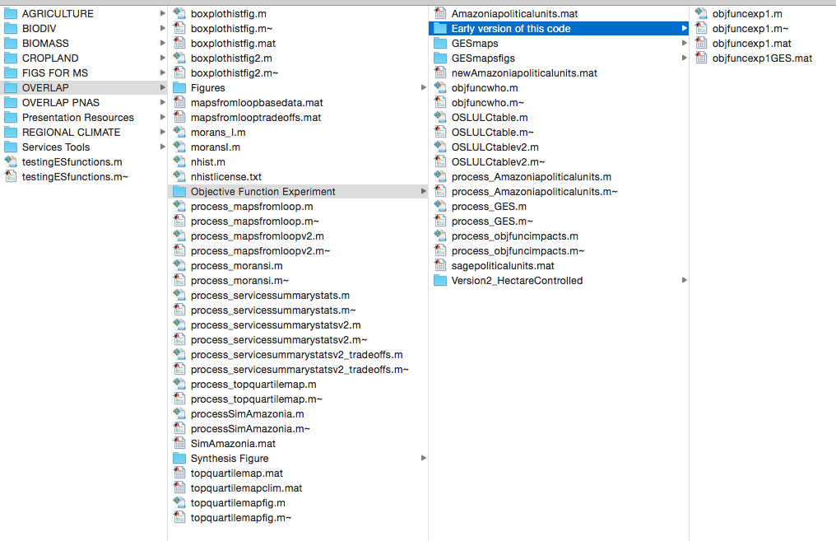
The problem that needs solving:

Slide 5
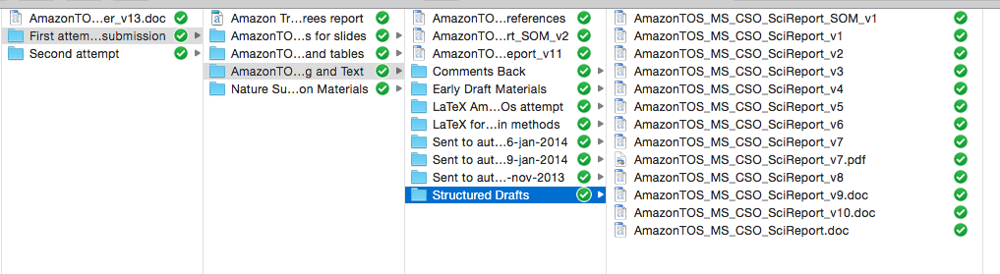


And it doesn’t apply only to code!
What is my PhD on again????
I WANT COOKIE DOUGH

Slide 6
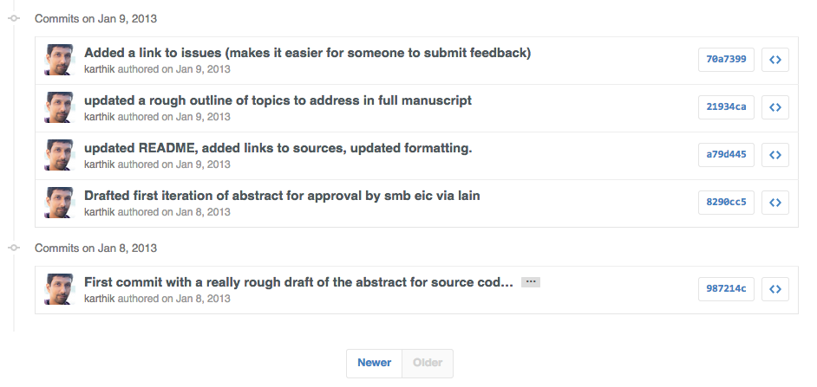
Git, a revision control system, lets you: (1) track the history of changes you’ve made (2) keeps your work reproducible (even to you!) (3) helps you keep good documentation and (4) collaborate without writing over others’ work
https://github.com/karthik/smb_git/commits/master?page=4
Notes:
Paper:
http://www.scfbm.org/content/8/1/7
Tutorials:
https://try.github.io/levels/1/challenges/1
http://www.dataschool.io/git-and-github-videos-for-beginners/
Doing this all through Rstudio
http://jonlefcheck.net/2013/11/04/a-basic-tutorial-to-version-control-using-git/

Slide 7
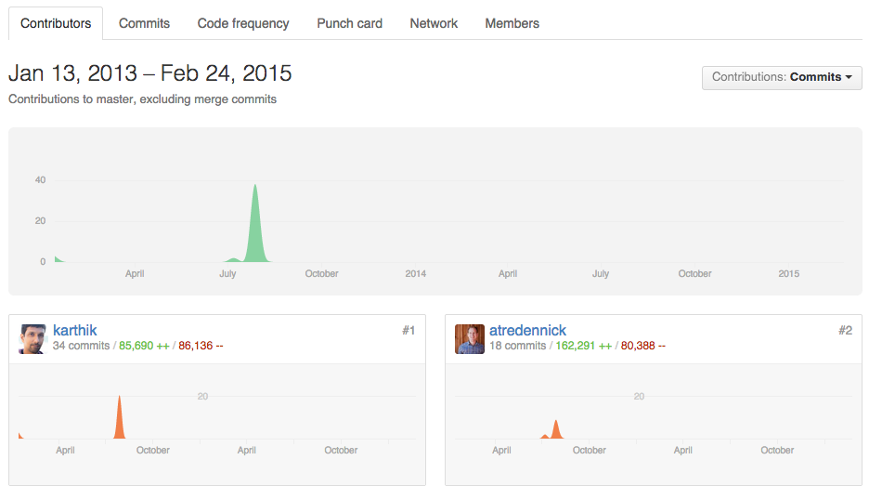
Git, a revision control system, lets you: (1) track the history of changes you’ve made (2) keeps your work reproducible (even to you!) (3) helps you keep good documentation and (4) collaborate without writing over others’ work
https://github.com/karthik/esa_data_viz/graphs/contributors
Notes:
Code can be made public
Talk about the spectrum of using this

Slide 8

Links:
https://github.com/
github.com/coconn
Let’s see an example of where PastChristine locked it down for FutureChristine
https://github.com/coconn/cso011code_TanguroN2OLosses/commits/master
Notes:
FOR EXPLANING
https://github.com/coconn/cso011code_TanguroN2OLosses/commits/master
Linux resources –
https://stackoverflow.com/questions/1516720/git-gui-client-for-linux
https://stackoverflow.com/questions/15398229/is-there-any-github-gui-client-for-linux-os
http://www.linux.com/learn/tutorials/796387-beginning-git-and-github-for-linux-users/
Command line resources
http://classic.scottr.org/presentations/git-in-5-minutes/

Slide 9

Task 1!
Log in to your Github profile
Click “Repositories”
Click “New”
Click “Initialize with a README” (best practice)
Repo to make: A storage area for a personal hero!
Click “Clone in desktop”
Save your repo wherever you like on your computer
Use google images to download a rad image
Put it in your personal hero folder on your computer
“Commit and sync”
Click refresh on your repo online
You should see the change!

Slide 10

Turn to your neighbor and take 2 minutes to think of a project at work you want to use this system for…
Task 2!
Create a new folder on your computer for that project (OR find that folder if it exists)
Go to your Github program
Click “Add a repo” (or “+”, etc.)
Find that folder!
Push that folder to Github!
Click refresh on your Github landing page online
You should see the new repo!

Slide 11

Task 3! Collaboration!
Go to https://github.com/coconn/Friday-Noon-Seminar-Git-Github
“Fork” my FNS repository
“Clone” it to your desktop
Make a file that has your best git/Github pun in it (.txt, .r, .doc, .pdf, whatever), and push it as a commit to your fork withing the Task3-Puns folder
Click “pull request” (you’re requesting that I, Christine, “pull” your edit into the original repo)
Done!

Slide 13
Some other slides that I might use as reference follow…

Slide 14
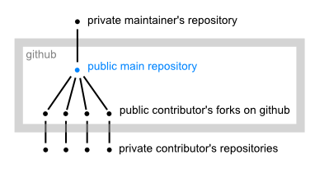
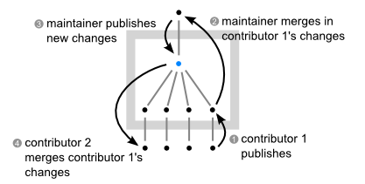
Collaborating with others
Notes:
http://www.eqqon.com/index.php/Collaborative_Github_Workflow – workflow fork-style overview
https://stackoverflow.com/questions/6286571/git-fork-is-git-clone – fork on github vs git clone
https://help.github.com/articles/using-pull-requests/ - collab models

Slide 15
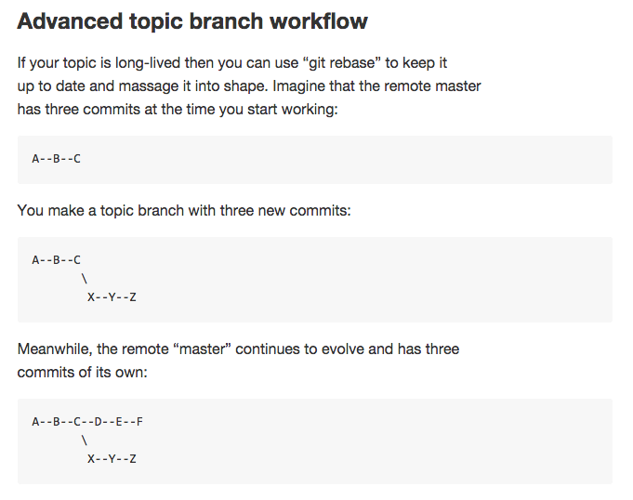
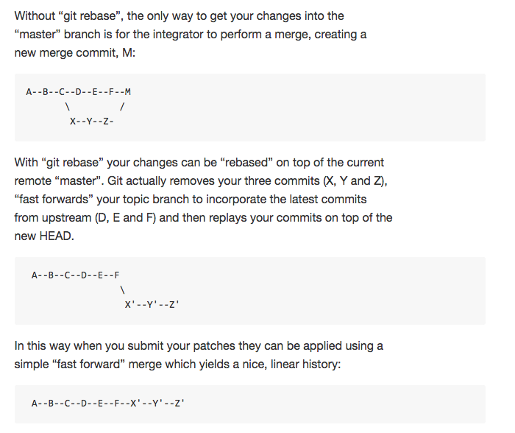
Branches
Notes:
https://github.com/dchelimsky/rspec/wiki/Topic-Branches

