Slide 1
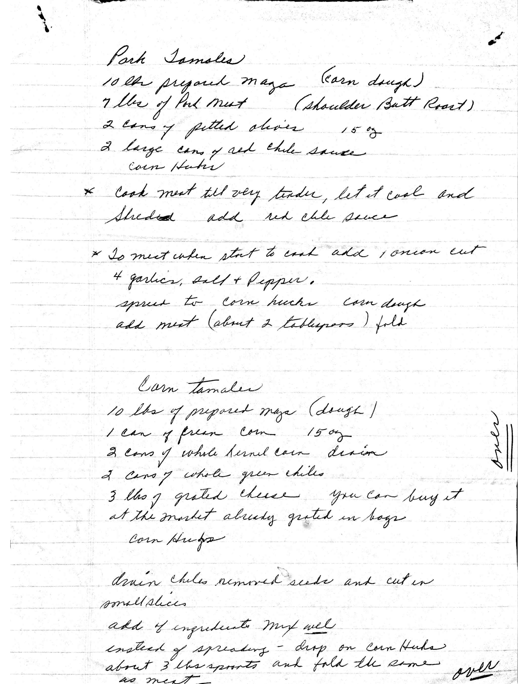
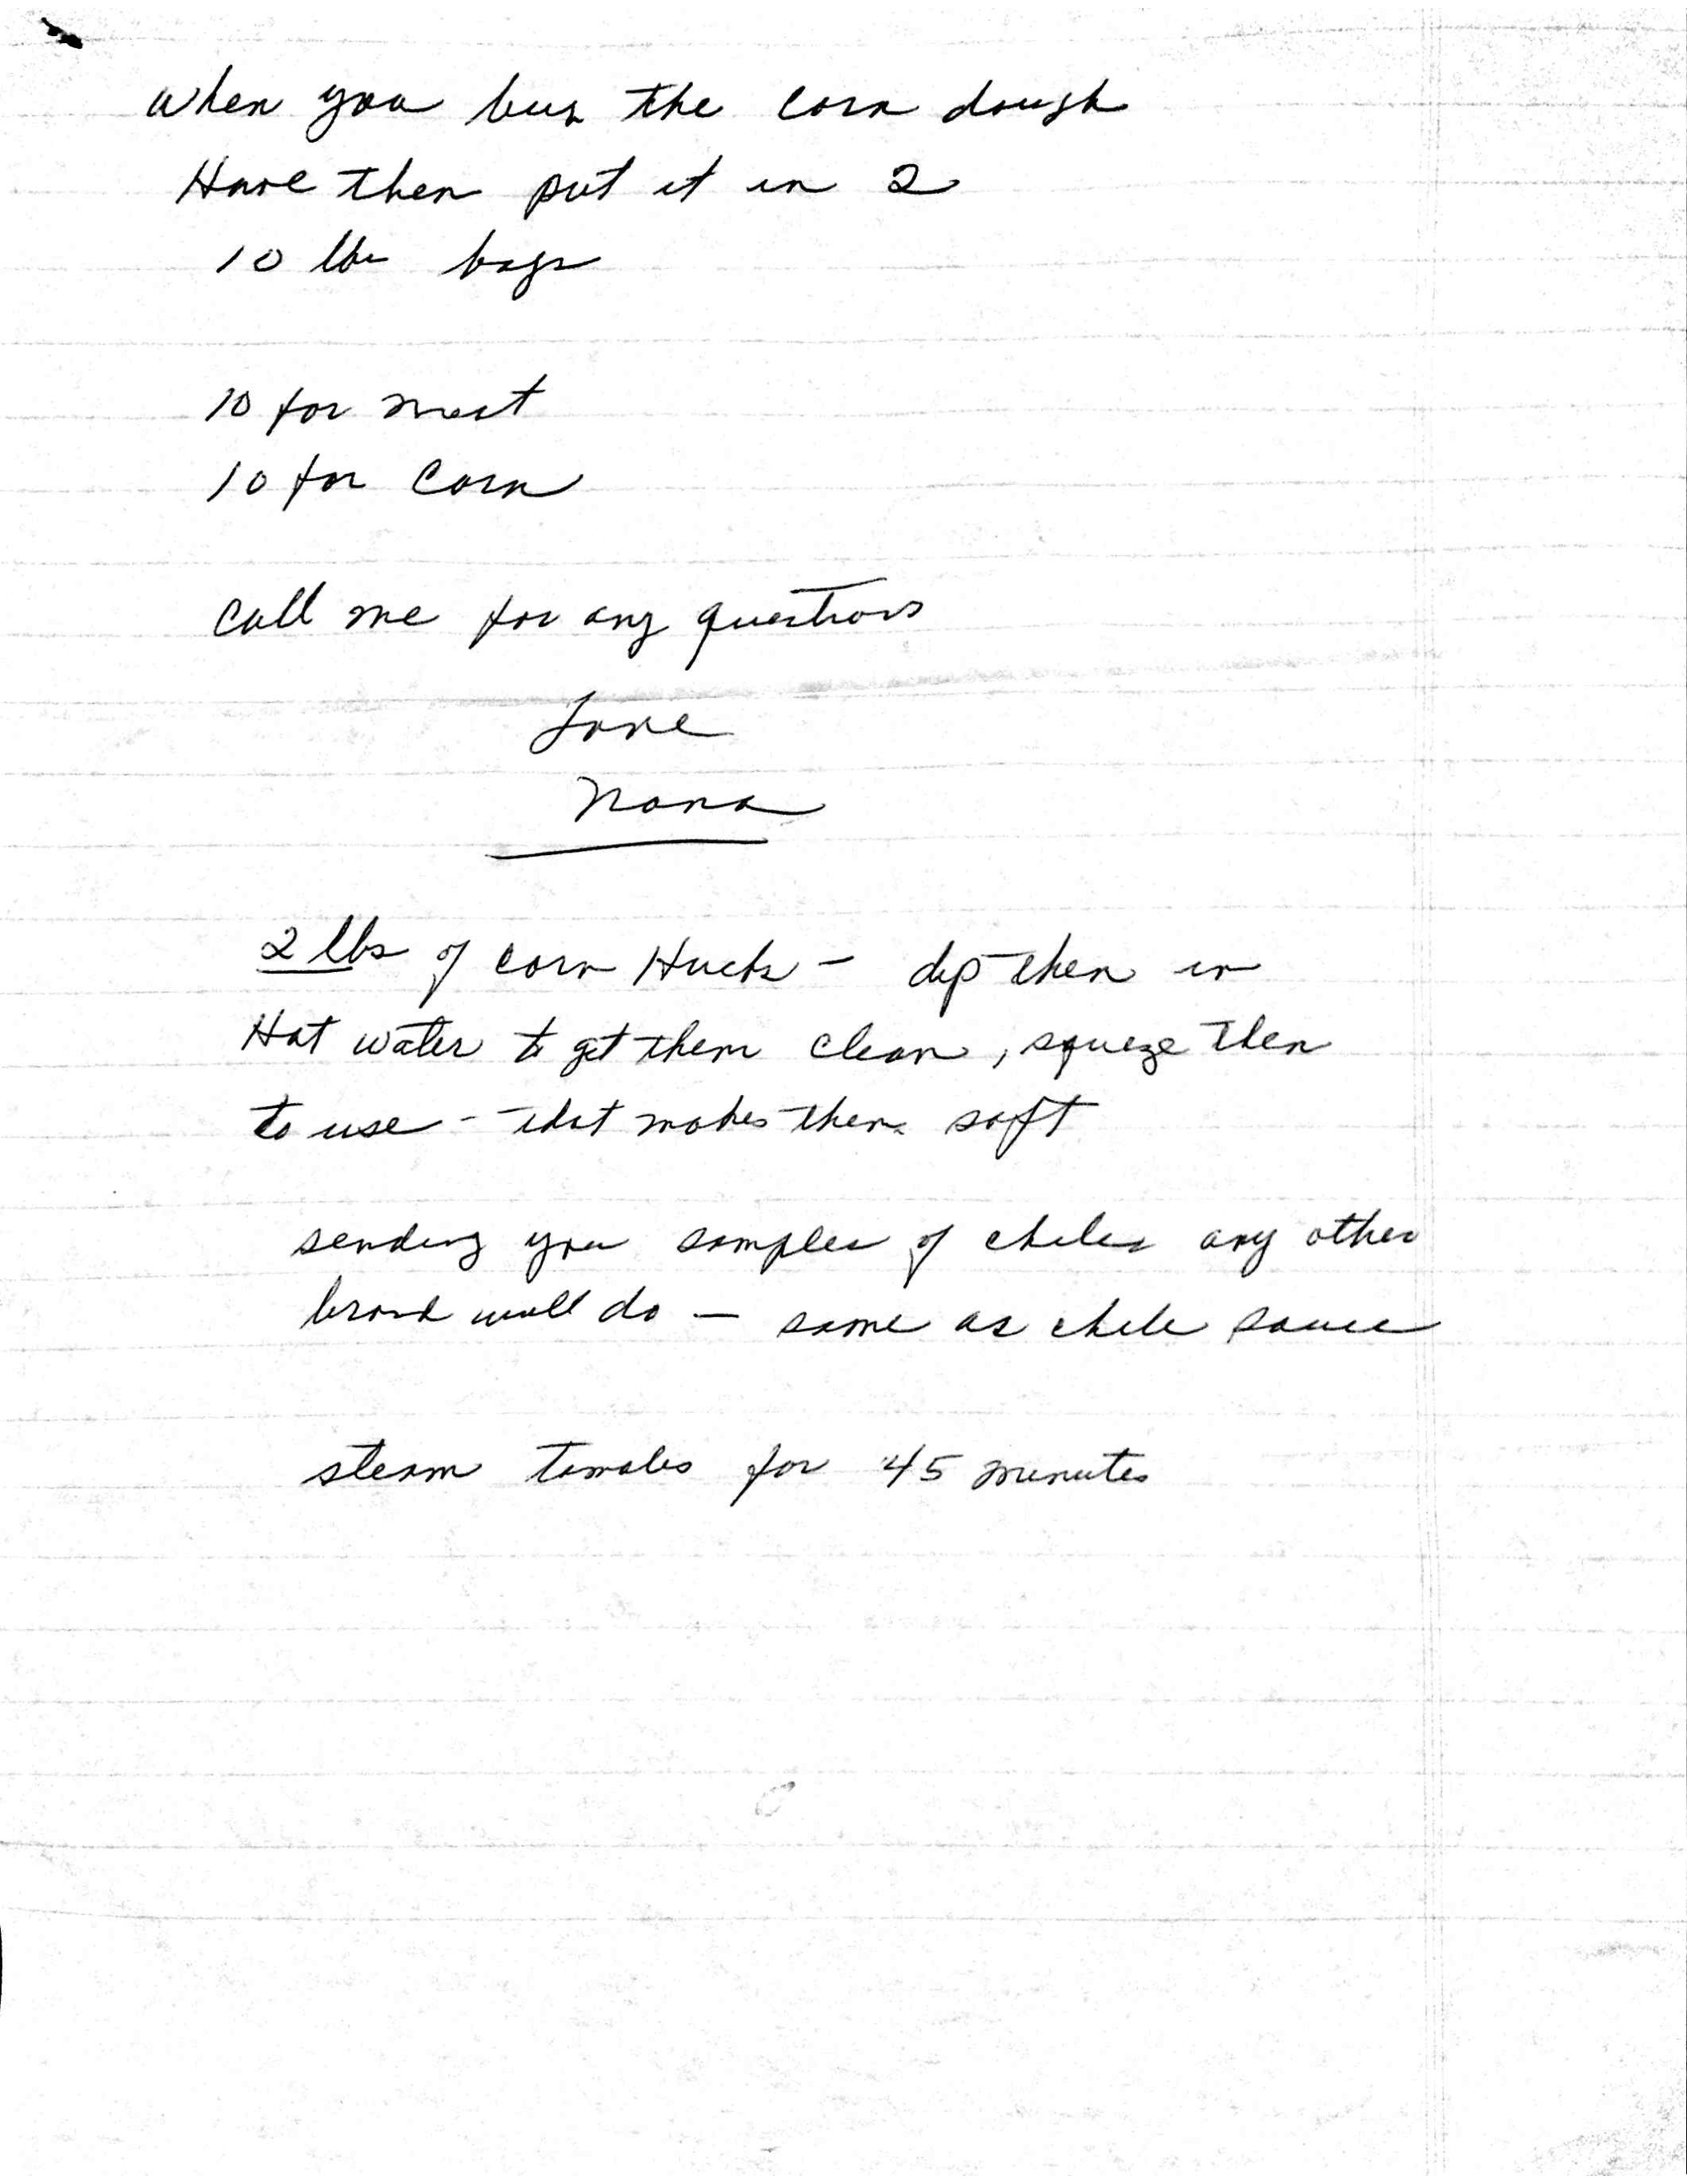
Notes:
54 w
36 h – 6 inches (1.5, 3, 1.5) = 30 / 2 (two towels) = 15
How many to make?
Nana = 4 (one yard)
Angela/steve = 2
Joey = 2
Mom/dad = 2
Me = 4
Brian = 2
= 16 total
16/4 = 4, so buy 4 yards worth

