Slide 1
Methane figures to show Sarah
Weekly mtg, 25-Feb-2015

Slide 2
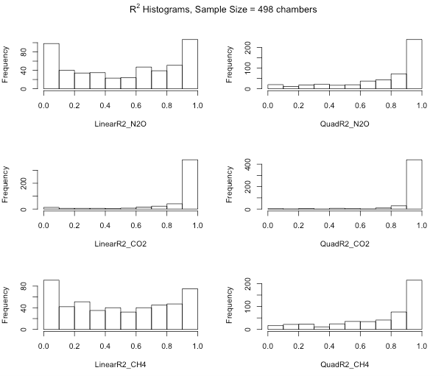
Linear R² values for methane are not much worse than N₂O

Slide 3
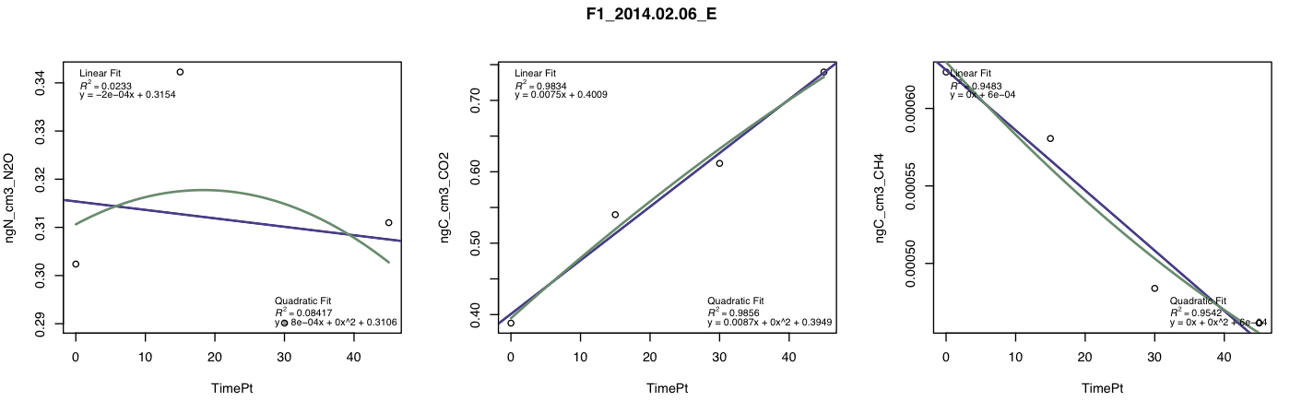
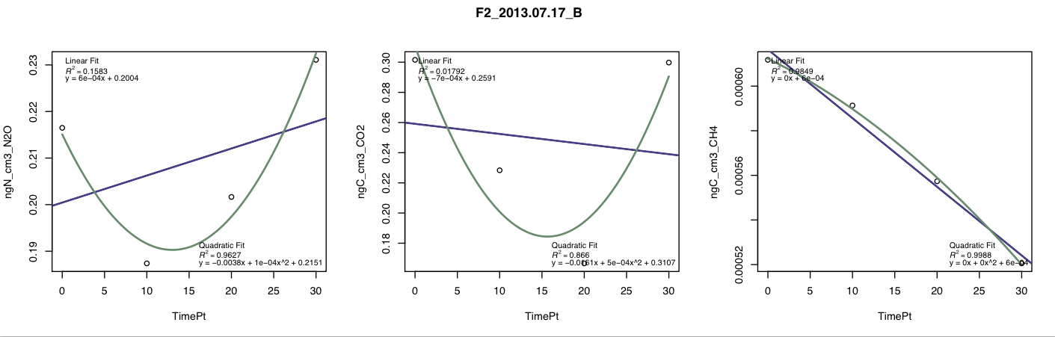
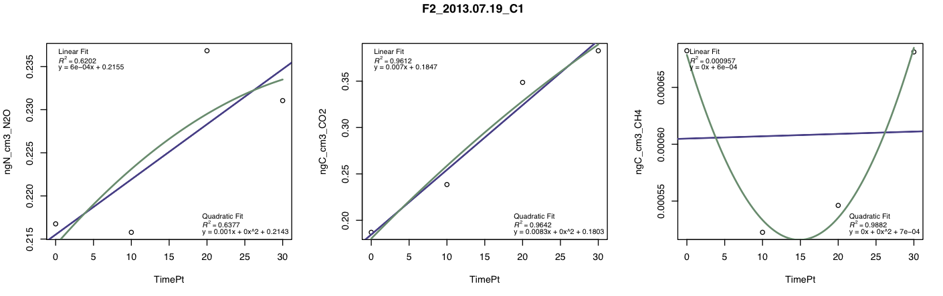
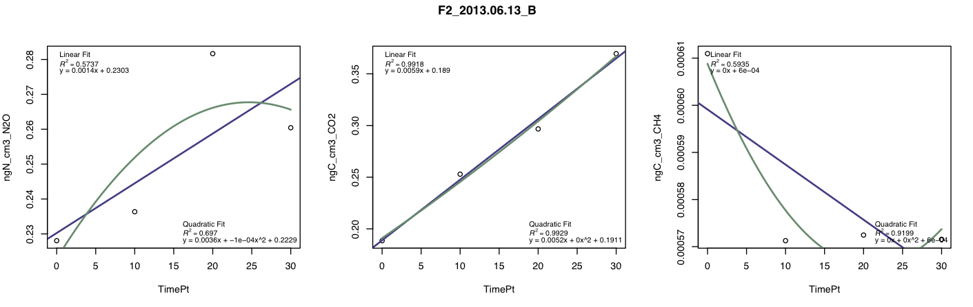
Some of these fits are pretty terrible – why would N2O and CH4 sometimes be terrible on their own without the other also being terrible? Eric says that if the CO2 fit is good, the data stays in. Right now I only bump samples if the respiration fit is poor… thoughts?

Slide 4
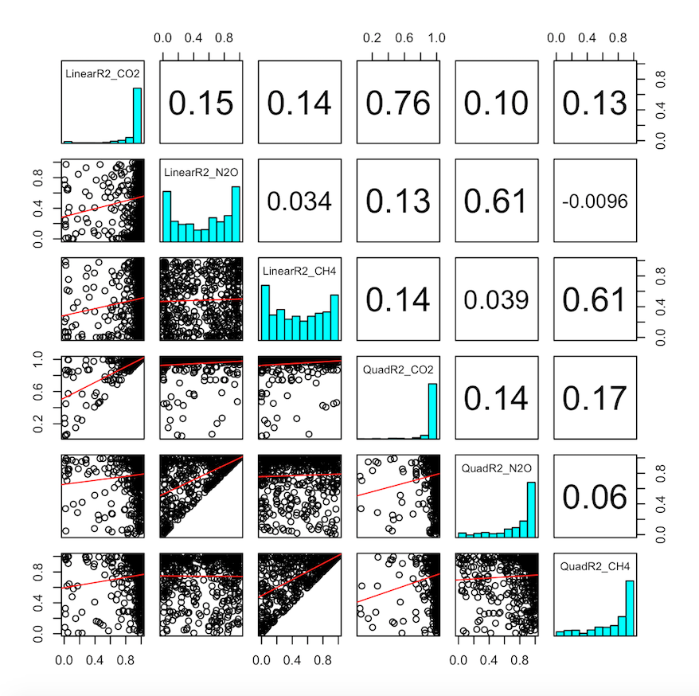

Slide 5
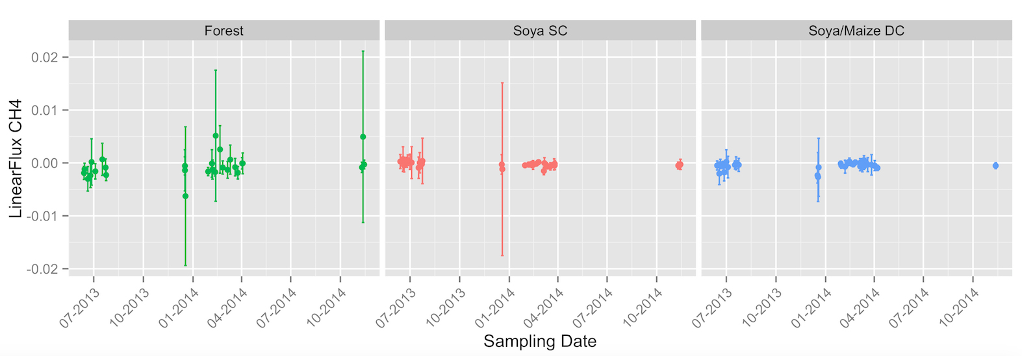
OK, so looks like weak methane uptake in both ag systems, and more clear uptake in forests. But standard deviations are consistently crossing zero. Ugggggggg – how to interpret when we already know that there are clear chamber to chamber differences?

Slide 6
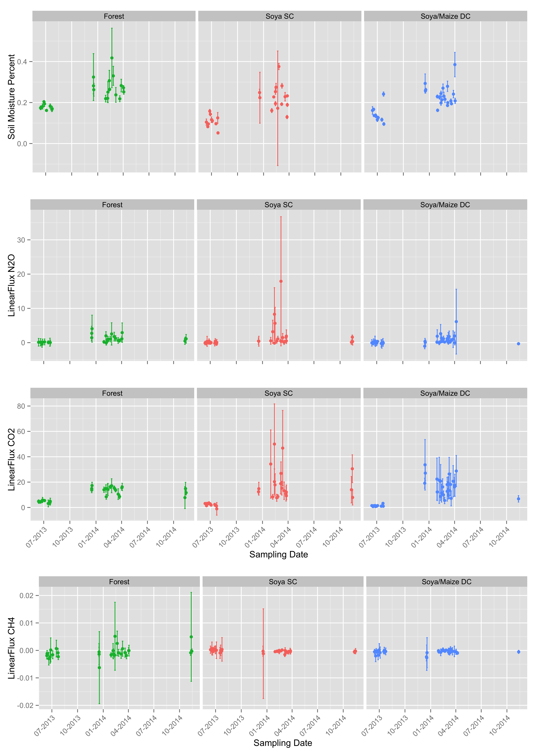
So we can compare to the other trace gases.

Slide 7
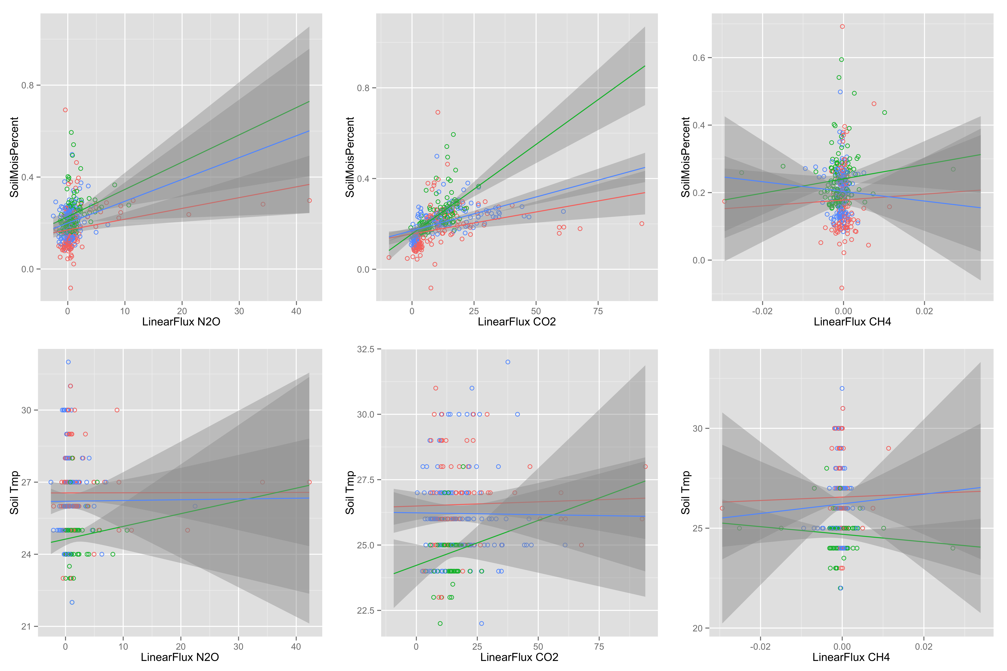
Moisture and soil temp relationships

