Slide 1
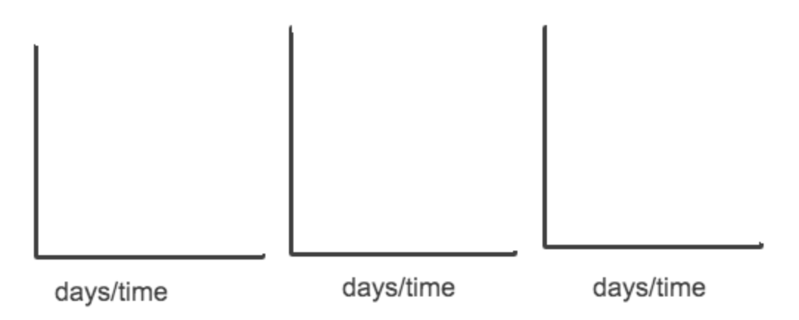
CO2 emitted (total)
CH4 emitted (total)
CO2-equivalent emitted (total), CO2 + CH4 combo
Key: red lines = drought year, cumulative total emissions over the study time period
blue lines = emissions if we projected the “control” (non-drought) period over the same time frame
We could do the simulation for CO2 and CH4 and then combine them by switching to CO2-equivalent

