Slide 1
Lex / Parse the Easy Way
Using CookCC

Slide 2
The Old Way

Slide 3
Lex + Yacc
Use *.l and *.y files.
Proprietary file format
Poor IDE support
Do not work well for some languages

Slide 4
The Difficulties
Difficult to read
No syntax highlighting
No variable / function usage highlight and analysis etc.
Difficult to write
Need to hook up lexer and parser manually
No context sensitive hints (function call and parameter hints)
No instant code error checking within the IDE
No auto-completions (auto-casting, auto-import, etc)
Fragmented code
Difficult to maintain
Multiple files to manage (*.l and *.y)
No code reformatting
No refactoring
Difficult to document

Slide 5
Difficult Lex Code Example
BEGIN(FIRSTCCL);
return '[';
}
}
"{-}" return CCL_OP_DIFF;
"{+}" return CCL_OP_UNION;
/* Check for :space: at the end of the rule so we don't
* wrap the expanded regex in '(' ')' -- breaking trailing
* context.
*/
"{"{NAME}"}"[[:space:]]? {
register Char *nmdefptr;
int end_is_ws, end_ch;
end_ch = yytext[yyleng-1];
end_is_ws = end_ch != '}' ? 1 : 0;
if(yyleng-1 < MAXLINE)
{
strcpy( nmstr, yytext + 1 );
}

Slide 6
Difficult Yacc Code Example
for ( i = $2; i <= $4; ++i )
ccladd( $1, i );
cclsorted = cclsorted && ($2 > lastchar);
lastchar = $4;
}
}
$$ = $1;
}
| ccl CHAR
{
ccladd( $1, $2 );
cclsorted = cclsorted && ($2 > lastchar);
lastchar = $2;
/* Do it again for upper/lowercase */
if (sf_case_ins() && has_case($2)){
$2 = reverse_case ($2);
ccladd ($1, $2);
cclsorted = cclsorted && ($2 > lastchar);
lastchar = $2;
}

Slide 7
Partial Solutions
Supports XML input
Solves the problem related to file format.
Better support for different languages
Patterns / Rules stand out more
Still do not solve other problems.
Integrated lexer and parser generator
Unfortunately, most still require manual hook up between the generated lexer and parser.

Slide 8
Specify Lexer / Parser using Annotations
Advantages:
Write code as normal and take the full advantage of the modern IDEs
Syntax highlighting
Context sensitive hints
Code usage and analysis
Refactoring
Auto-completion
Instant error checking
etc
Disadvantages:
Need to write a language specific annotation parser
Java rules and nothing else matters ☺

Slide 9
CookCC Features
Integrated lexer and parser (LALR (1))
Can specify lexer and parser separately.
If the lexer / parser are specified together, they are automatically hooked up.
Supports multiple input file types
XML (DTD): *.xcc
Yacc: *.y
Java annotation: *.java (launched within Java APT)
Support multiple output formats
Uses the powerful FreeMarker template engine for code generation.
Java
Case by case optimized lexer and parser
No runtime library required. Very small footprint.
Multiple lexer / parser DFA tables options (ecs, compressed).
Plain text (for table extraction)
XML (for input file conversion)
Yacc (for input file conversion)
More output languages can be added

Slide 10
CookCC Java Annotation Input
Quick Tutorial

Slide 11
Annotate Input Class
Put cookcc.jar in the project library path.
This jar is only required for compile time.
All CookCC annotations are compile time annotations (not required for runtime).
@CookCCOption mark a class that needs the lexer and parser.
Generated class would be the parent class of the current class. In this example, it would be Parser.
lexerTable and parserTable options are optional

Slide 12
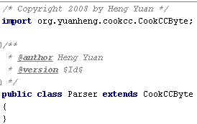
Create Dummy Parent Class
Parser is an empty class
CookCCByte contains functions that would appear in the generated class.
Generated class no longer extends CookCCByte
CookCCByte is not required for runtime
Extend CookCCByte for byte parsing and CookCCChar for unicode parsing.
Class scope is copied to the generated class.
File header (i.e. the copyright message) and class header will be copied to the generated class.

Slide 13
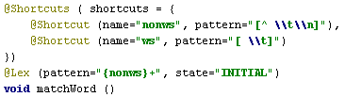
Lexer Annotations
@Shortcut specifies name of the regular expressions patterns that would be used regularly later on.
Can be annotated on any functions in any order.
Avoid creating cyclic name references.
@Shortcuts is a collection of shortcuts.
@Lex specific the regular expression pattern, and which states this pattern is used in. The function this annotation marked is called when the pattern is matched.
Usually the function scope should be either protected or package since they are called by the generated class only.
Backslash (\) needs to be escaped inside Java string, resulting in double backslash (\\)

Slide 14

Lexer Function Case 1
Function returns void
The lexer would call this function and then move on to match the next potential pattern.

Slide 15

Lexer Function Case 2
Function returns a non-int value
@Lex needs to contain the terminal token that would be returned. The return value from the function is going to be the value associated with this terminal.

Slide 16

Lexer Function Case 3
Function returns an int value
The lexer would return the value immediately.

Slide 17
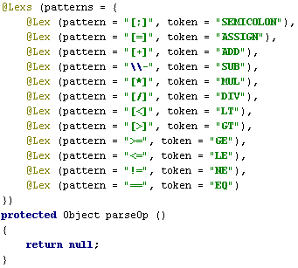
More Lexer Annotations
@Lexs is a collection of @Lex patterns

Slide 18
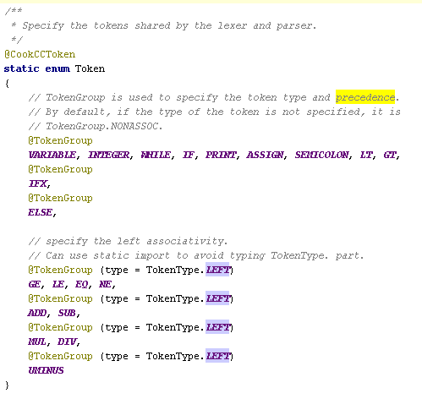
Token Annotations
@CookCCToken marks a Enum to specify tokens shared between the lexer/parser
@TokenGroup specify the token type. Tokens marked with @TokenGroup later on have higher precedences.
Tokens not marked with @TokenGroup would inherit the type and precedence of the previous token.
Symbols such as + - * / < > etc would have to have a name since they can’t be fit in the enum declaration. This restriction is imposed by CookCC per se, not annotation based parsing in general.

Slide 19
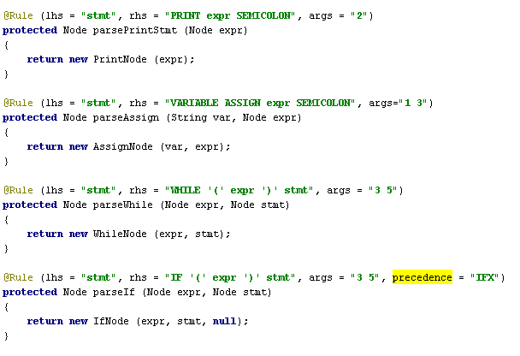
Parser Annotations
@Rule specifies a single grammar rule.
args specifies the arguments to be passed to the function
Advantages
No more cryptic names like $1 $2 or having to specify the types of the variable elsewhere.

Slide 20

Parser Function Case 1
Function returns void
The value associated with the non-terminal of the LHS is null.

Slide 21
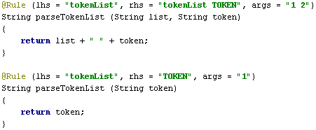
Parser Function Case 2
Function returns a non-int value
The return value is automatically associated with the non-terminal on the LHS.

Slide 22
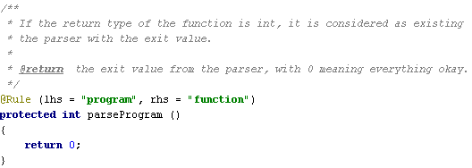
Parser Function Case 3
Function returns an int value
This function is used by the grammar start non-terminal to signal the exit of the parser with the particular value.
It can be used by error processing functions as well.

Slide 23
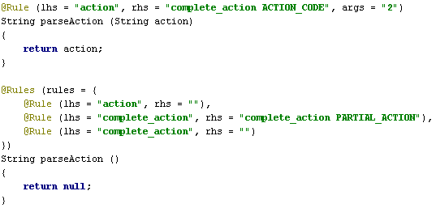
More Parser Annotations
@Rules is a collection of @Rule productions.

Slide 24
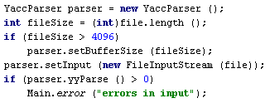
Execute Lexer / Parser
setInput (…) to set up the input source
setBufferSize to improve lexer speed.
yyLex () for lexer only scanner
yyParse () for parser

Slide 25
Generate Class
Run java annotation processing tool (APT) using CookCC as the processor to generate the class needed.
apt –nocompile –s . –classpath cookcc.jar;. Calculator.java
Unless the lex/parse patterns/rules are changed, it is not necessary to re-generate new classes.
Can be refactored at anytime.

Slide 26
Ant task
Using Ant task is easier.
Setup <cookcc> task
Execute task

Slide 27
Ant task (continued…)
Options

Slide 28
Acknowledgement
Dr. Stott Parker
For helpful discussions
Related Work
SPARK for Python
Uses Python doc string to specify the lexer / parser.
Aycock, J. "Compiling Little Languages in Python", Proceedings of the Seventh International Python Conference, p100, 1998.

Slide 29
CookCC Web Site
Project home:
http://code.google.com/p/cookcc/
License
New BSD License

