Slide 1
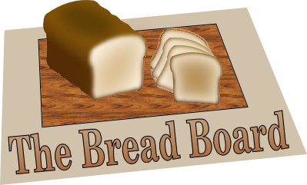
The Bread Board
Open and free tools to assist the Church in studying, sharing, and applying the Word

Slide 2
Agenda
Describe the current status of the software
Explain the goals and/or vision
(Why another open-source Bible study program?)
Demo
Talk about where we could go from here

Slide 3
Current status
Very stable
Nearly all features described here work at some level
A few user interface features are at an alpha level of quality

Slide 4
Design Vision
Focus the user's attention first and primarily on the Bible
  Unlike other Bible reader programs, by default, as much screen space as possible is devoted to THE TEXT and the NET Bible study notes (which are about THE TEXT).
  If desired, the few extra tools on the default screen can be minimized so the whole screen is devoted to THE TEXT.
  The TEXT and note editors can be arranged within the window for whatever work task is at hand.

Slide 5
Design Vision
Make searching fast, intuitive, and integrated
  Searching simply filters the book/chapter/verse list boxes to show the relevent verses.
  Searching happens in real time, as you type.
  An initial implementation is available today.

Slide 6
Design Vision
Enable note taking and authoring using open file formats
  Plain text
  HTML (for rich text)
  DocBook (for books and publications)
Currently implemented: Plain text

Slide 7
Design Vision
Enable the reading and study of classic Christian literature
  Store, read, and search e-books using open formats
    HTML, TXT, Mobipocket, EPub
  Currently implemented: HTML, TXT
Additional formats are currently supported by launching external applications
  PDF, Word doc, etc.

Slide 8
Design Vision
Provide powerful tools for church workers/teachers to organize, process, and share personal study notes
  Store notes in arbitrary user-defined folder hierarchies
  Search notes just as easily as the Bible
  Share and synchronize notes between computers and/or among different people
    Ie: Synchronize between a laptop and a desktop
    Ie: a Pastor and deacon should be able to collaborate on writing next Sunday's message

Slide 9
Design Vision
Enable ”collaboration centers”
  Basically a shared, distributed Inbox
    News feed
    Documents
    (maybe eventually) Music
  Imagine small group Bible studies using this to share notes
  Or imagine a Sunday School group using this to collaborate
  This is the only part not yet implemented at all

Slide 10
Design Vision
What currently works, what doesn't?
  All of this works at some level except for the ”shared inbox” idea
  I have been using this software in production for 3 years; what is implemented is stable
  However, the user interface is overly general and sometimes not intuitive
    Adding some default content could help remedy this situation
    Other things can be improved by tweaking the user interface

Slide 11
Immediate goals
To release the Bread Board as free/open-source software
  To obtain permission to distribute the NET translation as a part of this software, when distributed 100% for free
To obtain permission to receive donations so that this software can continue to be free–the same way that Bible.org itself functions.

Slide 12
Conclusion
Ultimately, the desire is to:
  Enable individual Bible study
  Raise awareness of classic Christian literature
  Enable collaboration in the church
  Provide an open, extensible platform that others (particularly churches) can build on

Slide 13
Contact Info
The author can be reached via email at:
  djo@coconut-palm-software.com

