Slide 1

Diabetes Prediction
Student: 呂育嘉(Louis)

Slide 2
OUTLINE
DATASET
CONCLUSION
ALGORITHM
EVALUATION
CODE
RESULT

Slide 3
DATASET
Independent variables
age
sex
BMI (body mass index)
bp (average blood pressure)
s1 tc, (total serum cholesterol)
s2 ldl, (low-density lipoproteins)
s3 hdl, (high-density lipoproteins)
s4 tch, (total cholesterol / HDL)
s5 ltg, (possibly log of serum triglycerides level)
s6 glu, (blood sugar lev)
Diabetes dataset
Total samples: 442
Dependent variable: Disease progression one year after baseline
Independent variables: 10 variables
Diabetes dataset
Train dataset:
353(80%)
Test dataset:
89(20%)

Slide 4
ALGORITHM

Slide 5
Linear Regression
Linear Regression is a statistical model built by looking for the relationship, between multiple independent variables and dependent variables.
Random Forest
Random forest is a model that contains multiple decision trees.
One independent decision tree is constructed in the forest. After the result of each decision tree is obtained, the final decision is determined by voting the result of.
Notes:
隨機森林是一個包含多棵決策樹的模型，在森林中建構一棵棵各自獨立的決策樹，在得出每個決策樹的結果後，以投票方式(眾數/取平均)來決定出最終的結果。

Slide 6
EVALUATIONS

Slide 7
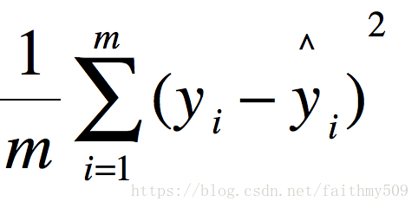
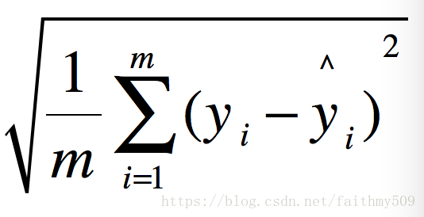
RMSE
MSE is the mean of the square of the difference between the predicted value and the actual observed value.
RMSE is the value of MSE after root, which is closer to the actual value of Y .
Notes:
MSE計算過程 1.拿預測的值(predict value)與真實數據(labeled value)相減 2.所有的相減值皆平方(避免誤差正負相消)，並取總和 3.再除以總數量平均
MSE是預測值和實際觀測值間差的平方的均值。
RMSE就是MSE加上開根號

Slide 8
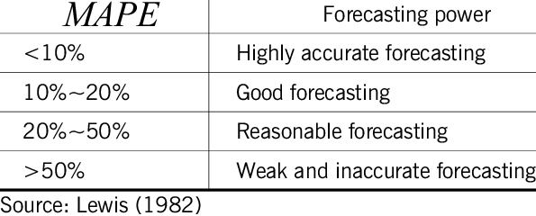
MAPE

Slide 9
COED

Slide 10
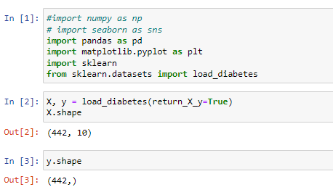
Get Datasets
Using form sklearn.datasets import diabetes data.
Confirm whether the data are correct.
Notes:
確認X與Y的資料有沒有正確

Slide 11
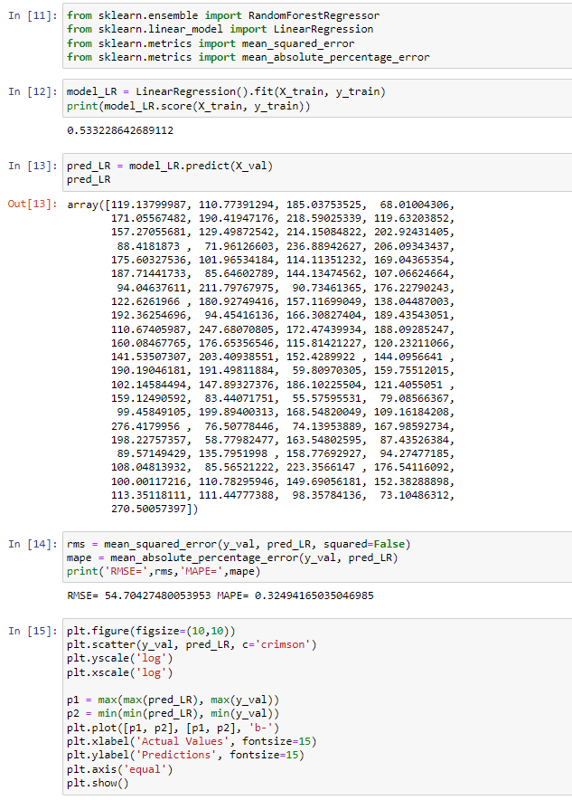
Train LR-Model
Perform LR model training and display the training accuracy.
Test the trained LR model with an X validation set.
RMSE and MAPE calculated using Y validation sets and LR models
Plot out the regression prediction
Notes:
進行LR模型訓練，並顯示訓練準確率
用X驗證集去測試訓練的LR模型
檢驗Y驗證集與LR模型的RMSE、MAPE
劃出線性回歸預測圖

Slide 12
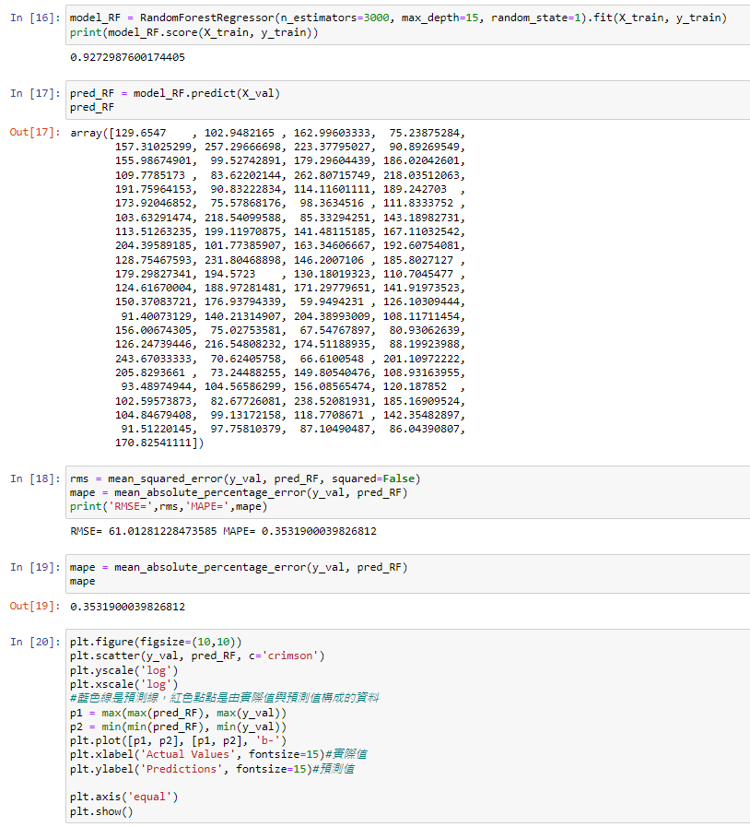
Train RF-Model
Perform RF model training and display the training accuracy.
In the n_estimators of the training model, we used 3000, and max_depth used 15. Test the trained RF model with an X validation set.
RMSE and MAPE calculated using Y verification sets and RF models. Plot out the regression prediction.
Notes:
執行 RF 模型訓練並顯示訓練精度，在訓練模型n_estimators，我們使用 3000，max_depth使用 15。
使用 X 驗證集測試經過訓練的 RF 模型。
RMSE 和 MAPE 使用 Y 驗證集和 RF 模型計算。
繪製出回歸預測。

Slide 13
RESULT

Slide 14
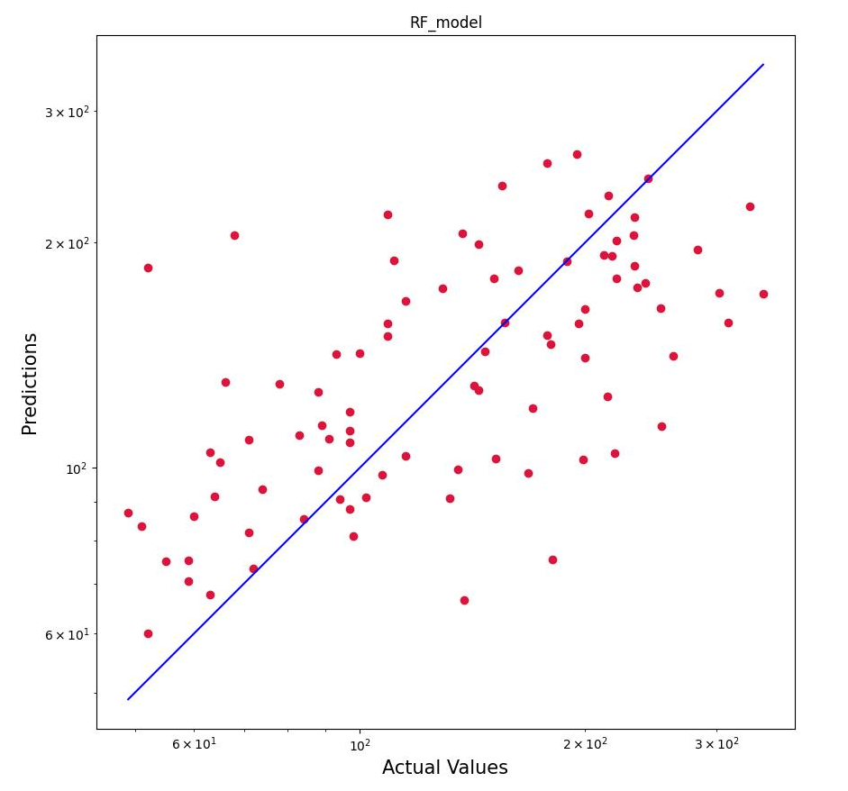
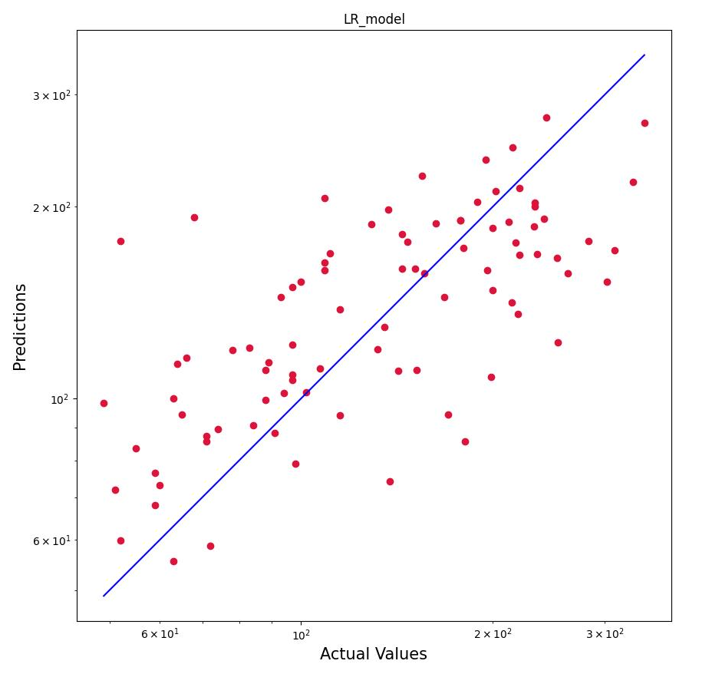
RESULT
LR RMSE:54.7
LR MAPE:32.4
RF RMSE:61
RF MAPE:35.3
Notes:
RMSE表示預測值與真實值的平均偏離程度
可以看到藍色線是預測線，紅點是由實際值與預測值構成的資料。
資料接近預測線表示預測的越準確，越遠表示越不準確。
準確率

Slide 15
CONCLUSION

Slide 16
CONCLUSION
For the RMSE and MAPE values of RF compared to LR, LR was found to perform better, but the MAPE results of the two models indicated that the model belonged to reasonable predictions.
Which we thought might be the missing step of screening features and did not remove irrelevant ones value, causing MAPE to fail to achieve good predictions.
In summary, we believe that in the diabetes data of sklearn, in the absence of steps to find relevant features, using LR will achieve more accurate prediction results.
Notes:
對於RF的RMSE和MAPE值與LR相比，發現LR表現更好，但兩個模型的MAPE結果表明，該模型屬於合理的預測，我們認為可能是篩選特徵的步驟缺失，並且沒有刪除不相關的值，導致MAPE無法達到良好的預測。 總結來說我們認為在sklearn的糖尿病資料裡面，在缺少尋找相關特徵的步驟，使用LR會達到較準確的預測結果。

Slide 17
Thank you

