Slide 1



Two-Stage LVLM system:
1st Place Solution for ECCV 2024 Corner Case Scene Understanding Challenge
Ying Xue¹, Haiming Zhang¹, Yiyao Zhu², Wending Zhou¹, Shuguang Cui¹, Zhen Li¹
1. Chinese University of Hong Kong (Shenzhen)
2. Hong Kong University of Science and Technology

Slide 2
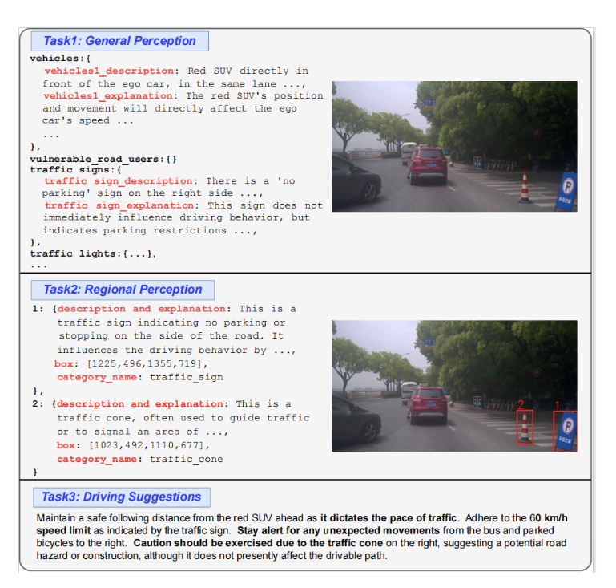
Introduction
The Corner Case Scene Understanding Track is aimed at improving global scene understanding, region reasoning, and actionable navigation for autonomous vehicles based on the CODA-LM dataset of corner cases.
This competition seeks to promote the development of more reliable and interpretable autonomous driving agents.

Slide 3
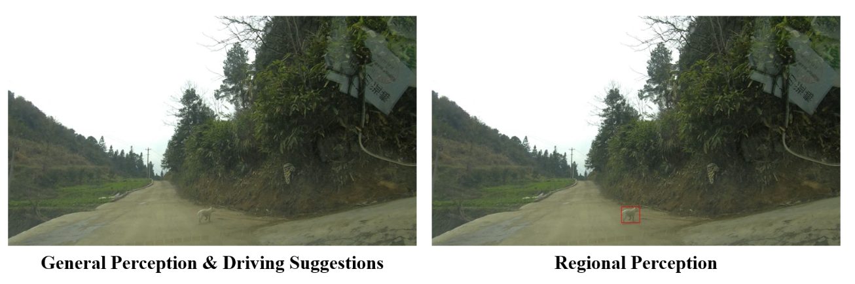
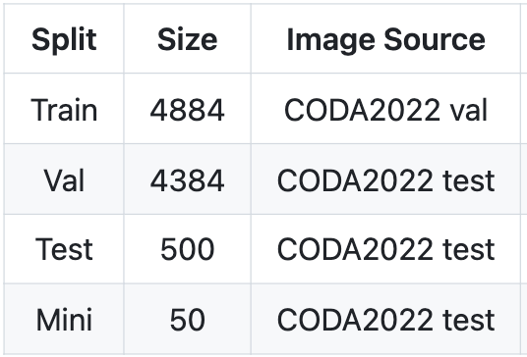
CODA-LM Dataset
Data sample
Image: Single frame, front view
Object Categories: vehicles, vulnerable road users, traffic signs, traffic lights, traffic cones, barriers, miscellaneous
Tasks:
General Perception: Describe the objects that influence the driving behavior of ego car, and explain why these objects impact.
Region Perception: Describe the object in the red rectangle, and explain why it affect ego car driving.
Driving Suggestion: Provide driving suggestion given the image.

Slide 4


Method Pipeline
VLM
Adapter
LLaVA-Next
GPT-4 Refine
Image & Text Inputs
Preliminary
Output
Final
Result
Stage 1
Stage 2

Slide 5
Stage 1: Preliminary Output
VLM
Adapter
LLaVA-Next
Train Phrase :
LLaVA-Next-7B Finetune by LoRA:
Freeze of the existing weights and only trains a couple of adapter layers on top of the base model.
Add adapters to all linear layers of the model, except for the ones present in the vision encoder and multimodal projector.
We fine-tuned three models with different percentages of the three tasks’ data samples.
Preliminary
Output

Slide 6
Stage 1: Preliminary Output
VLM
Adapter
LLaVA-Next
Inference Phrase:
Model Selection: Three candidate LLaVA-Next models first output a small part of test data for three tasks. For each task, GPT-4 should choose the most suitable answer.
For each task, the most frequently selected model will be the one to output preliminary results for each task.
Preliminary
Output

Slide 7
Stage 2: Refinement
Inference Phrase:
Given image, preliminary output and designed prompt, refine the draft output from Stage 1 by GPT-4.
The stronger common sense reasoning ability of GPT-4 can help to modify the inaccurate content of the preliminary output.
Prompt Design:
General Perception: Given the image, delete the inaccurate content, and add a commont on how much each road user affect the ego car (estimate its impact as high/moderate/low with an explanation).
Region Perception: [Only modify the output with incorrect category (gt category is know). Re-assign the draft with correct category.] Given the image with bounding box, modify the draft.
Driving Suggestion: Given the image and the general perception output, modify the draft.
GPT-4 Refine
Final
Result

Slide 8
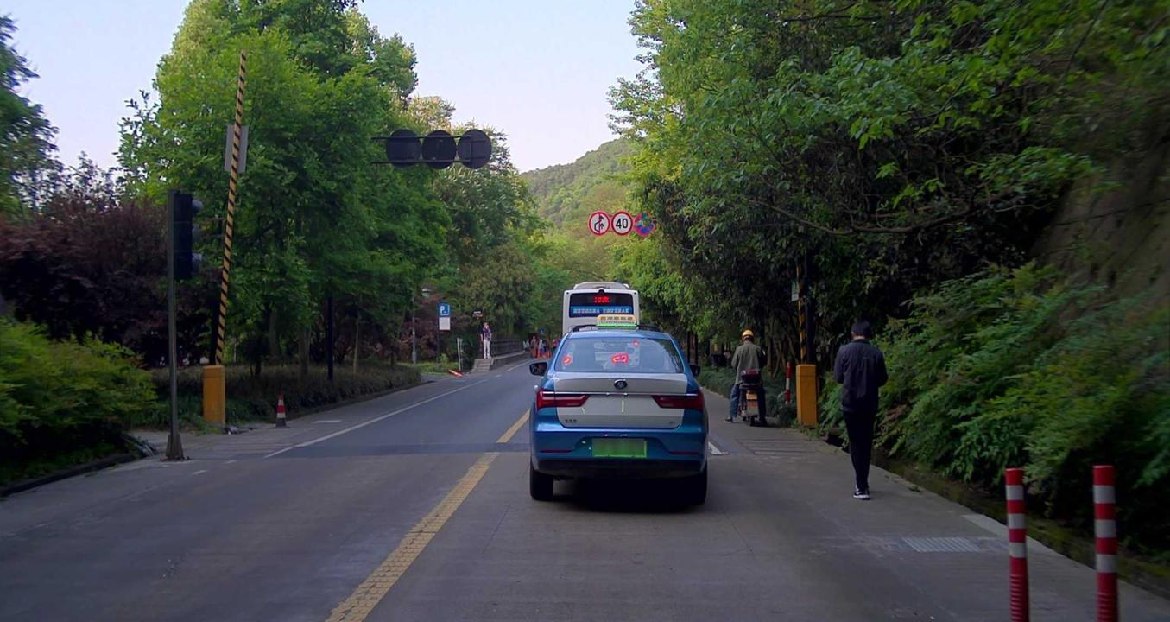
Results: General Perception
Answer: In the traffic image, there is a blue car directly in front of the ego car. This vehicle is significant as it directly impacts the ego car's ability to proceed. ……On the right side of the road, there is a pedestrian walking away from the ego car, wearing dark clothing. The pedestrian's presence requires the ego car to monitor them in case they decide to cross the road or enter the driving lane.\n\nAhead, there are multiple traffic signs indicating a maximum speed limit of 40 km/h. ……n\nAdditionally, red and white traffic cones are placed on the right side of the road, ……\n\nImpact on the ego car:\n\n- **Blue car ahead**: Immediate and significant impact …… **Bus**: Moderate impact……
GT: The scene depicts a variety of road users and objects, each affecting the driving dynamics of the ego car.\n\nA blue car with a taxi sign is directly in the ego car's path, dictating the pace and necessary following distance. ……\n\nOn the sidewalk to the right, a pedestrian is walking in the same direction as traffic, necessitating monitoring in case they step onto the road.……\n\nAbove, traffic signs are in place, indicating no overtaking, and setting a speed limit of 40 km/h, requiring compliance from the ego car. ……\n\nAdditionally, two red and white traffic cones on the right side of the road mark the driving area boundary and suggest a narrowing of the road, possibly hinting at nearby roadwork or a temporary obstacle. ……

Slide 9
Results: Driving Suggestion
Answer: ### Revised Draft Driving Suggestion:\n\n1. **Maintain a Safe Following Distance**: The ego car should maintain a safe distance from the blue car directly ahead. ……\n\n3. **Pedestrian Awareness**: ……\n\n4. **Stay Within the Speed Limit**: Multiple traffic signs indicate a maximum speed limit of 40 km/h. …….\n\n5. **Traffic Light Caution**: The traffic light is currently not illuminated. ……\n\n6. **Traffic Cones and Lane Restrictions**: The cones on the right side of the road signify a closed lane or road work. .……
GT: Proceed with caution given the potential unpredictability of the pedestrian and person standing by the bicycle. Maintain a safe distance from the blue car ahead, and prepare to reduce speed if needed to safely navigate past the parked white vehicle and traffic cones on the right. Observe the behavior of vehicles ahead for cues about the traffic light state, and comply with the posted speed limit and no-honking rule.

Slide 10
Evalution
GPT-4 Judge Criteria:
General Perception: Accuracy, Suppression hallucination, Correlation.
Region Perception: Similarity, Relevance
Driving Suggestion: Rationality, Relevance, Level of detail of the response. Predicted text should be specific and actionable, rather than vague or overly broad. Identify and correct any mistakes.

Slide 11
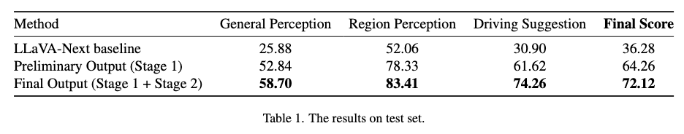
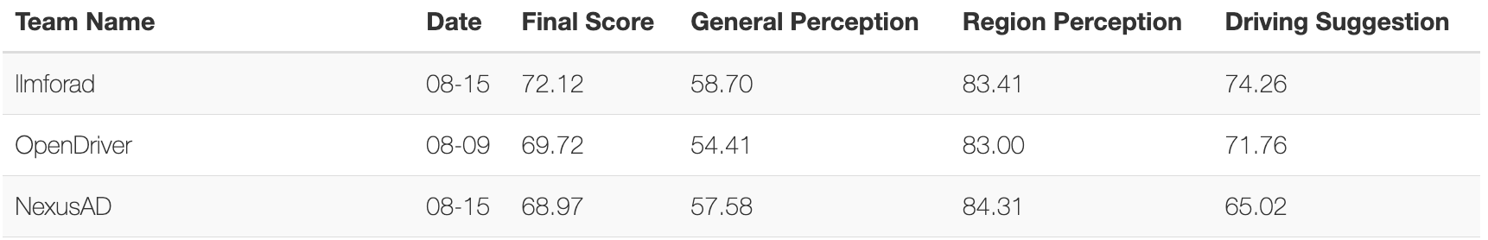

Results

Slide 12
Thanks for your listening!

