Slide 1
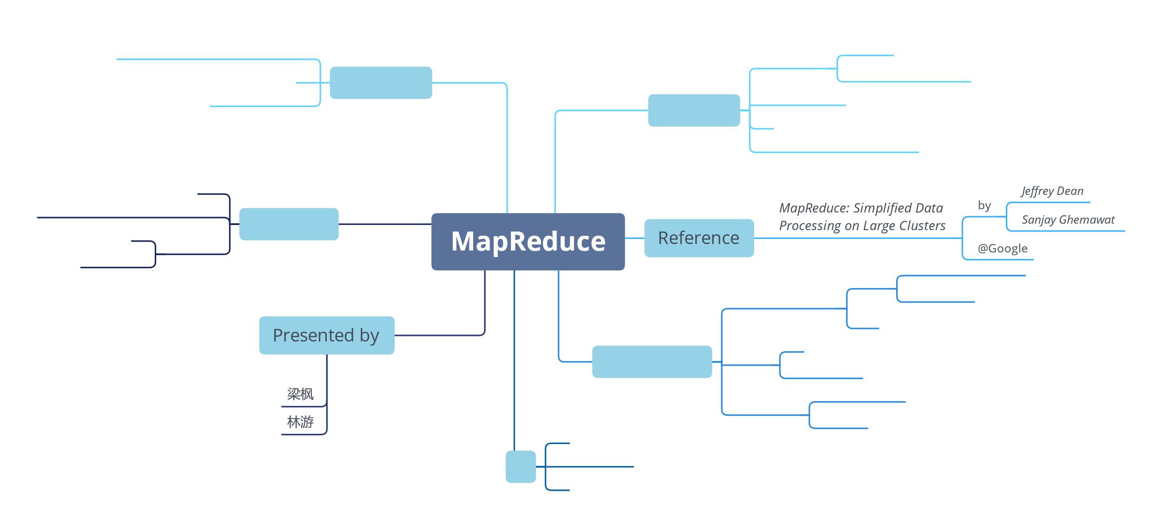

Slide 2
Concepts
Map
Reduce
Values-to-values Model
<Key, Value>pairs-to-<Key, Value>pairs Model
Notes:
our presentation will contain four parts,

Slide 3
Old-fashioned Concepts
Mapping: f(X) where X can be multi-dimensional
Reduce: g(X₁, X₂, …, X_{n})
Java
Arrays.stream(integers).map(x->x+1).sum();
SQL
SELECT sum(integers) from integer_table
Notes:
Map and reducing are two old fashioned concepts, by maping, we can have some input and get certain smaller output by special mapping function
By reduce, we can work on some input with the same key and compress into one output
These two concepts are in common used, for example, java stream can split the input array then do the map and reduce parallel in each slice
In database, map and reduce are more common.
大量数据map 到少的数据
Java stream 变成数据流 自动并行parallel
比较老的概念了，java 和sql 很成熟 数据库的专家很不屑

Slide 4
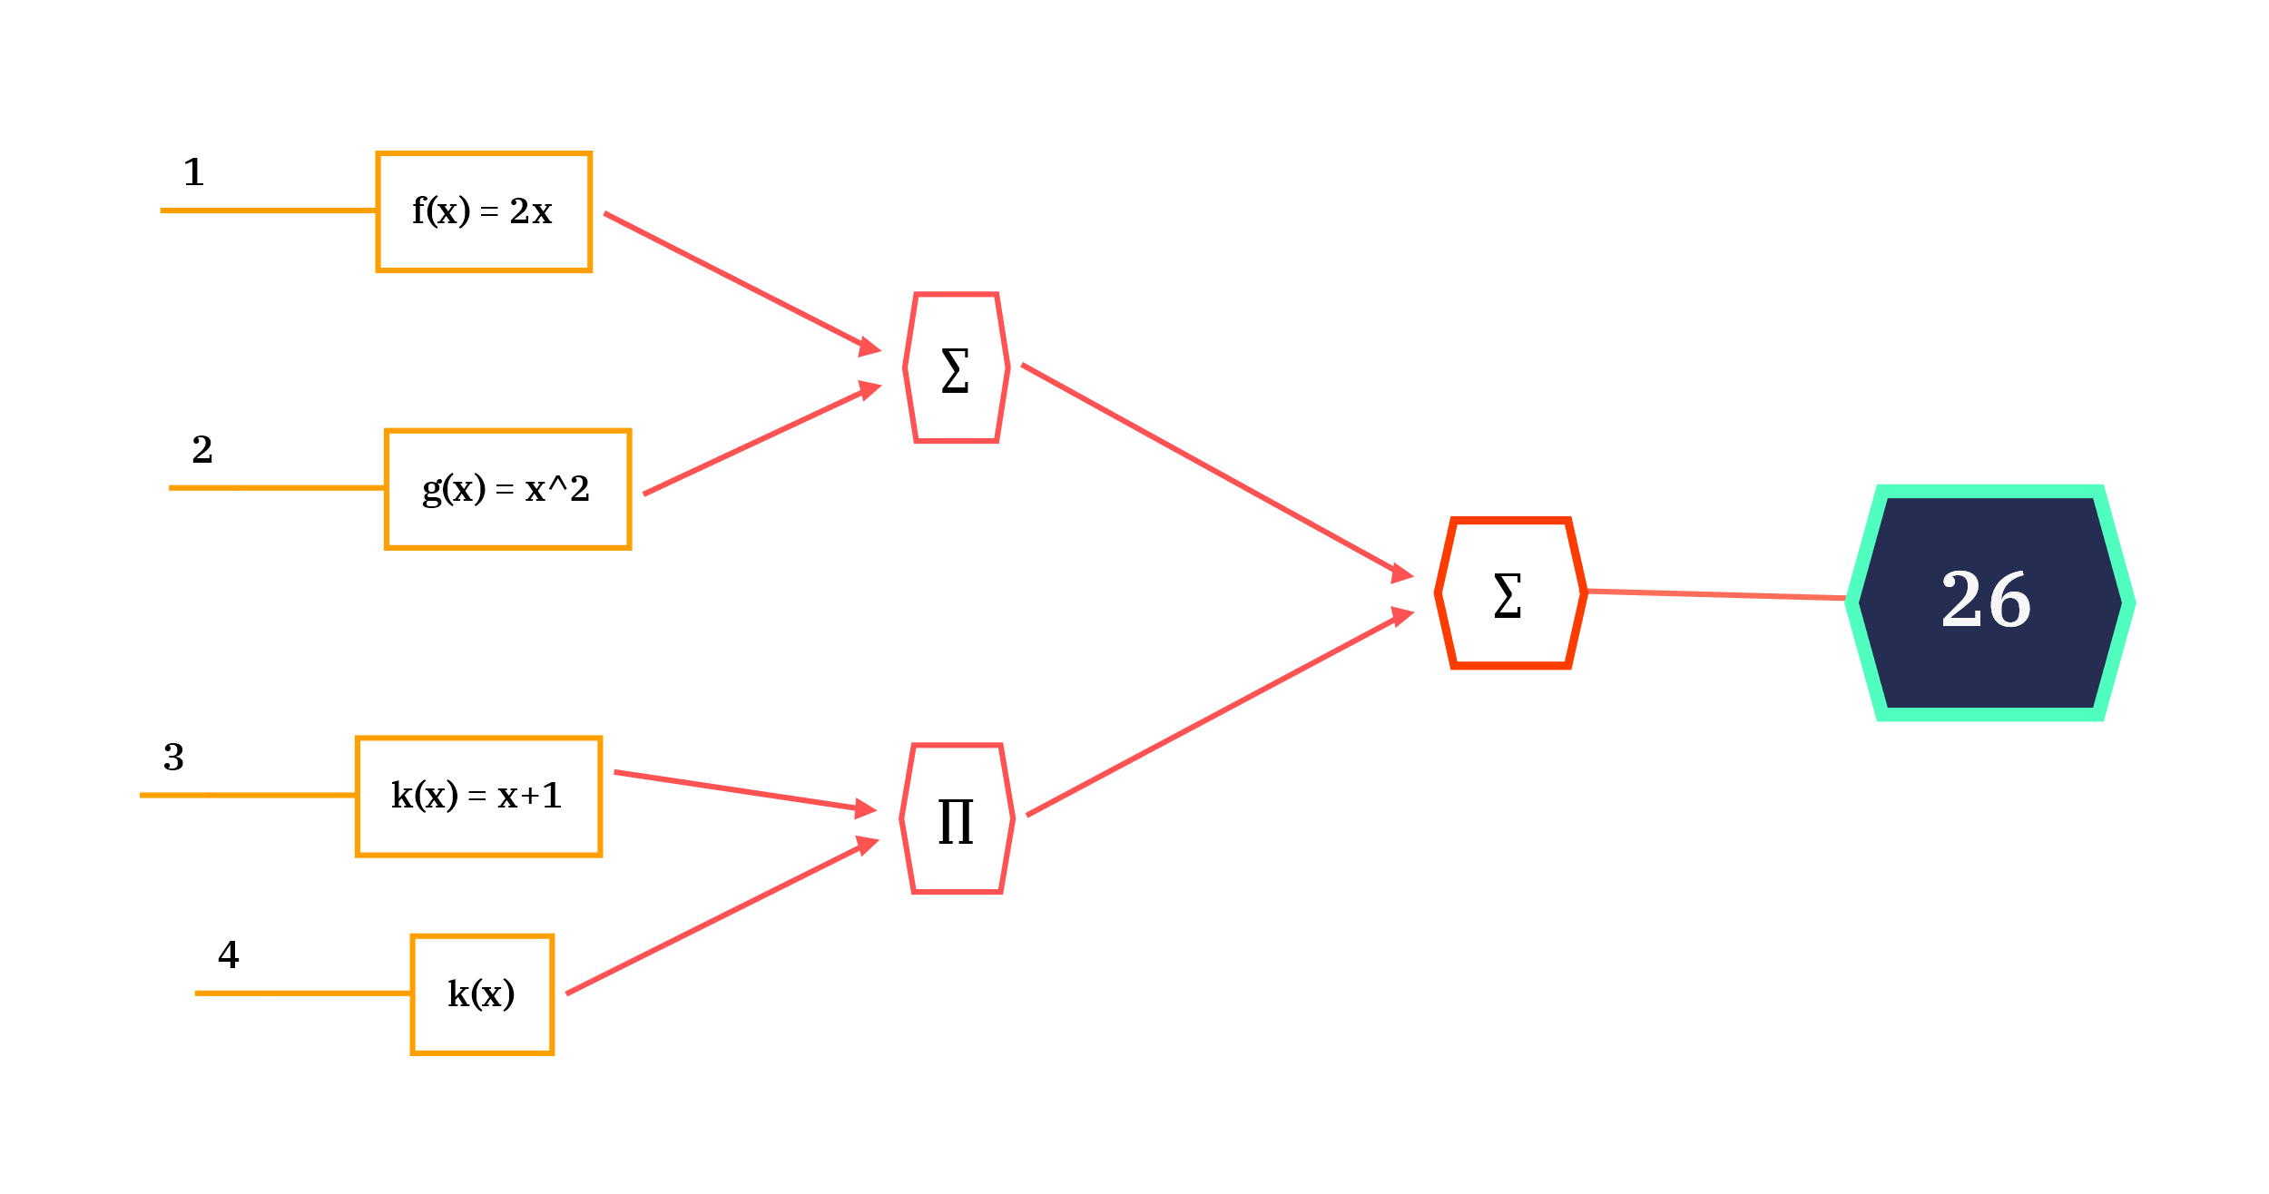
Old-fashioned Concepts
Mapping: f(X) where X can be multi-dimensional
Reduce: g(X₁, X₂, …, X_{n})
Notes:
For example ,the yellow part is map operation and the red part is reduce operation, then we can get the result more easily

Slide 5
Powerful Paradigm
“The major contribution of this work are a simple and powerful interface that enables automatic parallelization and distribution of large-scale computations”
Notes:
In common, the mapreduce provide an interface to ease the large-scale computations

Slide 6
Not so powerful (yet)
What if we want to count the occurrence of each letter(or word) in a corpus?
The previous values-to-values model cannot help!
SUSTech
S | U | T | e | c | h
2 | 1 | 1 | 1 | 1 | 1
to | be | or | not | that | is | a | question
2 | 2 | 1 | 1 | 1 | 1 | 1 | 1
To be or not to be, that is a question¹
1. From Hamlet by Shakespeare
Notes:
So far, I have introduce the value to value model, but that’s not enough
For example, when we want to count frequency of an alphabet in a word, not only do we have to keep the value, but also keep the key of the alphabet
Value to value not useful
如果要数数的话 只有值是不够的

Slide 7
<K, V>pairs-to-<K, V>pairs Model
But we were dancing¹
but | we | were | dancing
1 | 1 | 1 | 1
Dancing with our hands tied hands tied¹
dancing | with | our | hands | tied
1 | 1 | 1 | 2 | 2
but | we | were | dancing | with | our | hands | tied
1 | 1 | 1 | 2 | 1 | 1 | 2 | 2
Reduce
1. From Dancing with Our Hands Tied by Taylor Swift
Notes:
This time, we can count the frequency of the word in many sentences.

Slide 8
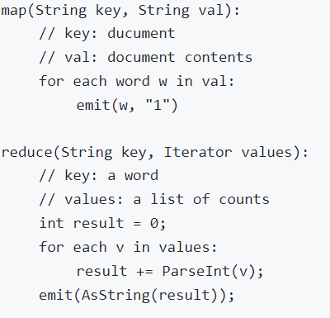
<K, V>pairs-to-<K, V>pairs Model
SUSTech
S | U | S | T | e | c | h
1 | 1 | 1 | 1 | 1 | 1 | 1
Reduce
S | U | T | e | c | h
2 | 1 | 1 | 1 | 1 | 1
Notes:
Let me take this process apart. pseudocode
By mapping ,we get the key-value pair where alphabet is the key and 1 is the value
By reducing, we get the key-value pair where the alphabet is the key and the total counter of the key is the value

Slide 9
Implementations
Structure & Workflow
Failure Detection and handling
Performance Refinements
GFS
Notes:
Now let’s come to the detail of the mapreduce

Slide 10
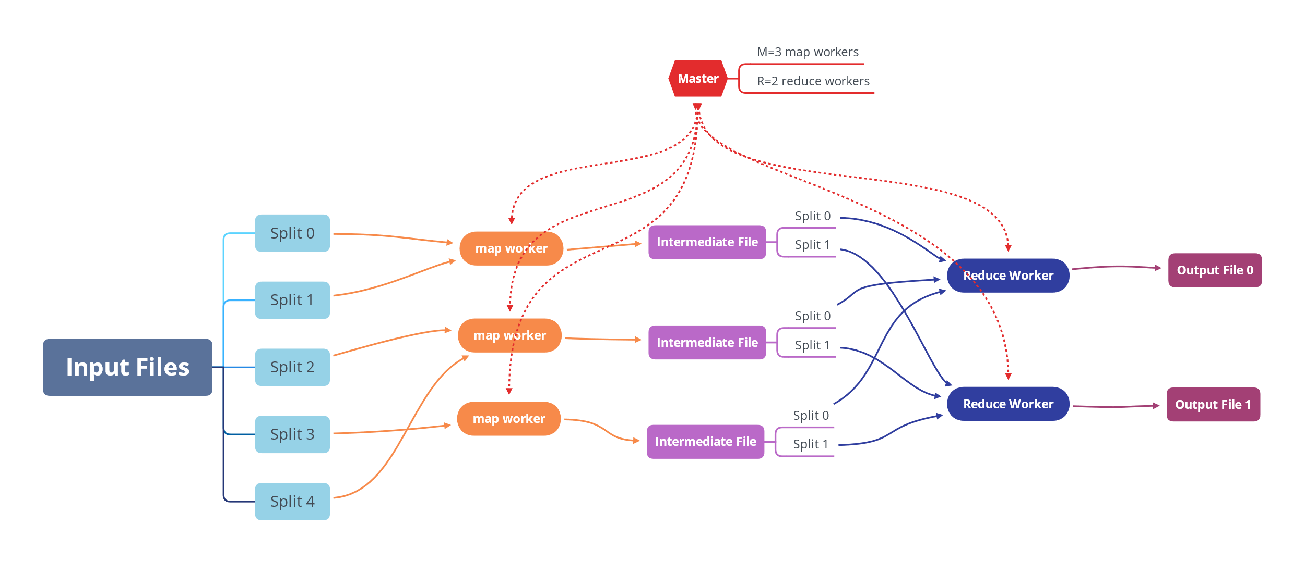
Structure
Notes:
This is the structure. User program fork the code to the corresponding machines. There are only one master, several map workers and reduce workers. master will keep trace of workers. When map worker assigned by master are asked to work, it will get the data slices which are split from the input file This behavior benefits from GoogleFS. And map the key-value pair to output key-value, and stored in the main memory, then store in correspond area of the local disk. After that, master get the location of the intermedia file and assign reduce worker to get the file and sort by key and do reduce. At last, the output of the reducing will be saved in persistent file. After all works are done, master will wakeup the user program

Slide 11
Workflow
Split Input Files (GFS comes into play)
Master assigns workers
Map workers read splits and perform mapping
Results of mappers are buffered in mem and backup in disk. Master gets notified
Reduce workers get notified by master and start reading and performing reducing
Reducers output results to final files

Slide 12
Failure Detection
The master pings every worker periodically
Notes:
User don’t need to care about the detail but there are auto failure detection. The master pings every worker periodically, to check the state of the worker.

Slide 13
Failure Recovery
Worker Failure of Completed Map Tasks
Re-execute the map tasks on other map workers
Worker Failure of Uncompleted Tasks
Re-execute tasks on other workers
Worker Failure of Completed Reduce Task
No need to re-execute
Why?
Notes:
If there are failure, there are three scenarios, if task is uncompleted, the master will assign other worker to re-execute the task. If Worker Failure of Completed Map Tasks are detected, then the corresponding task will be re-execute on other map worker. But no need to re-execute if the Worker Failure of Completed Reduce Task are detected. Because output of reduce task will be store in global file system. But the output of the map task will be stored in local disk.

Slide 14
What if the master fails?
Auto-checkpoint
Retry and start a new master
Notes:
the master periodically write to disk checkpoint. If the master task fails, you can start another master process from the last checkpoint.
However, since there is only one master process, it is troublesome to recover after the master fails, so our current implementation is to abort the MapReduce operation if the master fails.
The customer can check to this state and redo the MapReduce operation as needed

Slide 15
Performance Refinements
Configurable Partitioning Function
Combiner Function
Skipping Bad Records
Backup Tasks
Notes:
There are a few methods to improve the overall performance of the system, including configurable partitioning functions, combiner functions, skipping bad records and backup tasks.

Slide 16
Configurable Partitioning Function
Default
Hash(key) mod R
Possible One
Hash(getHostName(urlKey))
Or depending on data distribution, modify hash function
Notes:
As mentioned, the partitioning function is for partitioning <key,value> pairs and storing them separately in many files. It is configurable so to adjust different distributions of data. As a default, it takes the mode of hash values of keys. But when we deal with URLs, we may want to cluster pairs with the same host name. Or we can modify it to achieve better load balance.

Slide 17
Combiner Function
SUSTech
S | U | S | T | e | c | h
1 | 1 | 1 | 1 | 1 | 1 | 1
Reduce
S | U | T | e | c | h
2 | 1 | 1 | 1 | 1 | 1
Notes:
This is the previous example. It is the job of reducers to deal with pairs with the same key. But if there are many duplications, instead of wasting the bandwidth of the network, it is better to process them locally on the machines of mappers.

Slide 18
Combiner Function
SUSTech
S | U | S | T | e | c | h
1 | 1 | 1 | 1 | 1 | 1 | 1
Combiner
S | U | T | e | c | h
2 | 1 | 1 | 1 | 1 | 1
Notes:
So the combiner runs after the mapper and processes the output of mappers and then stores the output locally. Typically, the combiner is the same as the reducer.

Slide 19
Skipping Bad Records
Workers install a signal handler
Master keeps track of records and signals
If invoked, signal handlers send msg to master
If master see <record, signal> occur multiple times, next time it will skip the record when assigning work
Notes:
Skipping bad records can improve the availability of the system. For example, if a worker always crashes when encountering pairs with certain values due to bugs, the master can be aware of this situation and tell workers to skip these pairs. So the workflow is like this. Workers install a signal handler, and master keeps track of records and signals. If signal handlers are invoked, they will send messages to the master. If master see<record, signal> occur multiple times, next time it will skip the record when assigning work.

Slide 20
Backup Tasks
When a large MapReduce job(containing many map reduce tasks) is close to completion, the master assigns workers to do duplicate tasks of the left unfinished tasks(straggler).
Why?
Long Tail Effect
Due to some random problems, some tasks take extremely long time to finish.
Notes:
A map reduce job contains many map reduce tasks. But due to some reasons, a worker may take extremely long time to complete a task, which will greatly affect the overall throughput. Everyone is waiting for the left behind ones. So when most of the tasks in a job have been completed, the left tasks are assigned again to other workers. Either the duplicated tasks or the original ones are completed, the tasks will be marked as completed.

Slide 21
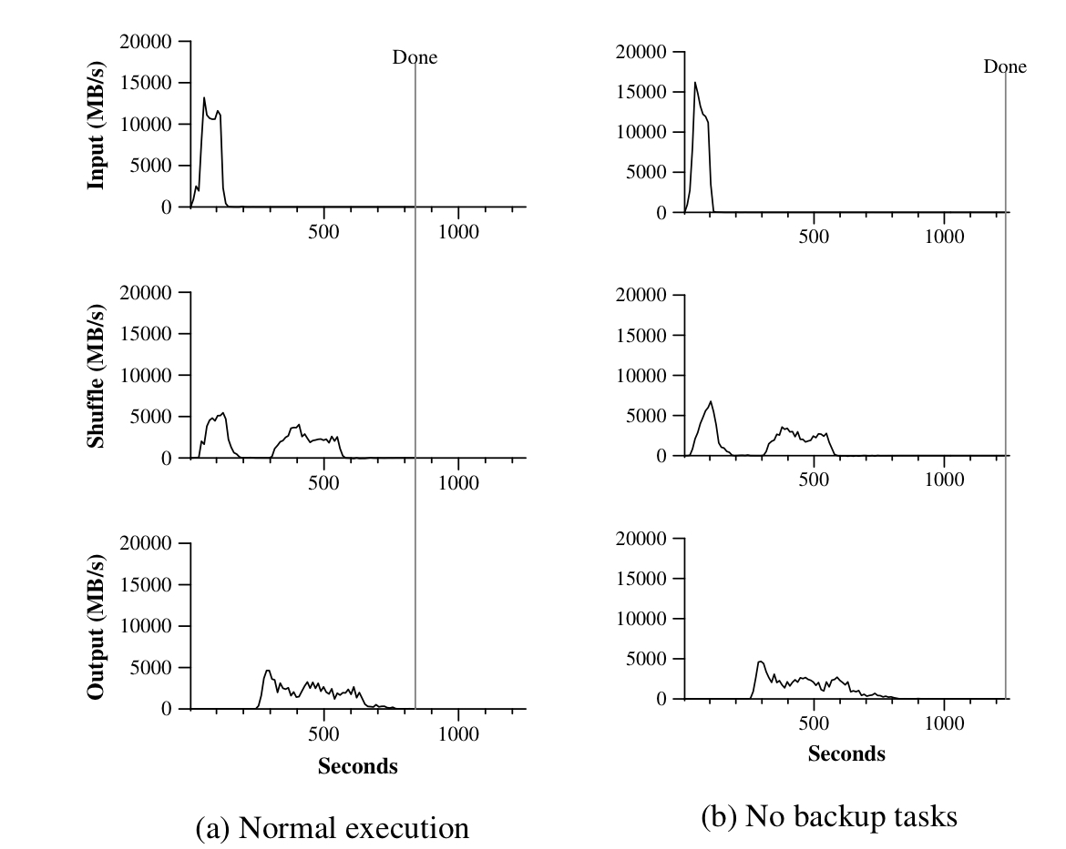
Backup Tasks
Long Tail Effect
Notes:
We can see from this diagram that backing up tasks greatly speed up the whole process. It takes roughly 600 seconds to finish a job with backing up while it takes 1000 seconds to finish without this approach. It is over 40 percents improvement.

Slide 22
Google File System¹
Distributed
Fault-tolerant
High Throughput
1. Reference: The Google File System by Ghemawat, Gobioff and Leung, 2003
Notes:
MapReduce is closely cooperated with GFS. In fact, it is built on top of GFS, using the APIs of GFS. Let’s see how GFS participates in the workflow of MapReduce.

Slide 23
MapReduce fits in with GFS
Global GFS Files
Global GFS Files
Local Files
Notes:
In MapReduce, it is the job of GFS to handle globally stored files. So GFS is responsible for storing input files, splitting them and providing READ/WRITE APIs. At the start of the workflow, mappers read file splits from GFS and then start processing. At the end, reducers write their output using GFS. How about intermediate files? They are stored locally on works’ machine.

Slide 24
API Stack
User Program
Map
Reduce
Optionals
MapReduce
Read
Write
Find
GFS
Fault Handling
File Backup
File Sharding
Notes:
This is the API stack of the whole system. We can see that MapReduce uses the READ/WRITE/FIND API of GFS. Why need the FIND API? When assigning tasks to workers, the master uses the FIND to find file splits and then locates workers that are the closest to file splits, which reduces the flow in the network and improves performance.

Slide 25
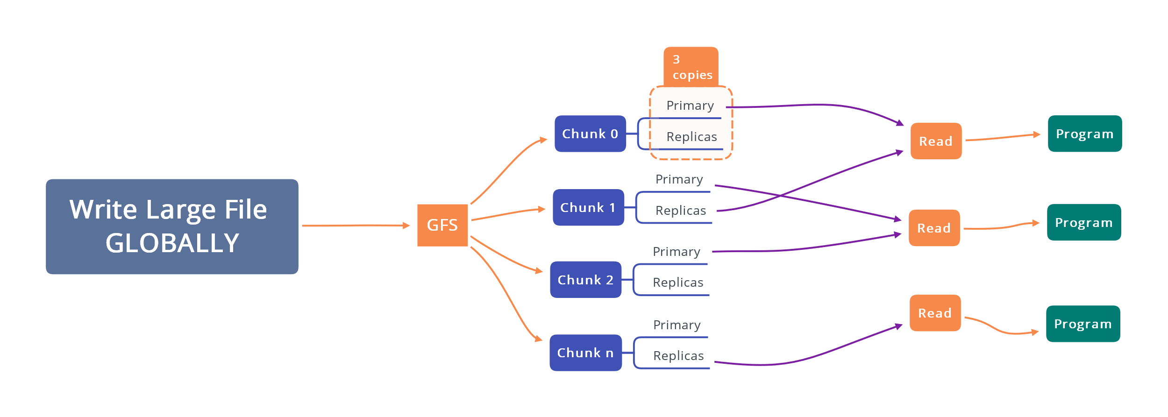
Read and Write Globally
Notes:
GFS also takes care of backing up files, ensuring the integrity of data. We can see that large files are split into chunks and duplicated with replicas. Program can read files from the primary chunk or its replicas, which improves the throughput of the system.

Slide 26
Details of Implementation (via Q&A)
Notes:
Then let’s dive in the implementation and see issues and solutions via Questions and Answers.

Slide 27
What is inside the Master?
Progress of a job (as mentioned in Backup Tasks)
A table recording status of tasks
A table matching map workers and reduce workers
A table keep track of addresses of file splits
File Split Name | Map MachineAddress | Map Worker PID | Local Output File | Reduce Machine Address | Reduce Worker PID | Status
fs1 | xxx.xxx.xxx.xxx | 1234 | Out1.txt | yyy.yyy.yyy.yyy | 5678 | Done
File Split Name (including replicas) | Address
fs1_0 | xxx.xxx.xxx.xxx
fs1_1 | yyy.yyy.yyy.yyy
Notes:
So what is inside the Master? First the master needs to keep track of the progress of a job. And a table records the status of workers and their input and output. Also, in order to find the nearest worker, the master records the addresses of file splits.

Slide 28
How to set the values of M and R ?
“Ideally, M and R should be much larger than the number of worker machines. Having each worker(machine) perform many different tasks improves dynamic load balancing, and also speeds up recovery when a worker fails”
“In practice, we tend to choose M so that each individual task is roughly 16MB to 64MB of input data.”
Notes:
How to set the numbers of mappers and reducers? We can refer to these two paragraphs. …………. Notice the size of the input data. By default a file chunk of GFS is 64MB large. So setting the input of this size can better fit in with GFS and improve performance.

Slide 29
How to debug?
Local Execution
Special library developed so that map reduce tasks can be executed in a local machine
Deterministic and Non-deterministic Semantics
Deterministic: “Our semantics are equivalent to a sequential execution”
Non-deterministic: “In the presence of non-deterministic operators, the output of a particular reduce task R1 is equivalent to the output of for R1 produced by a sequential execution of the non-deterministic program”
Notes:
As MapReduce is a distributed system, debugging becomes tricky. The developers develop a special version such that a MapReduce job can be executed sequentially on a machine. Also, the semantics of MapReduce is ensured to be consistent. If tasks are deterministic on distributed computers, they are equivalently executed in sequence on a single machine. And if tasks contain non-deterministic operators, the output of a particular reduce task R1 is equivalent to the output of for R1 produced by a sequential execution of the non-deterministic program.

Slide 30
What if the master gives two workers the same Reduce task?
They will both try to write the same output file on GFS! Atomic GFS rename prevents mixing; one complete file will be visible.
Notes:
What if by mistake or due to network issues, the master gives two workers the same Reduce task? GFS comes to help. They will both try to write the same output file on GFS! GFS prevent this from happening.

Slide 31
Extra Features?
Ordering Guarantee
Side-effects
Status Information
Counters
Notes:
Also, MapReduce gives extra features. The guaranteed order is default, and the others are optional.

