Slide 1
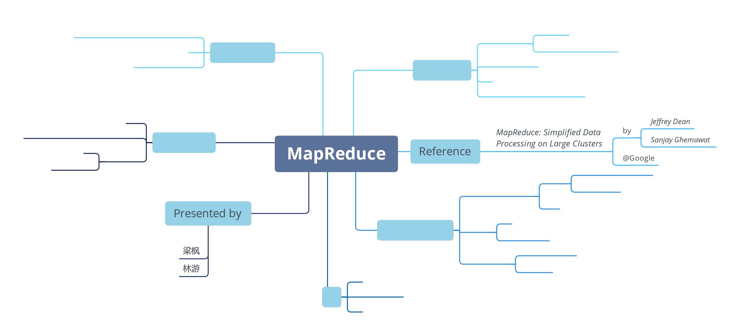

Slide 2
Concepts
Map
Reduce
Values-to-values Model
<Key, Value>pairs-to-<Key, Value>pairs Model

Slide 3
Old-fashioned Concepts
Mapping: f(X) where X can be multi-dimensional
Reduce: g(X₁, X₂, …, X_{n})
Java
Arrays.stream(integers).map(x->x+1).sum();
SQL
SELECT sum(integers) from integer_table

Slide 4
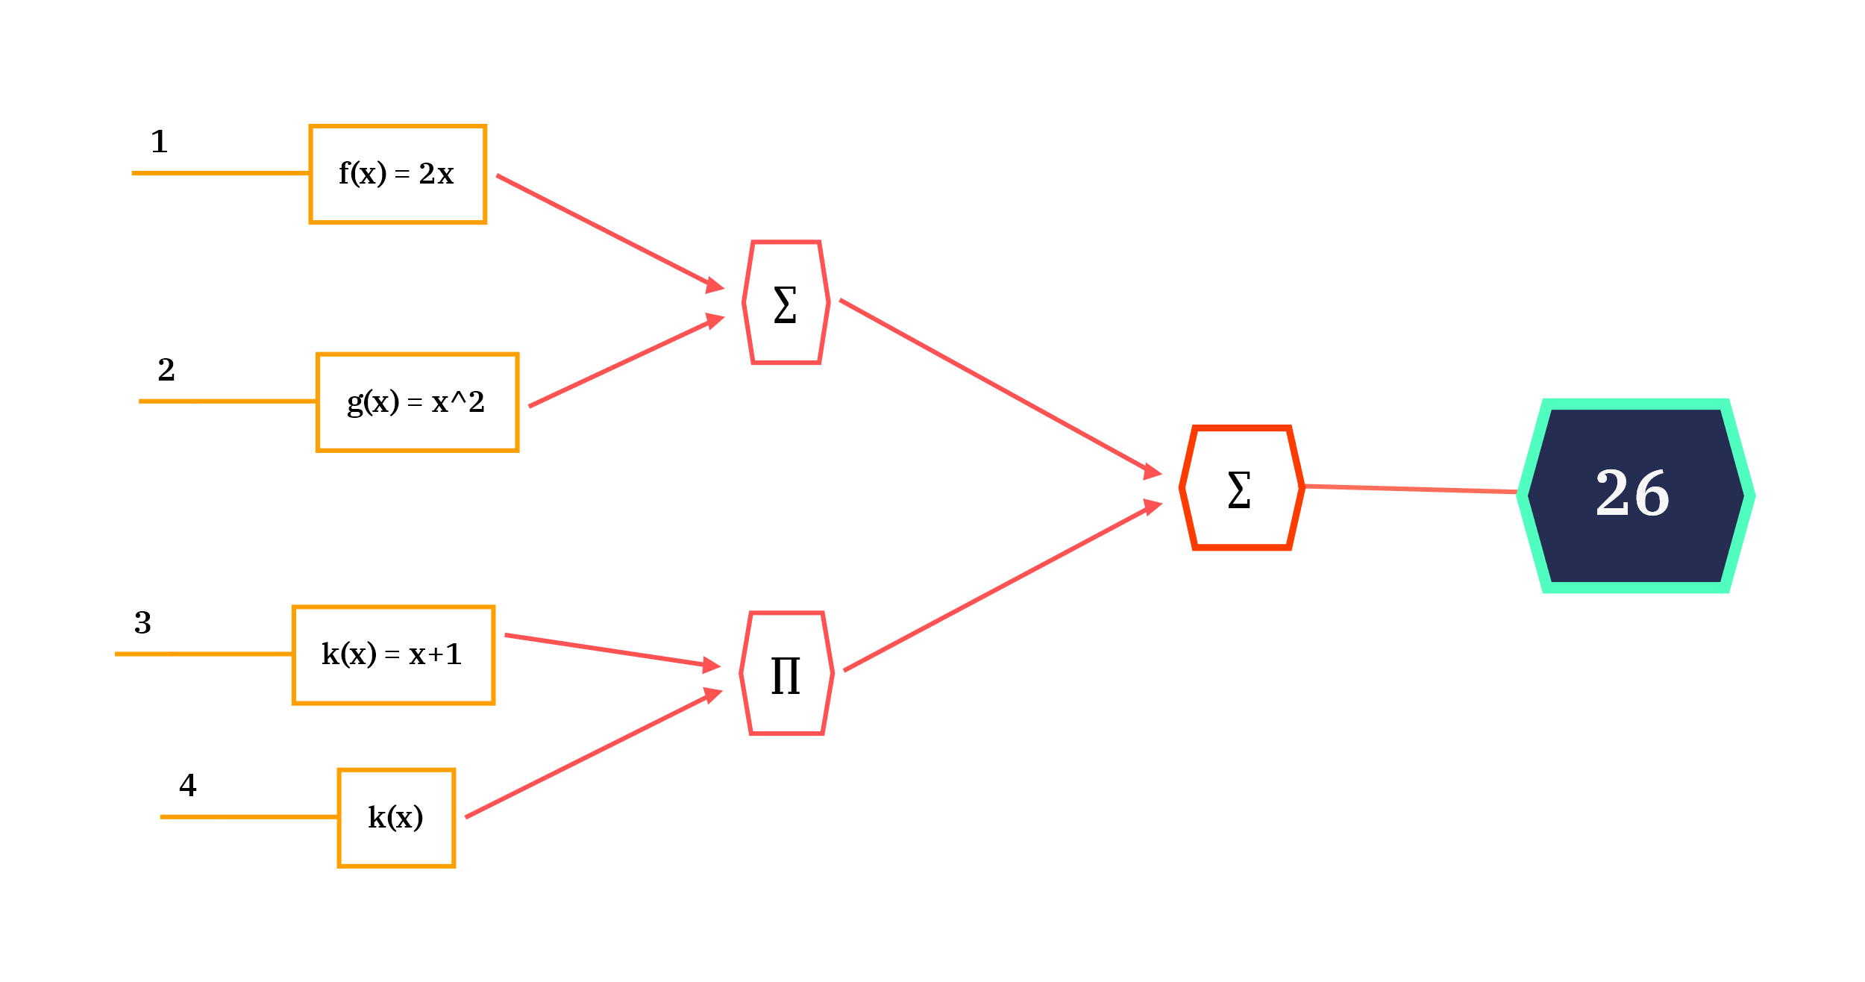
Old-fashioned Concepts
Mapping: f(X) where X can be multi-dimensional
Reduce: g(X₁, X₂, …, X_{n})

Slide 5
Powerful Paradigm
“The major contribution of this work are a simple and powerful interface that enables automatic parallelization and distribution of large-scale computations”

Slide 6
Not so powerful (yet)
What if we want to count the occurrence of each letter(or word) in a corpus?
The previous values-to-values model cannot help!
SUSTech
S | U | T | e | c | h
2 | 1 | 1 | 1 | 1 | 1
to | be | or | not | that | is | a | question
2 | 2 | 1 | 1 | 1 | 1 | 1 | 1
To be or not to be, that is a question

Slide 7
<K, V>pairs-to-<K, V>pairs Model
But we were dancing
but | we | were | dancing
1 | 1 | 1 | 1
Dancing with our hands tied hands tied
dancing | with | our | hands | tied
1 | 1 | 1 | 2 | 2
but | we | were | dancing | with | our | hands | tied
1 | 1 | 1 | 2 | 1 | 1 | 2 | 2
Reduce

Slide 8
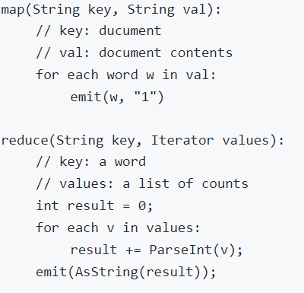
<K, V>pairs-to-<K, V>pairs Model
SUSTech
S | U | S | T | e | c | h
1 | 1 | 1 | 1 | 1 | 1 | 1
Reduce
S | U | T | e | c | h
2 | 1 | 1 | 1 | 1 | 1

Slide 9
Implementations
Structure & Workflow
Failure Detection and handling
Performance Refinements
GFS

Slide 10
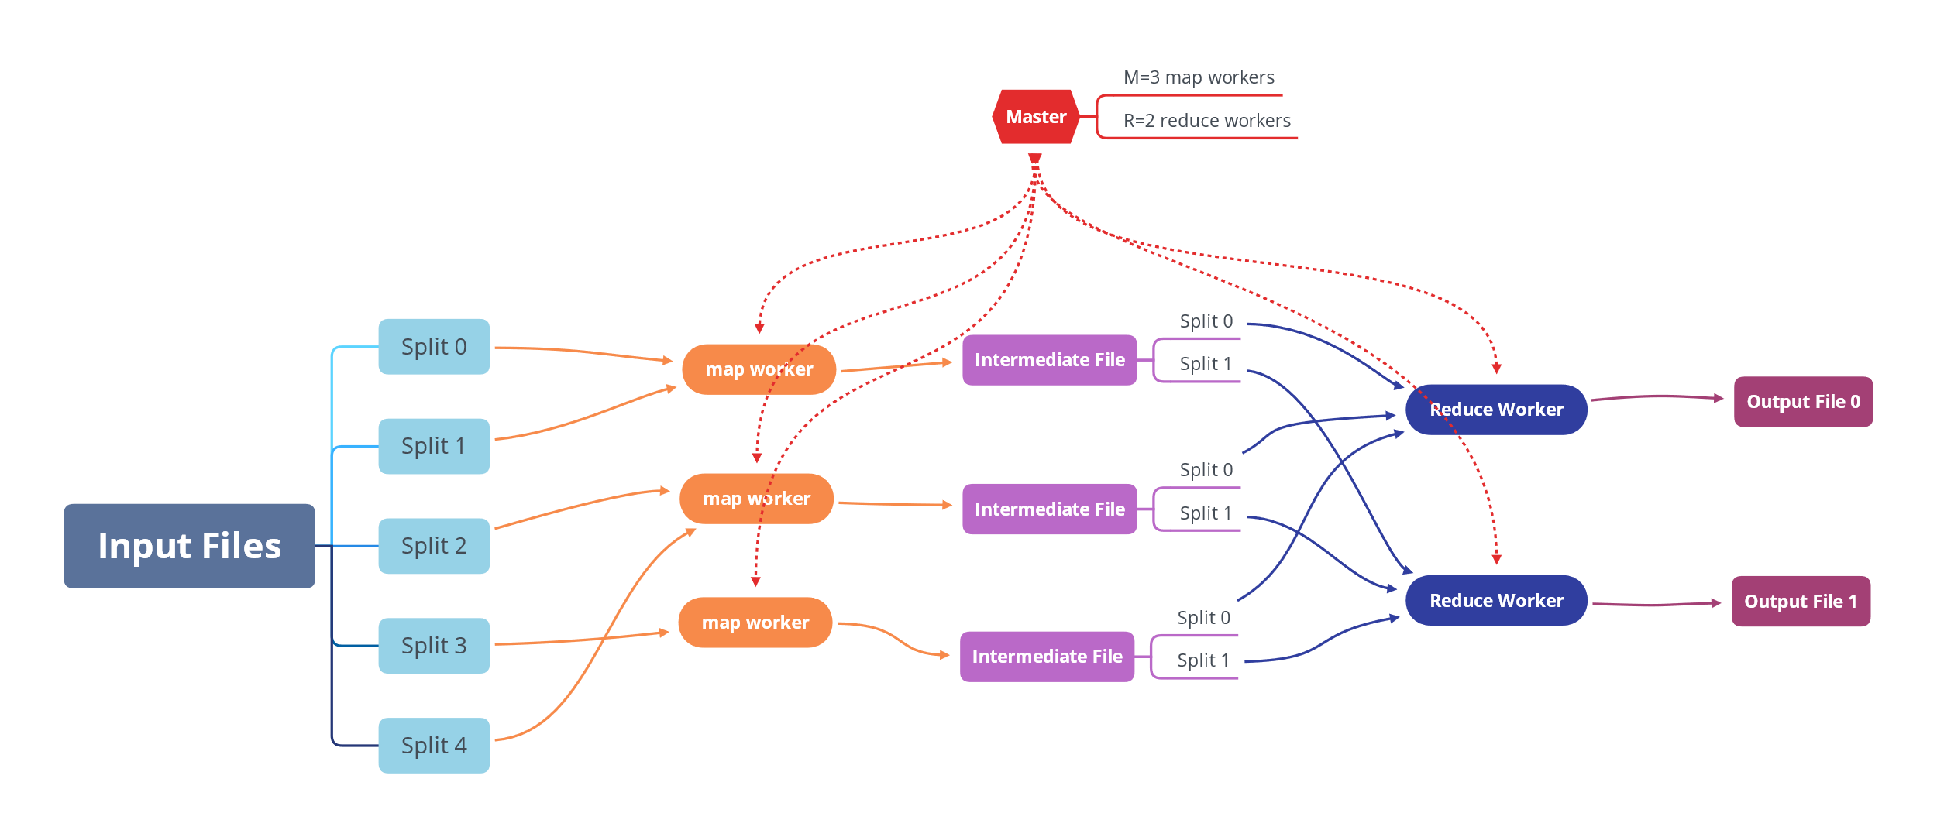
Structure

Slide 11
Workflow
Split Input Files (GFS comes into play)
Master assigns workers
Map workers read splits and perform mapping
Results of mappers are buffered in mem and backup in disk. Master gets notified
Reduce workers get notified by master and start reading and performing reducing
Reducers output results to final files

Slide 12
Failure Detection
The master pings every worker periodically

Slide 13
Failure Recovery
Worker Failure of Completed Map Tasks
Re-execute the map tasks on other map workers
Worker Failure of Uncompleted Tasks
Re-execute tasks on other workers
Worker Failure of Completed Reduce Task
No need to re-execute
Why?

Slide 14
What if the master fails?
Auto-checkpoint
Retry and start a new master

Slide 15
Performance Refinements
Configurable Partitioning Function
Combiner Function
Skipping Bad Records
Backup Tasks

Slide 16
Configurable Partitioning Function

Slide 17
Combiner Function

Slide 18
Skipping Bad Records

Slide 19
Backup Tasks

Slide 20
Google File System
Distributed
Fault-tolerant
High Throughput

Slide 24
Details of Implementation (Q&A)

Slide 25
What is inside the Master?

Slide 26
How to set the values of M and R ?

Slide 27
How to debug?

Slide 28
Extra Features?

