Slide 1
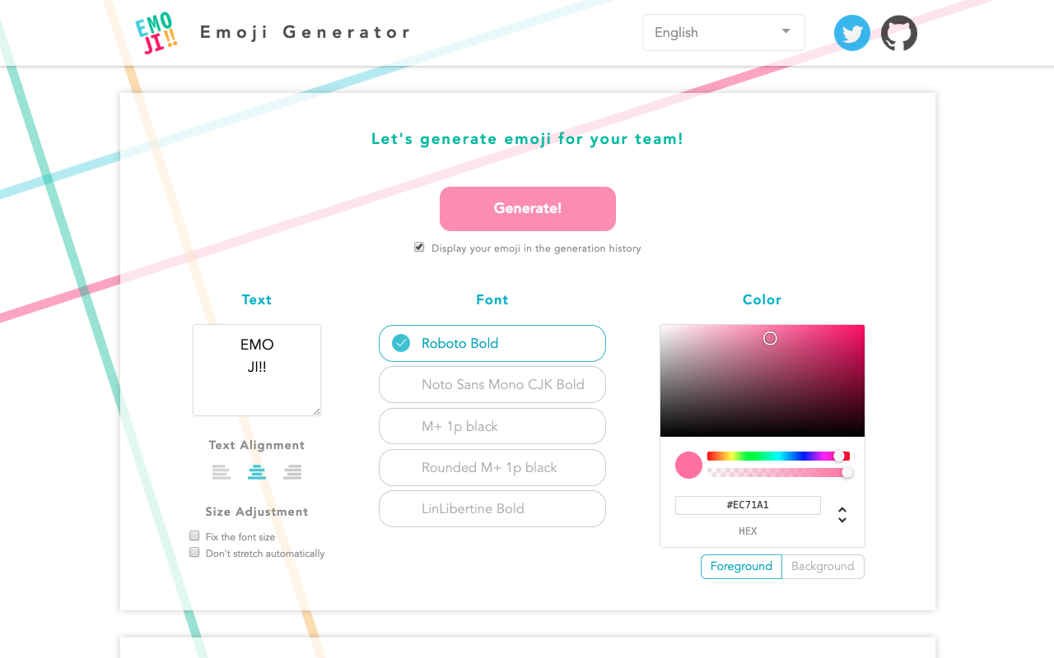
Just specify the color and text! Easily generate pretty emoji♪

