Slide 1
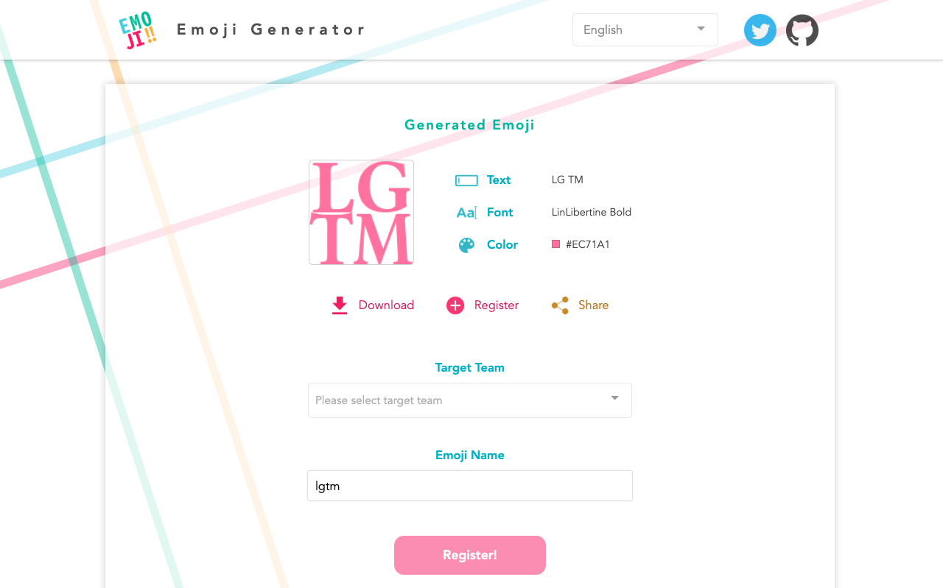
You can register directly with your Slack team!
Let's start using it right away♪

