Slide 1
Fortran
Intro

Slide 2
What it is
Fortran, as derived from Formula Translating System, is a general-purpose, imperative programming language. It is used for numeric and scientific computing.
Fortran was originally developed by IBM in the 1950s for scientific and engineering applications. Fortran ruled this programming area for a long time and became very popular for high performance computing, because It supports:
Numerical analysis and scientific computation
Structured programming
Array programming
Modular programming
Generic programming
High performance computing on supercomputers
Object oriented programming
Concurrent programming
Reasonable degree of portability between computer systems

Slide 3
Facts about Fortran
Fortran was created by a team, led by John Backus at IBM in 1957.
Initially the name used to be written in all capital, but current standards and implementations only require the first letter to be capital.
Fortran stands for FORmula TRANslator.
Originally developed for scientific calculations, it had very limited support for character strings and other structures needed for general purpose programming.
Later extensions and developments made it into a high level programming language with good degree of portability.
Original versions, Fortran I, II and III are considered obsolete now.
Oldest version still in use is Fortran IV, and Fortran 66.
Most commonly used versions today are : Fortran 77, Fortran 90, and Fortran 95.
Fortran 77 added strings as a distinct type.
Fortran 90 added various sorts of threading, and direct array processing.

Slide 4
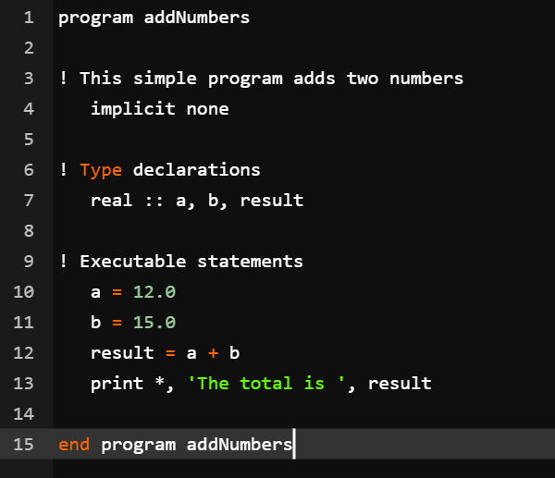
A Fortran program
All Fortran programs start with the keyword program and end with the keyword end program, followed by the name of the program.
The implicit none statement allows the compiler to check that all your variable types are declared properly. You must always use implicit none at the start of every program.
A Fortran program is made of a collection of program units like a main program, modules, and external subprograms or procedures.
Each program contains one main program and may or may not contain other program units. The syntax of the main program is as follows −
program program_name
implicit none
! type declaration statements
! executable statements
end program program_name
Notes:
Comments in Fortran are started with the exclamation mark (!), as all characters after this (except in a character string) are ignored by the compiler.
The print * command displays data on the screen.
Indentation of code lines is a good practice for keeping a program readable.
Fortran allows both uppercase and lowercase letters. Fortran is case-insensitive, except for string literals.
All Fortran programs start with the keyword program and end with the keyword end program, followed by the name of the program.
The implicit none statement allows the compiler to check that all your variable types are declared properly. You must always use implicit none at the start of every program.
Comments in Fortran are started with the exclamation mark (!), as all characters after this (except in a character string) are ignored by the compiler.
The print * command displays data on the screen.
Indentation of code lines is a good practice for keeping a program readable.
Fortran allows both uppercase and lowercase letters. Fortran is case-insensitive, except for string literals.

Slide 5
Basics
The basic character set of Fortran contains −
the letters A ... Z and a ... z
the digits 0 ... 9
the underscore (_) character
the special characters = : + blank - * / ( ) [ ] , . $ ' ! " % & ; < > ?
Tokens are made of characters in the basic character set. A token could be a keyword, an identifier, a constant, a string literal, or a symbol.
Program statements are made of tokens.

Slide 6
Identifier and Keywords
An identifier is a name used to identify a variable, procedure, or any other user-defined item. A name in Fortran must follow the following rules −
It cannot be longer than 31 characters.
It must be composed of alphanumeric characters (all the letters of the alphabet, and the digits 0 to 9) and underscores (_).
First character of a name must be a letter.
Names are case-insensitive
Keywords are special words, reserved for the language. These reserved words cannot be used as identifiers or names.
It has long list of KeyWords :
https://fortranwiki.org/fortran/show/Keywords

Slide 7
Fortran Style Guide
Naming Convention
Here is a style guide seems to be prevalent in most scientific codes (as well as the Fortran standard library), and you are welcome to follow it.
Use lowercase for all Fortran constructs (do, subroutine, module, …).
Follow short mathematical notation for mathematical variables/functions (Ylm, Gamma, gamma, Enl, Rnl, …).
For other names use all lowercase: try to keep names to one or two syllables; if more are required, use underscores to clarify (sortpair, whitechar, meshexp, numstrings, linspace, meshgrid, argsort, spline, spline_interp, spline_interpolate, stoperr, stop_error, meshexp_der).
Indentation
Use a consistent indentation to make your code readable. The amount of indentation is a matter of preference, the most common choices are two, three or four spaces.
Notes:
Comparison to Other Languages
On the other hand, in most of the rest of the programming world, where the main focus is, in one form or another, on defining and using large sets of complex objects, with tons of properties and behaviors, known only in the code in which they are defined (as opposed to defined by the same notation throughout the literature), it makes more sense to use longer, more descriptive names. The naming conventions one sees used in more general-purpose languages such as C++ and Python, therefore, are perfectly consistent with their more general-purpose missions. But Fortran has a different mission (numerical scientific computing).

Slide 8
Fortran - Data Types
Fortran provides five intrinsic data types, however, you can derive your own data types as well. The five intrinsic types are
Integer type
Real type
Complex type
Logical type
Character type
The character type stores characters and strings. The length of the string can be specified by len specifier. If no length is specified, it is 1.
character (len = 40) :: name
name = “Its me Magda”
The expression name(1:3) will give Its and name(8:12) - ?

Slide 9
Integer Type
program testingInt
implicit none
!two byte integer
integer(kind = 2) :: shortval
!four byte integer
integer(kind = 4) :: longval
!eight byte integer
integer(kind = 8) :: verylongval
!sixteen byte integer
integer(kind = 16) :: veryverylongval
!default integer
integer :: defval
print *, huge(shortval)
print *, huge(longval)
print *, huge(verylongval)
print *, huge(veryverylongval)
print *, huge(defval)
end program testingInt
Notes:
Older versions of Fortran allowed a feature called implicit typing, i.e., you do not have to declare the variables before use. If a variable is not declared, then the first letter of its name will determine its type.
Variable names starting with i, j, k, l, m, or n, are considered to be for integer variable and others are real variables. However, you must declare all the variables as it is good programming practice. For that you start your program with the statement −
implicit none

Slide 10
Floating Point Numbers
The default representation of floating point numbers is using single precision (usually 32 bits / 4 bytes). For most applications a higher precision is required. For this purpose a custom kind parameter can be defined. The recommended way of defining kind parameters is to use
It is recommended to have a central module to define kind parameters and include them with use as necessary.
Floating point constants should always be declared including a kind parameter suffix:
real(dp) :: a, b, c
a = 1.0_dp
b = 3.5_dp
c = 1.34e8_dp
In order to impose floating point division (as opposed to integer division 3/4 equal to 0), one can convert the integer to a floating point number by:
real(dp) :: a
a = real(3, dp) / 4 ! 'a' is equal to 0.75_dp
For many purposes it also suffices to directly infer the kind parameter from a literal like here
integer, parameter :: dp = kind(0.0d0)
or to rename the imported kind parameter from the iso_fortran_env module

Slide 11
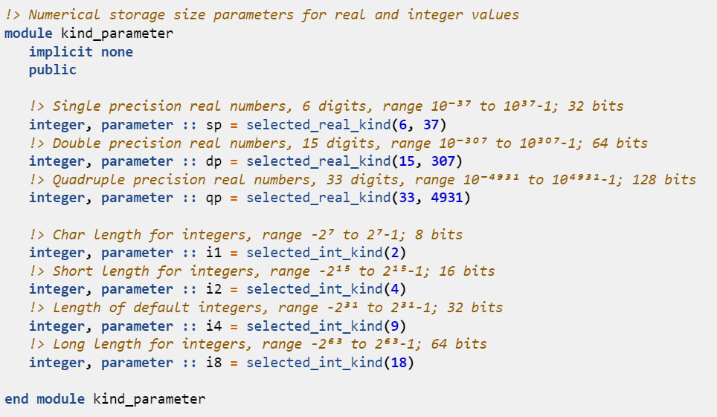

Slide 12
Variables
A variable is nothing but a name given to a storage area that our programs can manipulate. Each variable should have a specific type, which determines the size and layout of the variable's memory; the range of values that can be stored within that memory; and the set of operations that can be applied to the variable.
The name of a variable can be composed of letters, digits, and the underscore character. A name in Fortran must follow the following rules −
It cannot be longer than 31 characters.
It must be composed of alphanumeric characters (all the letters of the alphabet, and the digits 0 to 9) and underscores (_).
First character of a name must be a letter.
Names are case-insensitive.

Slide 13
Variable Declaration
Variables are declared at the beginning of a program (or subprogram) in a type declaration statement.
integer :: total
real :: average
complex :: cx
logical :: done
character(len = 80) :: message
Later you can assign values to these variables,

Slide 14
Fortran - Constants
The constants refer to the fixed values that the program cannot alter during its execution. These fixed values are also called literals.
Constants can be of any of the basic data types like an integer constant, a floating constant, a character constant, a complex constant, or a string literal. There are only two logical constants : .true. and .false.
The constants are treated just like regular variables, except that their values cannot be modified after their definition.
There are two types of constants −
Literal constants
Named constants
A literal constant have a value, but no name. A named constant has a value as well as a name.
Named constants are declared with the parameter attribute. For example,
real, parameter :: pi = 3.1415927
Notes:
you can go without explicit specification as well for example: REAL :: PI = 3.14159265

Slide 15
Fortran - Operators
Fortran provides the following types of operators −
Arithmetic Operators
Mainly Similar, ** is an exponentiation Operator, raises one operand to the power of the other.
Relational Operators
Almost Similar but there are also Equivalents : == .eq. /= .ne. > g.t. and so on
Logical Operators
.and. .or. .not. .eqv. .neqv.

Slide 16
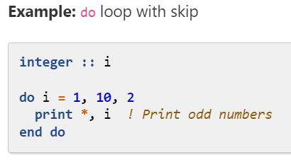
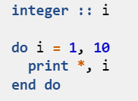
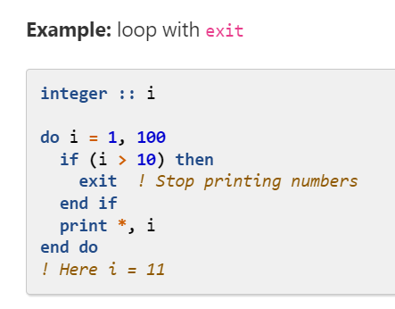
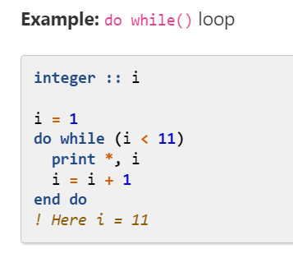
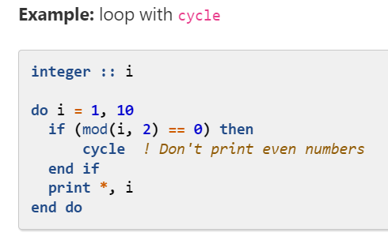
Loops
See the examples

Slide 17
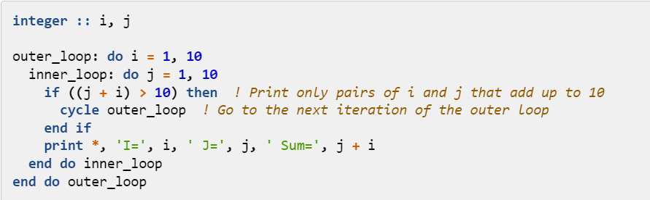
Nested loop control: tags
Fortran allows the programmer to tag or name each loop. If loops are tagged, there are two potential benefits:
The readability of the code may be improved (when the naming is meaningful).
exit and cycle may be used with tags, which allows for very fine-grained control of the loops.

Slide 18
Parallelizable loop (do concurrent)
The do concurrent loop is used to explicitly specify that the inside of the loop has no interdependencies; this informs the compiler that it may use parallelization/SIMD to speed up execution of the loop and conveys programmer intention more clearly : this means that any given loop iteration does not depend on the prior execution of other loop iterations.
Simply replacing a do loop with a do concurrent does not guarantee parallel execution.
Compilers are also free to do as they see fit, meaning they may not optimize the loop.
In general, compiler flags are required to activate possible parallelization for do concurrent loops.

Slide 19
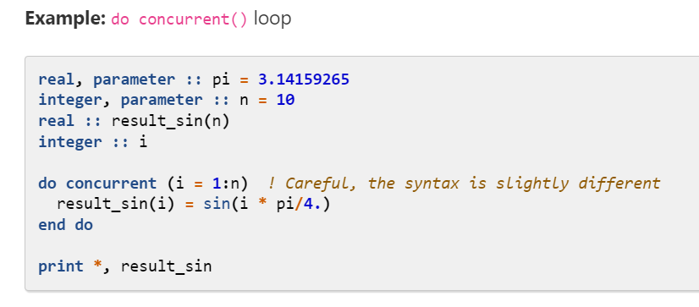
Example: do concurrent() loop

Slide 20
Arrays
Arrays are an important data structure in Fortran, used to store multiple values of the same data type. In Fortran, arrays are indexed starting from 1, which is different from some other programming languages that start indexing from 0.
Arrays are a central object in Fortran.

Slide 21
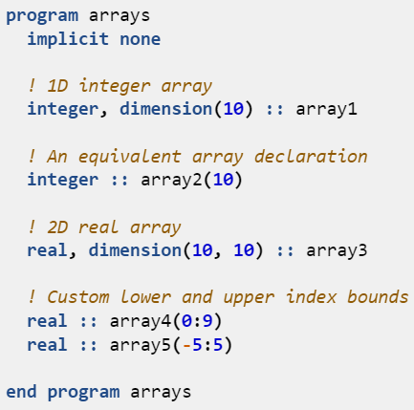
Array declaration
Example: static array declaration
We can declare arrays of any type. There are two common notations for declaring array variables:
using the dimension attribute
appending the array dimensions in parentheses to the variable name.
we have specified the size of our array in our program code—this type of array is known as a static array since its size is fixed when we compile our program.

Slide 22
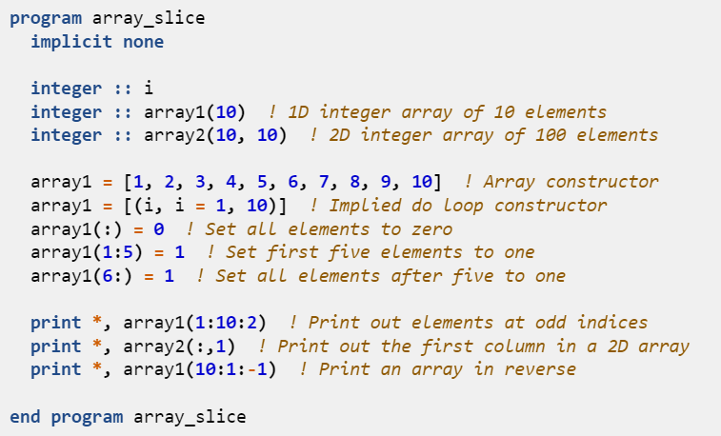
Array slicing
Example: array slicing
A powerful feature of the Fortran language is its built-in support for array operations; we can perform operations on all or part of an array using array slicing notation:

Slide 23
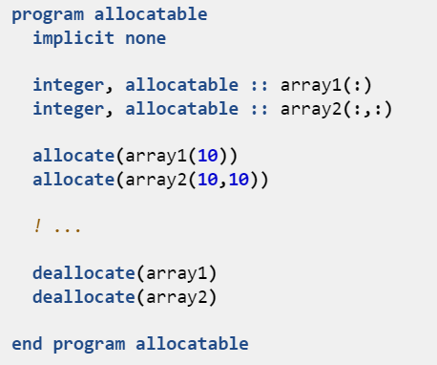
Allocatable (dynamic) arrays
Quite often, we do not know how big our array needs to be until we run our program, for example, if we are reading data from a file of unknown size.
For this problem, we need allocatable arrays. These are allocated while the program is running once we know how big the array needs to be.
TASK
Create 2 dimensional dynamic integer array
Ask user about dimensions at runtime to create array
Populate it and print

Slide 24
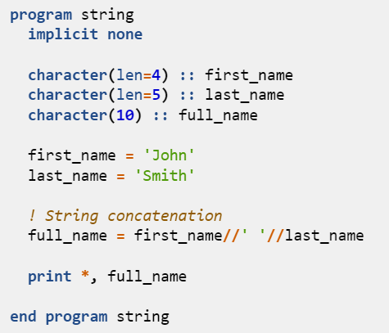
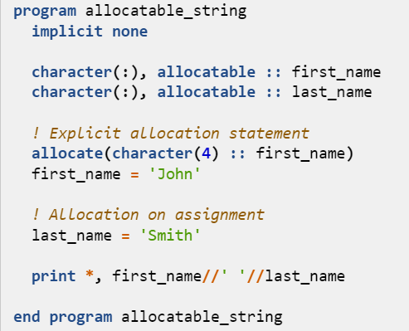
Character strings

Slide 25
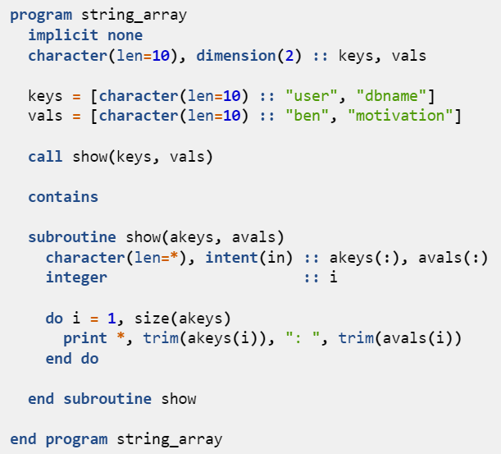
Array of strings
An array of strings can be expressed in Fortran as an array of character variables.
All elements in a character array have equal length.
However, strings of varying lengths can be provided as input to the array constructor, as shown in the example.
They will be truncated or right-padded with spaces if they are longer or shorter, respectively, than the declared length of the character array.
Finally, we use the intrinsic function trim to remove any excess spaces when printing the values to the standard output.

Slide 26
Organising code structure
Most programming languages allow you to collect commonly-used code into procedures that can be reused by calling them from other sections of code.
Fortran has two forms of procedure:
Subroutine: invoked by a call statement
Function: invoked within an expression or assignment to which it returns a value
Both subroutines and functions have access to variables in the parent scope by argument association; unless the value attribute is specified, this is similar to call by reference.

Slide 27
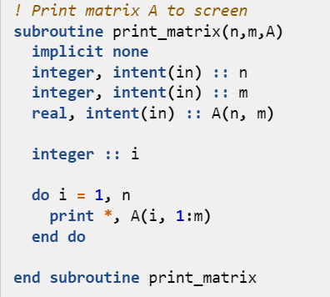
Subroutines
The subroutine input arguments, known as dummy arguments, are specified in parentheses after the subroutine name; the dummy argument types and attributes are declared within the body of the subroutine just like local variables.
Note the additional intent attribute when declaring the dummy arguments;
Optional intent attribute signifies to the compiler whether the argument is
‘’read-only’’ (intent(in)) - the value of the dummy argument may be used, but not modified, within the procedure.
‘’write-only’’ (intent(out)) - the dummy argument may be set and then modified within the procedure, and the values returned to the caller.
‘’read-write’’ (intent(inout)) - initial values of the dummy argument may be both used and modified within the procedure, and then returned to the caller.
In this example, the subroutine does not modify its arguments, hence all arguments are intent(in).
Notes:
program call_sub implicit none real :: mat(10, 20) mat(:,:) = 0.0 call print_matrix(10, 20, mat) end program call_sub

Slide 28
Functions
Many programming languages do not distinguish between functions and subroutines (e.g. C/C++, Python, Java). Pure functional programming languages (e.g. Haskell) only allow functions, because subroutines can, in some case, modify input variables as side-effects, which can complicate the code.
Functions are simpler than subroutines. A function must return a single value, and can be invoked from within expressions, like a write statement, inside an if declaration if (function) then, etc.
A subroutine does not return a value, but can return many values via its arguments and can only be used as a stand-alone command (using the keyword call).

Slide 29
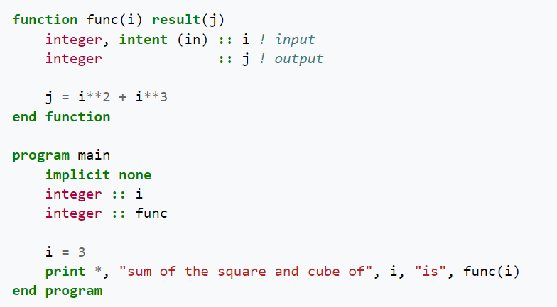
Functions cont
In Fortran, one can use a function to return a value or an array of values. The following program calls a function to compute the sum of the square and the cube of an integer.
It is good programming practice for functions not to modify their arguments—that is, all function arguments should be intent(in).
Such functions are known as pure functions. Use subroutines if your procedure needs to modify its arguments.

Slide 30
Modules
Fortran modules contain definitions that are made accessible to programs, procedures, and other modules through the use statement. They can contain data objects, type definitions, procedures, and interfaces.
Modules allow controlled scoping extension whereby entity access is made explicit
Modules automatically generate explicit interfaces required for modern procedures
It is recommended to always place functions and subroutines within modules.

Slide 31
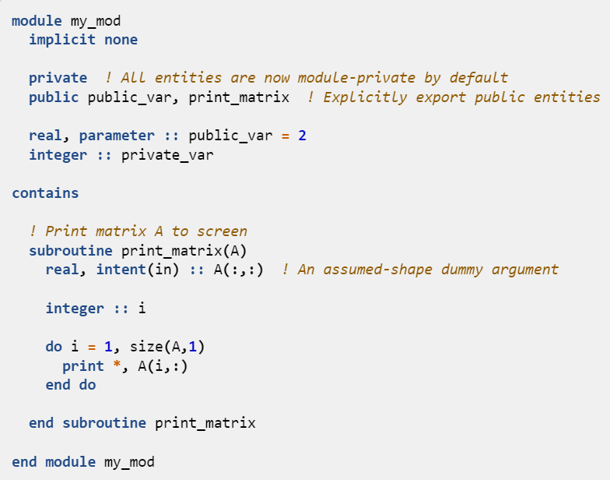
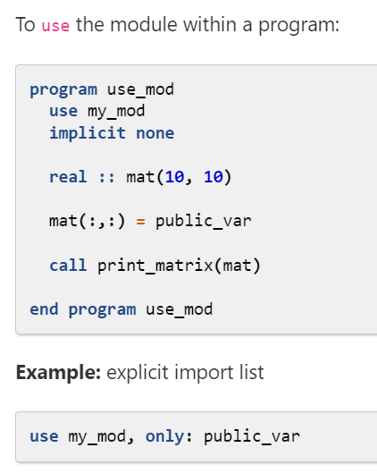
Notes:
Each module should be written in a separate .f90 source file. Modules need to be compiled prior to any program units that use them.

