Slide 1
Tawazun
توازن
AI media wellbeing for Libya
Tawazun helps people assess online content, understand its emotional impact, and choose how to respond.
By: Suliman Hashem, Buthina urayet, Abdulhafiz Al-Sallai
PROJECT PITCH
Notes:
Tawazun (توازن) means balance. The concept pairs media literacy with emotional self-awareness.

Slide 2
TAWAZUN / MEDIA WELLBEING
Online content creates two challenges at once
People must judge whether a post is credible while managing how its language makes them feel.
In June 2026, the UN in Libya raised concern about misinformation, disinformation, and inflammatory rhetoric on social media, including content targeting individuals and groups.
Misinformation, inflammatory rhetoric, and hate speech can mix with urgency and emotional pressure.
DESIGN OPPORTUNITY
Tawazun connects content analysis with emotional self-awareness and practical response guidance.
Source: United Nations in Libya, 1 June 2026
LIBYA • AI MEDIA WELLBEING PLATFORM
02
Notes:
Source: UN in Libya, “UN in Libya expresses concern over the spread of misinformation and inflammatory rhetoric,” 1 June 2026. https://libya.un.org/en/316507-un-libya-expresses-concern-over-spread-misinformation-and-inflammatory-rhetoric

Slide 3
TAWAZUN / MEDIA WELLBEING
Libya’s digital reach makes this a relevant setting
88.5%
6.62M
of Libya’s population used the internet at the end of 2025
estimated internet users in Libya at the end of 2025
Tawazun is designed for the spaces where people already encounter information, with a lightweight mobile-first experience.
DataReportal / Kepios, Digital 2026: Libya. Social media “user identities” are not necessarily unique people.
LIBYA • AI MEDIA WELLBEING PLATFORM
03
Notes:
Data source: DataReportal, Digital 2026: Libya. Data points are from October 2025 / late 2025 and were published in November 2025. It estimates 6.62 million internet users and 88.5% internet penetration. The report separately estimates 6.70 million social media user identities, but warns these may not represent unique individuals. https://datareportal.com/reports/digital-2026-libya

Slide 4
TAWAZUN / MEDIA WELLBEING
Mental wellbeing matters, and local data is limited
22.1%
A careful reading
This is not a Libya-specific prevalence survey. WHO says no official national prevalence data exist, and public mental-health research remains limited.
WHO estimate for mental disorders at a point in time in conflict-affected populations
That gap makes local listening and testing essential. Tawazun starts as a media-wellbeing tool, not a mental-health diagnosis or treatment service.
WHO EMRO, Mental health and psychosocial support, 2024 report
LIBYA • AI MEDIA WELLBEING PLATFORM
04
Notes:
WHO EMRO reports that no official national data exist on prevalence of mental-health conditions in Libya. WHO cites an approximately 22.1% estimate for conflict-affected populations such as Libya at a given time. This is contextual, not a Libya-specific prevalence study. Source: WHO EMRO, Mental health and psychosocial support, https://applications.emro.who.int/docs/9789292741716-eng.pdf. WHO also notes that public mental-health research is limited in Libya: https://www.who.int/about/accountability/results/who-results-report-2024-2025/region-EMRO/2024/libya

Slide 5
TAWAZUN / MEDIA WELLBEING
Tawazun is an AI media wellbeing platform for Libya
It helps users assess a post, understand how it affects them, and decide how to respond.
01
02
03
Read the post
Notice the impact
Choose a response
Spot loaded language, unsupported claims, urgency, or targeting.
Name the feeling the content brought up, without judgment.
Pause, check a source, try a grounding prompt, or disengage.
LIBYA • AI MEDIA WELLBEING PLATFORM
05
Notes:
The product promise is reflective and educational. AI should explain signals and possible techniques, not issue a definitive truth verdict or diagnose the user.

Slide 6
TAWAZUN / MEDIA WELLBEING
How the complete Tawazun experience works
Example: a user sees an alarming claim about a local service and feels worried.
01
02
03
04
Share
Understand
Check in
Choose
The user shares a post and selects how it made them feel.
AI explains urgency, emotional language, and source cues. It labels uncertainty.
The user can track mood patterns and try a calming prompt or practice example.
The source guide and response coach offer options. The story companion adds Libyan Arabic support.
The user stays in control at every step.
LIBYA • AI MEDIA WELLBEING PLATFORM
06
Notes:
Illustrative user journey for the complete platform. Example claim is fictional. The analyzer flags language and source cues, it does not make a definitive truth judgment. Mood tracking is opt-in. The story companion and practice simulator are product modules that users can choose when relevant.

Slide 7
TAWAZUN / MEDIA WELLBEING
Seven features, one connected platform
Each feature supports the same goal: informed responses with greater emotional awareness.
UNDERSTAND CONTENT
NOTICE AND RESPOND
LIBYAN ARABIC SUPPORT
01 Misinformation detector
04 Psychological impact analyzer
07 Story companion, “Al-Hakeem”
Explains claim and persuasion signals with uncertainty.
Connects content with user-reported feelings.
Uses reviewed Libyan Arabic stories for reflection.
02 Source checker
05 Mood and media tracker
Surfaces source cues and points to trusted references.
Shows opt-in patterns and suggests a media break.
03 Post simulator
06 Hate-speech response coach
Lets users practice spotting misleading techniques.
Offers ways to respond calmly or disengage.
Local reviewers guide language, examples, and resources across all seven features.
LIBYA • AI MEDIA WELLBEING PLATFORM
07
Notes:
The platform has exactly seven product features, numbered 01 to 07. Local review is a cross-cutting design principle, not an eighth feature. The story companion should use locally reviewed stories and Libyan Arabic prompts. Source checking should present evidence and uncertainty rather than claim perfect verification.

Slide 8
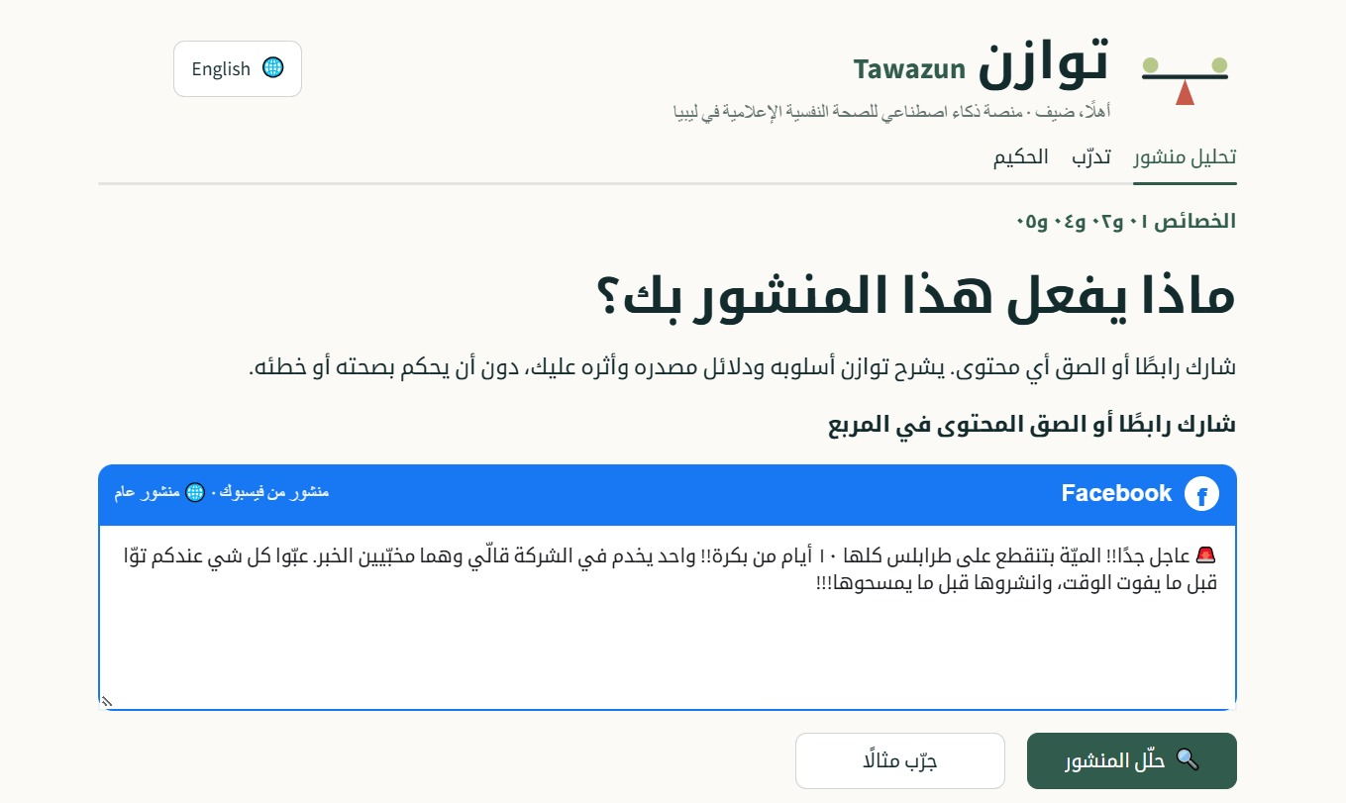
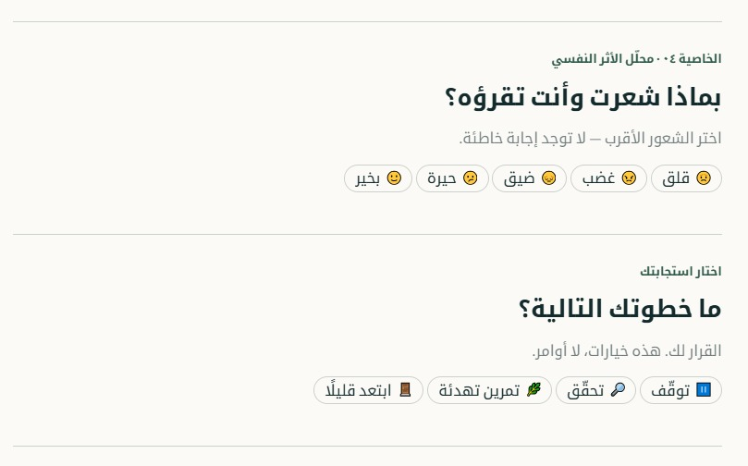
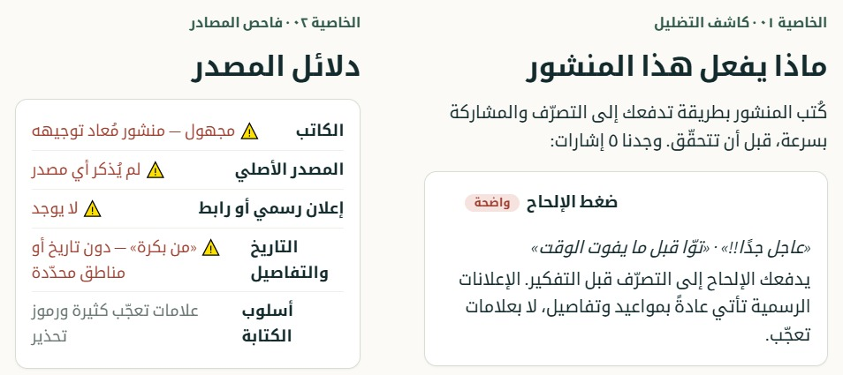
TAWAZUN / MEDIA WELLBEING
Tawazun prototype screens
Three Arabic interface screens show the core user journey. The post shown is a demo.
01 SHARE A POST
02 UNDERSTAND IT
03 CHECK IN
Submit a post or link
Review language and source cues
Name a feeling and choose a next step
A product prototype, not a claim that the example post is true.
LIBYA • AI MEDIA WELLBEING PLATFORM
08
Notes:
Screenshots supplied by the Tawazun team from its Arabic platform prototype. The post depicted in the first screen is a demonstration example; it is not presented as a verified real-world claim. English captions summarize the Arabic UI.

Slide 9
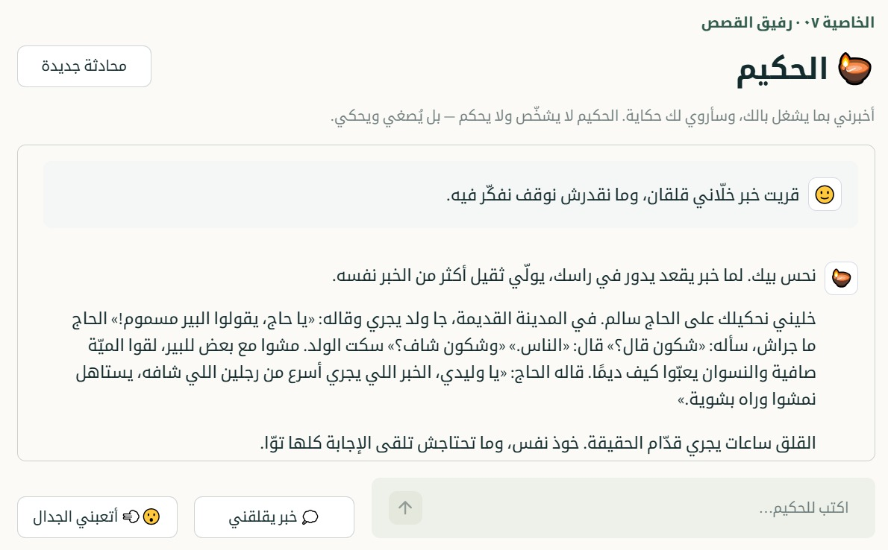
TAWAZUN / MEDIA WELLBEING
Al-Hakeem: a Libyan Arabic story companion
A familiar, nonjudgmental way to reflect when something is weighing on the user.
01
The user shares what is worrying them.
02
Al-Hakeem responds with a familiar Libyan story.
03
The user reflects on a takeaway at their own pace.
The companion offers reflection, not diagnosis or treatment.
LIBYA • AI MEDIA WELLBEING PLATFORM
09
Notes:
Screenshot supplied by the Tawazun team from its Arabic prototype. Al-Hakeem is intended as a reflective story companion using locally familiar Libyan Arabic; it is not a mental-health professional and should not diagnose or replace care. English slide text summarizes the Arabic screen.

Slide 10
TAWAZUN / MEDIA WELLBEING
AI’s role and safety boundaries
AI can
The product should
Explain emotional or persuasive techniques in plain language.
Reflect the feeling a user chooses to share.
Suggest a reviewed activity or source-checking step.
Show uncertainty and explain why a signal was flagged.
Avoid political judgments, diagnoses, or certainty scores.
Minimize data collection and let users skip or delete.
AI supports reflection. It does not decide what people should believe.
LIBYA • AI MEDIA WELLBEING PLATFORM
10
Notes:
Product safety principles: explain observable textual signals; avoid a false precision score; clearly label uncertainty; do not diagnose or offer treatment; minimize retention of sensitive user content; review Arabic and Libyan dialect outputs with local users and experts.

Slide 11
TAWAZUN / MEDIA WELLBEING
How the complete system works together
One platform brings information analysis, emotional reflection, learning, and response support into the same experience.
INPUT
AI ANALYSIS
USER CONTEXT
SUPPORT
Posts, links, or practice examples
Claim cues, source signals, emotional language, and hate speech
Self-reported feeling and optional mood history
Source guidance, calming prompts, practice, stories, or response coaching
Designed outcome
Users can better understand what a post is doing, how it affects them, and which next step they want to take.
LIBYA • AI MEDIA WELLBEING PLATFORM
11
Notes:
This slide describes the integrated product concept, not a claim of measured effectiveness. The user controls what they share, whether they use mood history, and which support option they choose.

Slide 12
TAWAZUN / MEDIA WELLBEING
Tawazun implementation architecture
One integrated application supports all seven features with a manageable starting stack.
FRONTEND
BACKEND
AI + SAFETY
DATA
DEPLOYMENT
Mobile-first Next.js website
Arabic RTL layout
Voice input optional
FastAPI modular API
All seven features in one deployable app
One Arabic-capable model
Reviewed safety rules
Explanations, not truth scores
PostgreSQL for app data
Reviewed sources, posts, and stories
Mood tracking is opt-in
One cloud provider
CI/CD and monitoring
Encryption and access controls
Add Redis, vector search, WhatsApp, or model fine-tuning only when user needs and evidence justify them.
LIBYA • AI MEDIA WELLBEING PLATFORM
12
Notes:
Recommended starting architecture for the complete platform. A single modular API contains all seven product features. Select one Arabic-capable model and one cloud provider at the outset. Additional infrastructure such as Redis, vector search, WhatsApp, multi-model routing, or fine-tuning is optional and should follow a demonstrated need. Privacy and security controls apply across every layer.

Slide 13
TAWAZUN / MEDIA WELLBEING
Support the complete Tawazun project
One integrated platform
We are looking for
We are proposing a complete media wellbeing service that brings all seven features together for people in Libya.
Support for the full project
Libyan users and community reviewers
Media-literacy and mental-health expertise
Tawazun connects content understanding with emotional wellbeing, in a form designed for Libya.
LIBYA • AI MEDIA WELLBEING PLATFORM
13
Notes:
The pitch asks for support to develop Tawazun as a complete integrated platform, with Libyan users and relevant local reviewers involved throughout.

Slide 14
TAWAZUN / MEDIA WELLBEING
Sources and evidence notes
DIGITAL ACCESS
DataReportal, Digital 2026: Libya (published Nov 2025; underlying internet figures late 2025).
https://datareportal.com/reports/digital-2026-libya
MISINFORMATION CONTEXT
United Nations in Libya, statement on misinformation and inflammatory rhetoric, 1 June 2026.
https://libya.un.org/en/316507-un-libya-expresses-concern-over-spread-misinformation-and-inflammatory-rhetoric
MENTAL-HEALTH CONTEXT
WHO EMRO, Mental health and psychosocial support (2024 report). The 22.1% figure refers to conflict-affected populations, not a Libya-specific prevalence survey.
https://applications.emro.who.int/docs/9789292741716-eng.pdf
NATIONAL DATA LIMITATION
WHO Libya country profile: public mental-health research is limited; mental-health data are not routinely collected in national health information systems.
https://www.who.int/about/accountability/results/who-results-report-2024-2025/region-EMRO/2024/libya
LIBYA • AI MEDIA WELLBEING PLATFORM
14
Notes:
Use the dates and caveats shown with each source. DataReportal cautions that social media user identities do not necessarily equal unique people. WHO’s 22.1% estimate is for conflict-affected populations and should not be presented as a national Libya prevalence measurement.

