Slide 1
외적

Slide 2




Y
B
5
$\vec{v_{AB}}$
A
$\vec{v}$ = 크기 + 방향
1
0
1
4
X
$\vec{v_{AB}}$
$\vec{v_{AB}}= (B_{x}−A_{x},B_{y}−A_{y}$) = (3, 4)

Slide 3

Y
$\vec{v_{2}}$
내적 (dot product)
= 스칼라 곱
$$θ$$
$\vec{v_{1}}$
$$\vec{v_{1}}= \left(x_{1},y_{1}\right)$$
$$\vec{v_{2}}= \left(x_{2},y_{2}\right)$$
0
X
$$\vec{v_{1}}\text{·} \vec{v_{2}}$$
$=$ $\left|\vec{v_{1}}\right|\left|\vec{v_{2}}\right|\cos{θ }$
$=$ $x_{1}x_{2}$ + $y_{1}y_{2}$

Slide 4





Y
외적 (cross product)
$\vec{v_{2}}$
$$θ$$
$$\vec{v_{1}}= \left(x_{1},y_{1}\right)$$
$$\vec{v_{2}}= \left(x_{2},y_{2}\right)$$
$\vec{v_{1}}$
0
X
$$\vec{v_{1}}\text{×}\vec{v_{2}}$$
$=\left(\left|\vec{v_{1}}\right|\left|\vec{v_{2}}\right|\sin{θ }\right) \vec{k}$
$=$ ($x_{1}y_{2}$ - $x_{2}y_{1}) \vec{k}$

Slide 5
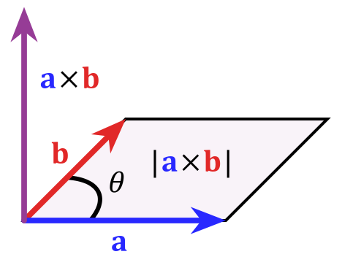
외적 (cross product)
$$\vec{v_{1}}= \left(x_{1},y_{1}\right)$$
$$\vec{v_{2}}= \left(x_{2},y_{2}\right)$$
$$\vec{v_{1}}\text{×}\vec{v_{2}}$$
$=\left(\left|\vec{v_{1}}\right|\left|\vec{v_{2}}\right|\sin{θ }\right) \vec{k}$
$=$ ($x_{1}y_{2}$ - $x_{2}y_{1}) \vec{k}$

Slide 6
A
외적 응용 예시
시계 방향 / 반시계 방향 체크
O
B

Slide 7

외적 응용 예시
B
$$\vec{v_{2}}$$
$\vec{v_{1}}\text{×}\vec{v_{P}}$와$\vec{v_{P}}\text{×}\vec{v_{2}} 같$은 방향 가리키는지?
P
$$\vec{v_{P}}$$
O
A
$$\vec{v_{1}}$$

