Slide 1
삼각 함수

Slide 2




(빗변)
(높이)
H
$$θ$$
$$S$$
(밑변)

Slide 3








$$A$$
$$\cos{θ }=\frac{a}{c}$$
$$\sin{θ }=\frac{b}{c}$$
c
b
$\tan{θ }=\frac{\sin{θ }}{\cos{θ }}$ $=\frac{b}{a}$
$$θ$$
B
$$C$$
a
$$c^{2}=a^{2}+b^{2}$$
$피$타고라스 공식

Slide 4



단위 원 (unit circle)
y
Degree 각도법 (도수법)
$$0^{o} \sim {360}^{o}$$
$$θ$$
Radian 각도법 (호도법)
$$0\sim 2π$$
x

Slide 5

단위 원 (unit circle)
1 rad = ${57.29}^{o}$
2$π$ = ${360}^{o}$
$π$ = ${180}^{o}$
$\frac{π}{2}$ = ${90}^{o}$
$\frac{π}{3}$ = ${60}^{o}$
$\frac{π}{4}$ = ${45}^{o}$
$\frac{π}{6}$ = ${30}^{o}$
1
1 rad
1

Slide 6



단위 원 (unit circle)
1
$$\sin{θ }$$
$$θ$$
$$\cos^{2}{θ }+\sin^{2}{θ }=1$$
-1
$$\cos{θ }$$
1
-1

Slide 7
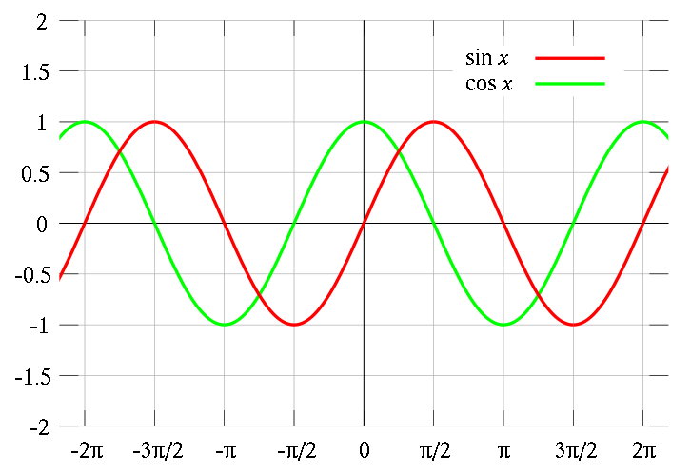

$\cos{(−θ )}$ = $\cos{θ}$
$\sin{(−θ )}$ = $−sin{θ}$

Slide 8




$$θ$$
$$θ$$
$$θ$$
$\cos{(\frac{π}{2}+θ )}$ = $−\sin{θ}$
$\cos{(\frac{π}{2}−θ )}$ = $\sin{θ}$
$\sin{(\frac{π}{2}+θ )}$ = $\cos{θ}$
$\sin{(\frac{π}{2}−θ )}$ = $\cos{θ}$

