Slide 1
CAPSTONE · EXECUTIVE PRESENTATION
A trusted data foundation, two decision
models, and a governed platform for
one hospital network.
Hospital Operations & Revenue Risk Intelligence Platform — turning one calendar year of visit and claims data across a multi-specialty, multi-city network into a queryable analytics layer, a priced pre-submission claim-outcome model, a served API, and a drift-monitored, governed deployment.
Advanced Certificate Programme in Applied AI & Machine Learning · Healthcare Business Capstone
github.com/code-4-fun/capstone-healthcare-analytics

Slide 2
WHERE WE'RE HEADED
Agenda
01
Hospital business problem & operational risks
02
End-to-end system architecture & data flow
03
Key insights from SQL analytics & EDA
04
Model performance, in business terms
05
Financial impact & revenue optimization potential
06
Deployment, scaling & governance strategy
Hospital Operations & Revenue Risk Intelligence Platform
2

Slide 3
THE BUSINESS PROBLEM
Three coupled failures, one connected fix.
Measured directly from the network's own 2025 data — 5,000 patients, 25,000 visits, 25,000 claims across departments, providers and insurers.
01
02
03
Patient-flow blindness
Revenue leakage
No predictive layer
No forward view of where demand, acuity and length-of-stay pressure will land, so staffing and bed planning stay reactive instead of planned.
Insurance claims are rejected or under-approved after the fact — 17.6% of billed value lost to denials, another 24.5% sitting in pending limbo.
Decisions are made on lagging reports, not on risk-scored, forward-looking signals a claims team can act on before submission.
Hospital Operations & Revenue Risk Intelligence Platform
3

Slide 4
THE STAKES, IN NUMBERS
What's on the table for hospital leadership.
17.6%
57.9%
62%
₹15L/mo
of billed revenue lost to denials (₹91.8M)
revenue realization, billed → collected
recall on Rejected claims at the deployed operating threshold
recoverable denial leakage at the chosen threshold
These are not abstract analytics metrics — they translate directly into a monthly claims-review workload, a cash-flow forecast, and a board-level revenue-leakage number.
Hospital Operations & Revenue Risk Intelligence Platform
4

Slide 5
HOW THE PLATFORM FITS TOGETHER
Each phase produces the artefact the next one consumes.
One pipeline, six phases, no hand-offs outside the repo — the same Postgres schema, feature catalogue and leakage register run from raw CSV to a served, monitored prediction.
PHASE 1
PHASE 2
PHASE 3
PHASE 4
PHASE 5
PHASE 6
SQL Analytics
EDA & Data Quality
Modelling
Evaluation
Deployment
Monitoring
Postgres · 10 BI views
Feature & leakage register
Model A + Model B
Threshold · fairness · cards
FastAPI · prediction log
Drift · governance · audit
Retraining triggers (drift, quarterly cadence) feed back into Phase 2 → 3 → 4
Raw CSVs → typed Postgres tables → curated feature frame → two calibrated classifiers → an evaluated, priced decision → a served, logged API → a monitored, governed production loop.
Hospital Operations & Revenue Risk Intelligence Platform
5

Slide 6
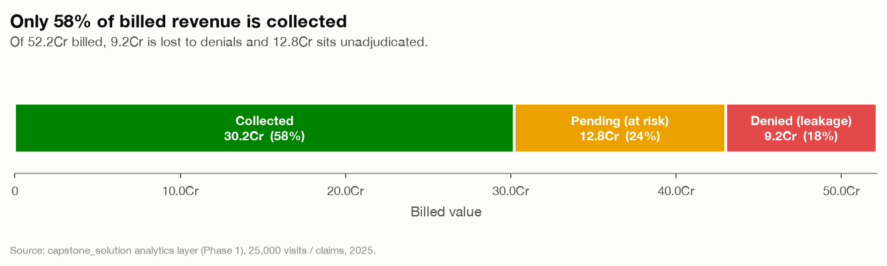
THE PLATFORM, PHASE BY PHASE
1
SQL Analytics Layer
Postgres · typed schema · 10 BI views · data-quality report
Three raw CSVs become a trusted, indexed capstone_solution schema — PKs, FKs and CHECK constraints enforced in-database, ten business-intelligence views, and a 12-check automated data-quality report. This is the spine every later phase reads from.
521.8M billed → 302.3M collected — 57.9% realization; rejections peak at 22.7% in the 15k–30k billed band, non-monotonic in amount.
solution/phase1_* · 1_FINDINGS.md
Revenue waterfall: billed → approved → collected, with pending and denial leakage broken out.
Hospital Operations & Revenue Risk Intelligence Platform
6

Slide 7
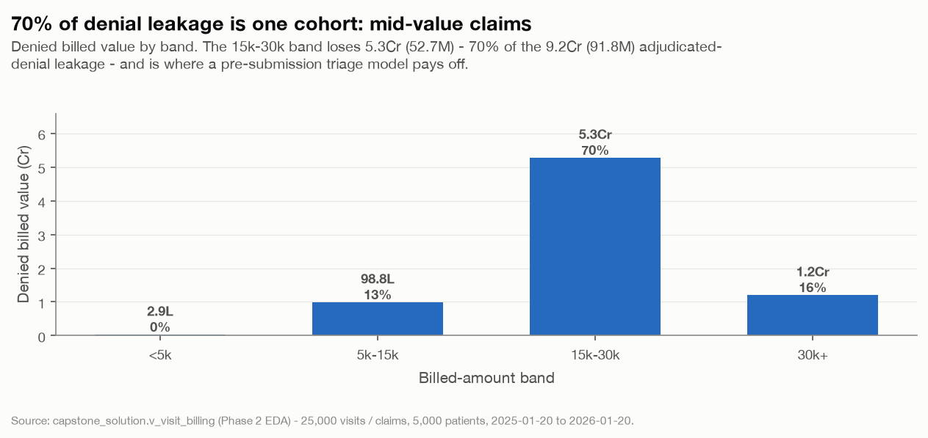
THE PLATFORM, PHASE BY PHASE
2
EDA & Data Quality
Profiling · leakage register · feature catalogue
Turns the analytics layer into modelling readiness: every candidate feature is profiled for signal against the permuted-target noise floor, four data-quality findings get a written handling policy, and the leakage register that governs Phase 3 is written down field by field.
Model A has no learnable signal — every feature sits below the noise floor. Model B is a billed-amount model, and the mid billed-band carries 70% of the 91.8M denial leakage.
solution/phase2_* · 2_FINDINGS.md
Denial leakage is concentrated in the mid billed-amount band, not spread evenly across claim size.
Hospital Operations & Revenue Risk Intelligence Platform
7

Slide 8
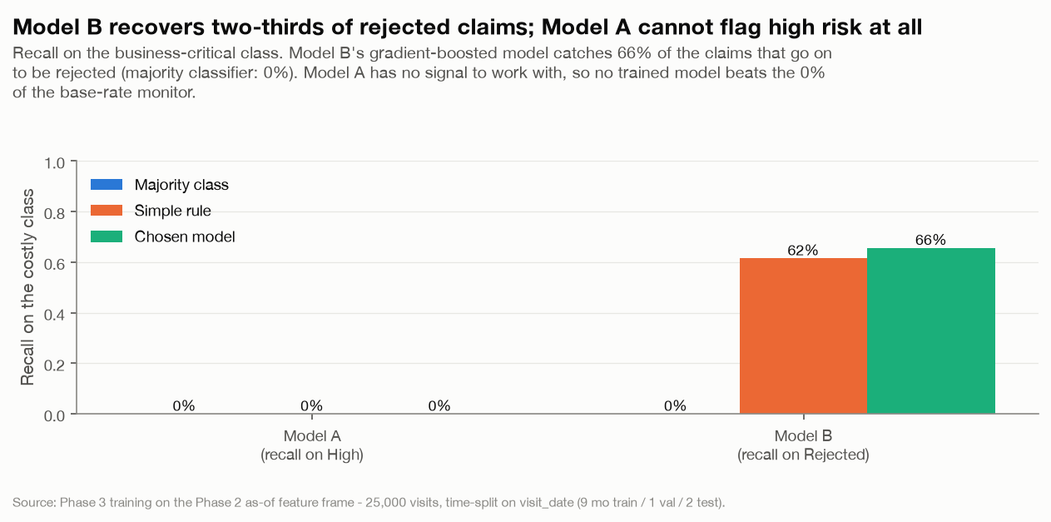
THE PLATFORM, PHASE BY PHASE
3
Model Development
Two time-validated classifiers · calibrated
Model A (visit risk) and Model B (pre-submission claim outcome) are both split on visit_date — 9 months train, 1 validate, 2 test, no shuffle — and calibrated on the validation month. Only the learned candidate that clears both the majority baseline and the domain simple-rule ships; otherwise the baseline itself ships as a monitor.
Model B recall on Rejected: 66% (vs 0% majority baseline, 62% simple rule) on the held-out test window.
solution/phase3_* · 3_FINDINGS.md
Recall on the costly class (Rejected) — the model versus the majority and simple-rule baselines.
Hospital Operations & Revenue Risk Intelligence Platform
8

Slide 9
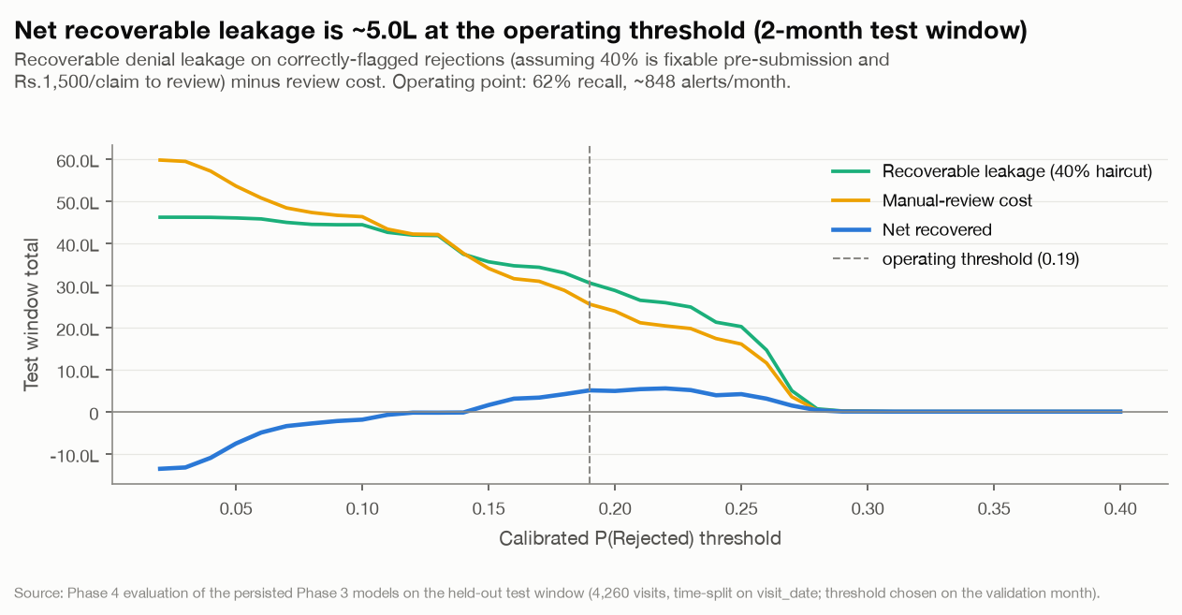
THE PLATFORM, PHASE BY PHASE
4
Evaluation & Explainability
Threshold, SHAP, leakage ablation, fairness, model cards
Turns Model B into an operating decision: the calibrated P(Rejected) threshold is chosen on validation to maximise net recoverable leakage, verified clean of leakage by ablation (injecting a forbidden field spikes accuracy to 0.96 — the shipped model sits at the clean row), and checked for fairness across gender, age band, city and insurer.
Operating threshold P(Rejected) ≥ 0.19 → ~850 review alerts/month, ~₹15L/month recoverable denial leakage (~₹5L net of review cost). No protected attribute fails the four-fifths parity test.
solution/phase4_* · 4_FINDINGS.md
Net recoverable leakage across candidate thresholds — the operating point maximises the business return.
Hospital Operations & Revenue Risk Intelligence Platform
9

Slide 10
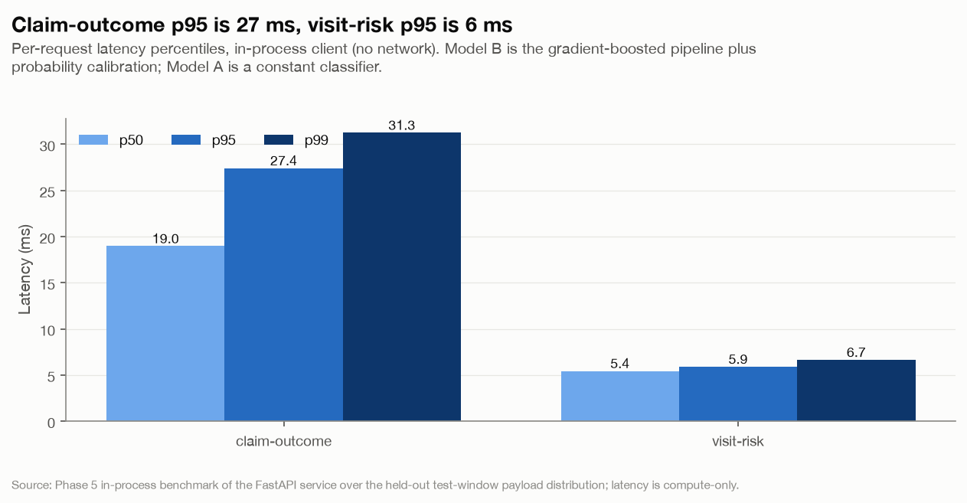
THE PLATFORM, PHASE BY PHASE
5
Deployment & API
FastAPI · versioned artefacts · prediction log
Serves the persisted Phase 3 models behind two endpoints, strict Pydantic validation bound to the Phase 1 domain constraints, and a Postgres prediction log that becomes Phase 6's drift baseline. Every response echoes its model, feature-spec and threshold versions.
Two endpoints in production shape — /predict/claim-outcome (review vs submit) and /predict/visit-risk (a base-rate monitor, not a per-visit decision), plus /model-info and /health.
solution/phase5_* · 5_FINDINGS.md
Served prediction latency — both endpoints benchmarked as part of every build.
Hospital Operations & Revenue Risk Intelligence Platform
10

Slide 11
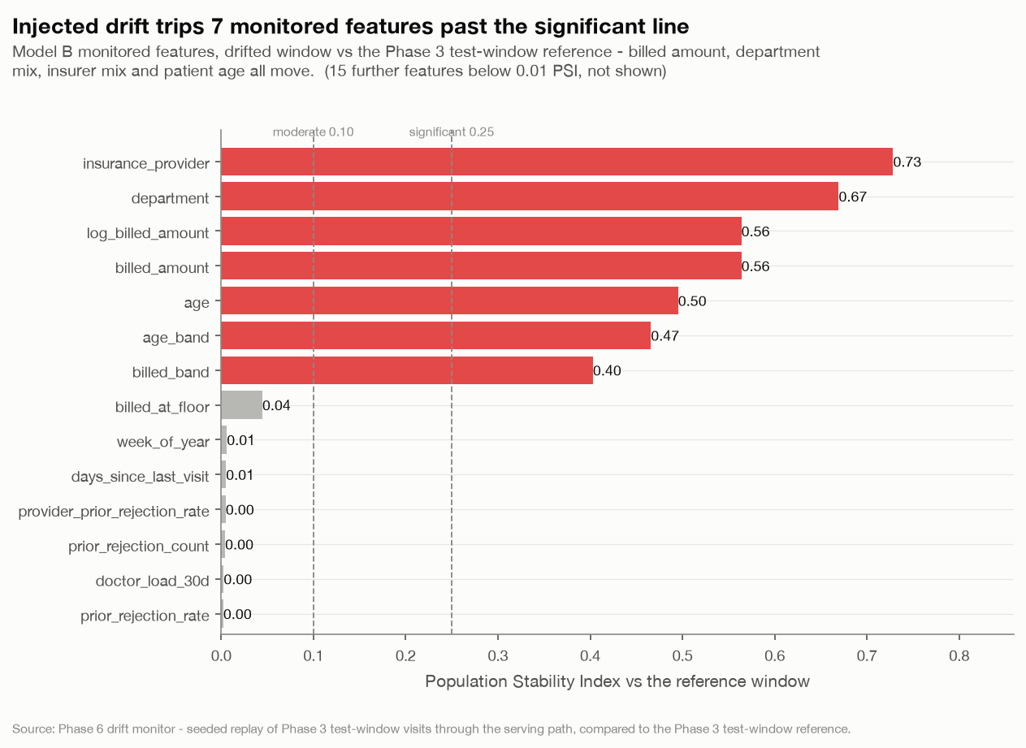
THE PLATFORM, PHASE BY PHASE
6
Monitoring, Drift & Governance
PSI/KS drift · append-only audit · Grafana · governance docs
Watches the prediction log a real deployment would generate: a request-validation gate, feature/prediction/performance drift against the Phase 3 training reference, an append-only drift_report and audit trail enforced by a database trigger, a Grafana dashboard, and the governance, retraining-policy and incident-runbook documents.
Drift job proven end to end — baseline traffic stays OK; injected drift trips feature-PSI alerts on billed amount, department and age, plus a ~34-point drop in Model B's recall on Rejected.
solution/phase6_* · 6_FINDINGS.md
Feature PSI on the drifted traffic window — billed amount, department and age cross the significant-drift line.
Hospital Operations & Revenue Risk Intelligence Platform
11

Slide 12
WHAT THIS MEANS FOR LEADERSHIP
Business impact, in money and risk terms.
$
~₹15L/month in recoverable denial leakage
at the chosen operating threshold, against a total ₹91.8M annual denial pool — roughly ~₹5L/month net of the review team's added workload.
◔
~850 claims/month routed to review
a manageable pre-submission triage queue rather than a blanket policy change, sized directly from the validation-month sweep.
✓
Denial drivers are not the obvious ones
rejection rate is non-monotonic in billed amount and nearly flat across department, provider and risk band — the mid billed-band is the lever, not any one team.
△
Visit-risk scoring is not yet a usable signal
Model A sits at the class-prior ceiling on this year's data; shipped as a risk-mix monitor, not a staffing decision — an honest ceiling, not a hidden one.
Hospital Operations & Revenue Risk Intelligence Platform
12

Slide 13
RESPONSIBLE DEPLOYMENT
Governed the way a healthcare decision system should be.
Leakage discipline, enforced in code
Fairness checked at the operating threshold
visit_date is the only temporal key; no post-outcome field can reach either model, checked by leakage_violations() before every fit and proven by ablation at evaluation time.
selection rate, recall, FPR and calibration gap measured per gender, age band, city and insurer against a four-fifths parity bar; gaps are monitored, not silently accepted.
Append-only audit trail
Drift-triggered retraining policy
prediction_log, drift_report and prediction_override reject UPDATE/DELETE at the database level — every prediction and every manual override is permanent.
written triggers (sustained PSI > 0.25, recall drop > 10pts, quarterly cadence), a shadow-then-promote procedure, and a one-config rollback via serving_config.json.
Hospital Operations & Revenue Risk Intelligence Platform
13

Slide 14
BUILD STATUS
All six phases built, verified, and reproducible from a clean checkout.
Phase
Scope
State
1
SQL analytics layer (Postgres)
✓ Built
2
EDA & data quality
✓ Built
3
Model development (classification)
✓ Built
4
Evaluation & explainability
✓ Built
5
Deployment & API (FastAPI)
✓ Built
6
Monitoring, drift & governance
✓ Built
—
Executive presentation (site + deck)
✓ Built
One command reproduces the whole stack from a clean checkout — docker compose up -d, then each phase's run_phase<n>.py.
Hospital Operations & Revenue Risk Intelligence Platform
14

Slide 15
One cohesive, deployable platform —
ready to propose to hospital leadership.
Analytics, machine learning, and MLOps deployment working as a single system: a trusted SQL foundation, calibrated and fair classifiers, a served API, and a governed monitoring loop — all reproducible from a clean checkout.
github.com/code-4-fun/capstone-healthcare-analytics
Thank you.

