Slide 1
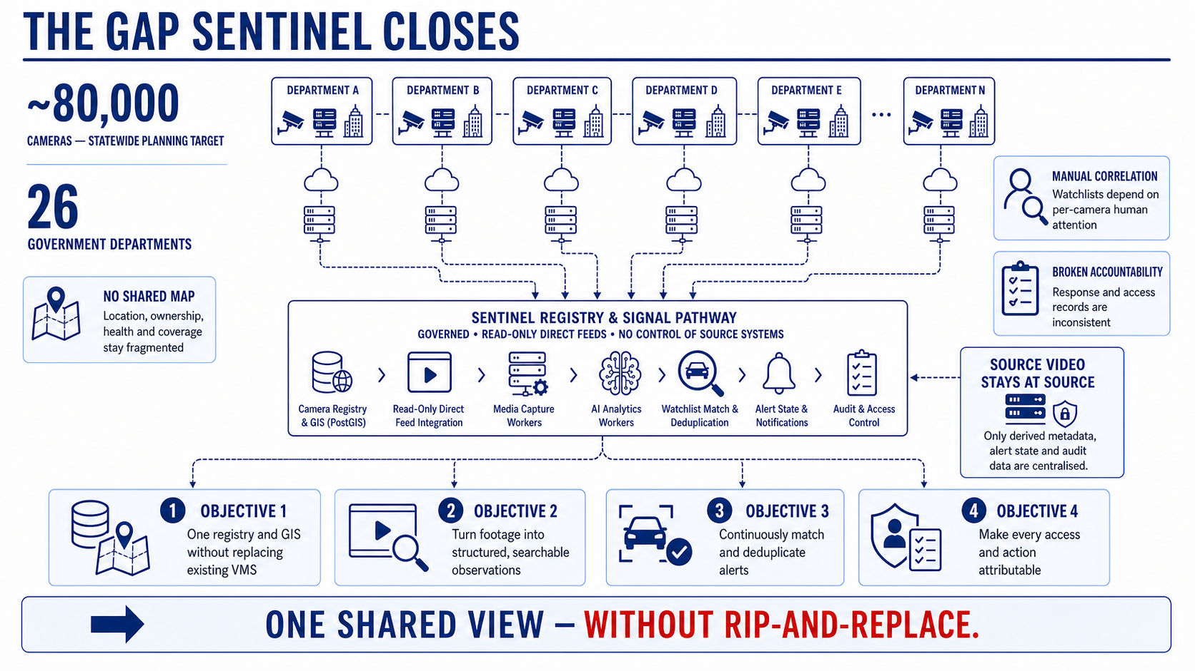
Notes:
Gujarat's CCTV estate is large, distributed and operationally fragmented. The challenge is not simply camera count. It is the absence of one governed view of location, ownership, health and access across 26 departments and an approximately 80,000-camera statewide planning horizon.
Sentinel sets four practical objectives: create a shared registry and GIS without replacing existing VMS systems; convert authorised footage into structured observations; correlate those observations against watchlists without flooding operators; and make access and response attributable. Those objectives define the architecture choices that follow.
[Sources]
- README.md
- docs/requirements.md
- docs/Sentinel-High-Level-Design.pdf, sections 1 and 9

Slide 2
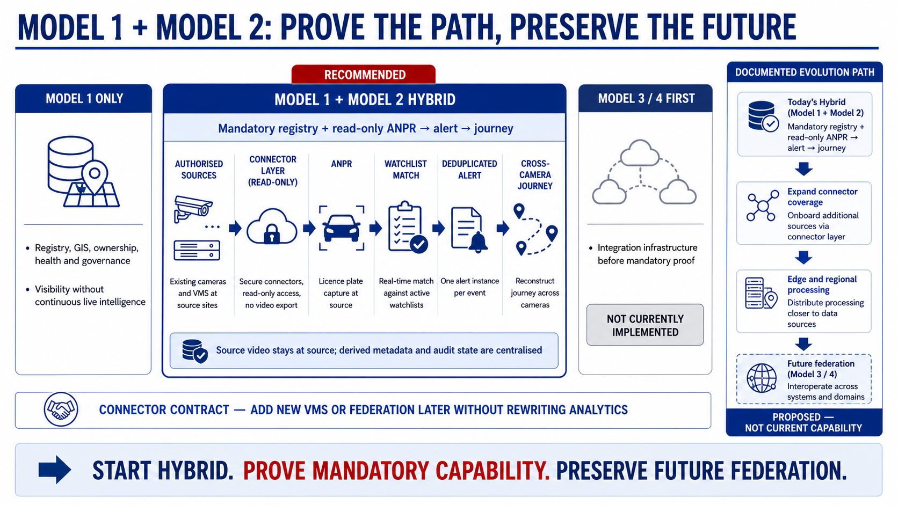
Notes:
Model 1 is mandatory and gives us the registry, GIS and governance foundation. On its own, however, it stops at visibility. It does not prove the live ANPR-to-alert-to-journey path.
Starting with federation middleware or a central VMS would front-load integration infrastructure before that mandatory path is proven. The accepted choice is therefore Model 1 plus read-only Model 2 integration, with every source behind a connector contract. That gives a working direct path now and a documented route to future federation without rewriting analytics or operator workflows.
[Sources]
- docs/decisions/0001-proposed-integration-shape.md
- docs/architecture.md
- docs/presentation-evidence-map.md

Slide 3
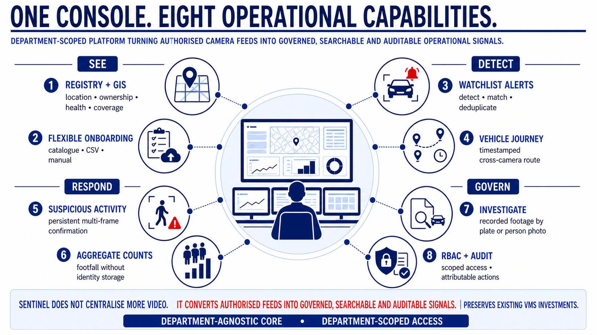
Notes:
The console joins capabilities that normally live in separate tools. Operators can discover and govern cameras, monitor health, run selected analytics, review alerts, reconstruct journeys and investigate recordings. Administrators manage watchlists, access and audit from the same department-scoped platform.
The bonus analytics are deliberately constrained. Suspicious-activity alerts require persistence and deduplication. Person counting publishes aggregates without identity. Person-photo investigation returns ranked candidates rather than asserting identity. The workflow remains useful without overstating certainty.
[Sources]
- PROJECT_STATE.md
- docs/Sentinel-High-Level-Design.pdf, sections 7 and 8
- docs/requirements.md, GOV-FUN-013

Slide 4
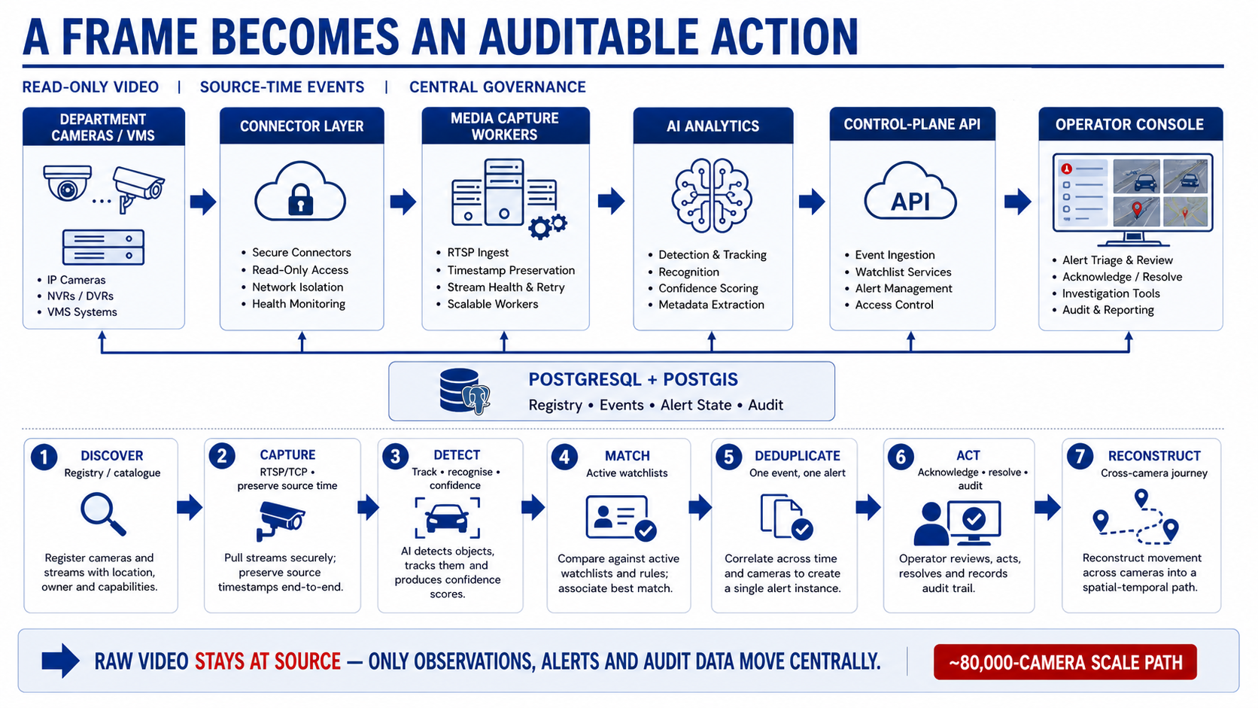
Notes:
Read this architecture from left to right. A source is discovered through the registry, opened through the connector layer and processed by an independent media worker. Analytics turns frames into structured observations, the control plane applies policy and the console presents the resulting operational work.
PostgreSQL and PostGIS hold the governed record underneath the workflow. The key design choice is at the bottom: continuous raw video stays with the authorised source. The centre receives observations, alert state and audit data, which makes the statewide scale story far more credible than centralising every stream.
[Sources]
- docs/Sentinel-High-Level-Design.pdf, sections 2 to 6
- docs/architecture.md
- docs/model1-build-spec.md

Slide 5
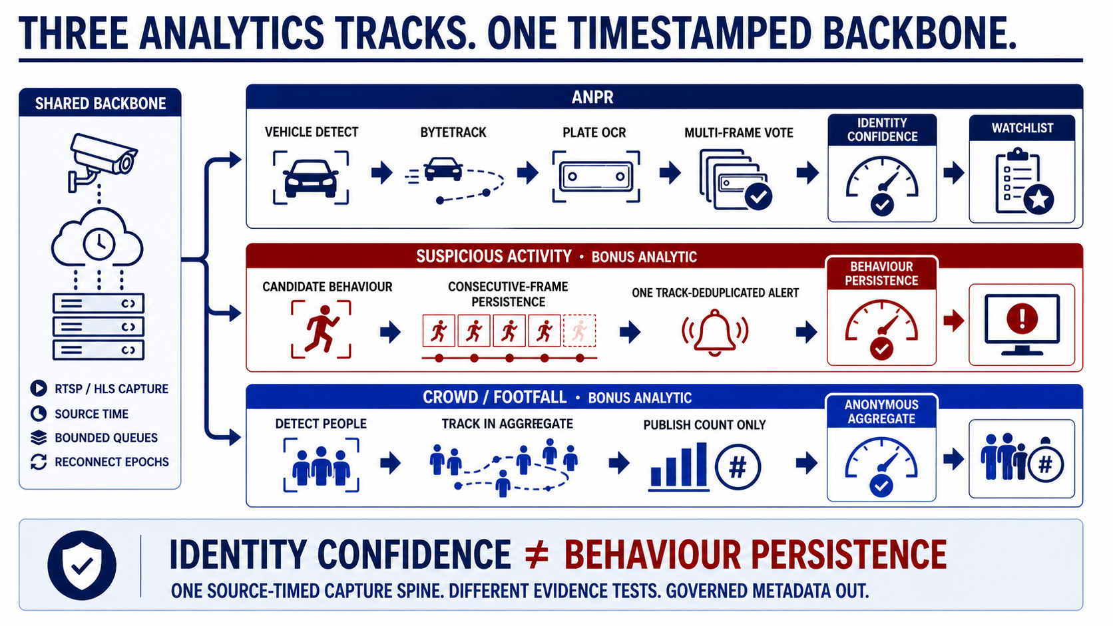
Notes:
All three analytic paths share capture, source-time handling, bounded queues and reconnect behaviour. They diverge because they answer different confidence questions.
ANPR must settle on the right plate identity, so it detects, tracks, reads and votes across multiple frames. Suspicious activity must persist long enough to avoid a one-frame alert, so the confidence gate is temporal. Person counting outputs an aggregate window and deliberately avoids creating an identity record. One backbone supports three different evidence contracts.
[Sources]
- docs/Sentinel-High-Level-Design.pdf, sections 6 and 7
- PROJECT_STATE.md
- multi-object-tracking/README.md

Slide 6
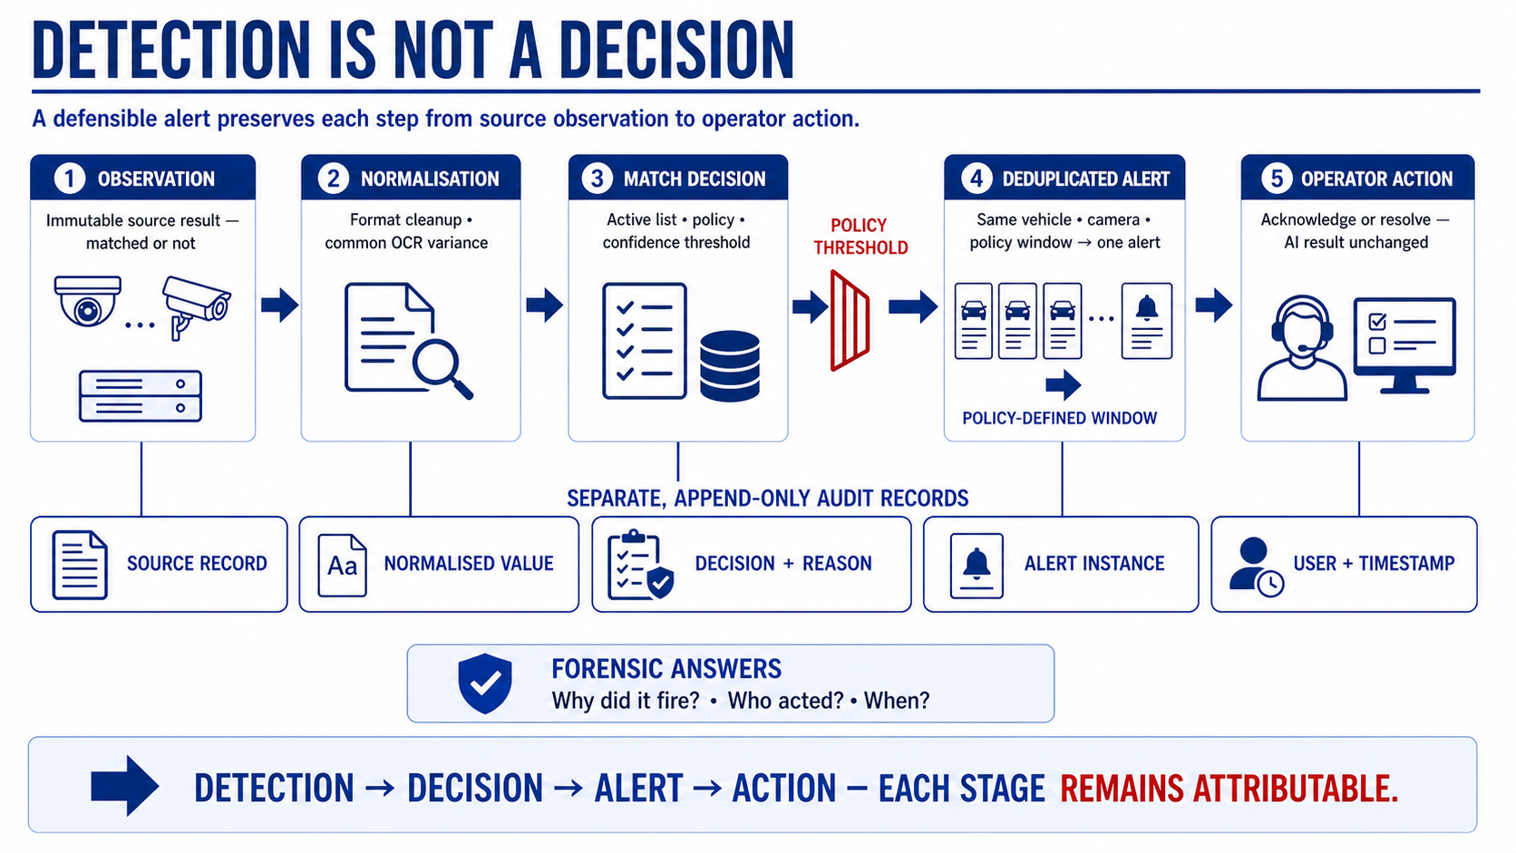
Notes:
The source observation is stored first. Normalisation and policy then determine whether that observation matches an active watchlist and whether confidence is sufficient to interrupt an operator. Deduplication ensures the same vehicle at the same camera does not create an alert on every frame.
Acknowledgement and resolution are separate records. They never rewrite what the analytic originally reported. That separation lets a reviewer answer why an alert fired, what evidence supported it and who acted on it.
[Sources]
- docs/Sentinel-High-Level-Design.pdf, sections 4, 7 and 8
- docs/architecture.md
- docs/model2-build-spec.md

Slide 7
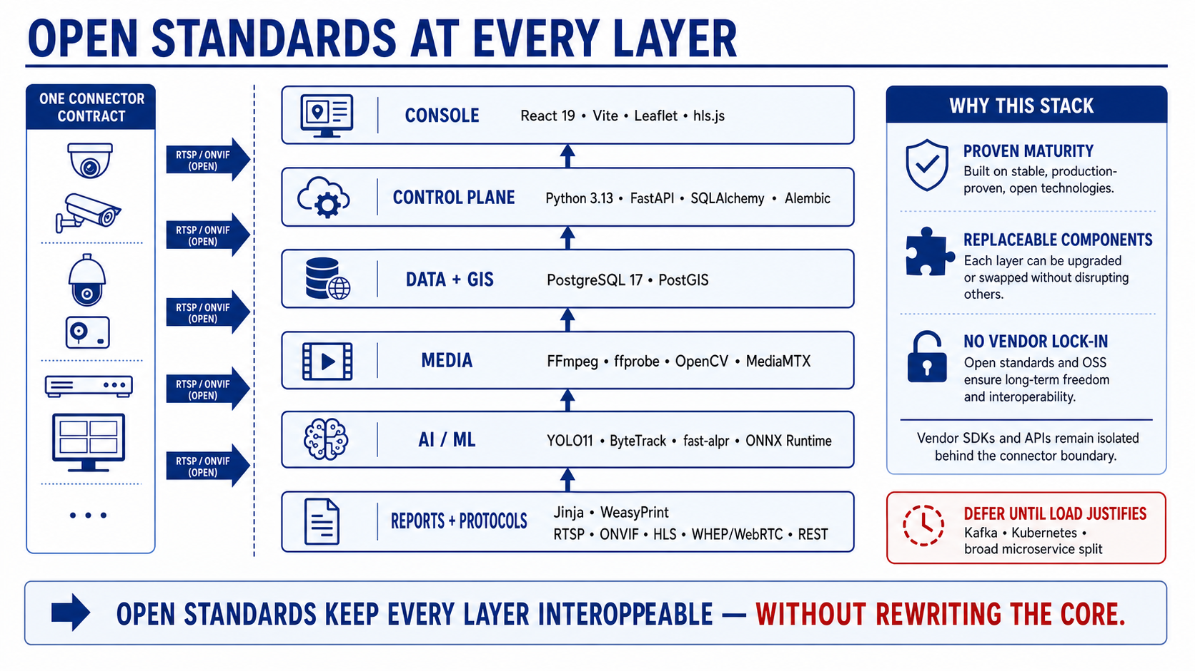
Notes:
The technology choices are intentionally conventional. React and Leaflet serve the operator workflow; FastAPI holds business rules; PostgreSQL and PostGIS provide the system of record; FFmpeg, OpenCV and MediaMTX handle media; and YOLO11, ByteTrack, fast-alpr and ONNX Runtime implement the current analytic baseline.
The important point is not novelty. Open transports and a connector boundary keep source-specific integration outside the reusable analytics, data and console layers. More complex infrastructure is deferred until measured load demonstrates a need for it.
[Sources]
- docs/Sentinel-High-Level-Design.pdf, section 13
- docs/decisions/0002-phase-1-implementation-stack.md
- backend/requirements.txt
- frontend-v2/package-lock.json

Slide 8
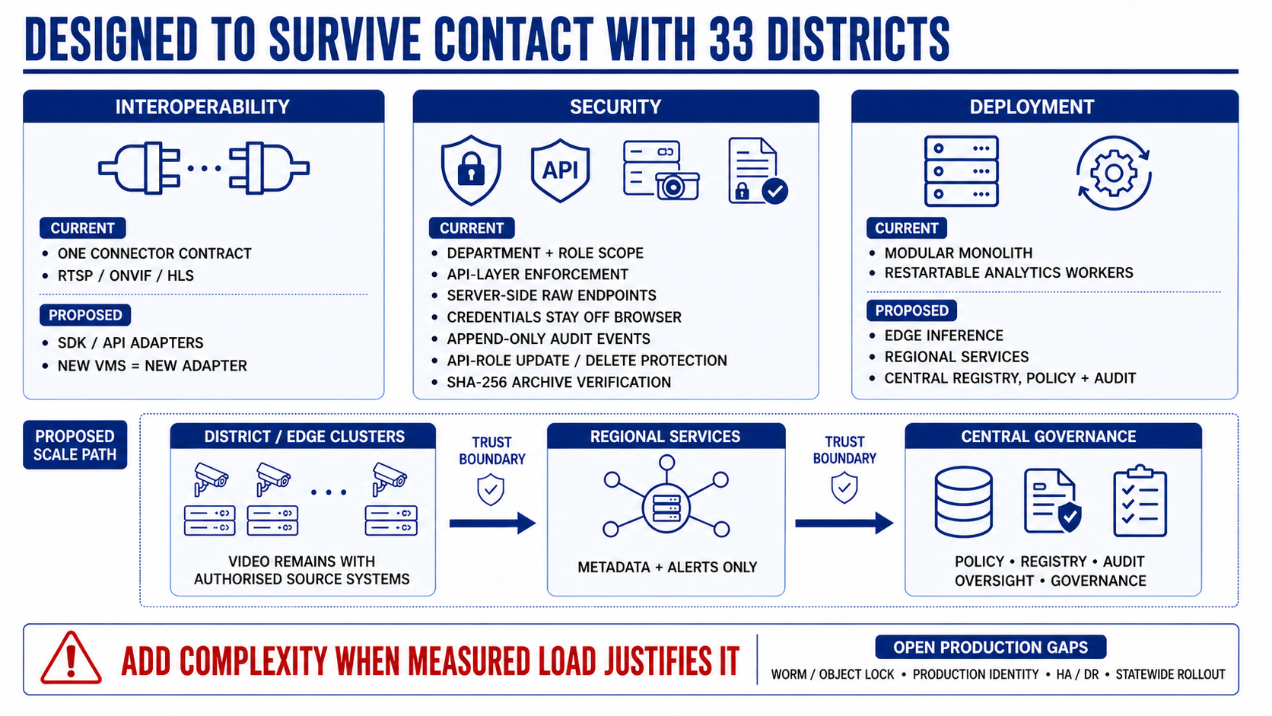
Notes:
Interoperability starts with one connector contract, not special cases in core code. Security is enforced by the API, with raw endpoints remaining server-side and department grants applied before data or media is returned. Audit rows are protected from ordinary application-role modification and can be exported with a digest.
The current deployment stays deliberately simple: one control plane with independently restartable workers. The proposed scale path moves capture and inference toward camera clusters, adds regional services and keeps the centre focused on registry, policy, search and audit. Production identity, immutable retention and HA/DR still require deployment work before acceptance.
[Sources]
- docs/Sentinel-High-Level-Design.pdf, sections 9 and 11
- docs/decisions/0003-department-rbac.md
- docs/requirements.md

Slide 9
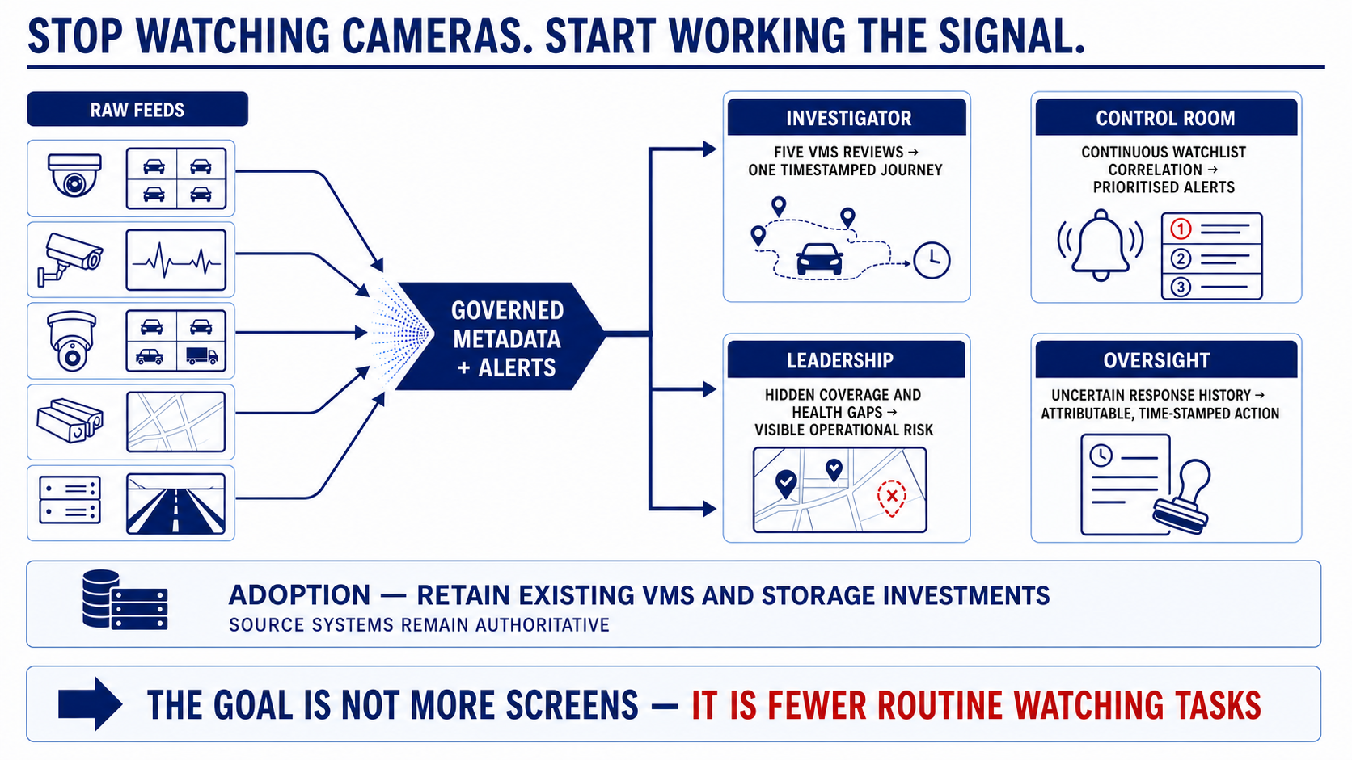
Notes:
For investigators, the change is from manually reviewing separate VMS systems to opening one timestamped journey. For control rooms, continuous watchlist correlation brings the alert to the operator. For leadership, registry and health data expose coverage and capability gaps before an incident does.
The adoption path matters just as much. Existing VMS and storage investments remain authoritative. Sentinel sits alongside them and centralises only the governed operational record. These are expected workflow benefits; statewide outcome evidence would follow deployment and measurement.
[Sources]
- docs/Sentinel-High-Level-Design.pdf, sections 1, 7, 8 and 9
- docs/requirements.md
- docs/presentation-evidence-map.md

Slide 10
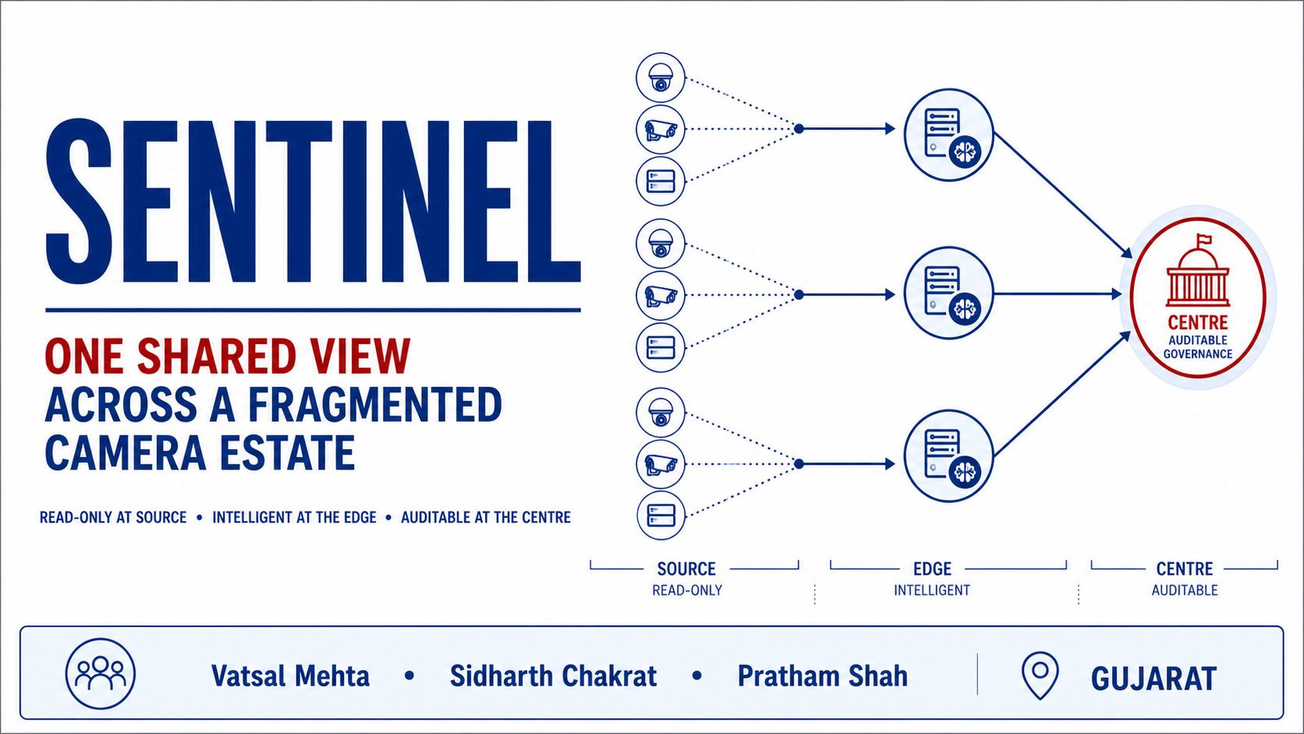
Notes:
Sentinel closes the loop opened on the first slide: one shared operational view across a fragmented camera estate, without forcing departments to replace the systems they already run.
The design is read-only at the source, intelligent near the camera and auditable at the centre. That is the foundation for a credible Phase 1 demonstration and a disciplined statewide evolution path.
[Sources]
- README.md
- docs/Sentinel-High-Level-Design.pdf
- docs/decisions/0001-proposed-integration-shape.md

