Slide 1



SMART INDIA HACKATHON 2026
TITLE PAGE
Problem Statement ID – 26106
Problem Statement Title- AI-Powered Email Threat Detection, GeoLocation and Forensic Intelligence Platform
Theme- Blockchain & Cybersecurity
PS Category- Software
Team ID- 142647
Team Name- Red Eye
Our solution: Security-Copilot · Detect → Trace → Attribute → Report

Slide 2
















SECURITY - COPILOT
Red Eye
AI-Powered Email Threat Detection, GeoLocation & Forensic Intelligence Platform
The Problem
Proposed Solution
Why it's different
$3.04 B
lost to Business Email
Compromise in 2025 (FBI IC3)
Drop in a raw email (.eml), a URL or pasted text. An AI agent investigates it like an analyst — traces its route, verifies the sender, geolocates the origin and checks every link & attachment — then returns a classified, attributed, explainable verdict with a forensic report.
Investigates, not just filters
An agent chooses its own tools & depth
₹22,495 Cr
lost by Indians to cyber
fraud in 2025 (MHA / I4C)
Explainable risk score
Every point carries a written reason
Ingest
Trace hops
Authenticate
Geolocate
Attribution, not guesswork
Spoofed · compromised · anonymised · direct actor
The gap
Filters only block or deliver — no forensic trace of where it came from
Headers, SPF/DKIM/DMARC, IP & WHOIS checked by hand, in 5+ separate tools
AI-written lures, lookalike domains & relay chains slip past static rules
Related frauds are never linked into campaigns
Classify
Attribute
Correlate
Report
Remembers past cases
SecureBERT memory clusters campaigns
Answers in the five classes the PS asks for:
Private & lawful by design
PII masked, evidence kept, report—never hack back
legitimate
suspicious
impersonated
phishing
fraud-related
+ 0–100 risk score · attribution · origin map · campaign ID
Not just “is this phishing?” — but where did it come from, who sent it, and what else is it connected to?

Slide 3
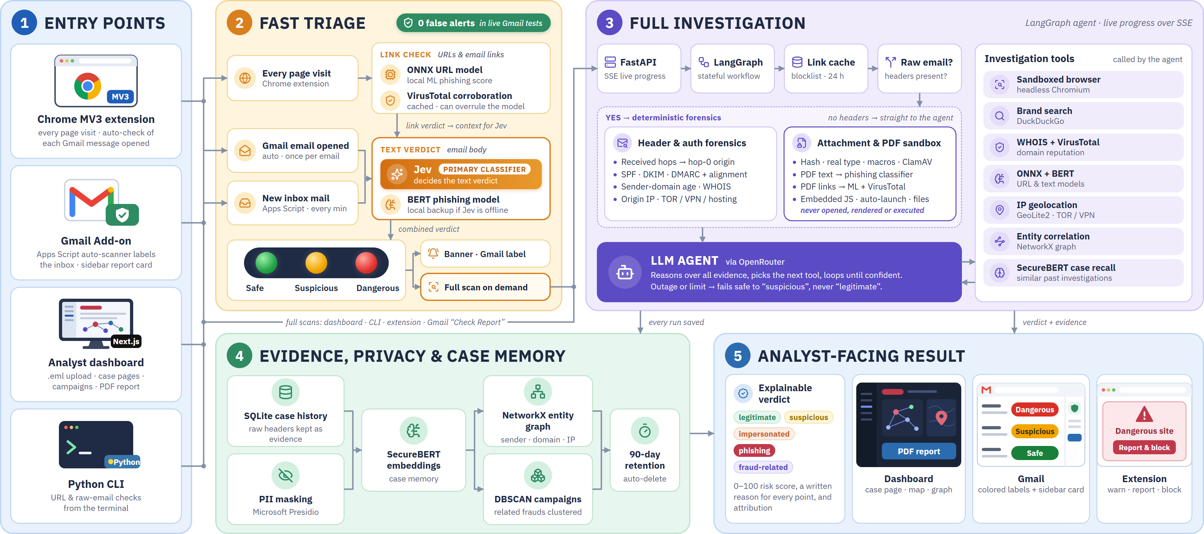
TECHNICAL APPROACH
Red Eye

Slide 4
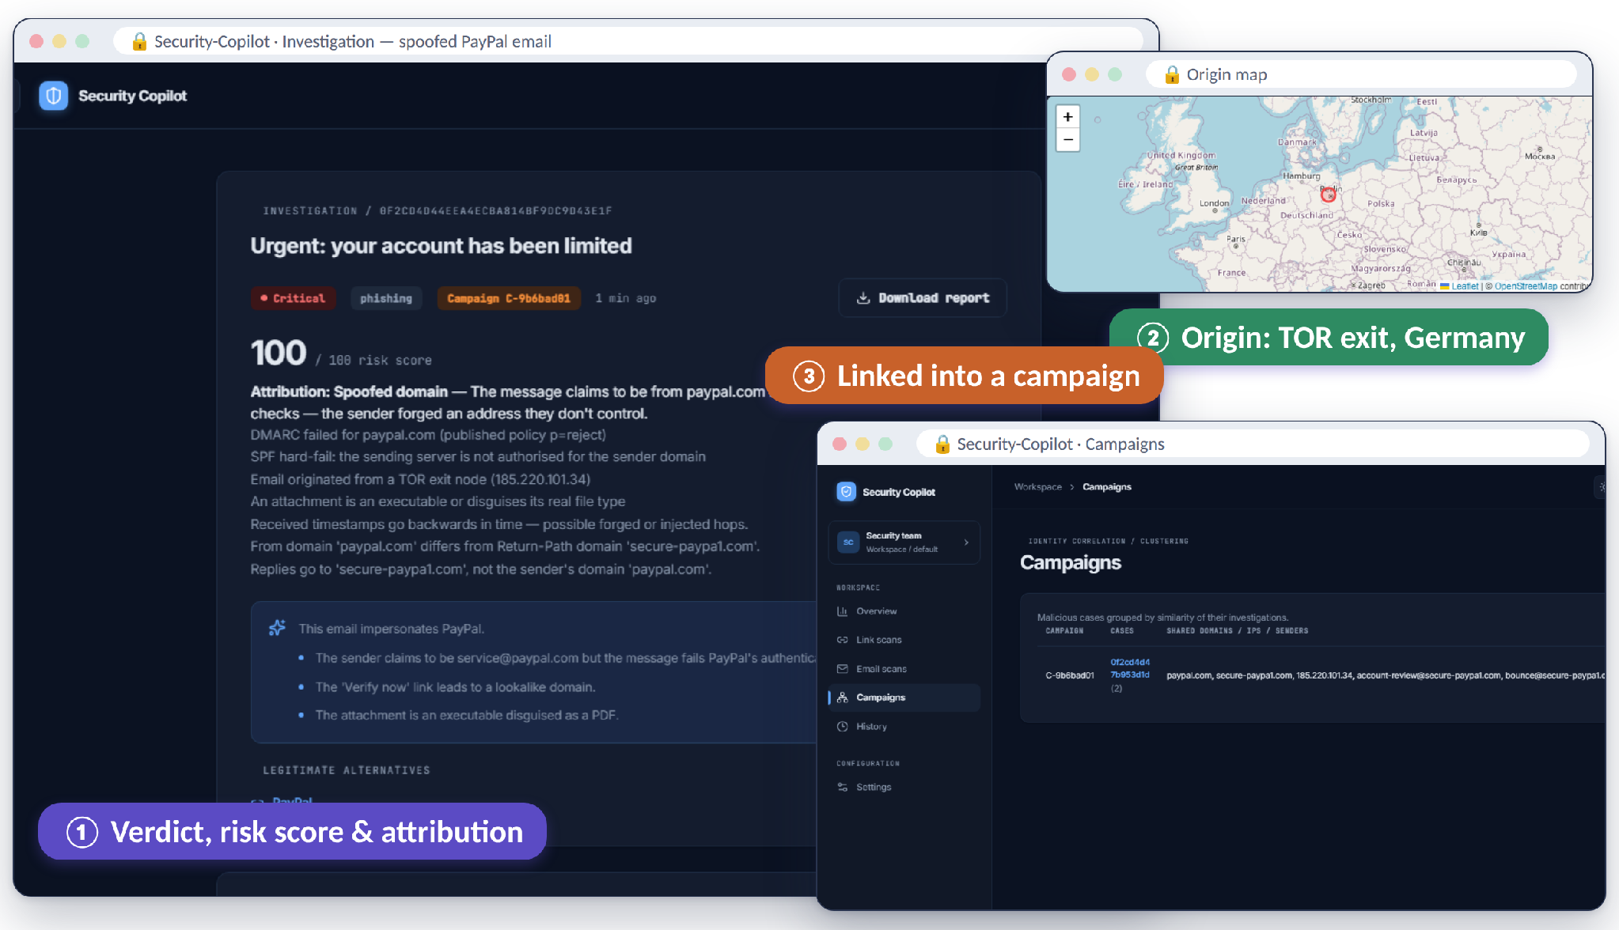








FEASIBILITY AND VIABILITY
Red Eye
BUILT AND RUNNING — the Security-Copilot web app on a real fraud case
KEY CHALLENGE → HOW WE HANDLE IT
TOR / VPN hides origin
Flag as anonymised; origin shown as “probable”
Flawless AI-written lures
Jev judges intent, not grammar; headers & links checked apart
LLM error or outage
Rule-based score; fails safe to “suspicious”
Weaponized attachments
Sandboxed read of text, links & scripts — never opened or run
Sensitive personal data
PII masked · 90-day auto-delete
0
6 / 6
12
26
₹0
API cost & rate limits
Offline GeoIP + cache; paid APIs optional
false alerts in
live Gmail tests
PS modules
delivered
AI & forensic
tools
automated tests
passing
paid threat-intel
APIs required
DKIM keys / DNS change
Receiver’s verdict kept beside live re-check

Slide 5





















IMPACT AND BENEFITS
Red Eye
Law enforcement
BEFORE
manual
no links
Institutions & SOC
Raw headers
SPF / DKIM
WHOIS
IP lookup
VirusTotal
Alert before the click
Court-ready PDF evidence
Campaign-level view
Origin, ISP & ASN
AFTER
Security-Copilot
one upload · one run
.eml · URL · Gmail
PDF
map
campaign
Verdict, trace path, origin, attribution and campaign — in one explainable report
Security-
Copilot
Economic
Cuts BEC & payment-fraud losses
Social
Digital trust for citizens & campuses
Banks & fraud units
Citizens & staff
Stops BEC payment fraud
Plain-English verdicts
Governance
Aids CERT-In 6-hr reporting · DPDP-aligned
Scalable
Open-source, CPU-only, self-hostable
Faster fund-freeze calls
One-click report & block
ROADMAP
Live platform
all 6 PS modules + Gmail add-on
Mailbox ingestion
Outlook · IMAP · hosted Gmail rollout
Institution pilots
colleges · cyber cells · banks
Blockchain evidence ledger
hash-chained chain of custody
National scale
multi-tenant · SIEM export

Slide 6





RESEARCH AND REFERENCES
Red Eye
1. Email authentication standards
2. AI / ML models & methods
3. Threat intel & geolocation
RFC 7208 — SPF
datatracker.ietf.org/doc/html/rfc7208
RFC 6376 — DKIM Signatures
datatracker.ietf.org/doc/html/rfc6376
RFC 7489 — DMARC
datatracker.ietf.org/doc/html/rfc7489
RFC 5322 — Message format & Received trace
datatracker.ietf.org/doc/html/rfc5322
Jev (typesafe) — primary phishing classifier
openrouter.ai/api/alpha/decisions
LangGraph — stateful agent orchestration
github.com/langchain-ai/langgraph
BERT phishing classifier (ealvaradob)
huggingface.co/ealvaradob/bert-finetuned-phishing
ONNX URL model (pirocheto)
huggingface.co/pirocheto/phishing-url-detection
SecureBERT, Aghaei et al. 2022
arxiv.org/abs/2204.02685
MaxMind GeoLite2 City / ASN
dev.maxmind.com/geoip/geolite2-free-geolocation-data
Tor Project bulk exit list
check.torproject.org/torbulkexitlist
X4BNet VPN & datacenter ranges
github.com/X4BNet/lists_vpn
AbuseIPDB · VirusTotal APIs
abuseipdb.com · virustotal.com
4. Forensic & privacy tooling
5. Threat landscape data
6. Our platform
checkdmarc · dkimpy (SPF/DMARC/DKIM)
pypi.org/project/checkdmarc
oletools — Office macro analysis
github.com/decalage2/oletools
pypdf · ClamAV — PDF sandbox & signature scan
pypi.org/project/pypdf · clamav.net
Microsoft Presidio — PII masking
microsoft.github.io/presidio
DBSCAN, Ester et al., KDD 1996 · NetworkX
networkx.org
FBI IC3 Internet Crime Report 2025
ic3.gov/AnnualReport/Reports/2025_IC3Report.pdf
MHA / I4C: ₹22,495 Cr cyber-fraud loss, 2025
theprint.in (Feb 2026)
CERT-In Directions, 28 Apr 2022 (6-hr reporting)
cert-in.org.in
Digital Personal Data Protection Act, 2023
meity.gov.in
Source code — Security-Copilot (SIH26106)
https://github.com/code-YK/Security-Copilot-Sih26
Backend: FastAPI + LangGraph agent
26 automated tests · pytest
Dashboard: Next.js · Extension: Chrome MV3
screens: case page, graph, campaigns
Gmail Add-on: Google Apps Script
developers.google.com/workspace/add-ons
Case study: spoofed PayPal email via TOR
risk 100 · campaign C-9b6bad01

