Slide 1
Intro
To
Python
Code Afrique Team

Slide 2
What is Python?
A language to tell a computer what to do
Computers are stupid---they need to be told EXACTLY what to do
There are many programming languages
Python is good for learning to program

Slide 3

Basic concept: Functions
For example:
$f\left(x\right)= 3x + 4$
$g\left(x\right)=$ $\sqrt{x}$
$sum\left(x, y\right)= x + y$

Slide 4
Functions in Python
def f(x):
return 3 * x + 4
def square(x):
return x * x
Function header
Body
Notes:
In Python, function is a group of related statements that perform a specific task.Let them play around on the laptops with creating their own functions. Do not forget to mention DOC strings

Slide 5
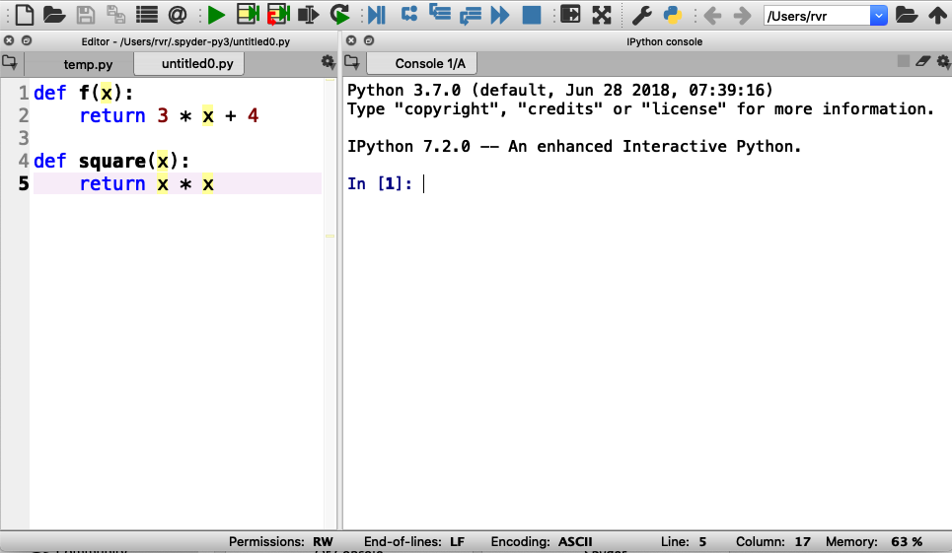
Using Spyder
Step 1: Enter functions in this box
Notes:
Everybody should do this. Wait for everybody to be done

Slide 6
Using Spyder
Step 2: Click on the green triangle (don’t forget)

Slide 7
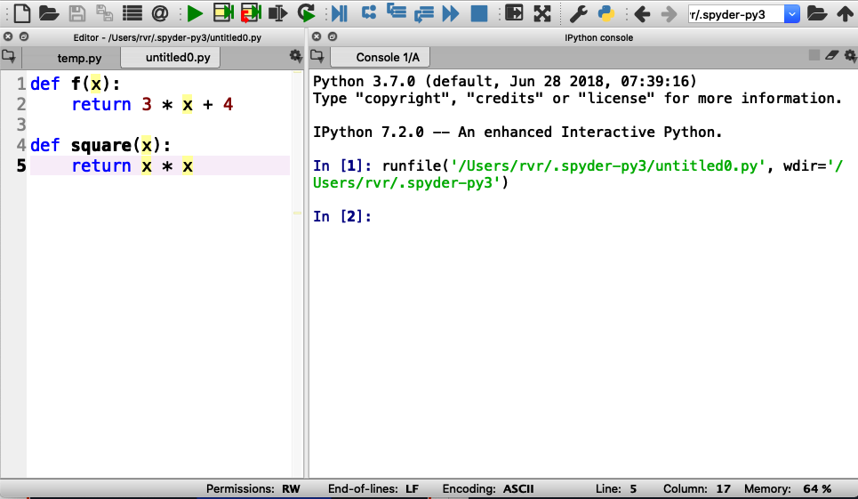
Using Spyder
Step 2: Click on the green triangle (don’t forget)
Output (and error messages) appear in “console” box

Slide 8

Using Spyder
Step 3: Type a function call here and hit “enter”

Slide 9
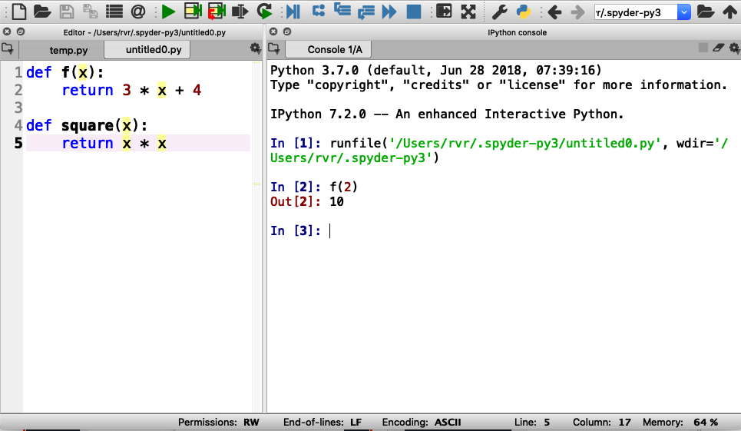
Using Spyder
Step 3: Type a function call here and hit “enter”
Result of function printed here
Notes:
After this, have them try other invocations of f() and square()

Slide 10

Try the following:
$f(0)$
$f(0.5)$
$f(−3)$
$square(−3)$
$square(123456789)$
$square(f(0))$

Slide 11

Time for you to play
Write the following function in Python :
$g\left(x\right)=x^{2}$ $+ 2x + 3$
Evaluate the following:
$g(0)$
$g(1)$
$g(−0.5)$
Notes:
Add

Slide 12

More time for you to play
Write a function $add\left(x, y,z\right)$ that returns the sum of its three inputs (that is, $x + y + z$)
Evaluate the following:
$add(1, 2, 3)$
$add(1, 1, −2)$
Notes:
Add

Slide 13
Errors and Bugs….
Remember: computers are stupid
Everything needs to be EXACTLY right

Slide 14
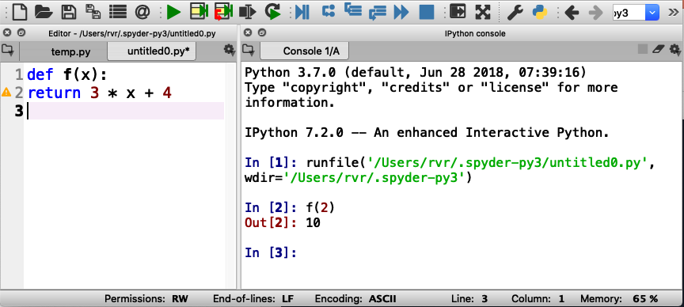
Indentation error
Everything in a function
MUST BE indented

Slide 15
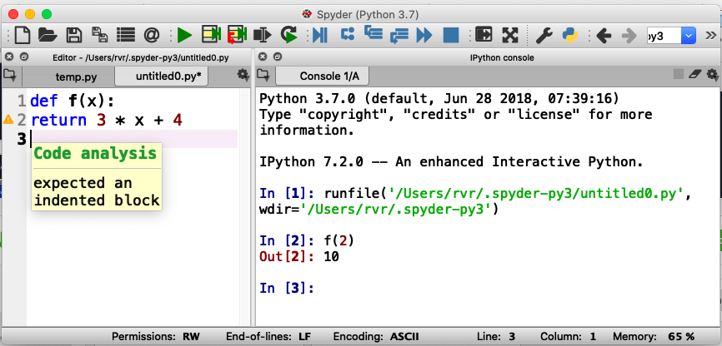
Indentation error
Hover mouse over triangle for information about the error

Slide 16
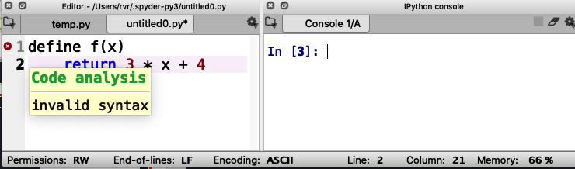
Syntax error
Missing :

Slide 17
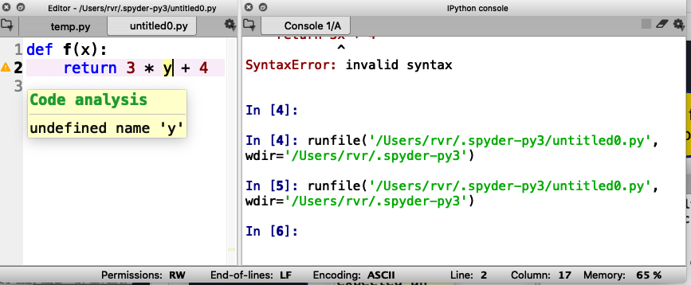
Undefined name warning
Should be ‘x’, not ‘y’

Slide 18
Remember: Keep hitting that green triangle
You need to do that each time you change or fix your code!

Slide 19
“Strings”

Slide 20
Strings!!
Examples of strings: “hello” “I love Code Afrique” “fdalepru”
A string is enclosed in quotation marks (“)
You can glue together two strings using +
For example, “hello, “ + “Jon” == “hello, Jon”

Slide 21
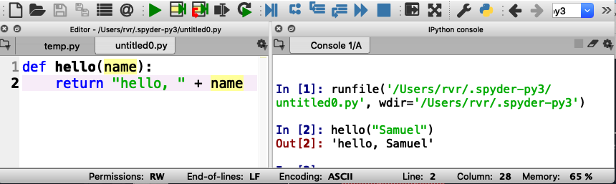
Functions with strings
Write a function hello(name) that returns the string “hello, name”

Slide 22
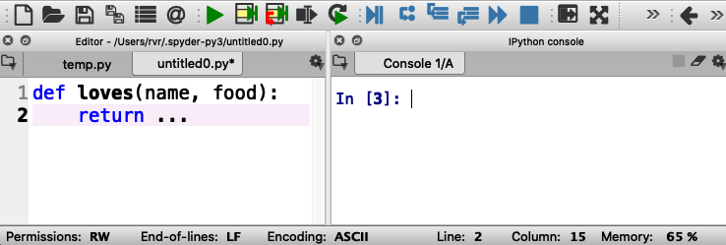
Now you try it
Write a function loves(name, food) that returns a string “name loves food”
Be sure to try it out here

Slide 23
What is your Code Afrique nickname?
Write a function nickname(first, last) that consists of the first three letters of your name (first name) followed by the last three letters of your surname (last name) , followed by “ca” (for Code Afrique)
For example: nickname(“Hakim”, “Weatherspoon”) == “Hakoonca”
You’ll need to learn about ”indexing” first

Slide 24
String indexing
A position in a string is called an index
Indexes start counting at 0
Shoshana
01234567
The index of ‘o’ is 2

Slide 25
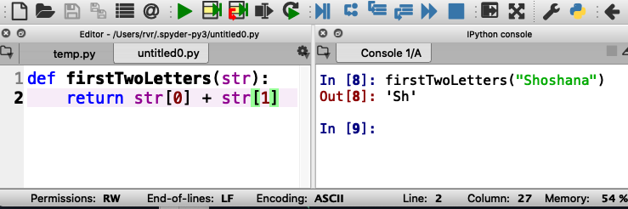
String indexing
Write a function firstTwoLetters(str)that returns the first two letters in the input string str
str[x] evaluates to the letter at index x

Slide 26
Quiz
If a string has 10 letters, what is the index of the last letter?
9
10
11
Notes:
The correct answer is 9

Slide 27
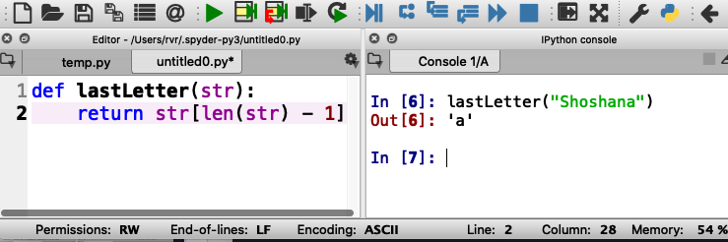
Length of a string
Write a function lastLetter(str)that returns the last letter in the input string str
Uses len(str) that returns the length of str

Slide 28
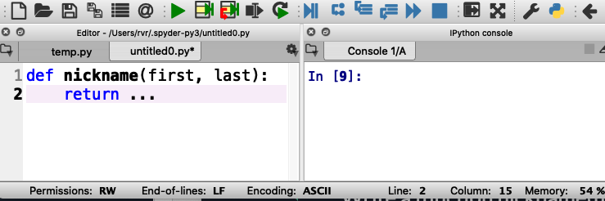
What is your Code Afrique nickname?
Write a function nickname(first, last) that consists of the first three letters of your name (first name) followed by the last three letters of your surname (last name) , followed by “ca” (for Code Afrique)
For example: nickname(“Hakim”, “Weatherspoon”) == “Hakoonca”

Slide 29
Lists

Slide 30
Examples of lists
[ 1, 2, 3 ] : a list of integers
[ 3.1415, 2.82 ]: a list of floating point numbers
[ “cats”, “dogs”, “elephants” ]: a list of strings
[ ]: an empty list
Fun fact: a string is a list of letters, and everything you can do with strings you can also do with other lists

Slide 31
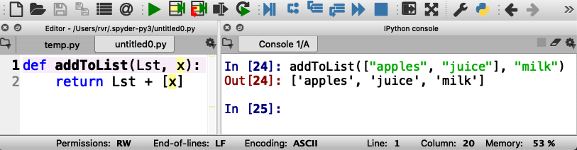
Example function with lists
Write a function addToList(Lst, x) that returns a new list consisting of Lst and x
For example addToList([ “apples”, “juice” ], “milk”) == [ “apples”, “juice”, “milk” ]
List consisting of x
Notes:
Have students type this in and try out other examples

Slide 32
Variables

Slide 33
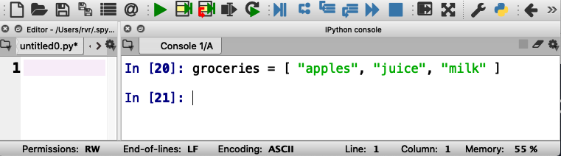
How to keep a shopping list?
groceries is a “variable”

Slide 34
How to keep a shopping list?
groceries is a “variable”
= in Python is used to assign a value to a variable
(do not confuse with ==)

Slide 35
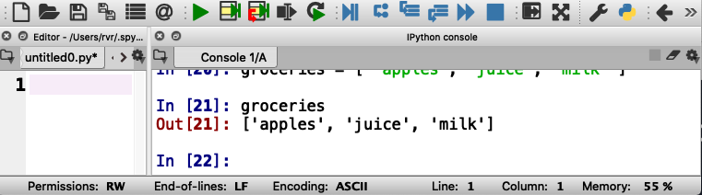
How to keep a shopping list?
Python remembers the values of variables, which can be lists, numbers, strings, and more.
Here the value of groceries is a list of strings.

Slide 36
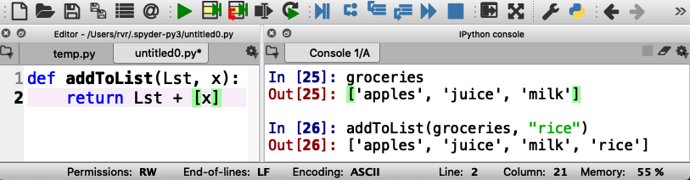
Adding “rice” to the shopping list
Does it work?

Slide 37
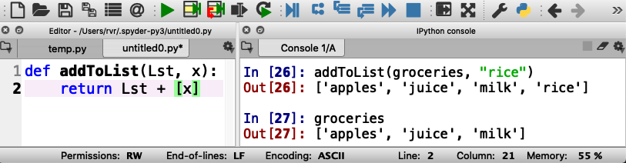
Adding “rice” to the shopping list
The value of groceries has not changed…

Slide 38
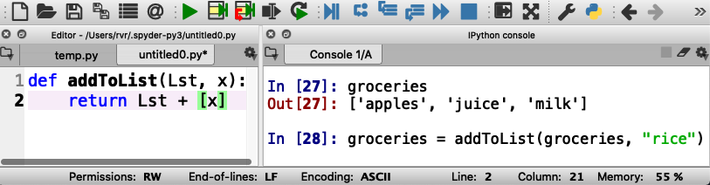
Adding “rice” to the shopping list
Here we update groceries with a new value

Slide 39
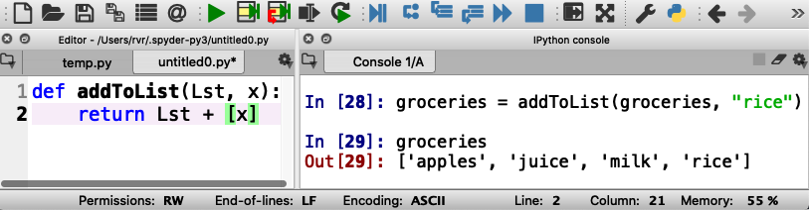
Adding “rice” to the shopping list
Now “rice” is in the list

Slide 40
Adding “rice” to the shopping list
Now practice adding some more items to groceries

Slide 41
Loops

Slide 42
Doing something with each element of a list
Write a function product(Lst) that returns the product of all elements in a list of numbers
How would you do this writing on a piece of paper?

Slide 43
Doing something with each element of a list
Write a function product(Lst) that returns the product of all elements in a list of numbers
How would you do this writing on a piece of paper?
Start with the first number
Multiply with the next number
Repeat until done with all numbers
This is called a “loop”

Slide 44
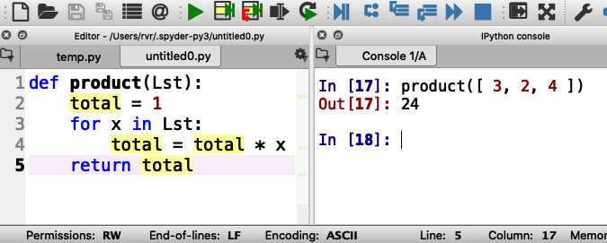
Loops in Python

Slide 45
Loops in Python
total is a variable

Slide 46
Loops in Python
total is a variable
x is the next element in Lst

Slide 47
Loops in Python
total is a variable
x is the next element in Lst
Here, total == 1 * 3 * 2 * 4

Slide 48
Write your own: below change product to sum That is, add all the items in the list together

Slide 49
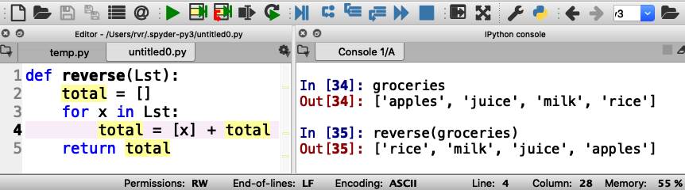
Example: write a function reverse(Lst) that reverses the elements in a list

Slide 50
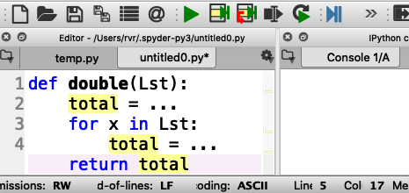
Your turn to practice
Write a function double(Lst) that returns a list consisting of all the numbers in Lst, but then doubled
For example, double([ 3, 1, 4 ]) should return [ 6, 2, 8 ]

Slide 51
Working with ranges
Write a function squares(start, end) that returns a list of all the squares of the numbers start (inclusive) through end (exclusive)
(in Computer Science, “inclusive” means that the value is included, and “exclusive” means that the value is excluded)
For example, squares(1, 10) returns [ 1, 4, 9, 16, 25, 36, 49, 64, 81 ]

Slide 52
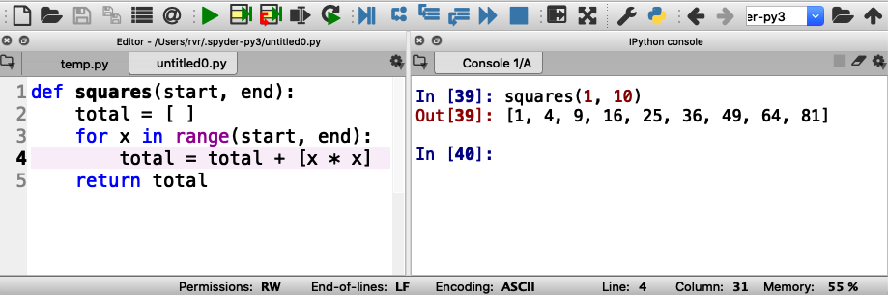
Working with ranges
range(start, end) generates the integers from start (inclusive) to end (exclusive)

Slide 53
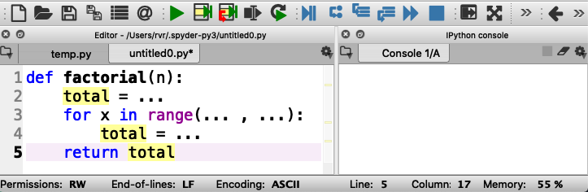
Now you practice with ranges
Write function factorial(n) that returns n!
n! is defined to be the product of all the integers from 1 to n
For example, factorial(3) is equal to 1 * 2 * 3 (that is, 6)

Slide 54

IF STATEMENTS

Slide 55
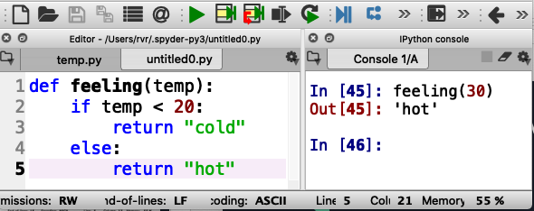
What if you want to do something only sometimes?
Write function feeling(temp) that returns “cold” if temp < 20 or “hot” otherwise

Slide 56
Correct indentation is important!

Slide 57
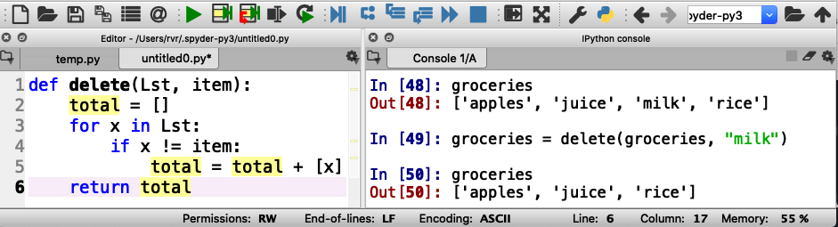
Using if statements in for loops
Write a function delete(Lst, item) that returns a list consisting of the elements of Lst except for item
!= means “is not the same as”

Slide 58
Correct indentation

Slide 59
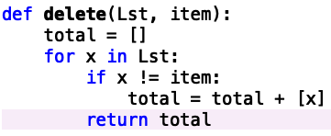
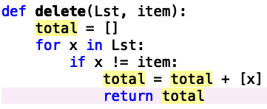
Incorrect indentations: what do these do?

Slide 60
Incorrect indentations: what do these do?
This returns after the first element in Lst
This returns after the first element that is not item
Notes:
Also, doesn’t return anything if the list is empty

Slide 61
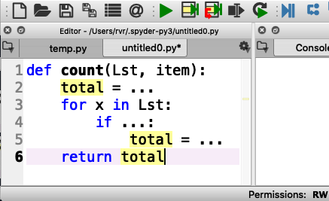
Your turn to practice
Write a function count(Lst, item) that counts how many times item occurs in Lst
For example, count([“apples”, “juice”, “milk”], “juice”) should return 1

Slide 62
Programs with multiple functions

Slide 63
How to write difficult programs
Split program into multiple definitions
Write a function shop(Lst, item) that returns the string “we have item” if item is in Lst, or “we need item” if not
For example: shop(groceries, “rice”) returns
“we have rice” if ”rice” is in groceries

Slide 64
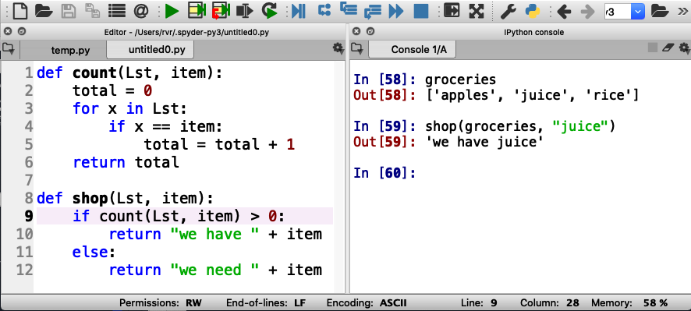
How to write difficult programs
Split program into multiple definitions
Write a function shop(Lst, item) that returns the string “we have item” if item is in Lst, or “we need item” if not

Slide 65
Just a little math before we go on

Slide 66
Two types of numbers
“integers”
Examples: 0, 1, 2, 3, -3, 93723881
”floating point numbers”
Examples: 3.14159, -0.05, 123.45

Slide 67
Division with integers and floating point numbers
What is 9 divided by 4?
Using integers, it is 2 with a remainder of 1
Using floating point numbers, it is 2.25

Slide 68
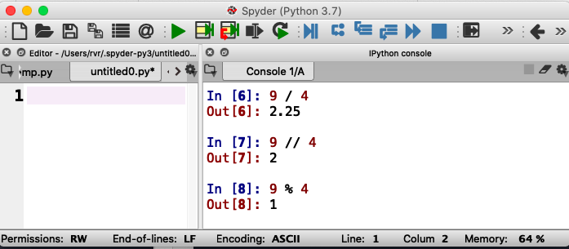
Same thing in Python
Floating point division
Integer division
Integer remainder (modulo)
You say “9 modulo 4”

Slide 69
Approaching Coding Questions

Slide 70
A 3-Step Approach To Coding Problems
Read the question carefully. Understand what information you have available to you and what the question wants you to do.
Try to write out an algorithm or solution to the problem in “English” or “pseudocode”.
Translate your English solution to code

Slide 71
Example
Q: Write a function isEven(x) that returns “even” if x is even and “odd” if not

Slide 72
Step 1: Read the question carefully
Q: Write a function isEven(x) that returns “even” if x is even and “odd” if not
After reading the question, we see that we have one integer number as our only input.
Since our function only has one input, our function header will look something like:
def isEven(x):

Slide 73
Step 2: Design a solution in “English”
Q: Write a function isEven(x) that returns “even” if x is even and “odd” if not
If the input parameter is divisible by 2, then we know it is even
Otherwise, it must be odd
We also know that we can check if something is divisible with the modulo operator, %

Slide 74
Step 3: translate English into code
If the input parameter is divisible by 2, then it is even
if num % 2 == 0:
return “even”
Otherwise, it must be odd
else:
return “odd”

Slide 75
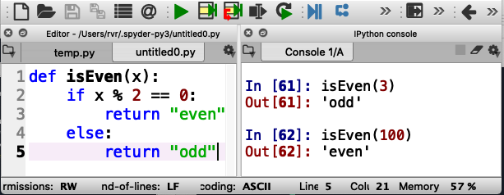
Finally, test it out
Test carefully!

Slide 76
Input/Output
Python functions can “print” (output) and read from the keyboard or even files (input)

