Slide 1

Criminal Investigation Tracker with Suspect Prediction
Project Supervisor - Dr. Ashwin M
Team Members:-
Swastik Srivastava 17BCE10006
Rohit Kumar Ranjan 17BCE10067
Sagar Singh 17BCE10122

Slide 2
Requirements
Software Requirements:-
Windows/Linux OS
SQL2008+
Python 3+/Jupiter Notebook
Hardware Components:-
Processor- i3+
Hard Disk- 4GB+
Memory- 2GB+

Slide 3
Problem Introduction
Crimes are the significant threat to the humankind. There are many crimes that happens regular interval of time. Perhaps it is increasing and spreading at a fast and vast rate. Crimes happen from small village, town to big cities. Crimes are of different type like:-robbery, murder, rape, assault, battery, false imprisonment, kidnapping, homicide. Since crimes are increasing there is a need to solve the cases in a much faster way.
The crime activities have been increased at a faster rate and it is the responsibility of police department to control and reduce the crime activities. Crime prediction and criminal identification are the major problems to the police department as there are tremendous amount of crime data that exist. There is a need of technology through which the case solving could be faster.

Slide 4
Aim & Objective
The aim of this project is to make crime prediction using the features present in the dataset. The dataset is extracted from the official sites. With the help of machine learning algorithm, using python as core we can predict the type of crime which will occur in a particular area.
The objective would be to train a model for prediction. The training would be done using the training data set which will be validated using the test dataset. Building the model will be done using better algorithm depending upon the accuracy. The K-Nearest Neighbor (KNN) classification and other algorithm will be used for crime prediction. Visualization of dataset is done to analyze the crimes which may have occurred in the country. This work helps the law enforcement agencies to predict and detect crimes in India with improved accuracy and thus reduces the crime rate.

Slide 5
Concepts Of The Proposed System
1.Predictive Modeling:-
Predictive modeling is the way of building a model that is capable of making predictions. The process includes a machine learning algorithm that learns certain properties from a training dataset in order to make those predictions.
Predictive modeling can be divided further into two areas:-
-Regression and pattern classification.
Regression models are based on the analysis of relationships between variables and trends in order to make predictions about continuous variables.
In contrast to regression models, the task of pattern classification is to assign discrete class labels to particular data value as output of a prediction. Example of a classification model is -A pattern classification task in weather forecasting could be the prediction of a sunny, rainy, or snowy day.

Slide 6
Types of Predictive Models Algorithms
Classification and Decision Trees:-
A decision tree is an algorithm that uses a tree shaped graph or model of decisions including chance event outcomes, costs, and utility. It is one way to display an algorithm.
Naive Bayes -In machine learning, naive Bayes classifiers are a family of simple probabilistic classifiers based on applying Bayes theorem with independence assumptions between the features.
Linear Regression – The analysis is a statistical process for estimating the relationships among variables. Linear regression is an approach for modelling the relationship between a scalar dependent variable Y and one or more explanatory variables denoted X. The case of one explanatory variable is called simple linear regression. More than one variable is called multivariate.
Logistic Regression- In statistics, logistic regression, is a regression model where the dependent variable is categorical or binary.

Slide 7
2.Data Preprocessing :-
This process includes methods to remove any null values or infinite values which may affect the accuracy of the system. The main steps include Formatting, cleaning and sampling. Cleaning process is used for removal or fixing of some missing data there may be data that are incomplete. Sampling is the process where appropriate data are used which may reduce the running time for the algorithm. Using python, the preprocessing is done.
3.Prepare Data:-
1.In this step we need prepare data into right format for analysis
2.Data cleaning
Analyze and Transform Variables. We may need to transform the variables using one of the approaches
Normalization or standardization
Missing Value Treatment

Slide 8
4.Random Sampling (Train and Test) :-
Training Sample: Model will be developed on this sample. 70% or 80% of the data goes here.
•Test Sample: Model performances will be validated on this sample. 30% or 20% of the data goes here
5.Model Selection:-
Based on the defined goal(s) (supervised or unsupervised)
We have to select one of or combinations of modeling techniques. Such as
•KNN Classification
•Logistic Regression
•Decision Trees
•Random Forest
•Support Vector Machine (SVM)

Slide 9
6.Build/Develop/Train Model :-
Validate the assumptions of the chosen algorithm
Develop/Train Model on Training Sample, which is the available data(Population)
Check Model performance -Error, Accuracy
7.Validate/Test Model:-
Score and Predict using Test Sample
Check Model Performance: Accuracy etc.
8.Results And Discussion:-
The results are obtained after undergoing various processes that comes under machine learning.

Slide 10
Supervised classification models
Decision Tree Classifier
Gaussian Naive Bayes
Logistic Regression
K-Nearest Neighbor
Ensemble Methods
Random Forest
Adaboost

Slide 11

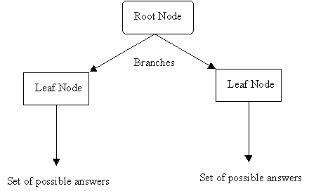
Decision Tree Classifier
Decision tree classification model forms a tree structure from dataset. Decision tree is built by dividing a dataset into smaller pieces. At each step in the algorithm, a decision tree node is splitted into two or more branches until it reaches leaf nodes.

Slide 12
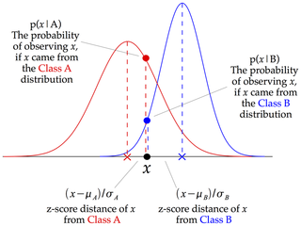
Gaussian Naive Bayes
Gaussian Naive Bayes is a supervised classifier that uses naive assumption that there is no dependency between two features. This classifier is implemented by applying Bayesian Theorem.

Slide 13
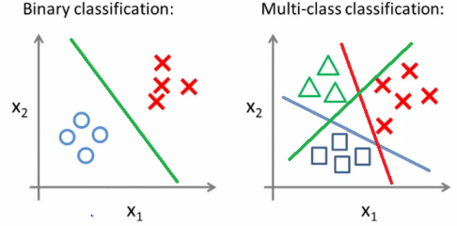
Logistic Regression
Logistic regression uses linear boundaries to classify data into different categories. Logistic regression can work on both binary and multiclass problems. For multiclass dataset, one vs the rest scheme is used. In this method, logistic regression trains separate binary classifiers for each class. Meaning, each class is classified against all other classes, by assuming that all other classes is one category

Slide 14
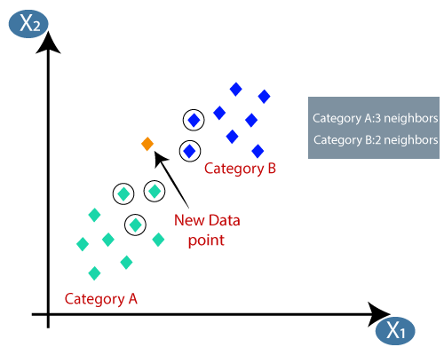
K-Nearest Neighbor
Nearest Neighbors method is used in both supervised and unsupervised learning. While testing with new data, KNN looks at k data points in training dataset which are closest to the test data point. k indicates the number of neighbors voting to classify a datapoint. The distance can be measured with various metrics. Euclidean distance is the most common choice

Slide 15

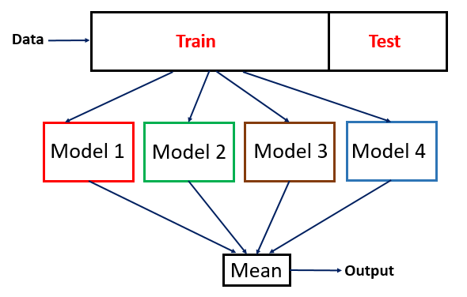
Ensemble Methods
Ensemble learning is a method of combining multiple learning algorithm together to achieve better performance over a single algorithm. Ensemble methods can be divided into two categories: averaging methods and boosting methods.

Slide 16

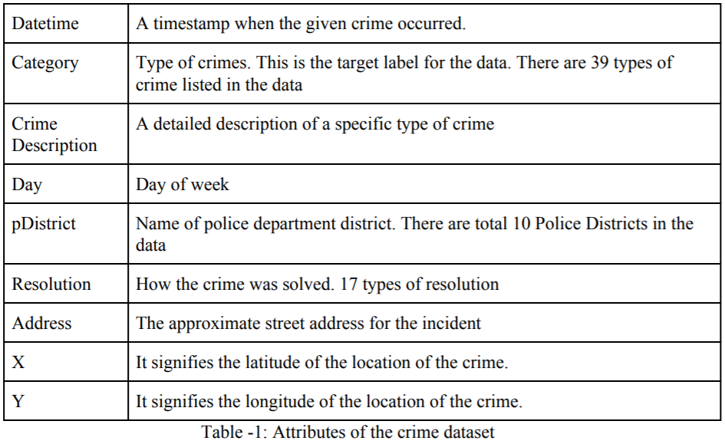
Crime dataset and attributes
The experiment is conducted on a specific dataset.
Attributes:-

Slide 17
Pre-processing
Python library Scikit-learn (sklearn) is used for preprocessing the dataset. Some attributes in the csv files contains string values and others are numeric values. In order to use this dataset in machine learning models, the text features need to be converted into a numeric value.. Python library numpy is used to contain both features and label of the dataset after converting them into numeric values.

Slide 18
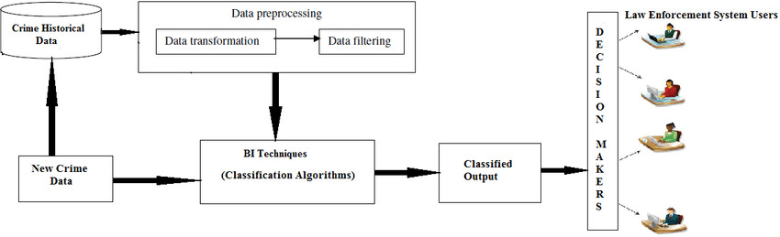
Overall system architecture diagram

Slide 19
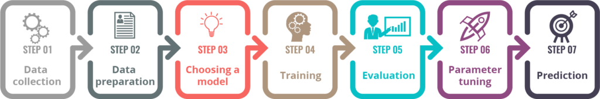
Process Involved

Slide 20
Novelty of the project
Pattern Identification of the crime
Classification of the criminal incident
Data Visualization
Criminal Profiling

Slide 21
Real Time Usage
It can be used by the police and other investigation agency for their investigation purposes.
It can be used for criminal profiling i.e. record the characteristics and behavior of criminals
It can be used to segregate crime areas based on the number of incident that had happened in the past.
It can be used for crime visualization.

Slide 22
Limitations
Difficulty in getting dataset from the law, courts and the concerned authority as the data may be highly confidential.

Slide 23
Data Categories Used for Model Building
Property crimes
Auto and Vehicles related crimes
Kidnapping crimes
Murder crimes
Rape crimes
This data-sets contains only those reports and incidents that were reported to the judiciary system throughout India from 2001-2012.

Slide 24
Future Add-ons
. A website which will provide an user-query API to get the data specification from the user and then providing the query results accordingly in form of charts and figures and all the statistics related to that query.
. User can also know about the various the “Sections” that will be imposed on a person on the commitment of a particular crime and the query result will also contain a brief detail of about all the “Sections” that will be imposed.

Slide 25
References
Malathi. A and Dr. S. Santhosh Baboo. Article:an enhanced algorithm to predict a future crime using data mining. International Journal of Computer Applications, 21(1):1–6, May 2011. Published by Foundation of Computer Science.
Eibe Frank and Remco R. Bouckaert. Naive bayes for text classification with unbalanced classes. In Proceedings of the 10th European Conference on Principle and Practice of Knowledge Discovery in Databases, PKDD’06, pages 503–510, Berlin, Heidelberg, 2006. Springer-Verlag.

