Slide 1
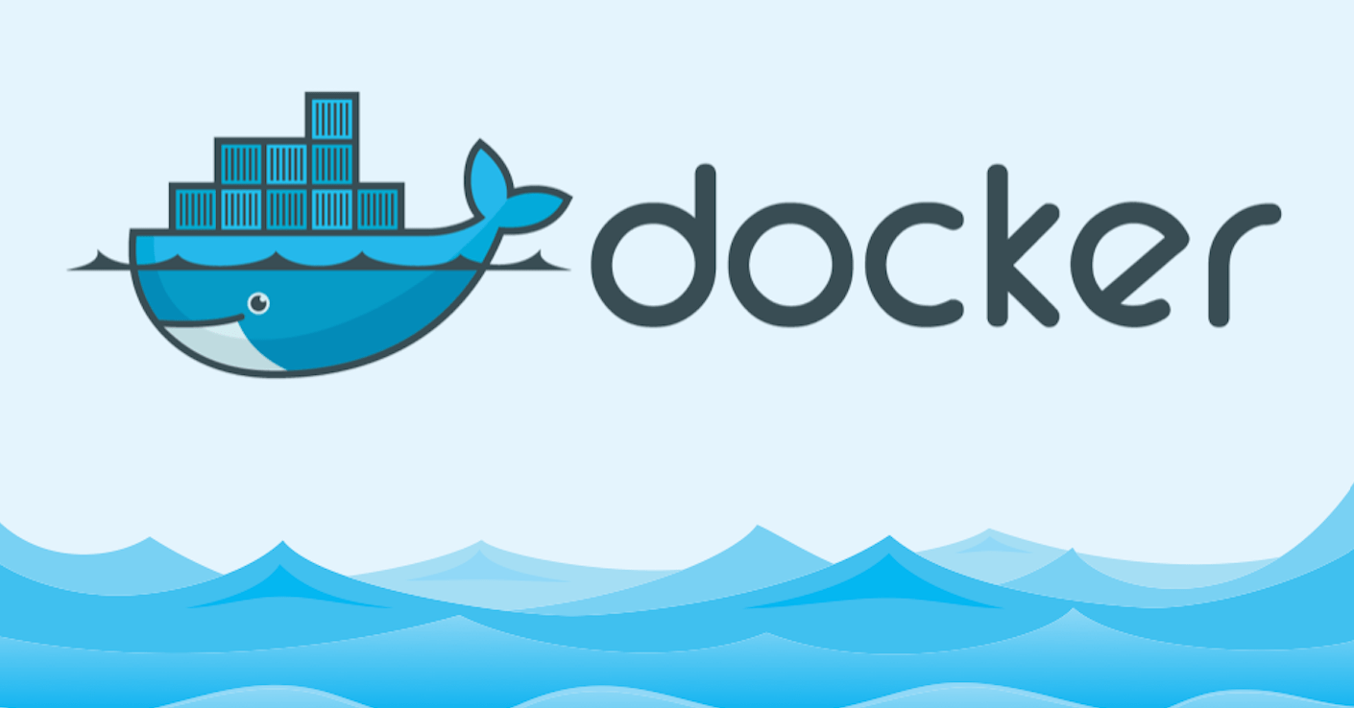

Slide 2
Agenda
Introduction
Docker Architecture
Docker Containers
Docker Images
Docker Volumes
Docker Compose

Slide 3
Docker
Docker is an open platform for developing, shipping, and running applications.
It allows you to build, test, and deploy applications quickly, packaging software into standardized units called containers.
Docker enables you to separate your applications from your infrastructure so you can deliver software quickly.
The whole idea of Docker is for developers to easily develop applications, ship them into containers which can then be deployed anywhere.

Slide 4
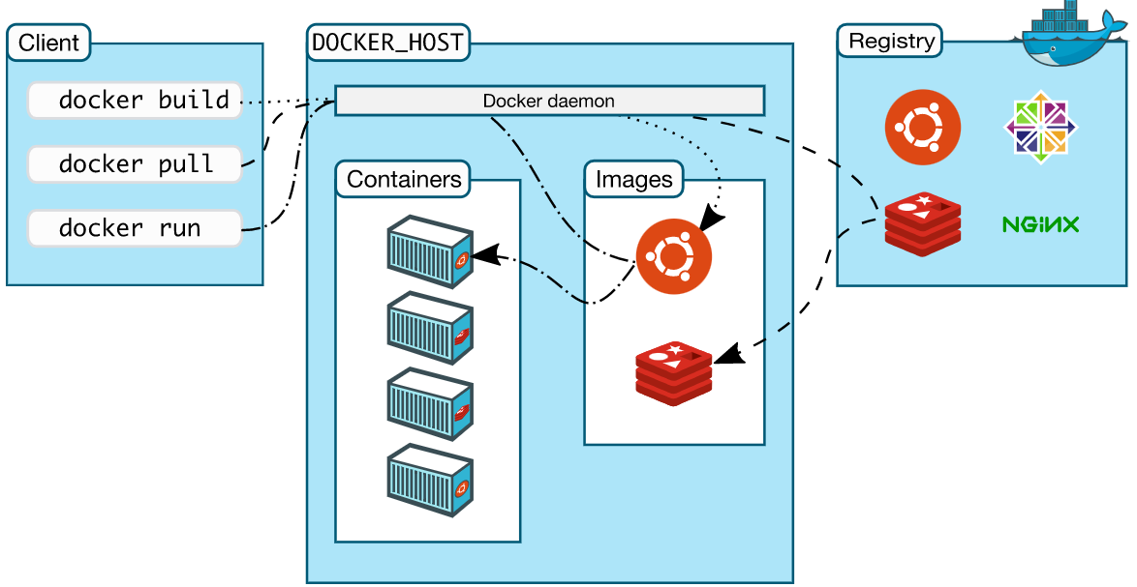
Architecture

Slide 5
Containers
Docker containers include the application and all of its dependencies.
It shares the kernel with other containers, running as isolated processes in user space on the host operating system.
Docker containers are not tied to any specific infrastructure: they run on any computer, on any infrastructure, and in any cloud.
Docker containers are basically runtime instances of Docker images.
$ docker container ls // List containers
$ docker run hello-world // Run a container
$ docker container exec // Run a command in a running container
$ docker ps // Shows running containers
$ docker container logs // Fetch the logs of a container
$ docker container inspect // Display detailed information on one or more containers
$ docker container start // Start one or more stopped containers
$ docker container stop // Stop one or more running containers
$ docker container kill // Kill one or more running containers
$ docker container rm // Remove one or more containers

Slide 6
Images
A Docker image is a read-only template that contains a set of instructions for creating a container that can run on the Docker platform
It provides a convenient way to package up applications and preconfigured server environments.
A Docker image is a file used to execute code in a Docker container.
These docker images can be deployed to any Docker environment.
Docker images have intermediate layers that increase reusability, decrease disk usage, and speed up docker build by allowing each step to be cached.
$ docker images // List of images
$ docker image rm // Remove an image
$ docker image build // Builds an image from a Dockerfile.
$ docker image inspect // Displays information on one or more images.
$ docker image prune // Removes unused images.
$ docker image pull // Pulls an image or a repository from a registry.
$ docker image push // Pushes an image or a repository to a registry. $ docker image history // Shows the history of an image

Slide 7
Volumes
Docker volumes ensuring data persistence while working in containers
Docker volumes are file systems mounted on docker containers to preserve data generated by the running container.
Volumes can be more safely shared among multiple containers.
Volume drivers let you store volumes on remote hosts or cloud providers, to encrypt the contents of volumes, or to add other functionality.
VOLUME ["/data"]
# Example:
FROM ubuntu
RUN mkdir /test
VOLUME /test

Slide 8
Compose
Docker Compose is a tool for defining and running multi-container Docker applications.
Docker Compose can be used to create separate containers, host them and get them to communicate with each other.
Each container will expose a port for communicating with other containers.
# Dockerfile
FROM node:16.13.0
WORKDIR /usr/src/app
COPY package*.json ./
RUN npm install
COPY . .
EXPOSE 3000
CMD ["npm", "start"]

Slide 9
Compose
# docker-compose.yml
version: '3'
services:
app:
container_name: docker-node-mongo
restart: always
build: .
ports:
- '80:3000'
external_links:
- mongo
mongo:
container_name: mongo
image: mongo
ports:
- '27017:27017'

