Slide 1
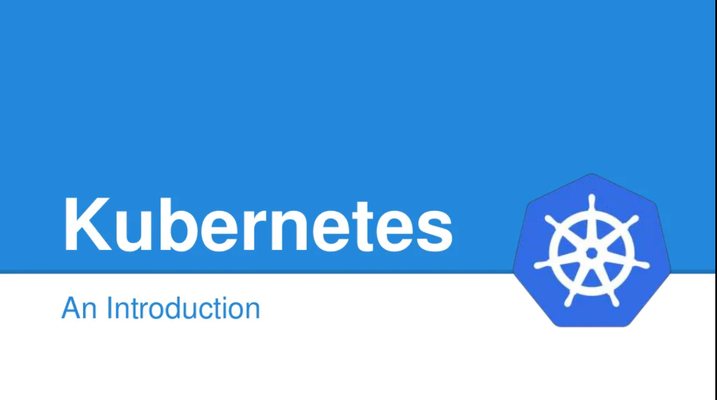
Kubernetes

Slide 2
Agenda
Kubernetes Overview
Kubernetes Architecture
Kubernetes Installation and Dashboard Setup
Kubernetes Pod
Kubernetes Node
Kubernetes Service
Kubernetes Deployment
Kubernetes Namespace
Kubernetes Volumes
Kubernetes Secrets
Deploy a NodeJS application in Kubernetes Cluster

Slide 3
Overview
Q. What is Kubernetes ?
Container management (orchestration) tool
Used to manage Docker containers as default implementation
Redundancy and availability of containers
Scalability or high performance
Self-Healing Capabilities
Service discovery and load balancing

Slide 4
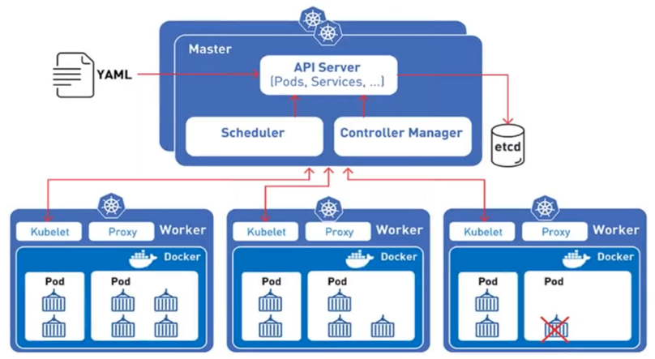
Architecture

Slide 5
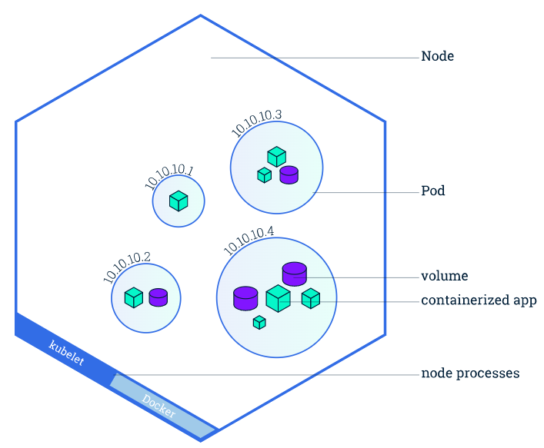
POD

Slide 6
POD
A Pod contains one or multiple application containers
Storage resources
Each Pod gets its own IP address
New IP address on re-creation
apiVersion: v1
kind: Pod
metadata:
name: nodejs-pod
labels:
name: nodejs
spec:
containers:
- name: nodejs
image: nodejs:14.16.0
resources:
limits:
memory: "128Mi"
cpu: "500m"
ports:
- containerPort: 80

Slide 7
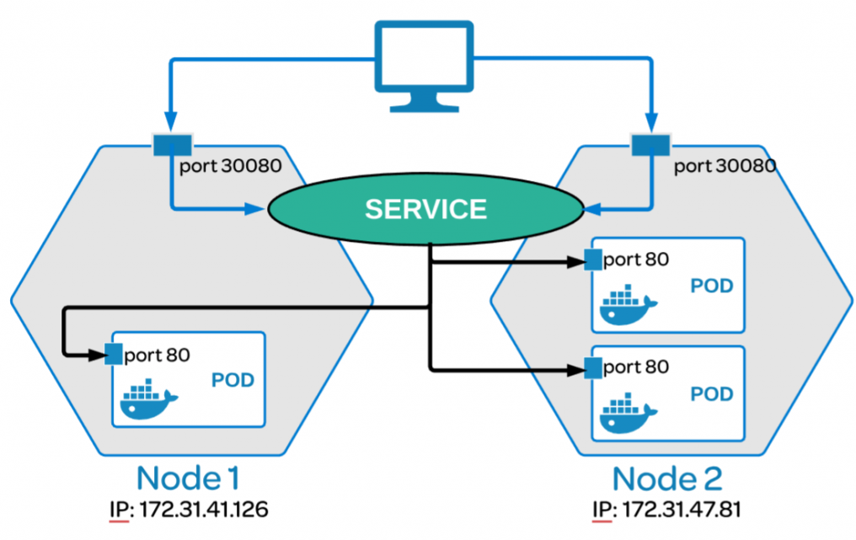
Service

Slide 8
Service
Pods can be configured to talk to the Service
Services provide discovery and routing between pods
Permanent IP address
Service do the load-balancing on available pod
It use labels and selectors to match pods with other applications.
Types: ClusterIP, NodePort, LoadBalancer, ExternalName
apiVersion: v1
kind: Service
metadata:
name: nodejs-service
spec:
selector:
app: nodejs
ports:
- port: 80
targetPort: 3000

Slide 9
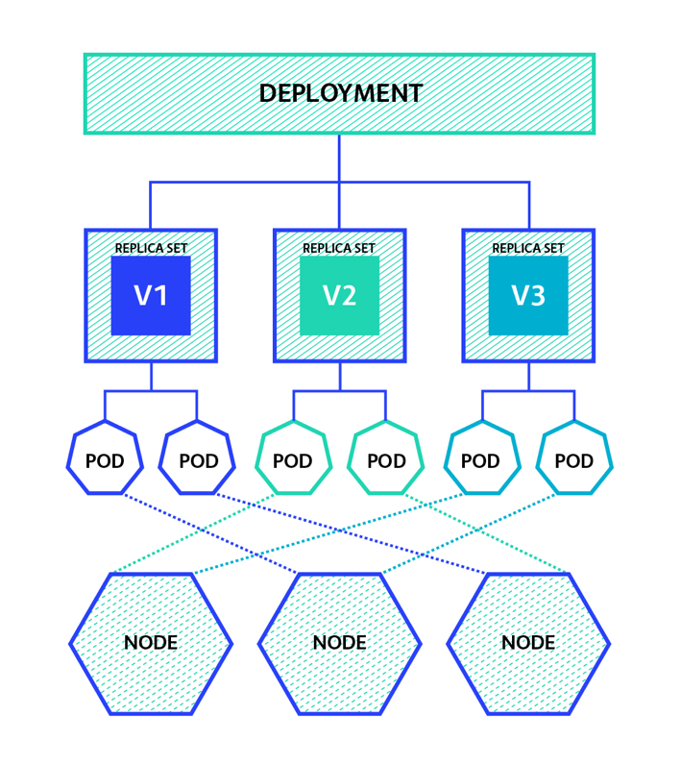
Deployment

Slide 10
Deployment
Create a Deployment to rollout a ReplicaSet.
Declare the new state of the Pods
Rollback to an earlier Deployment revision
Scale up the Deployment to facilitate more load.
Clean up older ReplicaSets

Slide 11
Deployment
apiVersion: apps/v1
kind: Deployment
metadata:
name: nodejs-deployment
spec:
replicas: 2
selector:
matchLabels:
app: nodejs
template:
metadata:
labels:
app: nodejs
spec:
containers:
- name: nodejsapp
image: sofyspace/nodejs-starter:1.0
resources:
limits:
memory: "128Mi"
cpu: "500m"
ports:
- containerPort: 3000

Slide 12
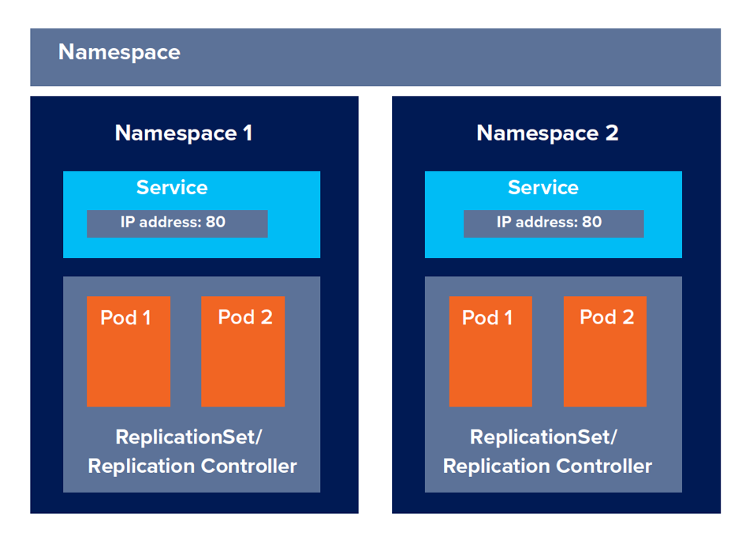
Namespace

Slide 13
Namespace
It is a logical cluster or environment.
It is a widely used method which is used for scoping access or dividing a cluster.
Partitioning landscapes: dev vs. test vs. prod
It divide cluster resources between multiple users
apiVersion: v1
kind: Namespace
metadata:
name: scm-dev-namespace
$ kubectl get namespaces
$ kubectl apply -f scm-dev-namespace.yaml
$ kubectl get namespace
$ kubectl describe namespace scm-dev-namespace

Slide 14
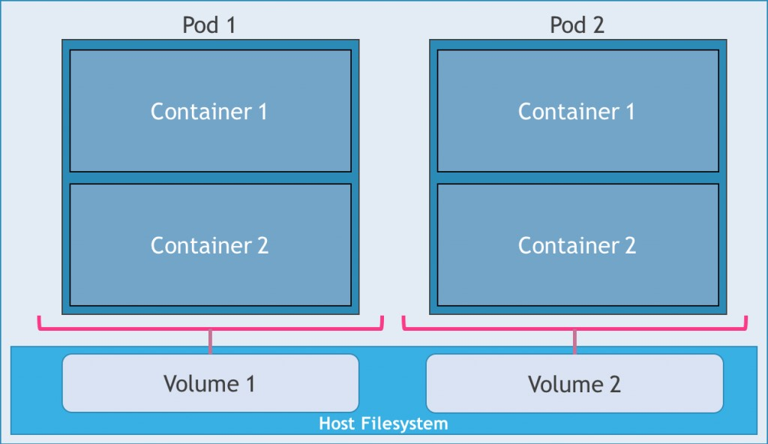
Volumes

Slide 15
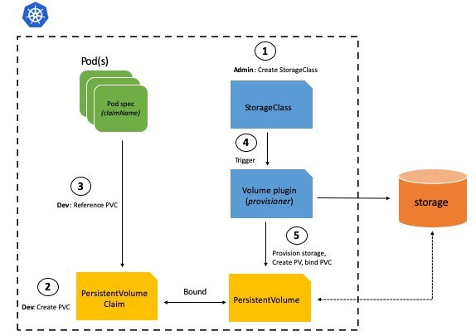
Volumes

Slide 16
Volumes
It is way to provide both long-term and temporary storage to Pods in your cluster
Volumes can support any type of storage infrastructure, including local storage devices, cloud storage services etc.
Volumes can be accessed directly from pods or Persistent Volumes.
A Persistent Volume (PV) is a type of object that defines how a cluster provides storage and lives longer than a lifespan of a pod or even a node.
A Persistent Volume Claim (PVC) is how you reserve a PV to mount it later as a volume in containers within a pod.
Storage Class represents a type of storage—for example, fast SSD storage vs regular magnetic drives or remote cloud storage.

Slide 17
Volumes
apiVersion: v1
kind: PersistentVolume
metadata:
name: nodejs-volume
spec:
capacity:
storage: 500Gi
volumeMode: Filesystem
accessModes:
- ReadWriteOnce
persistentVolumeReclaimPolicy: Recycle
storageClassName: slow
mountOptions:
- hard
- nfsvers=4.1
nfs:
path: /tmp
server: 172.17.0.2

Slide 18
Secrets
apiVersion: v1
kind: Secret
metadata:
name: nodejs-secret
type: Opaque
data:
nginx-root-username: dXNlcm5hbWU=
nginx-root-password: cGFzc3dvcmQ=
$ kubectl apply -f nodejs-secret.yaml
$ kubectl get secret nodejs-secret
$ kubectl describe secret nodejs-secret

Slide 19
Secrets
apiVersion: v1
kind: Pod
metadata:
name: nodejs-pod
labels:
name: nodejs
spec:
containers:
- name: nodejs
image: nodejs:14.16.2
resources:
limits:
memory: "128Mi"
cpu: "500m"
ports:
- containerPort: 80
env:
- name: NODEJS_ROOT_USERNAME
valueFrom:
secretKeyRef:
name: nodejs-secret
key: nodejs-root-username
- name: NODEJS_ROOT_PASSWORD
valueFrom:
secretKeyRef:
name: nodejs-secret
key: nodejs-root-password

Slide 20
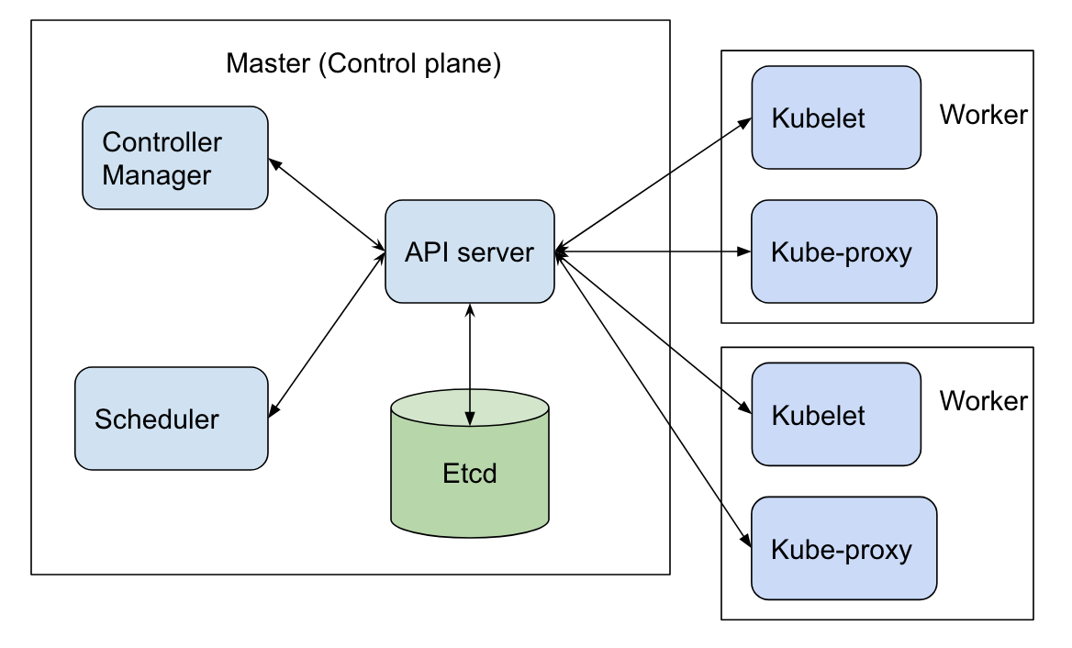
ETCD
etcd is an open-source distributed key-value store.
Kubernetes uses etcd to store state data, metadata and configuration data.
It allows nodes in Kubernetes clusters to read and write data.
It is accessible only by Kubernetes API server as it may have some sensitive information.

Slide 21
Kubelet
The kubelet is a service agent that controls and maintains a set of pods.
It interacts with etcd store to read configuration details and wright values.
It manages network rules, port forwarding, etc.
The kubelet runs on each node and enables the communication between the master and slave nodes.
It can register the node with the apiserver using one of the hostname.

Slide 22
Kube-Proxy
kube-proxy is a key component of any Kubernetes deployment.
Its role is to load-balance traffic that is destined for services (via cluster IPs and node ports) to the correct backend pods.
Kube-proxy can run in one of three modes, userspace, iptables, or IPVS.

