Slide 1


Slide 2
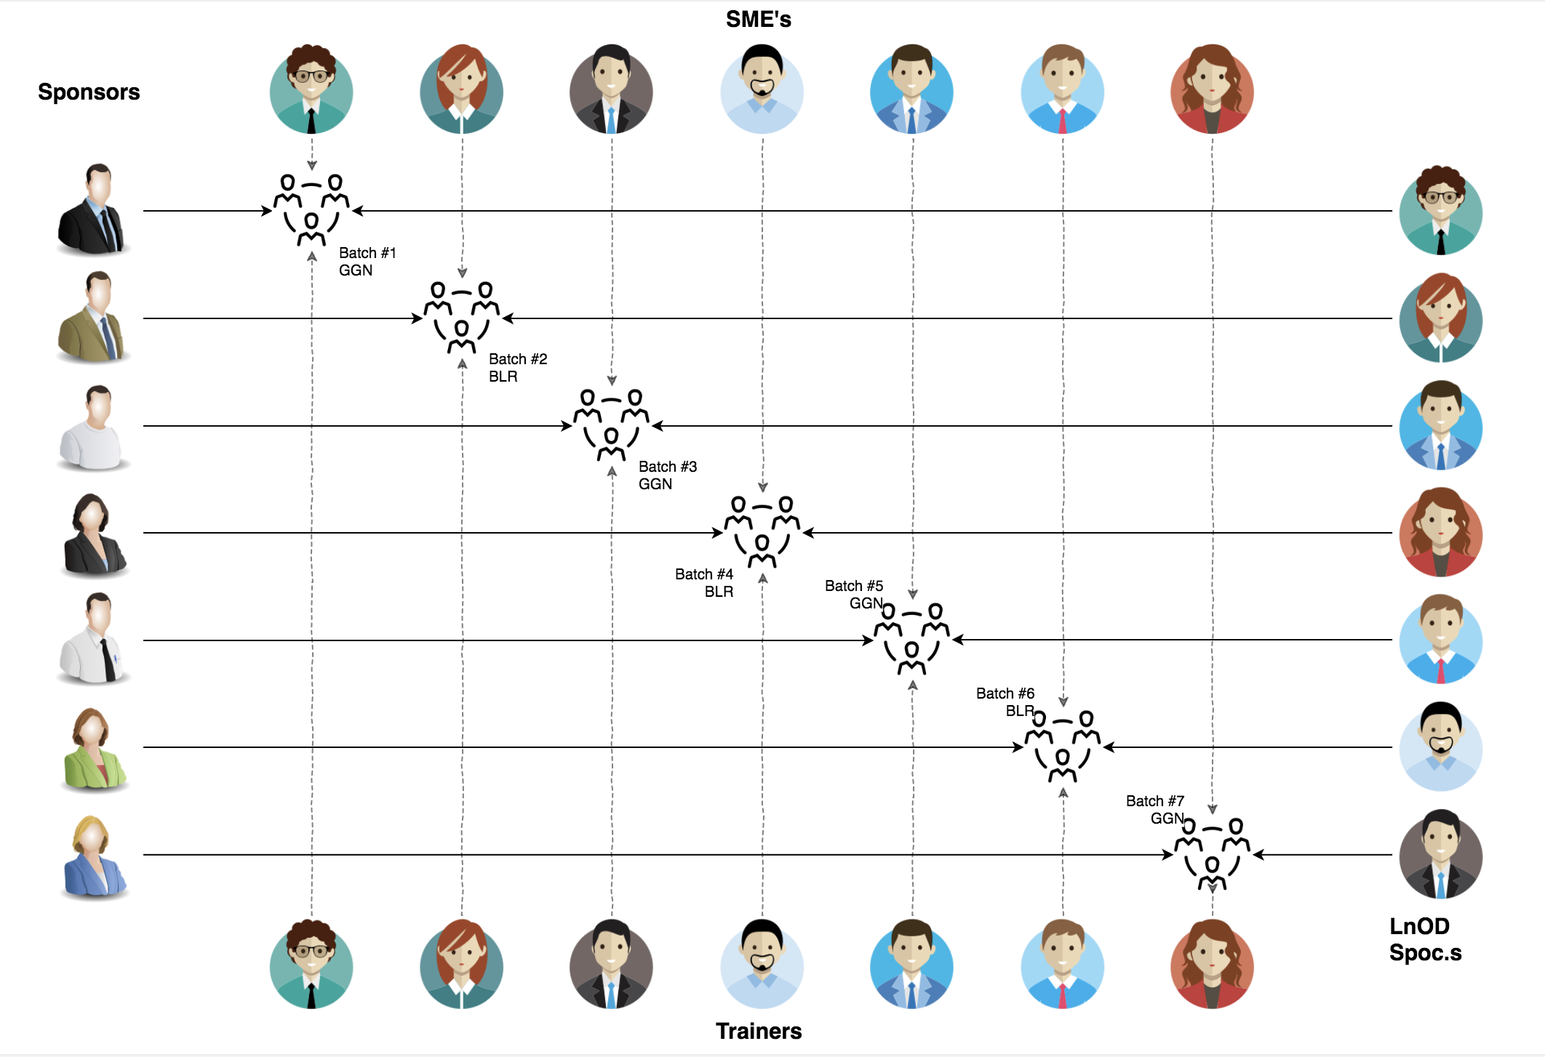
Stakeholders
Sponsors
Coforge
SME’s
1. Amit Balyan
2. Alin Bhattacharyya
3. Apoorv Kumar Saxena
Trainers
Amit Balyan
4. Others
Priyanka Singh

Slide 3
2 WEEKS OF TRAINING
10 DAYS
80 HOURS
4,800 MINUTES
2,88,000 SECONDS
LIMITLESS KNOWLEDGE

Slide 4

Agenda
01
ES6
02
CSS3
04
TypeScript
05
HTML5
06
Angular11
07
React.js
08
Redux
09
Jasmine
Notes:
Time – 1 min

Slide 5
Framework for 2 Weeks
Our every day plan is discussion about techonologies/ doudt clearance / Share the experience.
Day 1:
ES6 :-- Basic ES6 + Advanced ES 6
DAY 2:
HTML 5 :- Basic + Advanced + JS Api in HTML 5
DAY 3:
CSS 3 :- Advanced concept of CSS 3
DAY 4:
TypeScript :- JS to TypeScript
DAY 5:
Angular :- M -V-C Architecture

Slide 6
Framework for 2 Weeks
Day 6:
Angular :-- Advanced Concept + API Integration
DAY 7:
Angular :- Basic + Advanced Routing + From Integration + Lazy Loading
DAY 8:
Angular :- Auth Integration + Testing with Jasmine
DAY 9:
React :- React setup + API integration
DAY 10:
Redux :- React + Redux Concept

Slide 7

Our Journey
Notes:
Time - 2 mins

Slide 8
Es6
Destructuring
Arrow Function
class and constructor
Encapsulation
Inheritance
HTML5
Core HTML Element (Canvas / SVG, SSE, offline browsing, SessionStorage, Localstorage)
JS API
CSS3
Selector
transfor
Animation
box shadow
Psedo class
Box Model

Slide 9
Type script (TS)
Installation
what is the importance of TS
TS container
TS data types internal
Angular
@Component :-- >> Angular Component
@pipe :----> Angular filter
@Directive :--> Angular directive used in the Angular Template
@injectable :--> Angular Server Implementation
@input/@output :---> its use for Sharing the Data between the Angular Component.
@ngModule:--> its use to create the Internal/ External Module in Angular App.
React Js
Why react js
What is react js different from other framework
Redux

Slide 10

Project Goals
Notes:
Time – 3 mins

Slide 11




Our Vision
To create an Online Flight Booking System using angular 11, where a customer can login, search and book flight and also can see the booking.
1
2
Quality
Security
3
4
Interactivity
Speed
Notes:
User satisfaction and brand value

Slide 12
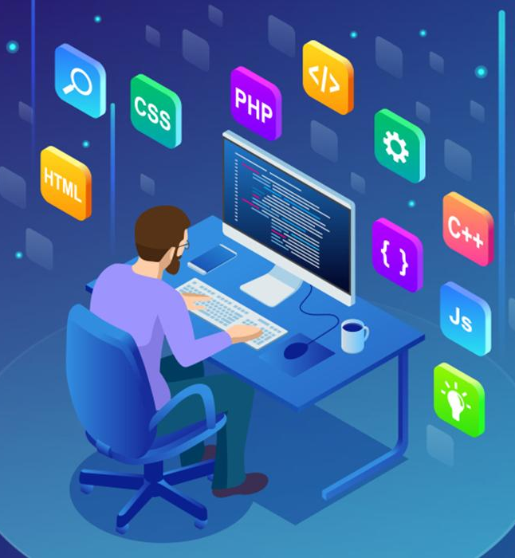
Tech Stack
Notes:
Time – 2 mins

Slide 13







Frontend
Framework
Library
Language
Testing
Notes:
Time – 1 min

Slide 14

Development
Notes:
Time – 1 min

Slide 15

Challenges & Learnings
Notes:
Time – 2 mins

Slide 16

Demo
Notes:
Time –
Architecture – 5 mins
NFR Dashboard – 3 mins
Demo – 10 mins
1. Show the Responsiveness and Wave tool first

Slide 17
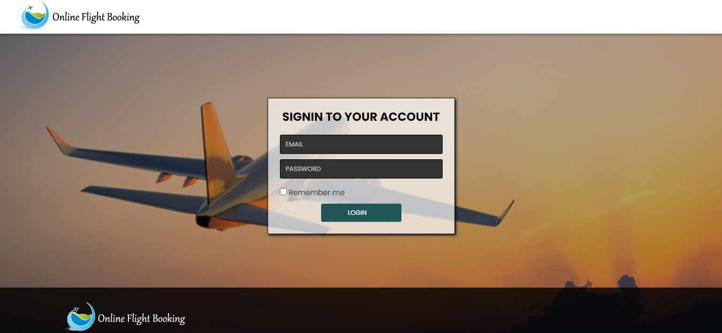
Deo
Notes:
Time –
Architecture – 5 mins
NFR Dashboard – 3 mins
Demo – 10 mins
1. Show the Responsiveness and Wave tool first

Slide 18
Thank you
Notes:
Time – After this show the testimonial video. 1 min

