Slide 1


JobEchoAI: AI-Powered Candidate Evaluation Platform
Presenting by Code Wizards
Nayan Das
Atanu Koley

Slide 2
Problem Statement-1
In the modern hiring landscape, evaluating a candidate’s skills efficiently is crucial. Your task is to develop a platform where users can upload their CVs, and based on their skills and experience, they will be assessed through a tailored test. The system should generate a personalized evaluation and provide an assessment score reflecting their expertise. Key Features: - CV parsing to extract relevant skills and experience. - AI-driven test generation customized for each candidate. - Automated scoring and detailed performance feedback. Objective: Create an intelligent assessment tool that helps job seekers identify their strengths while enabling recruiters to make informed hiring decisions.

Slide 3
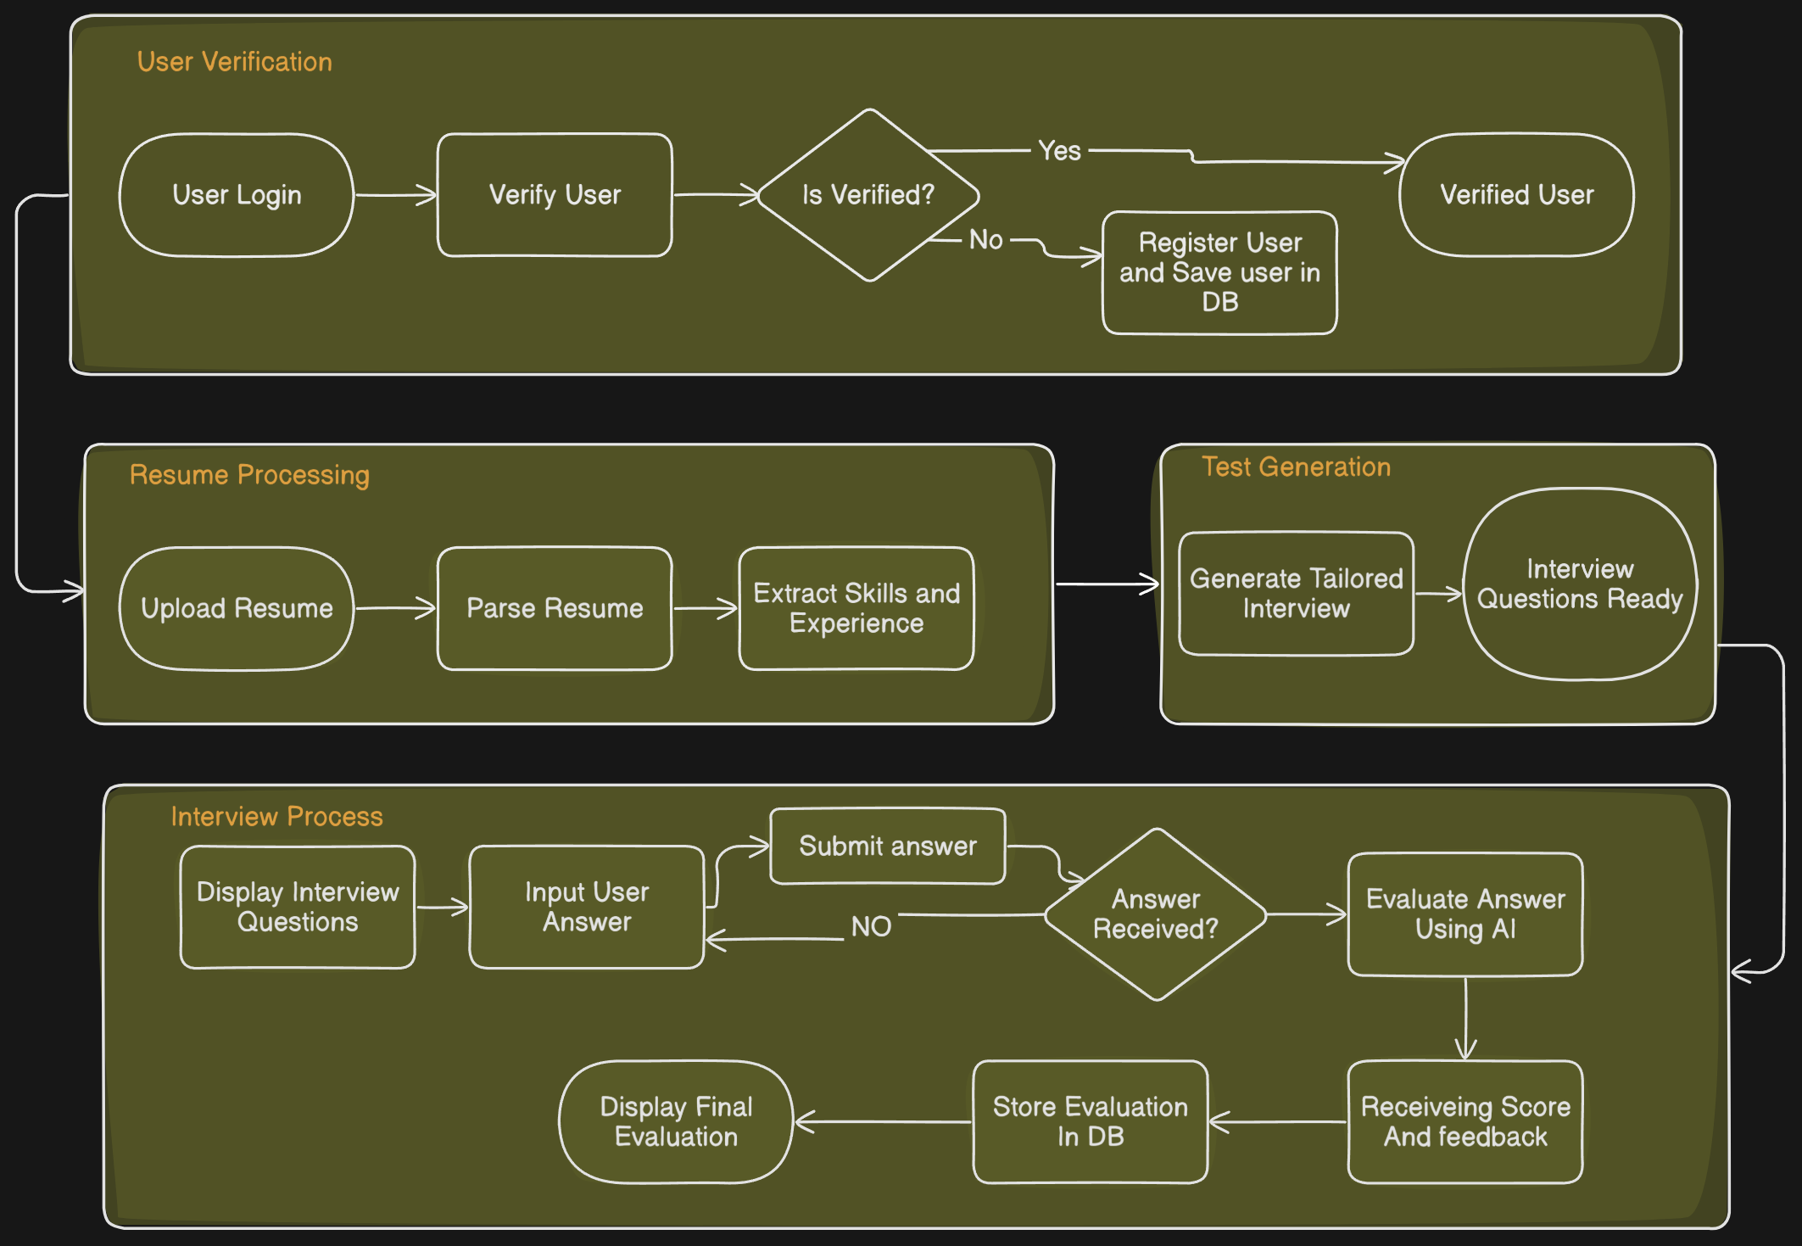
Workflow of our project

Slide 4
Techstacks of Our website
Frontend
Backend
Authentication
Database
Next.js and Tailwind CSS build a responsive UI for seamless user interactions. Sadcn Components for better UI design.
Next.js API routes handle logic, processing CVs, generating tests, and managing user authentication. Google Gemini AI API for resume
evaluation and test case generation.
Clerk ensures secure user management, handling signup, login, and role-based access control.
Neon Database provides scalable data storage for user data, CV information, and test results.

Slide 5




User Authentication and Data Security
Clerk integration handles secure user signup, login, and session management.
All user informations are stored in Neon database.
Data is encrypted at rest and in transit, ensuring confidentiality and integrity.

Slide 6

CV Upload and Processing
1
Users upload their CVs (PDF, DOCX) via the Next.js frontend.
2
The backend API receives the CV file and utilizes PDF parsing libraries (e.g., PDF.js ) to extract text.
4
Then gemini AI generates test questions as per the skill sets and make the difficulty level of those questions as per experience.
3
Google gemini AI identify key skills and year of experiences from the extracted text.

Slide 7




Personalized Test Generation
The backend API retrieves the extracted skill profile associated with the uploaded CV.
An algorithm(Gemini AI) selects relevant test questions from the Neon Database based on the user's skill profile.
Test formats include descriptive type questions, providing a comprehensive assessment.
The difficulty of questions is dynamically adjusted based on user experience, ensuring an appropriate level of challenge.

Slide 8
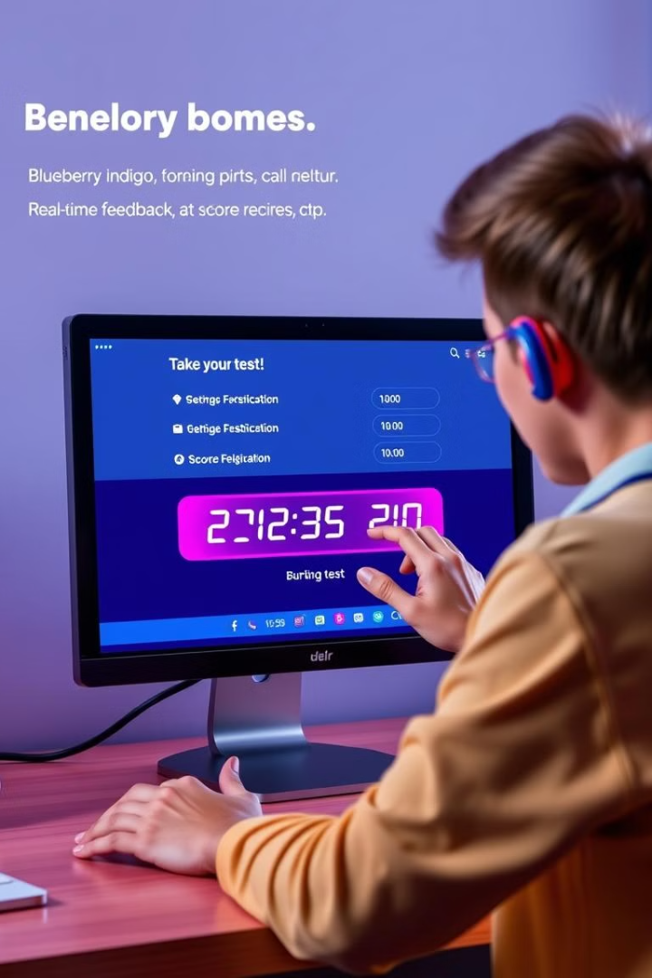
Real-time Test Execution and Result Analysis
1
Users answer test questions via typing, and their responses are sent to the backend API.
2
The backend API(Gemini AI) evaluates answers and calculates scores in real-time, with an automated gemini api calling.
3
Result analysis provides a comprehensive breakdown of the user's performance, including overall scores, skill-based scores,user answer,correct answer, and areas for improvement.

Slide 9
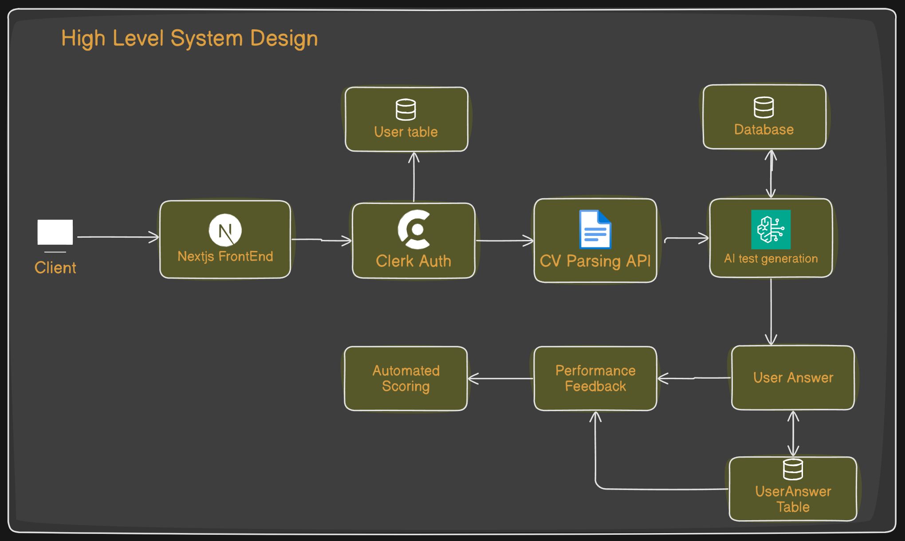
High-level Syatem Design

Slide 10
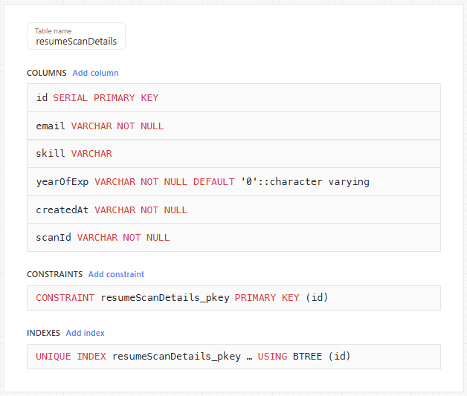
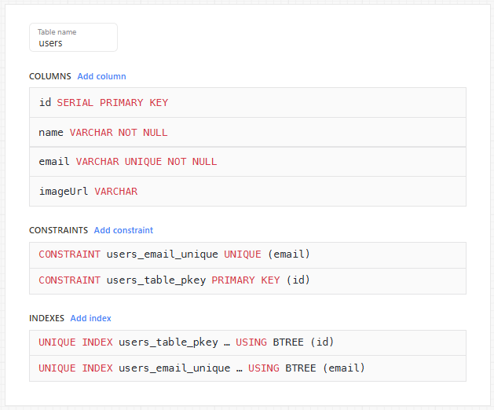
Database Schema (Neon PostgreSQL)
User Table(store user info)
Resume Deails (Store Skills and experience)

Slide 11
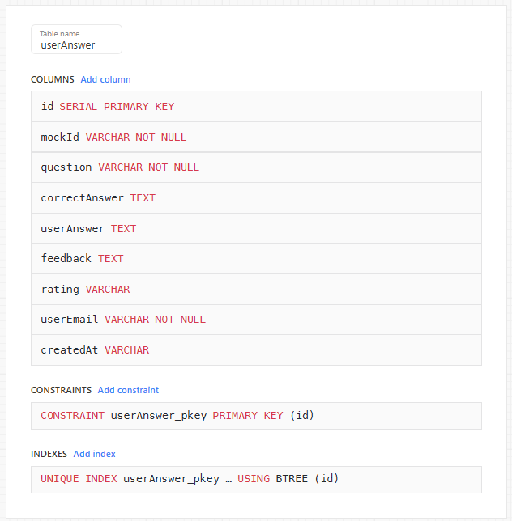
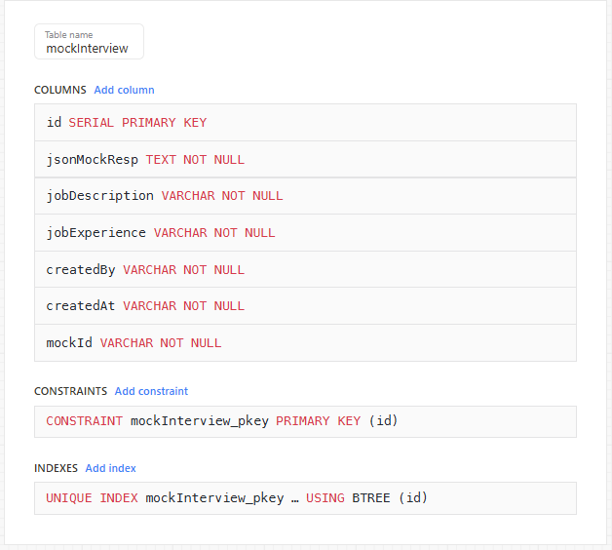
Interview Details
User Answers Details

Slide 12
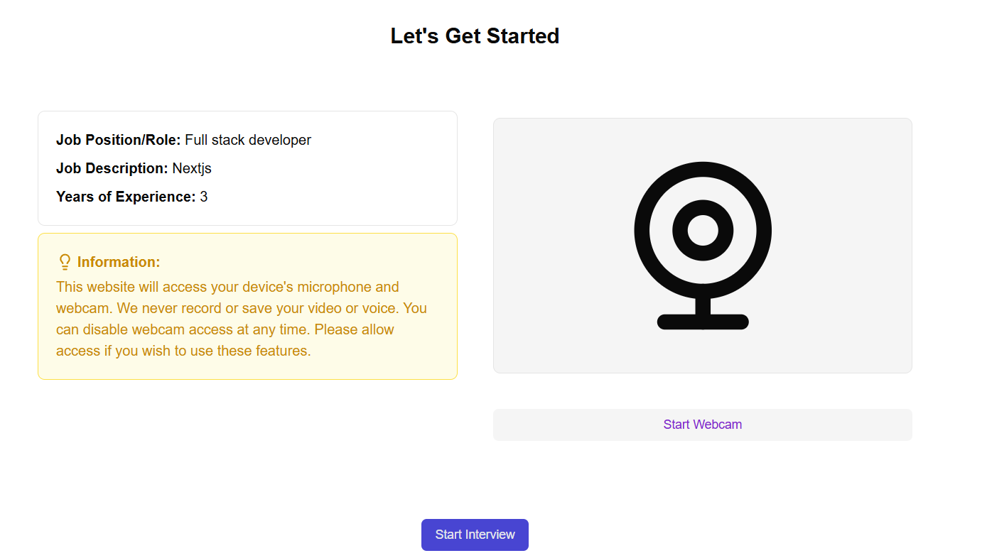
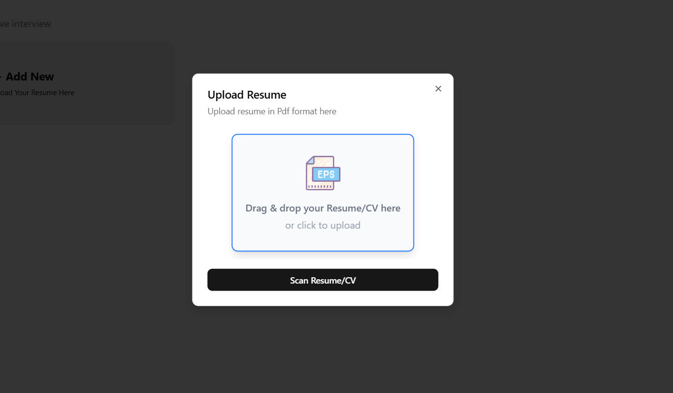
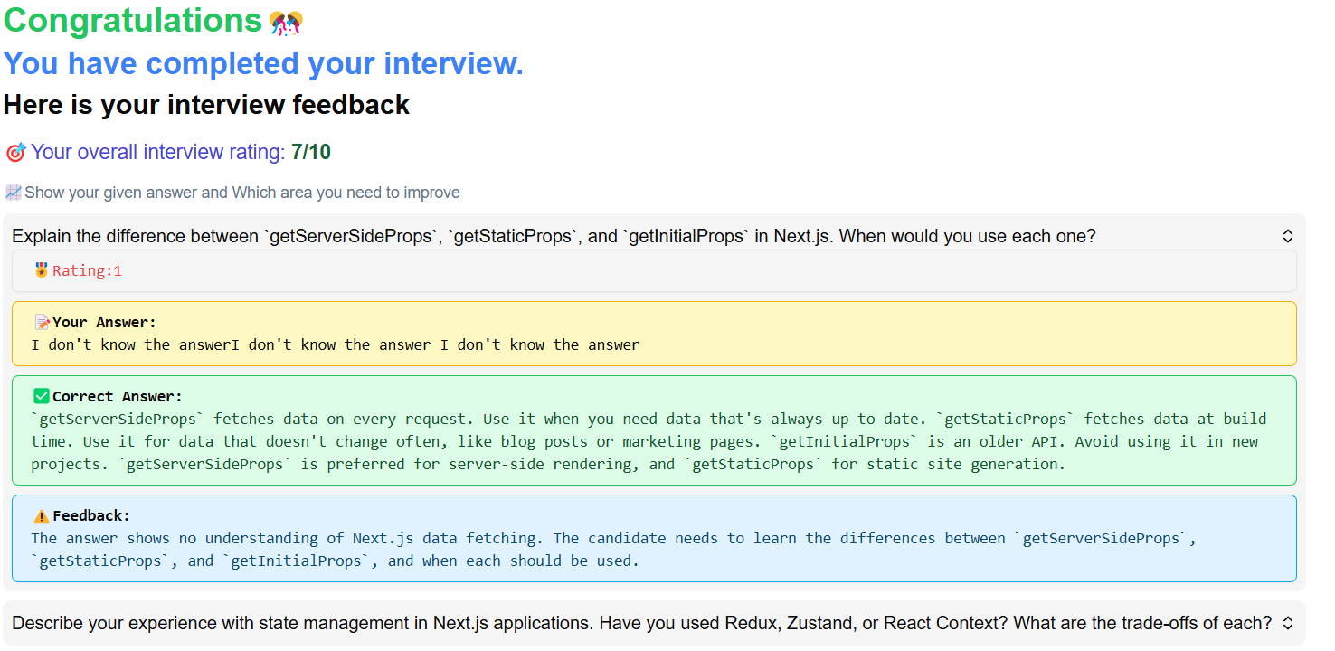
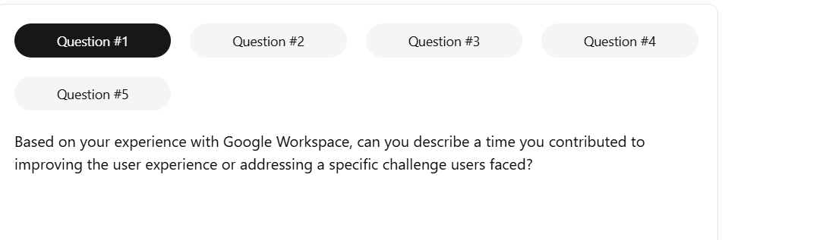
UI/UX Design with Tailwind CSS
CV Upload Form
Skill Profile Display
Test Presentation
Result Visualization

Slide 13

Business Idea behind the project
For Job Seekers: Personalized assessments help candidates understand their strengths, improve their skills, and showcase their expertise beyond just a CV.
Revenue Model:
B2B SaaS Model: Subscription-based pricing for companies to access automated assessments. Tiered pricing based on the number of assessments per month.
Pay-Per-Test Model: Employers can pay per assessment generated.
Freemium for Job Seekers: Basic assessments are free, but detailed reports and skill improvement suggestions are premium option to purchase premium AI coaching or interview preparation guides.

Slide 14
Thanks You

