Slide 1
Sentiment Prediction Using ML
Q-Commerce Reviews
Supervised Machine Learning Project

Slide 2
Dataset
Q-Commerce Consumer Survey Dataset
Manually labeled for sentiment

Slide 3
Methodology
Preprocessing → TF-IDF → Logistic Regression
Post-processing rules

Slide 4
Results
Sentiment distribution and ROC analysis
Positive, Neutral, Negative

Slide 5
Conclusion
Survey-based sentiment successfully analyzed
System is explainable

Slide 6
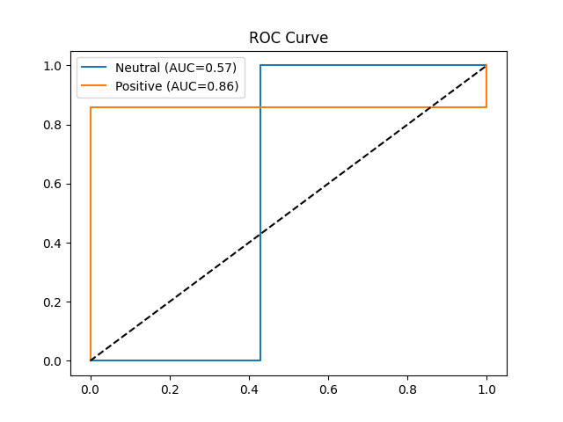
ROC Curve for Sentiment Classification

Slide 7
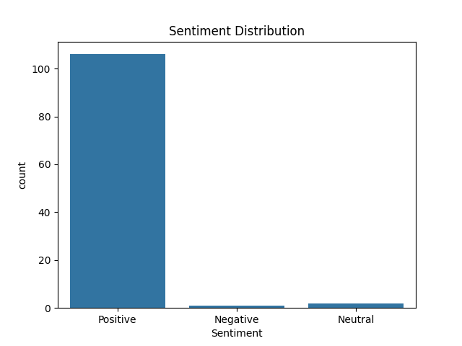
Sentiment Distribution (Histogram)

Slide 8
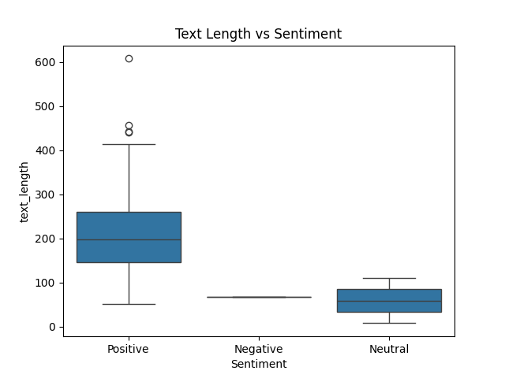
Text Length vs Sentiment (Boxplot)

Slide 9
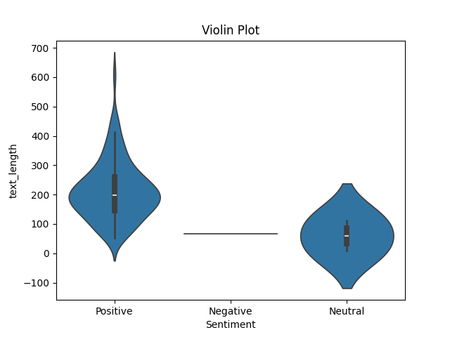
Text Length Distribution (Violin Plot)

