Slide 1

























LIVE LIKE YOU MEAN IT
Designing Spaces for a
Brighter
Tomorrow
Thoughtful Design | Premium Materials
Quality Execution | Homes That Last
Client Details
Client Name
:
Mr. Aravindan
Phone No
:
7418414780
Location
:
Individual Villa Adyar
Date
:
10/10/2026
Architect Details
Architect Name
:
Mr. Abishek
Phone No
:
93611 84787
Email ID
:
designs.cookscape@gmail.com
PERSONALIZED DESIGN
PREMIUM MATERIALS
QUALITY WORKMANSHIP
HOMES
THAT LAST

Slide 2


Slide 3


Slide 4
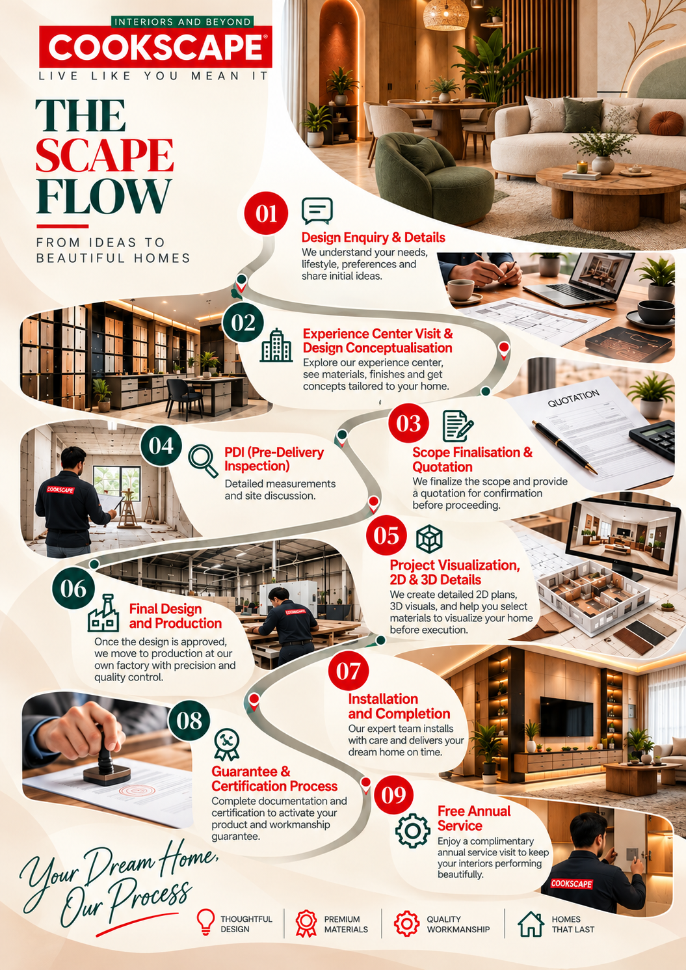


Slide 5


Slide 6
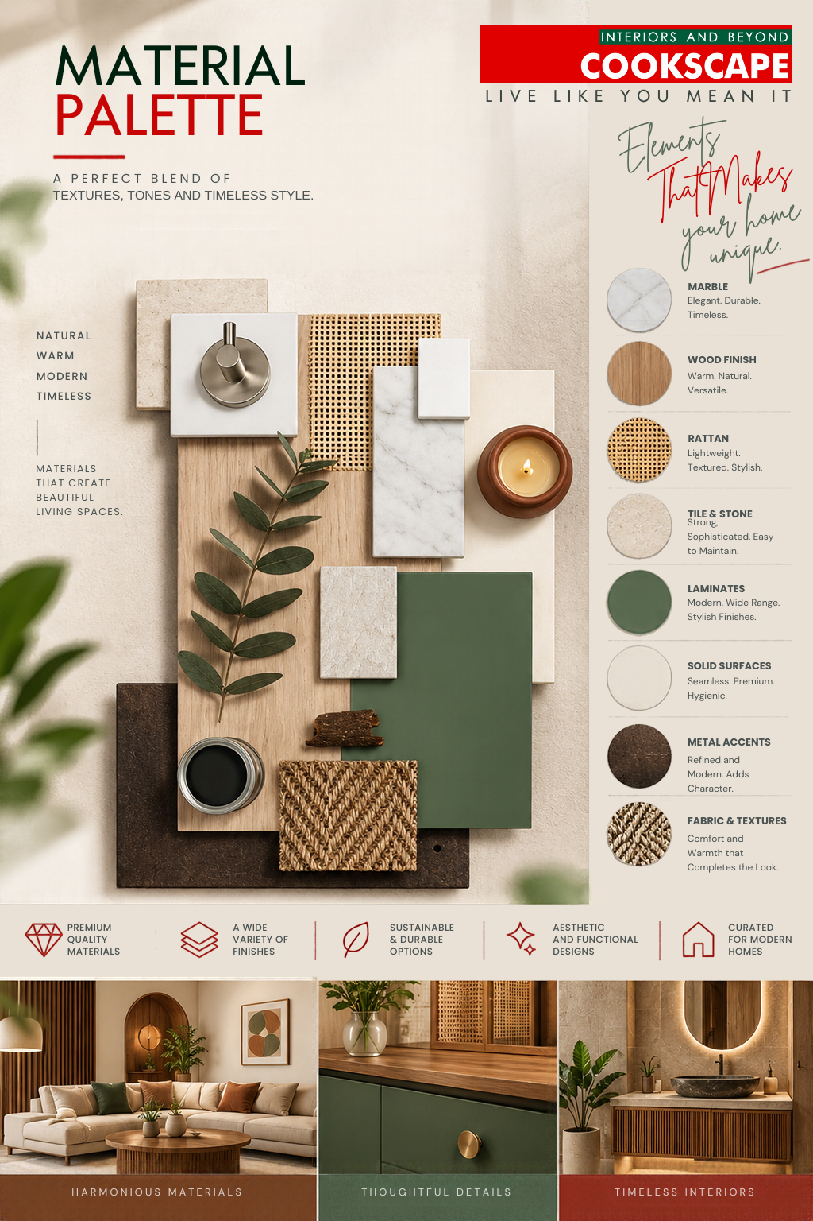

Slide 7
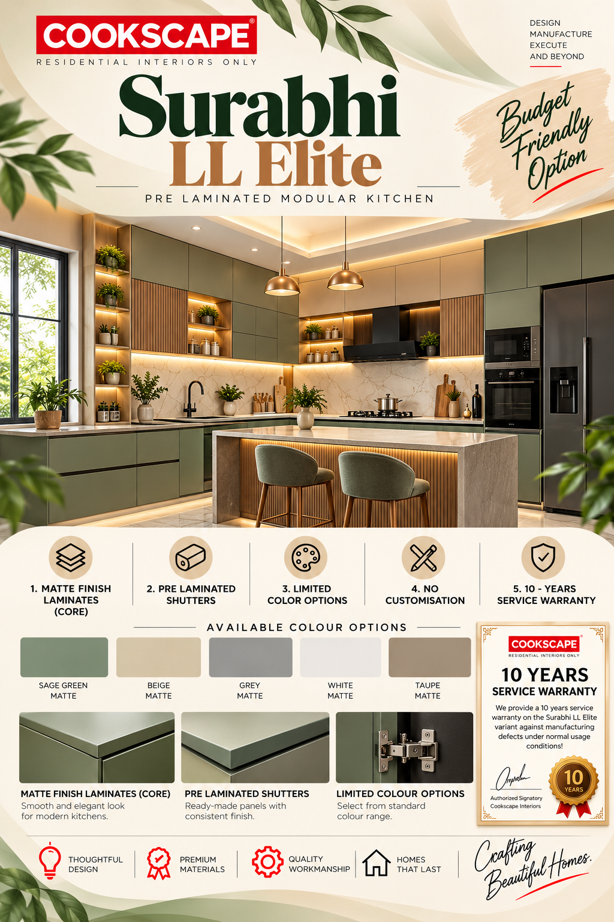
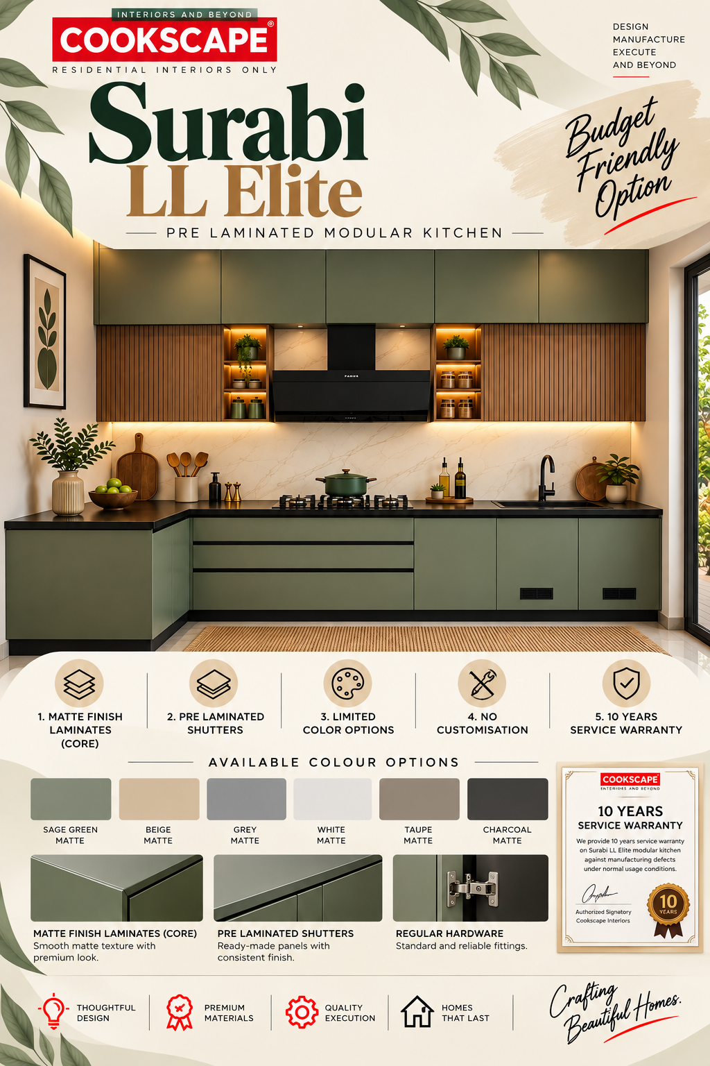
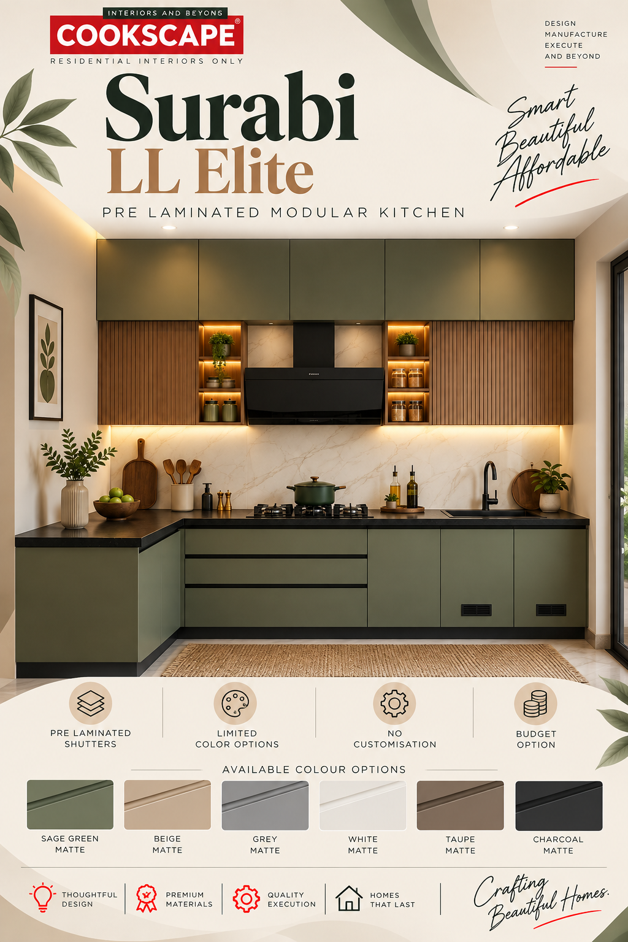




Slide 8
SURABHI - LL ELITE
Kitchen Specification | Details
Carcass Material | Marine Ply , BSL -BWR
Carcass Finish | Frosty White
Shutter Finish | Solid laminate colours, Prelam Aqua Shield-MDF-Clr-BSL
Shutter Material | Hydroguard Plus HDF, Prelam Aqua Shield-MDF-Clr-BSL, Commercial Ply, Aqua Shield-MDF-R, MDF
Handles | Dual Switch EBCO
Hardware and Accessories | Tyrox
Handles | Tyrox_CH-15060_160 NB_Nickel Brush_160mm, Tyrox_CH-15061_96 NB_Nickel Brush_96mm
Finish: | Nickel Brush
Wardrobe Specification | Details
Carcass Material | Prelam Aqua Shield MDF-R, PLHMR - BSL -HYH
Carcass Finish | Frosty White
Shutter Finish | Solid laminate colours, Prelam Aqua Shield-MDF-Clr-BSL
Shutter Material | Hydroguard Plus HDF, Prelam Aqua Shield-MDF-Clr-BSL, Commercial Ply, Aqua Shield-MDF-R, MDF
Handles | Dual Switch EBCO
Hardware and Accessories | Tyrox
Handles | Tyrox_CH-15060_160 NB_Nickel Brush_160mm, Tyrox_CH-15061_96 NB_Nickel Brush_96mm
Finish: | Nickel Brush

Slide 9
SURABHI - LL ELITE
Quotation

Slide 10
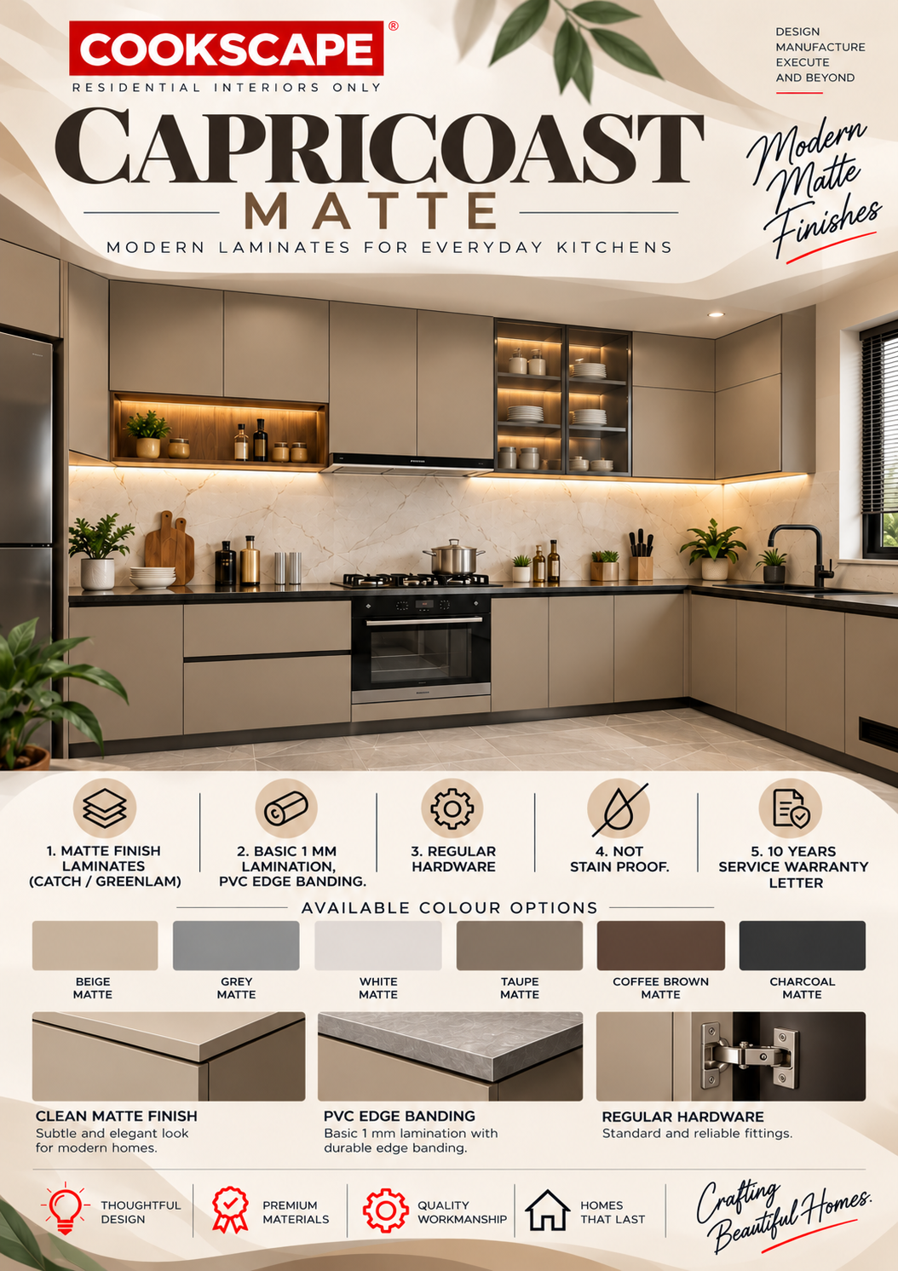

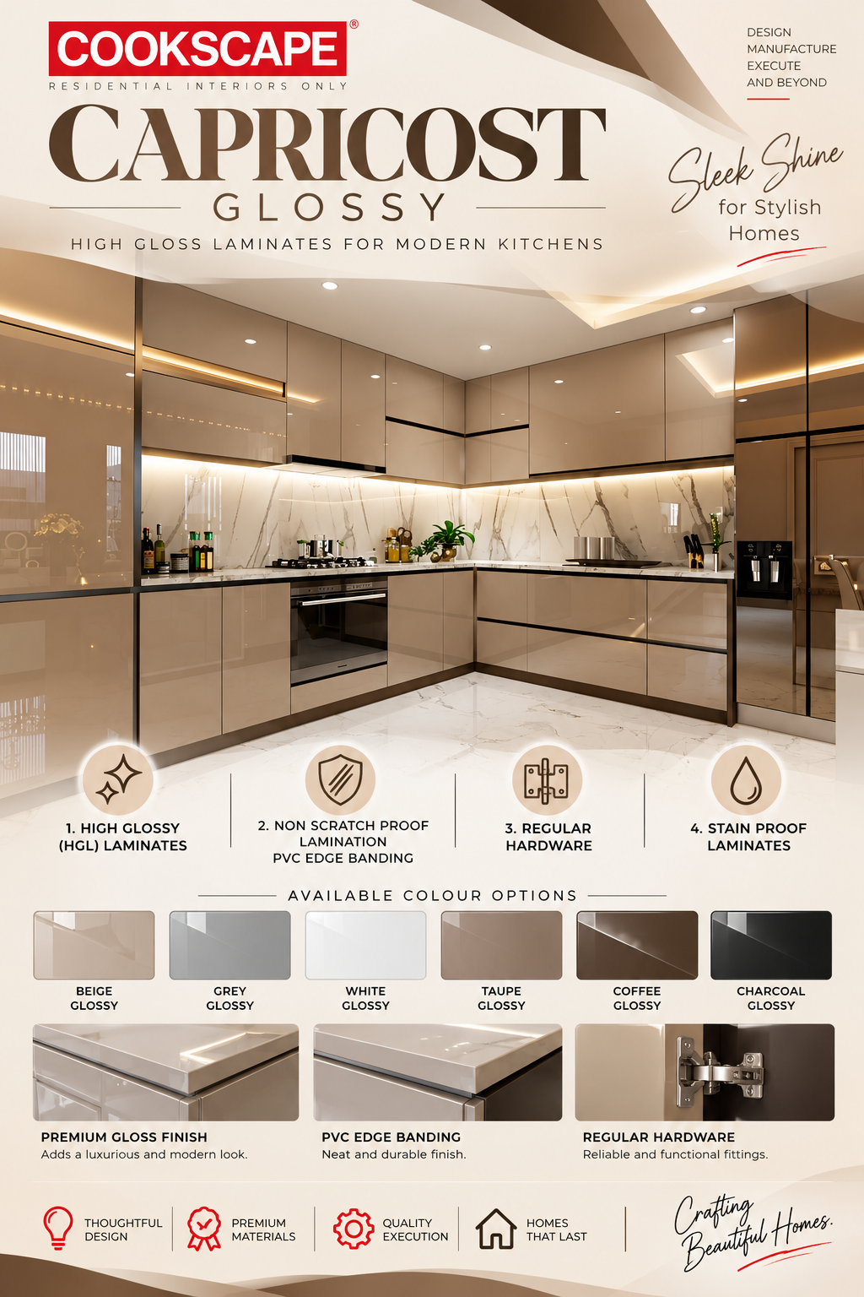

Slide 11
CAPRICOAST MATTE
Specification | Details
Carcass Material | GREENPLY BWP 710 Grade
Shutter Finish | Matte Finish Laminate
Shutter Material | (HDHMR) / GREENPLY BWP 710 Grade
Primary Hinges | EBCO
Hanger-rods | Multi Profile Hanger HD Rods - EBCO
Wardrobe Locks | Dual Switch EBCO
Leg & Wall Bracket | ABS / Adjustable
Sliding Track | CNR Brand with a Two Way sliding system
Lift Up Piston | HETTICH / BLUM (15 KGS)
Screws & Clamps | HP Screws / Self threading Type
Skirting | Matching Shutter Finish Skirting
Mirrors & Glass | 4mm Saint Gobain
Installation Process | Self-Drilling Screws with Screw caps
Installation Duration | 4 Weeks (may increase if the scope includes Civil, Electrical work)
Inclusive in Cost | Installation and Transportation
Taxes | Prices Excludes GST
Laminate Pasting Process | Machine Pressed Lamination
Throughfeed Edge Banding | Machine Edge Banding
Edge Banding | Regular PVC Edge Banding
Adhesives | Fevicol SR
HOT MELT Adhesive | Pidilite / SR
Customization | Available for Inner Partition is available at an additional cost
Additional Process | -
Laminate / Facia Brand | CATCH / New Mica
Hardwares & Utilities | EBCO
Kitchen Accessories | HETTICH / EBCO
Production Timeline | 4 Weeks from Physical Sign Off On The Colour Drawing

Slide 12
CAPRICOAST MATTE
Quotation

Slide 13
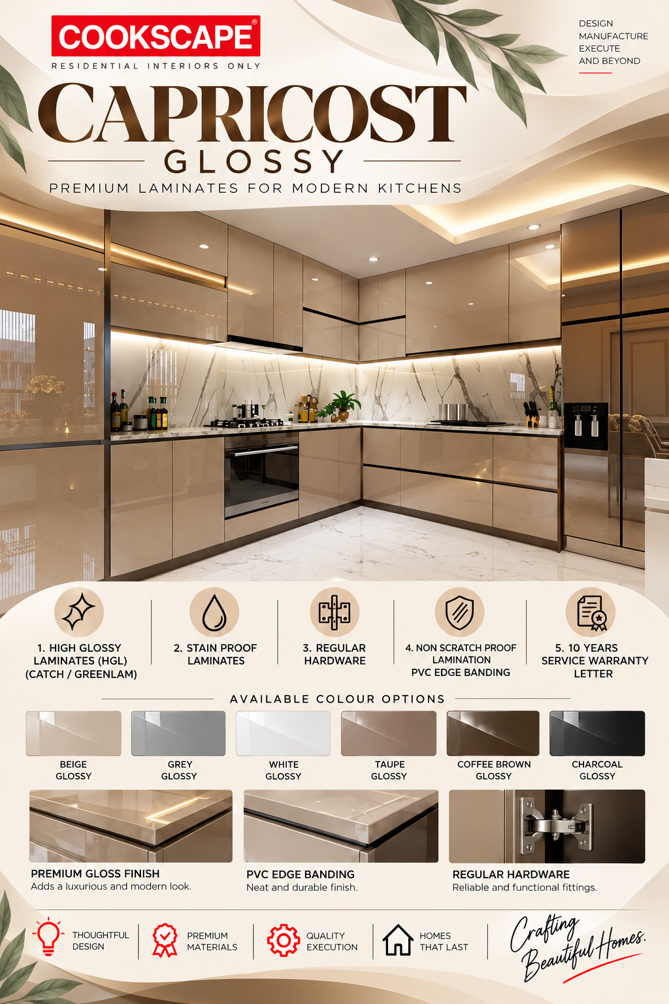


Slide 14
CAPRICOST GLOSSY
Specification | Details
Carcass Material | GREENPLY BWP 710 Grade
Shutter Finish | GLOSSY Finish Laminate (HGL)
Shutter Material | High Density High Moisture Resistant Boards (HDHMR)
Primary Hinges | EBCO (12 kg)
Hanger-rods | Multi Profile Hanger HD Rods - EBCO
Wardrobe Locks | Dual Switch EBCO
Leg & Wall Bracket | ABS / Adjustable
Sliding Track | CNR Brand with Two Way sliding system
Lift Up Piston | BLUM / HETTICH 15 Kgs Load
Screws & Clamps | HP Screws / Self threading Type
Skirting | Matching Shutter Finish Skirting
Mirrors & Glass | 4mm Saint Gobain
Installation Process | Self-Drilling Screws with Screw caps
Installation Duration | 4 Weeks (may increase if the scope includes Civil, Electrical work)
Inclusive in Cost | Installation and Transportation
Taxes | Prices Excludes GST
Laminate Pasting Process | Machine Pressed Lamination
Throughfeed Edge Banding | Hot melt Glue Machine Edge Banding
Edge Banding | Regular PVC Edge Banding
Adhesives | FevicolSR
HOT MELT Adhesive | Pidilite / SR
Customization | Available for Inner Partition is available at an additional cost
Additional Process | -
Laminate / Facia Brand | CATCH / New Mica
Hardwares & Utilities | EBCO (12 kg) / All Regular Hinges only
Kitchen Accessories | HETTICH / EBCO
Production Timeline | 4 Weeks from Physical Sign Off On The Colour Drawing

Slide 15
CAPRICOST GLOSSY
Quotation

Slide 16
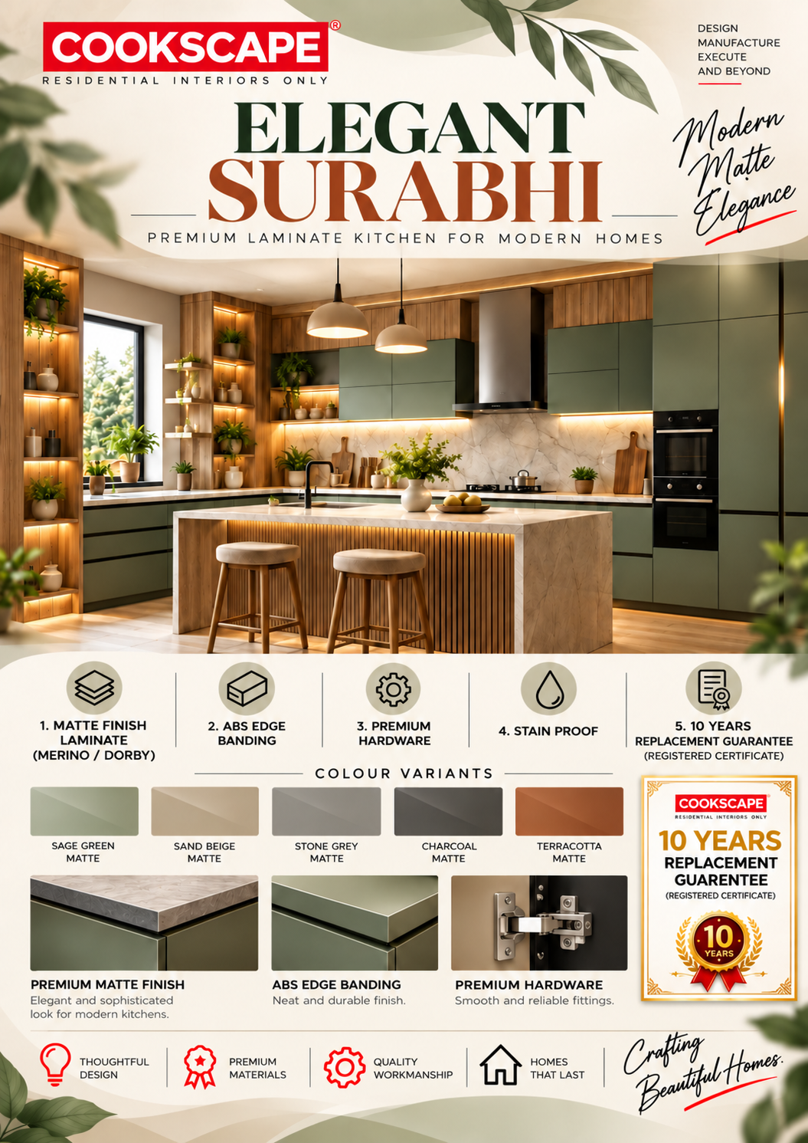



Slide 17
ELEGANT SURABHI
Specification | Details
Carcass Material | GREENPLY BWP 710 Grade with both side Laminate
Shutter Finish | SUPER Matte Finish Laminate – 1mm (Branded)
Shutter Material | BWP 710 Grade GURJAN Ply / GREENPLY HDHMR
Primary Hinges | HETTICH | EBCO (12 kg)
Hanger-rods | Multi Profile Hanger HD Rods - EBCO
Wardrobe Locks | Dual Switch EBCO
Leg & Wall Bracket | ABS / Adjustable
Sliding Track | CNR Brand with Two-Way slide
Lift Up Piston | BLUM / HETTICH 15 Kgs Load
Screws & Clamps | HP Screws / Self threading Type
Skirting | Matching Shutter Finish Skirting
Mirrors & Glass | 4mm Saint Gobain
Installation Process | Self-Drilling Screws with Screw caps
Installation Duration | 4 Weeks (may increase if the scope includes Civil, Electrical work)
Inclusive in Cost | Installation, Transportation includes Packing & Unloading
Taxes | Prices Excludes GST
Laminate Pasting Process | Machine Pressed Lamination
Through feed Edge Banding | Hot melt Glue Machine Edge Banding
Edge Banding | E3 Brand / PVC / Rehau
Adhesives | SYNTHETIC ADHESIVE Grade: LK453
HOT MELT Adhesive | ANABOND - SU2710
Additional Process | Ext. Grading, Fungus - Resistant Spray Coating, Multi Boring on Ply
Customization | Available for Inner Partition is available at an additional cost
Shutter Material | GREENPLY HDHMR OSR For Glossy / SF Matte laminates
Laminate / Facia Brand | MERINO LAM SF, RH Series / New Mica
Hinges Grade | Grade 1 Soft closing for kitchen , Auto & Soft close for Wardrobes
Kitchen Accessories | HETTICH, HAFELE, EBCO as per the client preference
Production Timeline | 45 Days from Physical Sign Off On The Colour Drawing

Slide 18
ELEGANT SURABHI
Quotation

Slide 19
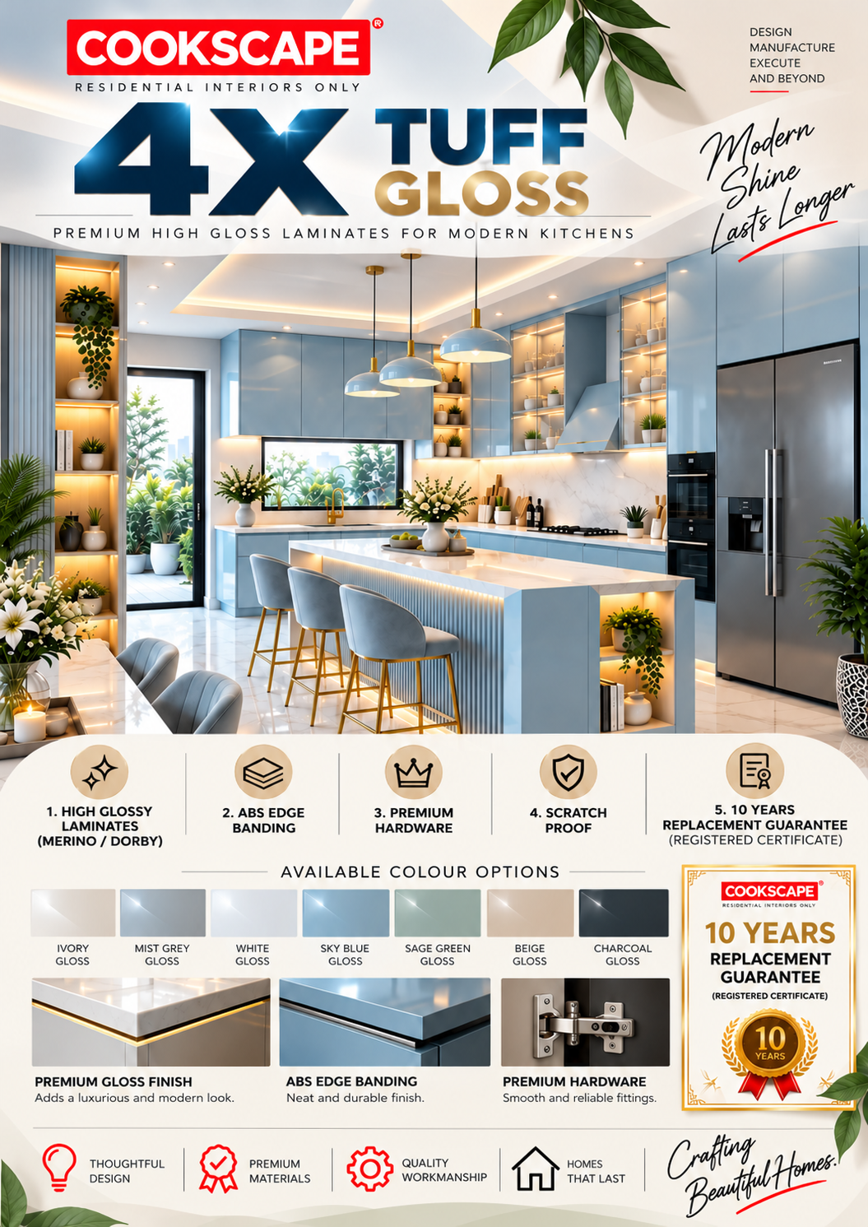

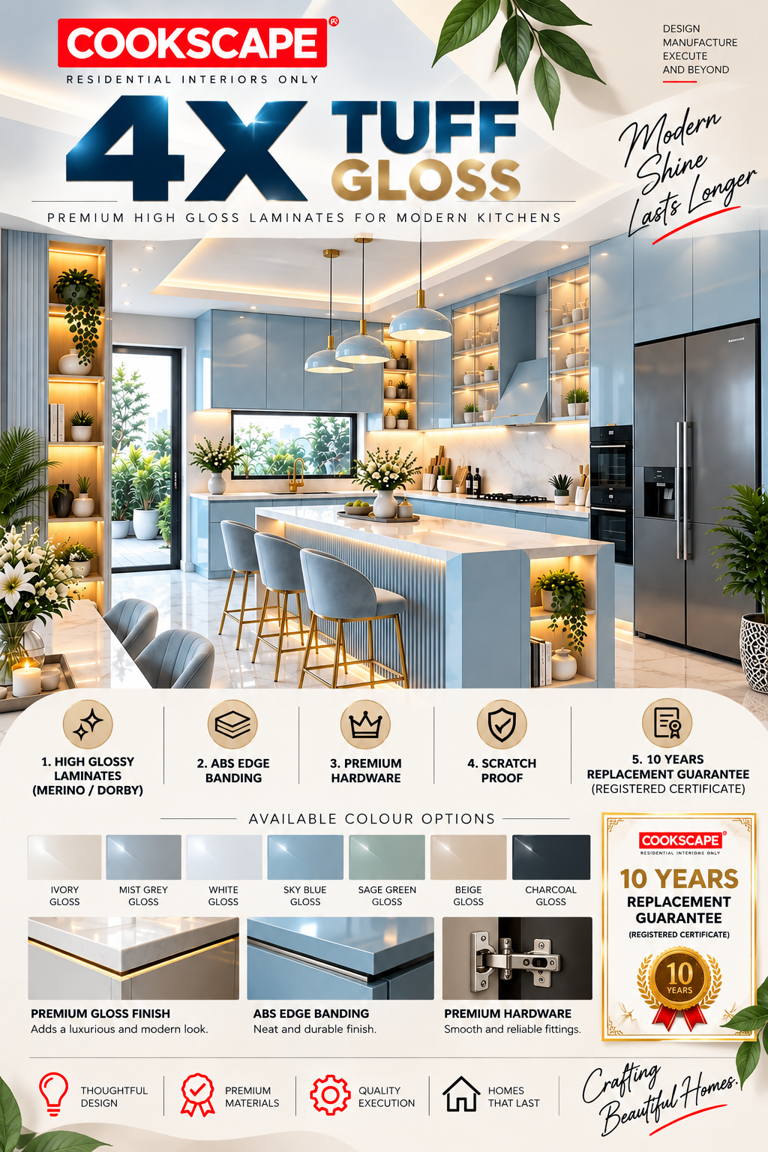

Slide 20
4X TUFF GLOSS
Specification | Details
Carcass Material | GREENPLY BWP 710 Grade
Shutter Finish | GLOSSY - SCRATCH & STAIN PROOF
Shutter Material | BWP 710 Grade GURJAN Ply / GREENPLY HDHMR
Primary Hinges | EBCO (12 kg)
Hanger-rods | Multi Profile Hanger HD Rods - EBCO
Wardrobe Locks | Dual Switch EBCO
Leg & Wall Bracket | ABS / Adjustable
Sliding Track | CNR Brand with Two Way sliding system
Lift Up Piston | BLUM / HETTICH 15 Kgs Load
Screws & Clamps | HP Screws / Self threading Type
Skirting | Matching Shutter Finish Skirting
Mirrors & Glass | 4mm Saint Gobain
Installation Process | Self-Drilling Screws with Screw caps
Installation Duration | 4 Weeks (may increase if the scope includes Civil, Electrical work)
Inclusive in Cost | Installation and Transportation
Taxes | Prices Excludes GST
Laminate Pasting Process | Machine Pressed Lamination
Throughfeed Edge Banding | Hot melt Glue Machine Edge Banding
Edge Banding | E3 Brand / PVC
Adhesives | SYNTHETIC ADHESIVE Grade: LK453
HOT MELT Adhesive | ANABOND - SU2710
Additional Process | Ext. Grading, Fungus - Resistant Spray Coating, Multi Boring on Ply
Customization | Available for Inner Partition is available at an additional cost
Shutter Material | GREENPLY HDHMR OSR For Glossy / SF Matte laminates
Laminate / Facia Brand | Merino MR+ / Royal Touche GLOSS
Hinges Grade | Grade 1 Soft closing for kitchen & Auto close for Wardrobes
Kitchen Accessories | HETTICH Brand
Production Timeline | 45 Days from Physical Sign Off On The Colour Drawing

Slide 21
4X TUFF GLOSS
Quotation

Slide 22
DESIGN PROCESS AND TIMELINES
A structured design journey covering concept development, material selection, 3D visualization, and final approvals. Each stage is planned with a clear timeline to ensure smooth execution and timely project delivery.
1.Project Onboarding & Design Initiation
The design phase commences upon receipt of the initial 10% advance payment. A dedicated Design Lead will be assigned to manage project coordination, design discussions, and approvals throughout the process.
2.Design Stages & Review Meetings
Our design process is structured into two key phases to ensure clarity, collaboration, and timely decision-making throughout your project.
Stage 1 – Design Development & Approval
During this phase, our design team will collaborate with you to finalize layouts, material selections, finishes, colours, and overall design concepts. The proposed designs will be reviewed through scheduled discussions, and upon approval, the project will proceed to the next stage.
Stage 2 – Technical Drawings & Design Sign-Off
Detailed production drawings and execution documents will be prepared following design approval. The final project scope, specifications, and project value will be confirmed during this stage. A 35% payment and formal Design Sign-Off are required before the project is released for production and execution.
3.Design Timelines
The estimated design timeline may vary based on project complexity, design revisions, and the availability of clients for review meetings and approvals.
Timelines are subject to timely client feedback, approval schedules, and availability for design discussions. Delays in approvals or revisions may impact the overall design schedule.
Project Type | Estimated Timeline
2 BHK | 5-7 days
3 BHK | 7-10 days
4 BHK | 10-20 days
LUXURY VILLA & HIGH END DESIGN | 30 days

Slide 23
EXECUTION PROCESS AND TIMELINES
A structured design journey covering concept development, material selection, 3D visualization, and final approvals. Each stage is planned with clear timelines ensuring smooth execution and timely project delivery.
1.Commencement of Execution
Following Design Sign-Off, the approved drawings and specifications will be released for production. As all design selections and project requirements are finalized at this stage, no further changes will be permitted once manufacturing begins. Any exceptional requests may be subject to additional costs and timeline revisions.
2.Production & Quality Checking Process
The production phase is scheduled for 45 working days, Which will be followed by a detailed Quality Control (QC) inspection. If any rework is required to meet approved quality standards, an additional 7 working days may be necessary for rectification and final approval.
A 40% payment is due upon QC clearance and before material dispatch to the project site.
3.Installation Timelines
Installation begins upon successful delivery of materials to the project site and may vary based on project scope and site readiness. Timelines are subject to uninterrupted site access, civil readiness, utility availability, and timely client approvals.
4.Project Monitoring, Walkthrough & Quality Inspection
A dedicated Application Engineer (AE) will be assigned to oversee the execution and installation process.
The Application Engineer (AE) will be responsible for:
I. Regular Site Inspections & Monitoring
II. Daily Site Updates & Coordination
III. Weekly Progress Reports
IV. Quality Checks During Execution
V. Final Project Inspection, Snag List & Walkthrough
VI. Completion Report & Handover Documentation
VARIANTS | Estimated Timeline
SURABHI LL ELITE | 15 Working Days
CAPRICOAST VARIANTS | 30 Working Days
SURABHI / MR+ &VENEER | 45 Working Days
TRADITIONAL / VANITY / IRIS | 60 Working Days

Slide 24
INCLUSION & EXCLUSION POLICY
INCLUDED IN SCOPE | EXCLUDED / CHARGED EXTRA
Mirrors, handles, drawers, wardrobe locks, tower bolts, and skirting | Appliances, hob, chimney, sink, granite, dado tiles
Packing and Shipment charges are included Orders above ₹1.5 Lakh | Demolition, civil works, electrical and plumbing works
Local transportation, Loading and Unloading are included | Outstation transportation charges
Installation, Alignment, Woodwork and Thinner Cleaning are included | Outstation labour, boarding charges
Quality Control and Inspection are included | Bathroom utilities and fittings
Project certification included | GST as applicable
No hidden charges within approved scope | Special handles and premium accessories
Soft-close and auto-close hardware for eligible kitchen models | Additional shelves beyond approved design
Standard hinges for wardrobes and other units | Additional mirrors beyond approved scope
Wardrobe locks included | Wall pelmets and decorative additions
Approved design and manufacturing scope | Locks for units other than wardrobes
Implementation of the Final approved layout | Design changes, alterations, or additions requested during installation

Slide 25
PAYMENT TERMS AND WORK STAGES
STAGE | % | DETAILS
Project Consultation & Estimation | 0% | Initial requirement gathering and design consultation. Site assessment and project feasibility discussion. Variants, material options, finishes, and budget alignment. Preliminary scope definition and budgetary estimate.
Project Booking & Design Initiation | 15% | Confirmation of project engagement. Detailed site measurement and technical assessment. Design development discussions and layout planning. Selection of finishes, colours and accessories. Presentation of conceptual 3D visualizations and design proposals for approval.
Design Approval & Production Release | 35% | Release of approved designs for manufacturing and production. Procurement planning and production scheduling commence. No modifications to the approved designs, dimensions, or specifications shall be permitted after this stage.
Production Completion & QC Clearance | 40% | Completion of manufacturing activities. Comprehensive Quality Control (QC) inspection of all materials and components. Approval for dispatch from the Factory to the project site. Payment due before material dispatch and commencement of site installation.
Installation Completion & Handover Stage | 10% | Completion of modular woodwork installation at the site. Final payment is due before the installation of accessories, hardware and finishing elements. The project proceeds to the final quality inspection, and handover process. A 10 - Years Guarantee Certificate will be provided, For Applicable Variants.

Slide 26
TERMS & CONDITIONS
1. Builder & Site-Related Delays:
Cookscape shall not be responsible for delays arising from builder-related activities, pending civil works, Pending Plumbing and Electrical Works, site readiness issues or other third-party dependencies. Any such delays may affect the overall project timeline.
2. Payment-Linked Material Supply:
All materials shall be invoiced prior to dispatch. Procurement, Production, Quality Certification and dispatch the installation activities are subject to the receipt of the respective payment as per the agreed payment schedule.
3. Additional Transportation & Labour Charges:
Once the Order (has been released for production), any additional orders, scope enhancements, or revisions beyond the approved proposal may incur additional transportation, logistics, and labor charges.
4. Dispatch, Invoicing & E-Way Bill Compliance:
Materials shall be dispatched only against valid invoices and statutory documentation, including E-Way Bills wherever applicable. Dispatch schedules are subject to payment clearance.
5. Final Material Dispatch Policy:
All the project material shall be supplied in accordance with the agreed payment schedule. Cookscape reserves the right to withhold dispatch of material against outstanding payments.
6. Accessories, Hardware & Finishing Components:
Accessories, hardware fittings, appliances, and décor elements form an integral part of the project and shall be supplied and installed upon clearance of the applicable payment milestone.
7. Scope Variations:
Any addition, deletion, design revisions, material upgrades, or scope changes requested after approval of the drawings may result in revised costs and timelines and shall be executed only after mutual approval.
8. Cancellation & Refund Policy:
In the event of project cancellation, booking advances and amounts paid towards site measurements, design development, working drawings, 3D visualizations, and production planning shall be non-refundable.

Slide 27
9. Quality & Handover:
Cookscape maintains stringent quality standards throughout project execution. Clients are encouraged to communicate any concerns identified during the final inspection or handover process to ensure prompt resolution.
FREQUENTLY ASKED QUESTIONS (FAQS)
1.What exactly is included in the quoted price?
The quoted price includes Design services, PDI, woodwork related materials, Hardware, manufacturing, Transportation, installation, Supervision, Inspection and services work specifically mentioned in the quotation.
2.How long is this quotation valid?
This quotation is valid for 15 days from the date of issue unless otherwise specified. Prices may be revised after the validity period due to market fluctuations in material and labor costs.
3.How is the total project cost calculated?
The total project cost is calculated based on the approved design, material specifications, project scope, installation work, and site conditions.
4.Are design services and drawings included in the quotation?
Yes. Design consultation, space planning, and relevant drawings are included in accordance with the scope defined in the quotation.
5.Can the design be modified after final approval?
Minor modifications may be accommodated before production begins. Significant design changes after approval may impact project cost and timeline.
6.Can additional requirements be added during project execution?
Yes. Additional requirements can be incorporated through a variation order process, subject to feasibility, revised pricing, and timeline adjustments.
7.What materials, brands, and finishes will be used for my project?
All materials, brands, and finishes will be selected in accordance with the approved specifications and material schedule provided during the design stage.
8.Will I receive material samples before production begins?
Yes. Material samples, finish swatches, or references will be shared for approval wherever applicable before production commences.

Slide 28
9.Can materials or finishes be upgraded after project confirmation?
Yes. Material or finishes can be upgraded during the loading stage. However , Once the order has been released for production no further changes can be accommodated.
10.Is GST included in the quoted amount?
GST is applicable as per prevailing government regulations. The quotation will clearly specify whether GST is included in the quoted amount or charged separately.
11.What is the estimated project completion timeline?
The estimated project timeline will be communicated based on project scope, design complexity, material availability, and site readiness.
12.When does the project timeline officially begin?
The project timeline officially begins upon receipt of the advance payment, final design approval, and confirmation of site readiness.
13.What factors could delay the project completion?
Project delays may occur due to design changes, delayed approvals, site readiness issues, material shortages, unforeseen site conditions, or other external factors beyond our control.
14.What is the payment schedule and payment structure?
Payments are generally structured in stages, including advance payment, production milestone payments, and final payment before handover. The detailed schedule will be specified in the quotation.
15.Are transportation and installation charges included in the quotation?
Transportation and installation charges are included for orders above 3 lakhs. Onsite Partitioning, Assembly of Space-saving furniture and Removal of existing units during renovation projects additional charges may be applied separately with the client’s approval.
16. Is Annual Maintenance Service Chargeable?
No, Annual maintenance service is provided free of charge for the first 10 years from the date of installation, subject to the terms and conditions specified in the guarantee services will be chargeable on a call-out basis.

Slide 29


