Slide 1
Data science for the modern exercise physiologist
Saving time and working efficiently:
The role of open science and computation

Slide 2
PURPOSE AND SCOPE
Success Story 1: How to save time in managing human data
Lots of the problems we face on a day-to-day basis are very similar
Incorporating ”computational thinking” into our process can save time, increase efficiency, and promote transparency
A couple of very simple examples of what has helped me, and what I think could help many of you (see link at the end for all code)
GOAL: This more clearly about where time could be saved and the possibility of human error reduced
Notes:
Thanks for the introduction Jason.
I'm going to talk about one success story using data science in the field of exercise physiology. It is a success story because the way of thinking, and the skills developed, enabled me to get a job at the end of my training, but also – and probably more importantly – it saves me countless hours and reduces the possibility for human error.
So, while we all work in different research areas, the process that we are involved with – from a data handling and analysis standpoint – are very very similar.
I am going to briefly talk about some examples of how using computational thinking and processes, and integrating open-science practices can and has made my life much easier, and I believe that the concepts introduced could and hopefully will help all of you.
In most cases I’m just going to be talking about automating tedious, but time consuming tasks, and removing the human error associated with data handling, analysis, and presentation.
I will try to avoid getting too much into code, but instead, I will try to explain a way of thinking that is required before you know the language (or code). If you go away from this talk thinking about where you are wasting time, by completing the same repetitive task, or where you think errors could creep into your work, then I will be happy. I’ll be even happier if you can imagine how data science and open science practices could help you there.

Slide 3
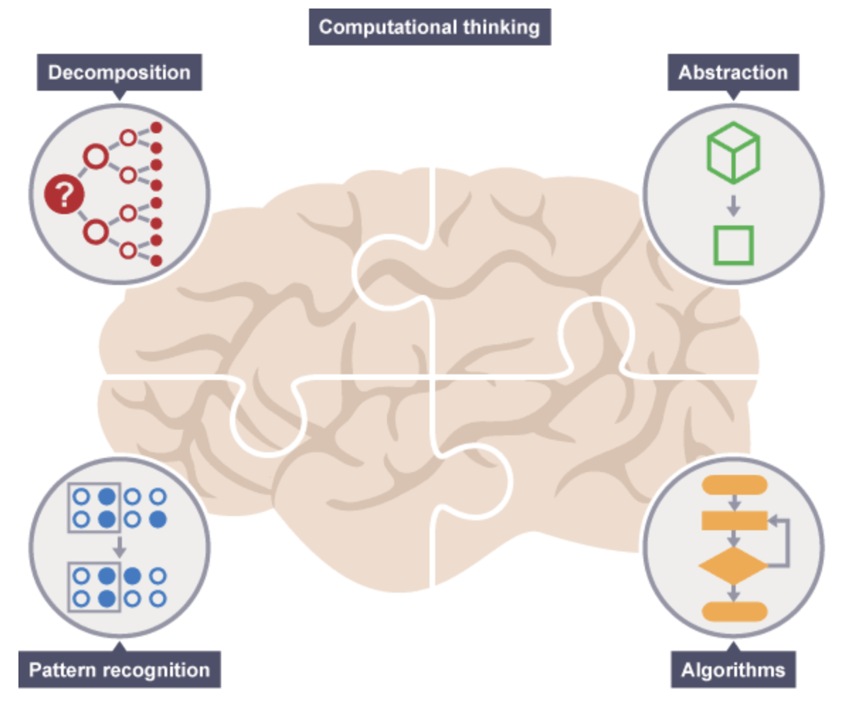
“Computational thinking”
Decomposition: breaking down a complex problem or system into smaller, more manageable parts
Pattern Recognition: recognizing similarities among and within problems [DRY principle]
Abstraction: focusing on important information only
Algorithms: step-by-step solutions/rules to solve the problem
https://www.bbc.co.uk/bitesize/guides/zp92mp3/revision/1
Notes:
So just to explain briefly what I mean by computational thinking. It is just a framework for a way of thinking that we are all likely involved in without realizing. However, it formalizes a way of thinking which is very much complementary to the topics we will introduce in this symposia.
This description is taken from the BBC site, and does a very good job of describing the four key elements.
Firstly, we are all exposed to complex problems, or problems which are made up of lots of smaller problems. Understanding and recognizing this is called decomposition.
Secondly, lots of the stuff we do is just the same thing over and over and over again. Pattern recognition simply relates to recognizing these patterns within and between problems.
Abstraction relates to stepping back and seeing the big picture to understand what is important besides the specific details.
While the term algorithms has lofty and complex associations, at its root it simply refers to a strategy or plan for solving a problems.

Slide 4
PROBLEMS
Problem 1: Time wasted and human error when collating, filtering, and pre-processing multiple data files related to the same study.
Problem 2: Time wasted, and human error when transferring descriptive or inferential statistics from an analysis file (excel/SPSS/R) to a word document.
Notes:
So we encounter problems every day that would be greatly benefited from applying some computational thinking. I will go through two very quickly, and hopefully the concepts introduced could get your creative juices flowing and you could see the endless possibilities here.
I’m going to go through two problems that relate to two very different areas which we spend a lot of time; handling and analysing data, and writing it up.

Slide 5
PROBLEM 1: files files files
My own example: 12 week crossover intervention (34 exercise bouts per intervention) with heart rate recorded every session.
816 csv files into one excel sheet = a monster!
Notes:
In my PhD I ran a 12 week crossover intervention with 12 individuals completing two interventions. Heart rate (among other things) was recorded for each of the 34 exercise bouts per intervention. This means that there was an upper limit of 816 exported HR files.
The size of the trial is not relevant, but the issue of many of the same files for a given study is a problem faced by us all. Similarly, this could relate to HR, but could also be metabolic cart, could be blood pressure, temperature, or anything else that is measured continuously or even non-continuously.
Now the way that I processed these files was to import them all into Excel, and then filter, subset, and clean the data. That process almost broke my Excel and laptop every time I opened the file.

Slide 6
PROBLEM 1: files files files
Decomposition:
Import the separate files
Identify what the data relates to (i.e., what participant? What trial?)
Combine the data to get descriptive stats/figures/prepare for analysis
Pattern Recognition:
The same process for every single file of the same type, and potentially of other types too (e.g., csv for HR, tab delim for skin temperature)
The same process for multiple different studies
Abstraction: Import files and combine
Notes:
If we apply a computational thinking lens to this problem, all it boils down to is the need to import a file, identify what the data relates to, and then combine it with the other files which are the same/similar.
So there is a pattern here, but it is also an issue which we encounter with every study that we run. With some of the more sophisticated software we can have one output for multiple different physiological inputs (i.e., one file contains all of the variables), but it is still a file per participant.
So it is a process which if we can automate, would save us a lot of time, now and in the future. Also, with all of that handling of data, there is the possibility of errors since we are only human.

Slide 7
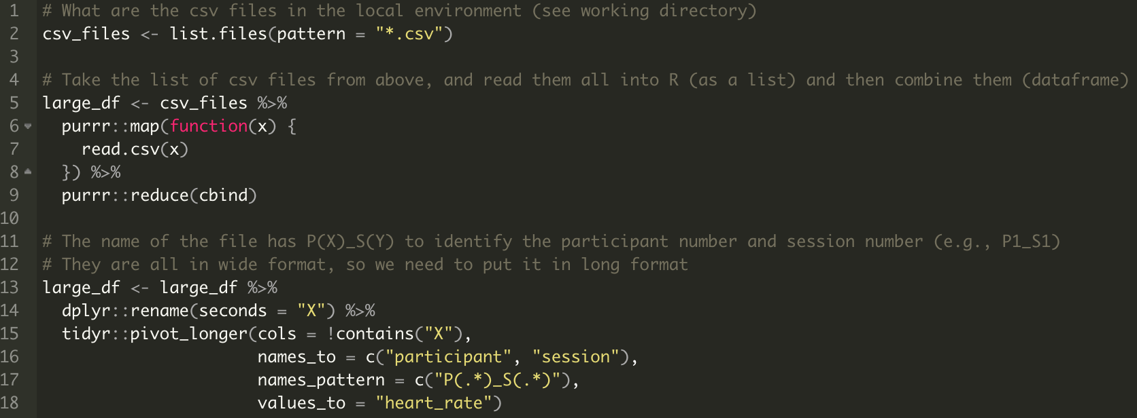
Algorithm:
Identify the files
One by one, import them all
and group them together
Identify what data relates to
what subject, and what trial
Notes:
So, we have understood the problem, and recognized the patterns of repetitive tasks.
If you can do this with your processes, then you only need the language to complete the algorithm.
The code on the screen equates to 12 lines of actionable code. This code completes the separate tasks that we have identified within the problem, and has saved me countless hours. The process in Excel took days, this codes takes seconds to run.

Slide 8
Related Problem: Human handling of data results in errors, lack of transparency, and routes for dishonest practices.
Writing all raw data to OSF (or Github/Gitlab etc) retains the integrity of the data and transparency of the process.
But also much faster!
Algorithm:
For every participant, and
Every session, group together
180 rows and take the mean
Notes:
A related issue here, is that to retain the integrity of our data, we should have a transparent and documented process of how we went from our raw data, to our statistical inferences.
I’m sure you all have files on your computer with _FINAL or _FINAL2 or _FINAL_FINAL, but if your PI or another researcher wanted to know how you got from your raw data to the final outcomes, it is exceedingly hard to trace.
Not only that, but we end up with so many un-necessary files in our systems, or tabs in our excel sheets, and often they just relate to processing of the data.
Instead, and ideally, we should have a log of everything that we have done with the data from its generation to the inferences made. This is where data science comes into its own. However, it is also much quicker to do.
In the example before, my HR files were sampled every second, and there was a warm up and cool down-period, but all I was interested in was the resting HR and the HR at the end of exercise.
In Excel, you could take the average of one, two, or three minutes, for every trial, and every participant, but this is time intensive, assumes that excel functions transfer from cell to cell, and results in another tab or another excel sheet entirely.
The same process is completed in seconds with 3 lines of code, and it means that our raw data stays untouched.

Slide 9
PROBLEM 2: EVER-CHANGING VALUES
Values change for legitimate reasons. Adjusting descriptive data or statistical outputs from one document to another is extremely time consuming, and again, introduces error in transcribing.
The PhD study previously described was going to be analyzed with a typical ANOVA. After consulting and working with a statistician my supervisor and I realized that a mixed model was more appropriate.
But now, all of the p values, point estimates, and Cis were going to change!

Slide 10
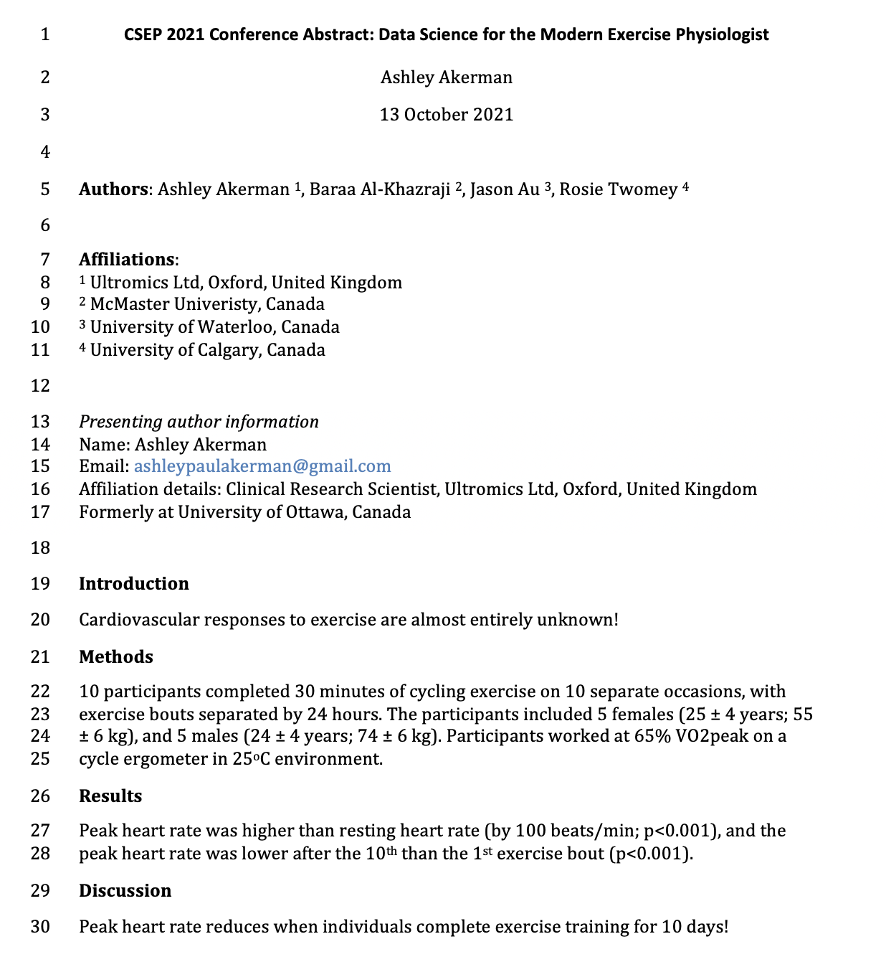
PROBLEM 2: EVER-CHANGING VALUES
Removing the need for a person to transcribe values from one program to another is extremely efficient, but often seen as a daunting task.
Once you have the grasp of R, using Rmarkdown is not that far away….

Slide 11
Thanks for your time and attention!
Email: ashleypaulakerman@gmail.com
Twitter: @AshleyAkerman
All code, related content, and slide available at: https://osf.io/skp56/
Generating hypothetical data
Writing data to OSF from R
Reading data from OSF to R
Batch processing similar files
Generating and writing to word from R (Rmarkdown)

