Slide 1
Stop Writing Slop
Automated Code Quality with Cursor
How AGENTS.md closes the AI feedback loop and builds a
self-correcting, production-ready code quality engine
github: cursor-quality-tricks

Slide 2
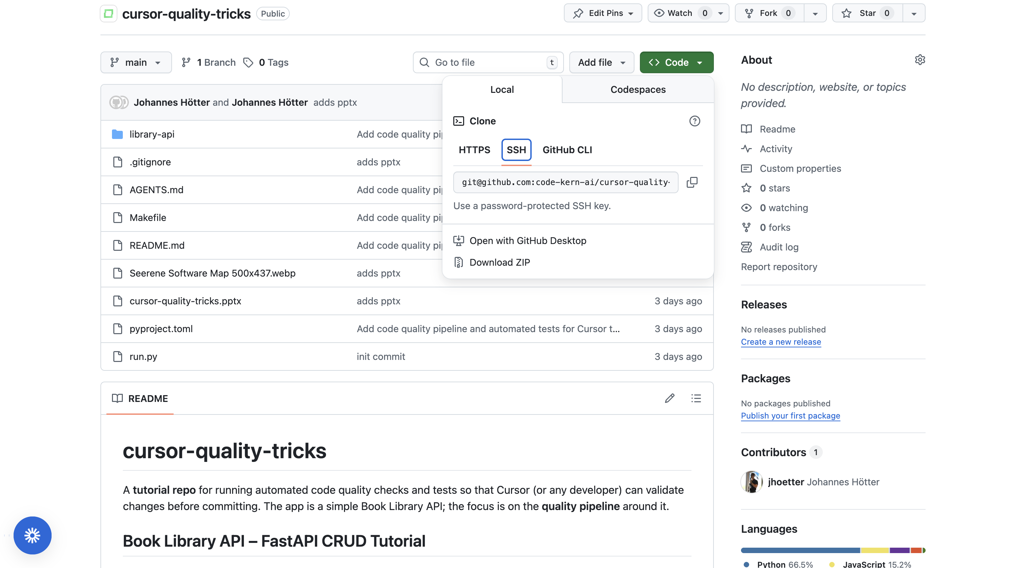

Slide 3
The Problem with AI-Generated Code
Without Automation
With AGENTS.md Automation
→ Manually ask: "please check the quality"
→ AGENTS.md defines which quality tools to run
→ Forget to ask → bugs slip through unnoticed
→ Cursor runs checks automatically at session end
→ Cursor has no defined standard for quality
→ Failures appear directly in the agent context
→ Each AI session is inconsistent and ad hoc
→ Cursor self-corrects before any code is committed
→ Tech debt piles up with every shortcut taken
→ Every session enforces the exact same standards

Slide 4
Automate code quality assurance with Unix + AGENTS.md
Tell Cursor what to check — every time, automatically.
AGENTS.md
# Agent instructions
AGENTS.md is a special instructions file that Cursor reads before every session. By specifying which tools to run and when, you embed quality enforcement directly into the agent — no manual prompting required.
# cursor-quality-tricks
## Quality and testing
Always run `make check`
before committing.
Do NOT commit if it fails.
1
Defines rules once — Agent reads these instructions every session
make check runs:
-> make lint (Ruff)
-> make format (Ruff)
2
Specifies exact tools — Lint, format, typecheck, complexity, tests
-> make typecheck (mypy)
-> make quality (Radon)
-> make test (pytest)
3
Enforces at session end — No human prompting needed — ever

Slide 5
The Quality Pipeline: make check
Five automated validation layers — all triggered by a single command, all visible to the agent
1
2
3
4
5
Lint
Format
Types
Complexity
Tests
Ruff
Ruff
mypy
Radon
pytest
Catches unused imports, style issues, and simple bugs. Enforces import order.
Enforces consistent code style — line length, quotes, and spacing throughout.
Finds type mismatches and missing annotations in all Python source files.
Cyclomatic complexity + maintainability index per function and per file.
CRUD, API endpoint, and model validation tests against in-memory SQLite.

Slide 6
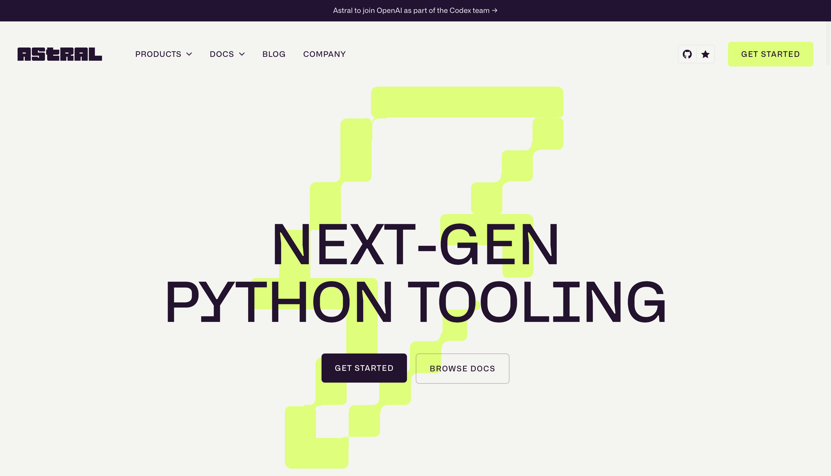

Slide 7
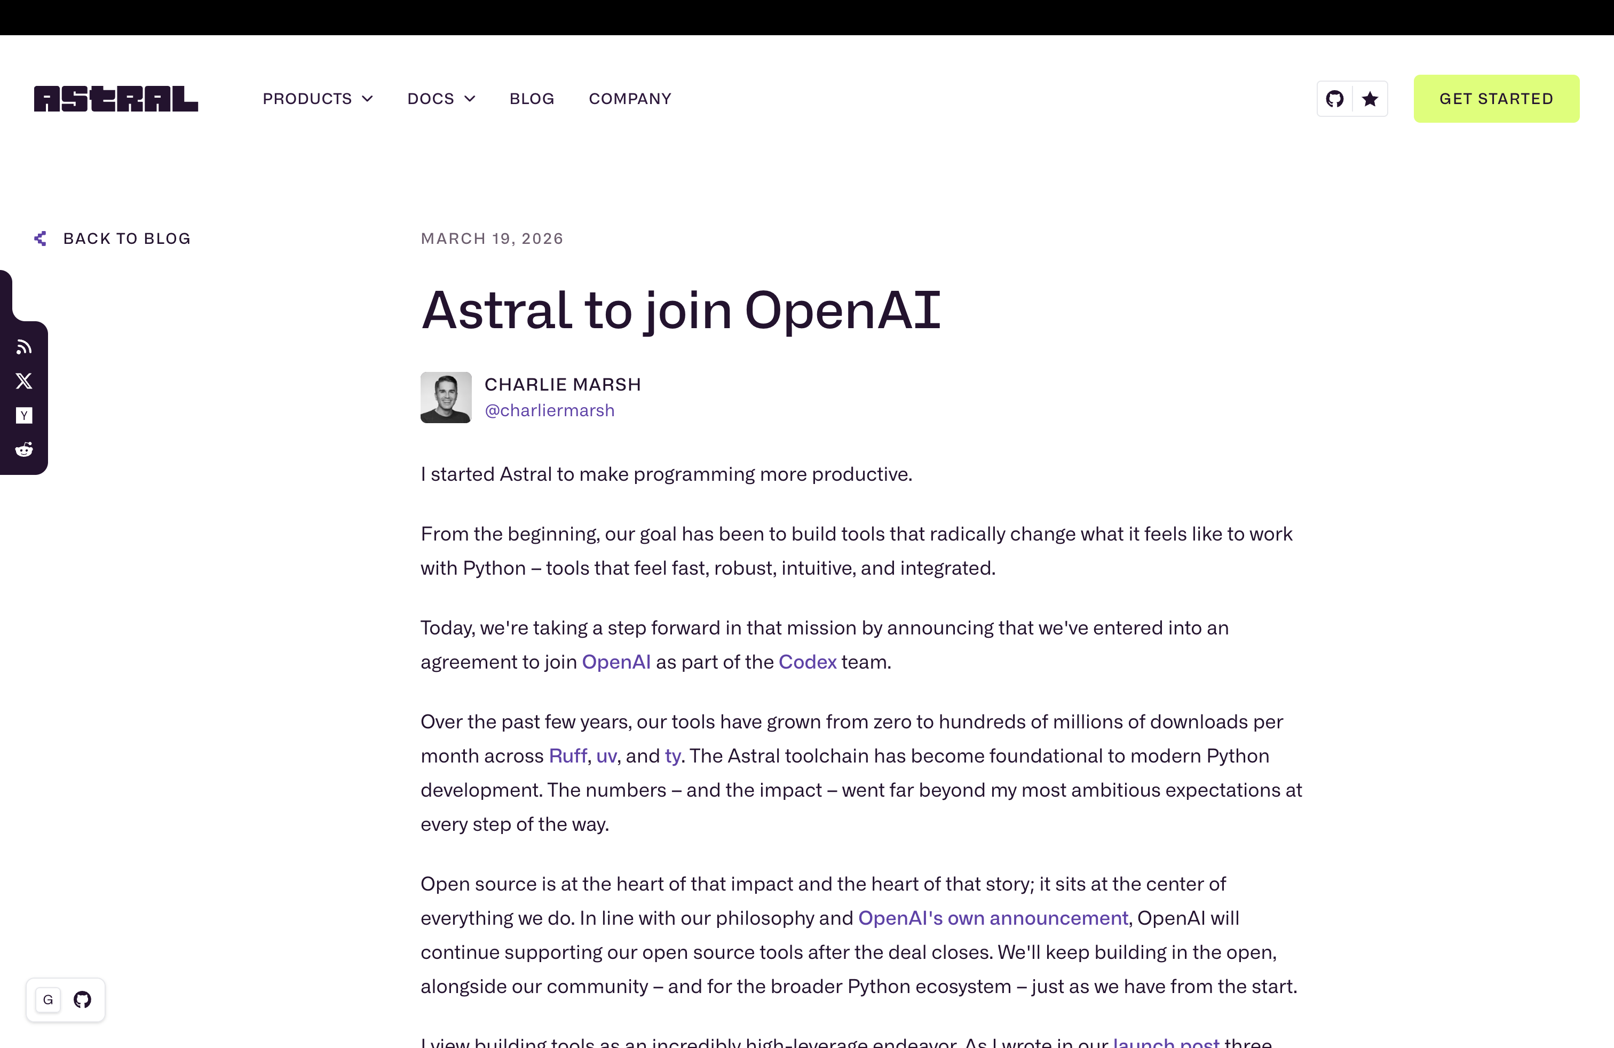

Slide 8
The Self-Correction Loop
Instead of "please check the quality" — Cursor sees failures and fixes them automatically
1
2
3
4
5
Write Code
Run make check
Read Output
Self-Correct
Re-run & Commit
Agent generates a new feature or logic from your prompt.
>
AGENTS.md tells Cursor to run the full pipeline automatically.
>
Lint errors, type failures, broken tests appear in context.
>
Agent traces back: "Did I break something in my changes?"
>
Pipeline turns green. Only then does Cursor commit code.

Slide 9
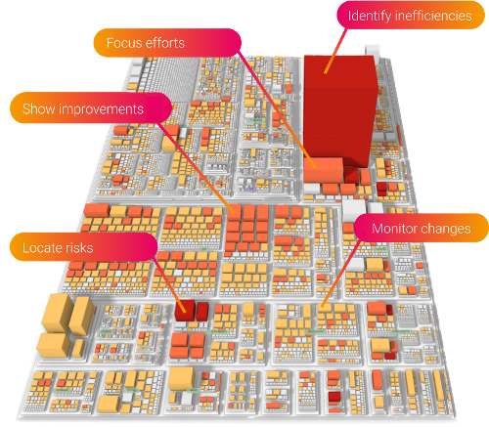
Code as a City: Visualizing Complexity
What does your codebase actually look like?
Software cities map your entire codebase into a 3D landscape. Every building is a module or function — and its height represents complexity.
Flat buildings
Small, focused functions — easy to test and change
Tall buildings
Growing complexity — needs refactoring attention
Skyscrapers
Warning: unmaintainable, high bug risk, tech debt
Goal: make check catches skyscrapers before they're committed
Source: Seerene Software Map — each building = a module, height = cyclomatic complexity

Slide 10
Why This Scales to Larger Projects
100%
0
5x
Sessions quality-gated
Manual QA prompts needed
Quality layers enforced
Consistent Standards
Smarter Code Generation
Larger Codebases Stay Clean
Every AI session enforces the same lint, type, complexity, and test rules. Quality is determined by your pipeline — not by how well you phrased your prompt.
When Cursor knows tests will run, it writes code that passes them. The agent is incentivised to generate cleaner, well-typed, modular code from the start.
Complexity checks (Radon) catch functions growing too large. With CI-style discipline enforced by the agent, even big projects remain maintainable over time.

Slide 11
Get Started: cursor-quality-tricks
Step 1 — Install & Run
Step 2 — Run the Pipeline
Step 3 — Teach Cursor
# from repo root:
# From repo root:
# AGENTS.md already configured:
pip install -r requirements.txt
make check
pip install -r requirements-dev.txt
"Always run make check
# Or individual steps:
before committing.
python run.py
make lint | make test
Do NOT commit if it fails."
# -> http://127.0.0.1:8100
make typecheck | make format
Book Library API starts with sample data seeded
Everything passes green on the first run
Point Cursor to AGENTS.md — it self-enforces quality

