Slide 1
Interfacing of 16X2 LCD module to AT89C51 of 8051 microcontroller.
By: Adeel Subhan (19I-1869)
Majid Ahmad (19I-1796)

Slide 2
Content
LCD Basics
LCD interfacing WORKING
LCD for interfacing with 8051 microcontroller
Algorithm
Uses

Slide 3
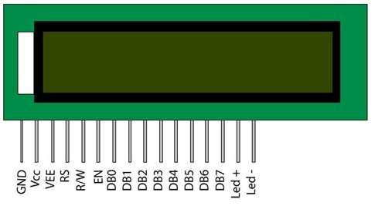
LCD Basics
16×2 Liquid Crystal Display. It can display 32 characters at a time in two rows. LM016L is a 16×2 LCD module.
Pin 4: RS (command register when low, data register when high)
Pin 5: R/W (high for read from register, low for write to the register)
Pin 6: EN (sends data to data pins when high to low pulse is given)
Pin 7-14: DB0-DB7 (8-bit data pins)

Slide 4
LCD interfacing WORKING
Data register: It is for placing the data which is to be displayed. Data can be any character, alphabet or number.
Command register: It is for placing the commands. There is a set of commands for LCD to perform specific tasks.

Slide 5
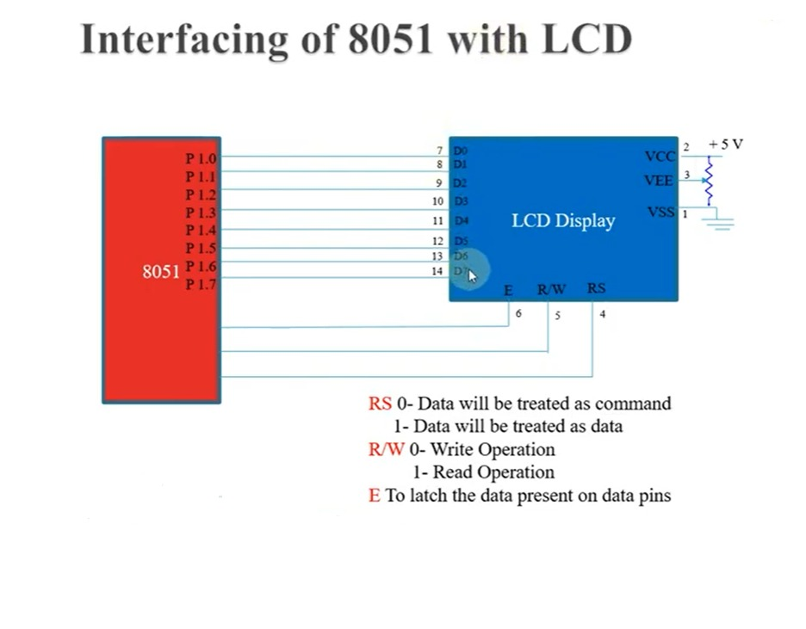
LCD INTERFACING WITH 8051 MICROCONTROLLER

Slide 6
Algorithm
Firstly, initialize all the ports.
Initialize the LCD to turn it ON and to a form that it is ready to accept commands.
Now command the LCD to write.
Display the contents using the required functions.

Slide 7
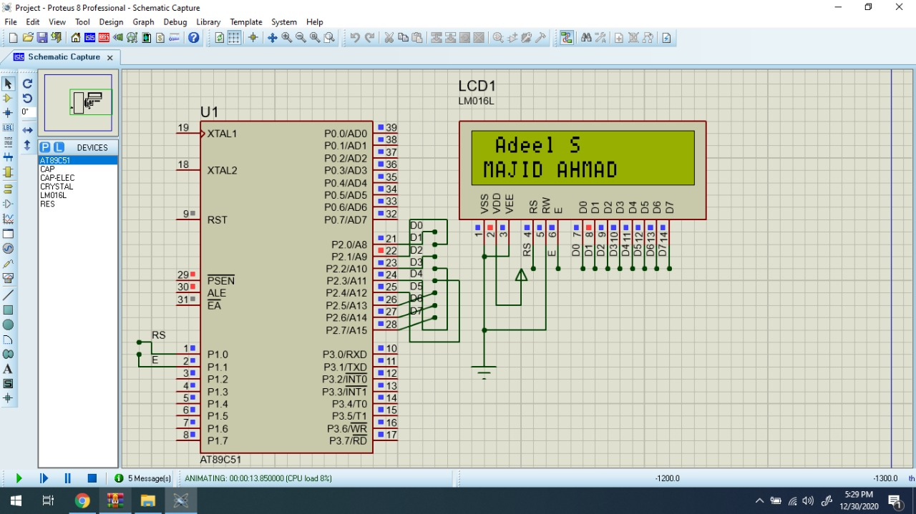
Output
Thus, interfacing LCD with AT89C51 and displaying characters was simulated using proteus with the help of keil. The result were visually verified using Run feature in proteus.

