Slide 1
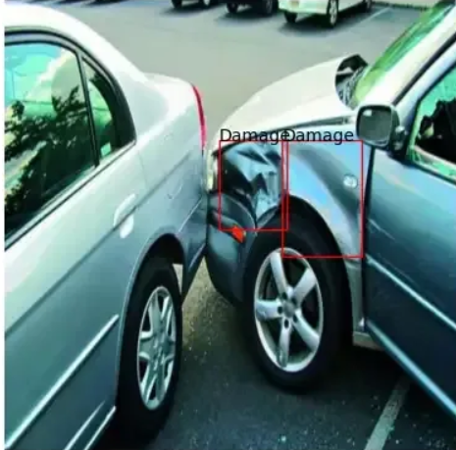
Car Damage Detection using AI
LINGARAJ APPA ENGINEERING COLLEGE,BIDAR
NIKHIL REDDY USN:3LA20CS008
SIDDHARTH USN: 3LA20CS033
Guide name and Designation:
Prof.Ambika & Professor

Slide 2
TABLE OF CONTENTS
Abstract
Introduction
Literature Survey
Proposed architecture
Implementation
References

Slide 3
ABSTRACT
The detection of car damage plays a crucial role in various domains, including insurance claims processing, automotive maintenance, and accident analysis.
Key components of the proposed approach include data preprocessing techniques for enhancing image quality, CNN-based feature extraction for learning discriminative features, and post-processing methods for refining detection results.

Slide 4
INTRODUCTION
In today's fast-paced world, automobiles play a fundamental role in our daily lives, facilitating transportation, commerce, and leisure activities. However, with the increasing number of vehicles on the road, accidents and incidents of car damage have become inevitable occurrences.
In this paper, we present a comprehensive approach to automated car damage detection, focusing on the application of deep learning algorithms to analyze images of damaged vehicles.

Slide 5
OBJECTIVE
Development of Automated Car Damage Detection System
Efficiency and Accuracy Enhancement
Reduction of Subjectivity
Streamlining Insurance Claims Processing
Facilitating Prompt Decision-making in Repair Services
Support for Accident Analysis and Investigation
Improvement of Customer Satisfaction
Validation through Extensive Experiments
Scalability and Applicability Assessment
Provision of Reliable Solution for Automotive Industry

Slide 6
METHODOLOGY
Data Collection
Data Preprocessing
Model Development
Training
Evaluation
Optimization
Integration

Slide 7
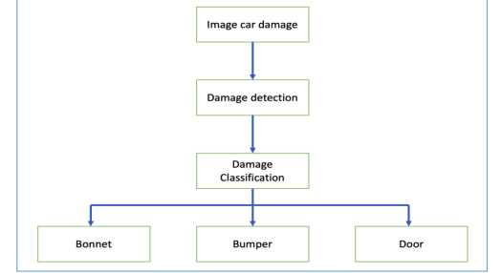
METHODOLOGY

Slide 8
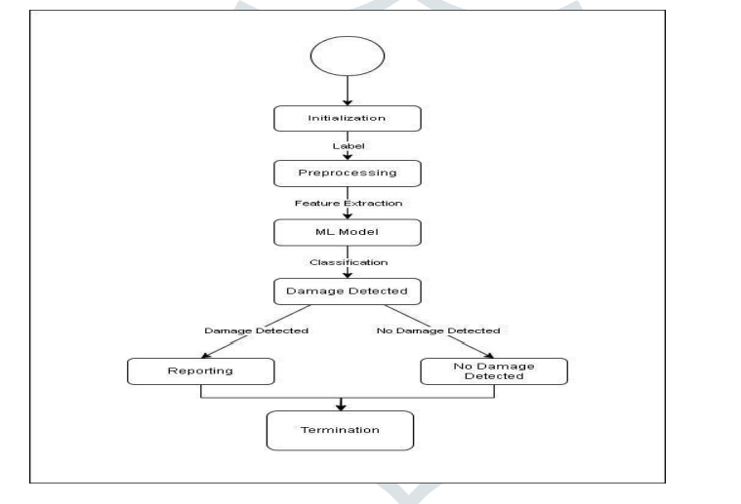

Slide 9
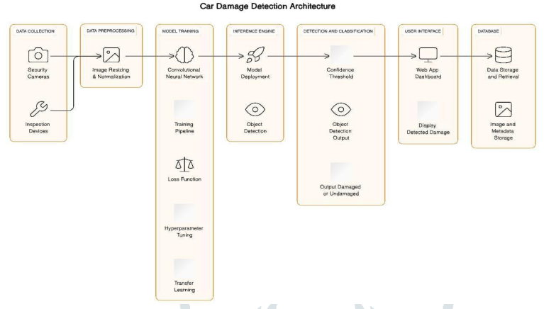
Proposed Architecture

Slide 10
Results
Image Acquisition
Preprocessing
Damage Classification
Severity Estimation
Feature Extraction

Slide 11
Conclusion
The Car Damage Detection project has demonstrated the feasibility and effectiveness of using computer vision and machine learning techniques to automate car damage assessment.
The project has shown that with the right combination of image processing, machine learning models, and an intuitive "In the field of user interface development, automating tasks such as car damage assessment is not only achievable but also highly beneficial."
Overall, the Car Damage Detection Project represents It significantly contributes to the computer vision field and paves the way for future advancements in automated image-based assessments

Slide 12
REFERENCES
M. Chen, F. Bai and Z. Gerile, “Special Object Detection Based On Mask RCNN,” 2021 17th International Conference on Computational Intelligence and Security (CIS), 2021, pp. 128-132, DOI: 10.1109/CIS54983.20 21 .00035.Ahmed, M. S., Mohammed, A. S., & Agusiobo, O. B. (2006). Development of a Single Phase Automatic Change Over Switch. AU Journal of Technicial Report, 10(1), 68–74.
M. Ye et al., “A Lightweight Model of VGG-16 for Remote Sensing Image Classification,” in IEEE Journal of Selected Topics in Applied Earth Observations and Remote Sensing, vol. 14, pp. 6916-6922, 2021, DOI: 10.1109/JSTARS.2021.3090085.Brown, B., Guditis, J., Critical, S. D., & Competency, P. (2006). Critical-Power Automatic Transfer Systems – Design and Application. IEEE Central TN Section, 1(August), 1–18.
H. Bandi, S. Joshi, S. Bhagat and A. Deshpande, “Assessing Car Damage with Convolutional Neural Networks,” 2021 International Conference on Communication information and Computing Technology (ICCICT), 2021, pp. 1-5, DOI: 10.1109/ICCICT50803.2021.9510069.Christian, M. (2012). Smart Phase Change-over system with AT89C52 Microcontroller. Journal of Electrical and Electronics Engineering, 1(3), 31–34.
P. M. Kyu and K. Woraratpanya, “Car Damage Detection and Classification,” in Proceedings of the 11th International Conference on Advances in Information Technology, Bangkok Thailand, Jul. 2020, pp. 1–6, DOI: 10.1145/3406601.3406651.
Phyu Mar Kyu, Kuntpong Woraratpanya,” Car Damage Detection and Classification” IAIT2020: Proceedings of the 11th International Conference on Advances in Information Technology July 2020 Article No.: 46 Pages 1–6 https://doi.org/10.1145/3406601.3406651.
H. Patel, “hemilpatel971/Damage-car-detection,” GitHub, Aug. 13, 2019.
Sourish Dey .2019. “CNN Application-Detecting Car Exterior Damage”. [8]. Jeffrey de Deijn. 2018. “Automatic Car Damage Recognition using Convolutional Neural Networks” (2018).

Slide 13
Thank You

