Slide 1
ENCM 509 – Fundamentals of Biometric Systems Design Final Project
Wednesday, 9th April, 2025
Multi-Modal Recognition System
Presented By: Rumaisa Shoeb Talukder
Group #: 23

Slide 2
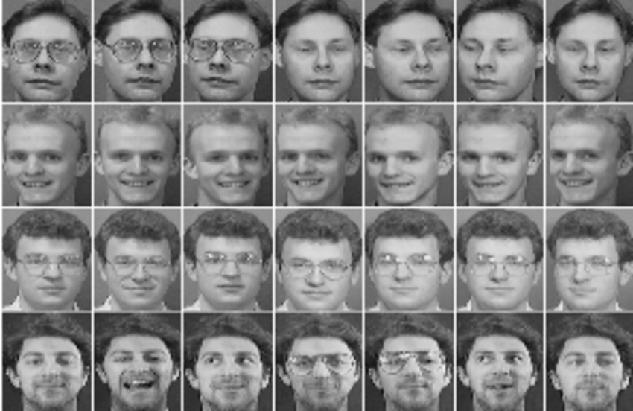

Introduction & Background
Goal: Recognize the genuine subject from a set of biometric samples using multi-modal authentication (voice + face).
Purpose:
Provide a reliable decision: Genuine vs Impostor
Prevent security breaches and misidentification
Deliver a solution that is simple, efficient, and more user-friendly than complex models
How does it relate to ENCM 509?
Applies key concepts from the ENCM 509, such as Gaussian Mixture Models (GMM).
Demonstrates multi-modal authentication techniques by combining speaker recognition and facial recognition for enhanced verification

Slide 3
Why choose Speech and Facial?
Easy to capture together: Both voice and face can be easily captured simultaneously with minimal equipment.
No special hardware needed: Works effectively with standard cameras and microphones.
Complementary modalities: Combines audio (voice) and visual (face) data for enhanced recognition accuracy.
User-friendly: Provides a natural, non-intrusive experience for users.
Secure and versatile: Difficult to forge both modalities simultaneously, making it ideal for multi-factor authentication.

Slide 4


Processing & Metrics Used
VOICE (SPEECH)
Dataset: Speaker Recognition Audio Dataset
MFCC
Captures the timbral and frequency characteristics of speech and provides a compact representation of voice data
MFCC feature distributions align well with Gaussian assumptions used in GMM-based classification.
GMM Scores
Models the probability distribution of MFCC features for speaker recognition.
Handles speech variations well (e.g., pitch, accent, noise).
Provides log-likelihood scores for precise speaker identification.
FACE
Dataset: AT&T Database of Faces
LBP
Captures local texture patterns for robust facial recognition.
Fast, efficient and simple - ideal for genuine vs. impostor classification.
Euclidean Distance
Calculates straight-line distance between feature vectors
Compares facial features by measuring the closeness of training and test data.
A fast and straightforward method for distinguishing genuine vs. impostor faces.

Slide 5
Procedure/Flowchart: Speaker Recognition Process
Load Data: Training & testing .wav files for genuine speakers and probe for impostor speakers.
Feature Extraction: Extract MFCC features from training samples.
Model Training: Train a Gaussian Mixture Model (GMM) on the genuine speaker's MFCC features.
Training vs. Testing (same speaker)
Training vs. Impostor/Probe (different speaker)
Comparison: Compare GMM scores to distinguish between genuine and impostor.
Calculate GMM scores for:
Gaussian Components = 20
Training Samples Per Subject = 6
Testing Samples Per Subject = 4
Probe Samples Per Subject = 4 (prev. 6)
Subjects = 2

Slide 6
Procedure/Flowchart: Facial Recognition Process
Load Data: Training & testing images (.pgm) for genuine subjects and probe for impostor subjects.
Feature Extraction: Extract LBP (Local Binary Pattern) features from images.
Comparison: Compare Euclidean distances to classify genuine vs. impostor.
Calculate Euclidean distances between:
Training vs. Testing (same subject)
Training vs. Impostor/Probe (different subject)
Subject Selection:
- Based on Speakers
Total Images Per Subject = 20
Training Samples Per Subject = 6
Testing Samples Per Subject = 4
Probe Samples Per Subject =4
Subjects = 2

Slide 7


Scenario 1: Subjects and Results
Subject A (Genuine)
Female, Southern Accent
Speaker: 0015
Facial Subject: s35
Euclidean Distance Stats (Training vs. Test Set):
Minimum Distance: 0.0086
Maximum Distance: 0.0675
GMM Scores (Training vs. Test Data):
[-46.268, -46.392, -46.365, -46.688]
Subject B (Impostor)
Female, British Accent
Speaker: 0033
Facial Subject: s10
Euclidean Distance Stats (Training vs. Probe Set):
Minimum Distance: 0.0283
Maximum Distance: 0.1199
GMM Scores (Training vs. Probe Data):
[-62.014, -61.550, -61.295, -62.134]
Lower Euclidean distances and Higher GMM scores (closer to zero) indicate higher similarity and a better match.
Higher Euclidean distances and Lower GMM scores indicate dissimilarity and a poor match.

Slide 8
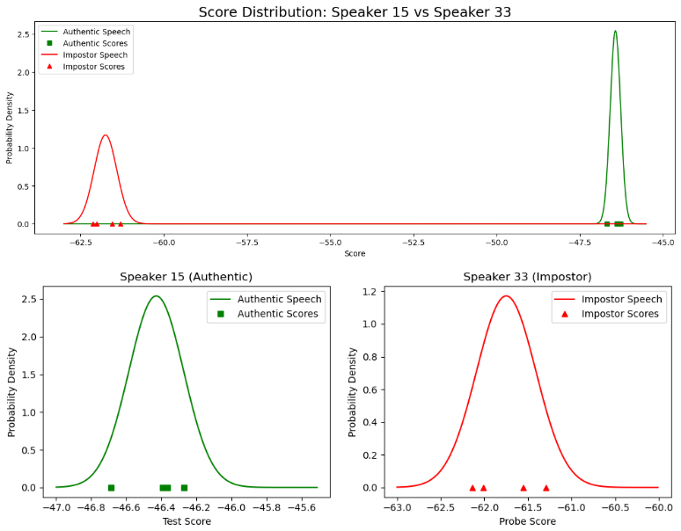
Scenario 1: Speech Visualization using PD Graph
Probability Density Graph:
Higher y-values indicate a stronger likelihood of the sample belonging to the original speaker's GMM model, while lower y-values suggest weaker association.
Speaker 15 has a stronger similarity to the training data (original speaker) than Speaker 33

Slide 9
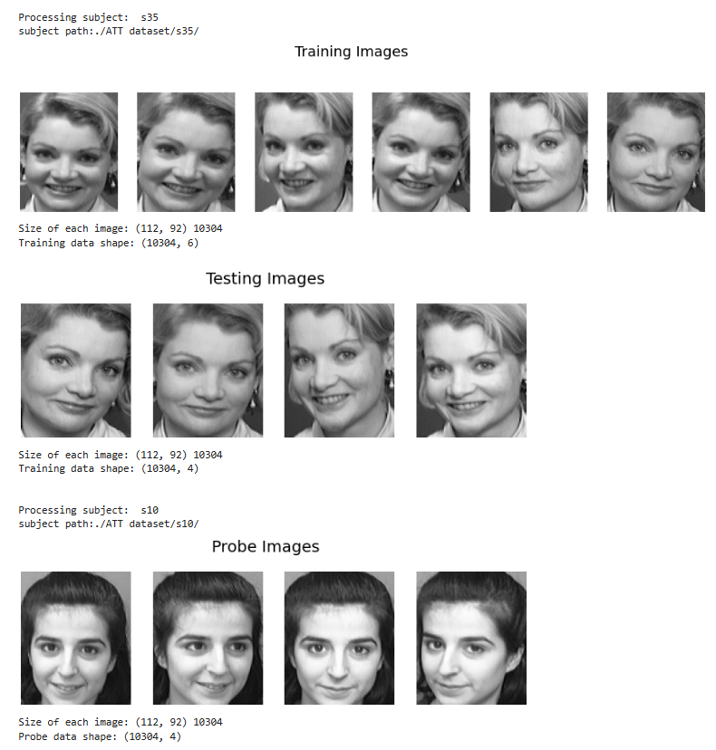
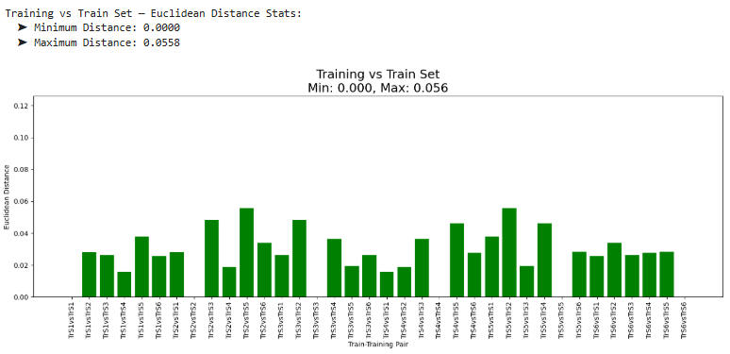
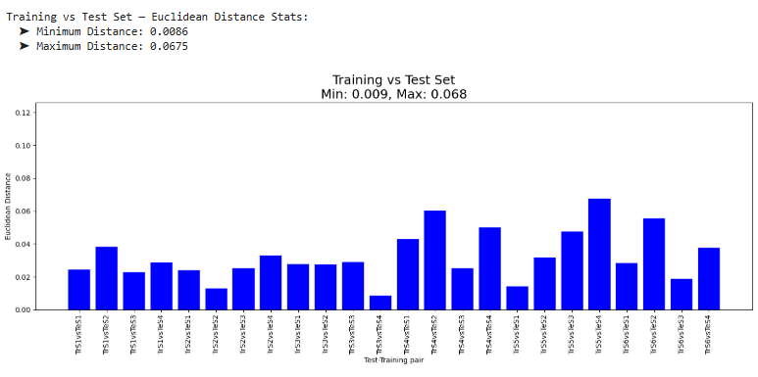
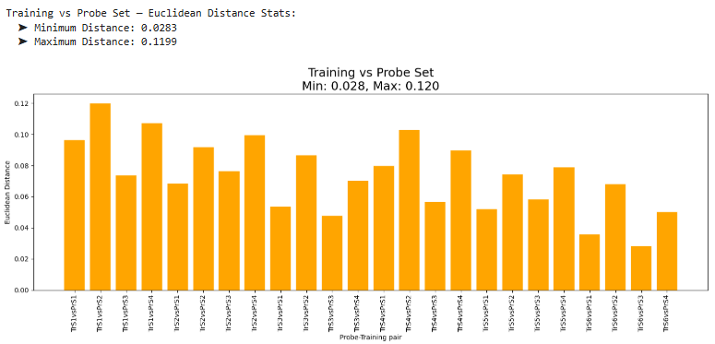
Scenario 1: Facial Visualization using Euclidean Distances

Slide 10


Scenario 2: Results
Subject C (Genuine)
Male, Similar accent
Speaker: 0025
Facial Subject: s34
Euclidean Distance Stats (Training vs. Test Set):
Minimum Distance: 0.0065
Maximum Distance: 0.0344
GMM Scores (Training vs. Test Data):
[-47.722, -47.906, -48.042, -48.191]
Subject D (Impostor)
Female, Similar Accent
Speaker: 0050
Facial Subject: s8
Euclidean Distance Stats (Training vs. Probe Set):
Minimum Distance: 0.1061
Maximum Distance: 0.1779
GMM Scores (Training vs. Probe Data):
[-54.414, -54.026, -54.806, -53.628]
Lower Euclidean distances and Higher GMM scores (closer to zero) indicate higher similarity and a better match.
Higher Euclidean distances and Lower GMM scores indicate dissimilarity and a poor match.

Slide 11
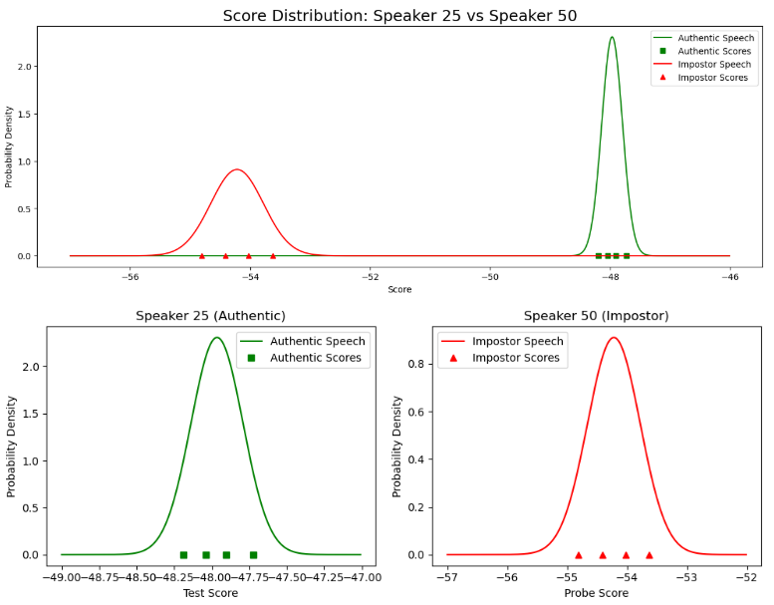
Scenario 2: Speech Visualization through PD Graph
Probability Density Graph:
Higher y-values indicate a stronger likelihood of the sample belonging to the original speaker's GMM model, while lower y-values suggest weaker association.
Speaker 25 has a stronger similarity to the training data (original speaker) than Speaker 50

Slide 12
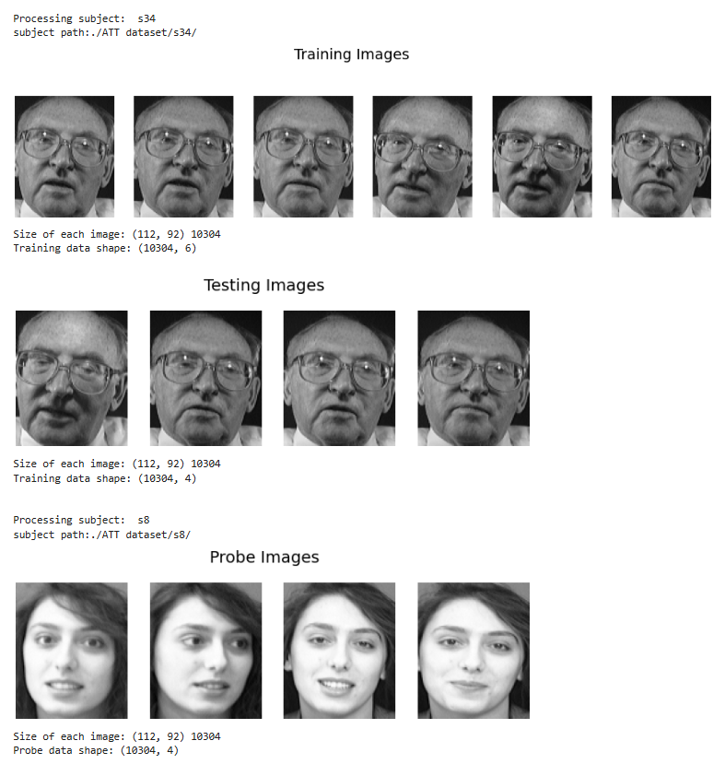
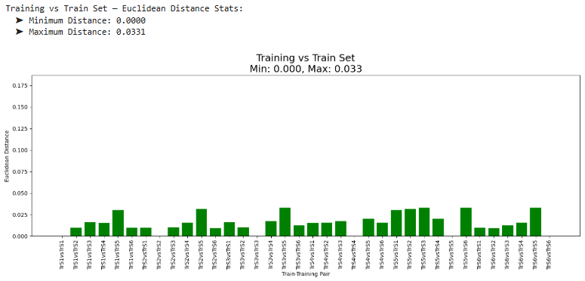
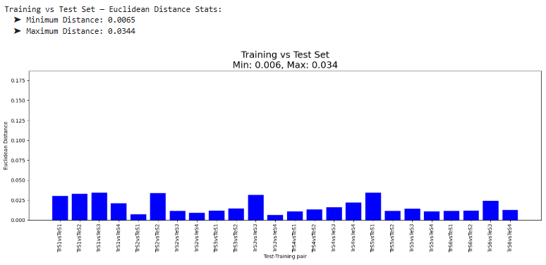
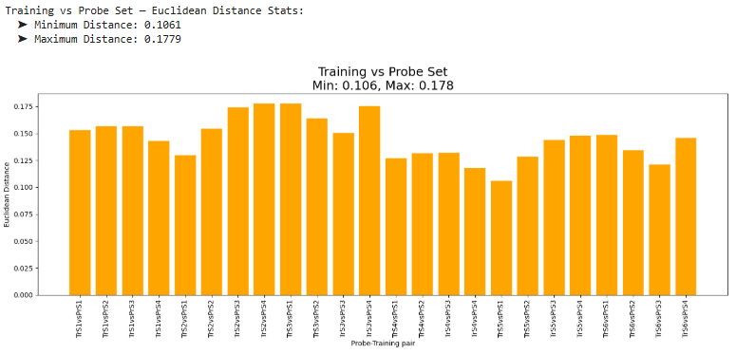
Scenario 2: Facial Visualization using Euclidean Distances

Slide 13
Scenario 1 vs Scenario 2
Female vs. Female (Speaker 0015 vs. Speaker 0033):
Self-comparison: Around -46.268 to -46.688
Cross-speaker comparison: Around -61.295 to -62.134
Difference ≈ 15.24
Reason: Distinct vocal characteristics between the two female speakers, such as accent (British vs Southern)
Male vs. Female (Speaker 0025 vs. Speaker 0050):
Self-comparison: Around -47.722 to -48.191
Cross-speaker comparison: Around -53.628 to 54.806
Difference ≈ 6.26
Reason: Overlapping vocal features between male and female speakers
Female vs. Female (Subject 35 vs Subject 10):
Self-comparison: Min (0.0086), Max (0.0675)
Cross-speaker comparison: Min (0.0283), Max (0.1199)
Difference ≈ Min(0.0197), Max(0.0524)
Reason: Some distinct facial characteristics such as hair colour – (lighter vs darker)
Male vs. Female (Subject 34 vs Subject 8):
Self-comparison: Min (0.0065), Max (0.0344)
Cross-speaker comparison: Min (0.1061), Max (0.1779)
Difference ≈ Min(0.0996), Max(0.1435)
Reason: More distinct facial characteristics such as glasses and no glasses, skin colour contrast, hair
Notes:
Accent Differences > Gender Differences in Some Cases:
Accents like British and Southern American have drastically different vowel shifts, intonations, and phoneme structures, making accent distinctions more significant than gender in some instances.
Male vs. Female Overlap in Features:
Despite pitch range differences, men and women often share similar phonetic structures if they come from the same region, reducing the distinction in GMM scores.

Slide 14
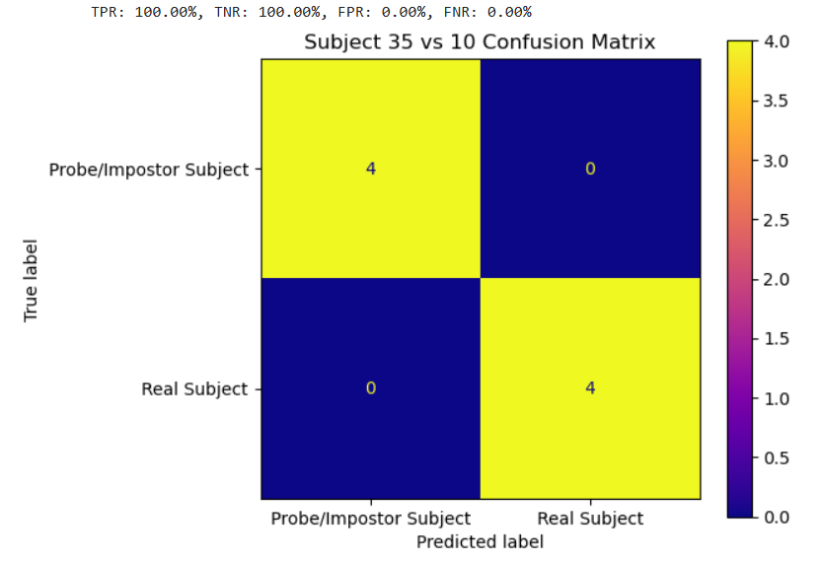
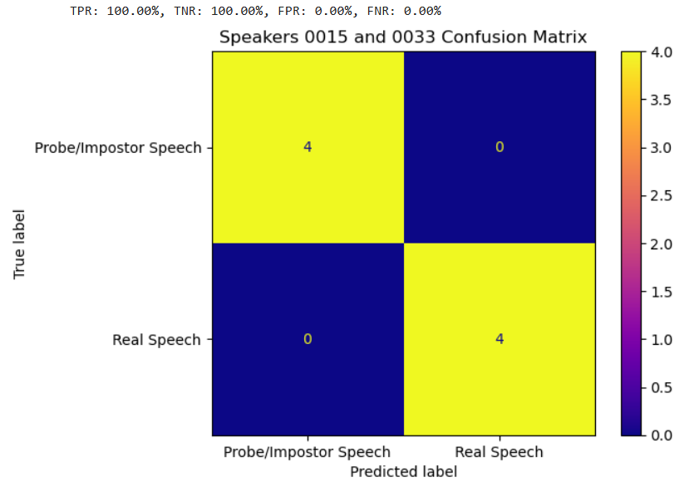
Verification: Confusion Matrices
How well the model classifies data:
Example of Face Recognition
Example of Speech Recognition

Slide 15
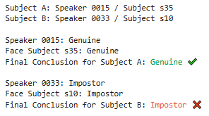
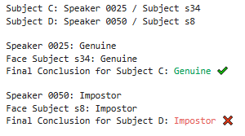
Final Results: Classification and Fusion
Speaker & Face Classification
Calculate mean and standard deviation from training data:
GMM scores (speaker)
Euclidean distances (face)
Set a decision threshold using training data:
Speaker: mean - 10 × std
Face: mean + 2 × std
Compare average test/probe values against thresholds:
If above (GMM) or below (distance) threshold → classify as Genuine
Otherwise → classify as Impostor
Fusion of Results
Both Speaker and Face are Genuine:
Final Result: Genuine
Both Speaker and Face are Impostor:
Final Result: Impostor
Speaker or Face is Impostor:
Final Result: Impostor
Final classification printed with color and symbol (✔️ / ❌) for visual clarity.

Slide 16
Summary
A simple multi-modal recognition system combining speaker and facial recognition.
Using GMM with MFCC for speaker identification
Using Euclidean Distances with LBP for facial recognition
Enhances authentication accuracy and security through dual-modality verification
Applies concepts from ENCM 509
Suitable for real-world use cases: Banking, Healthcare, Personal devices
Helps prevent fraud and unauthorized access

Slide 17
The End
Thank You!
Questions? Feedback?

Slide 18
The End
Thank You!
Questions? Feedback?

Slide 19
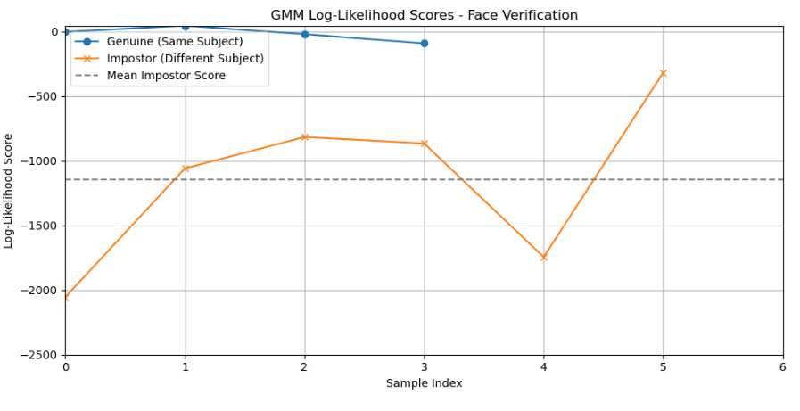
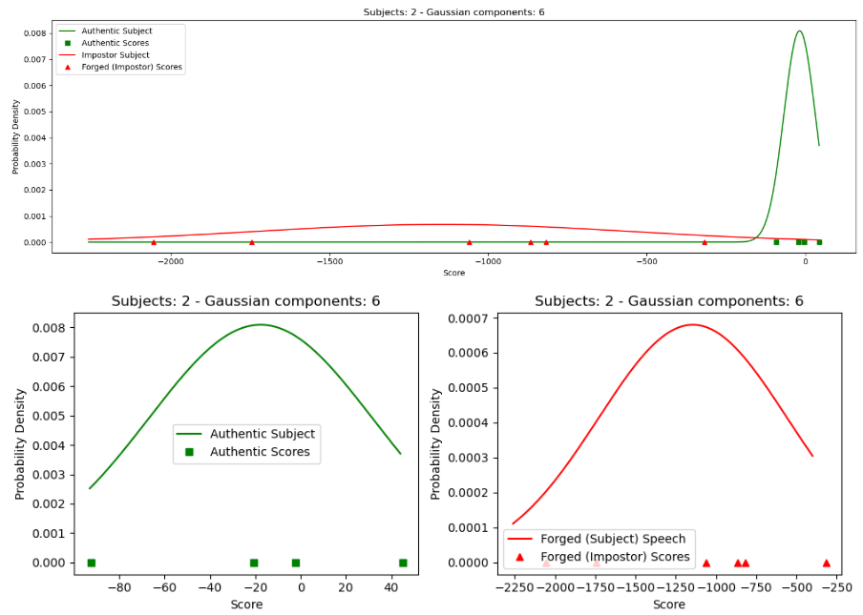
Why not GMM for Facial Recognition?
Subject s35 vs Subject s10
Did not seem as ideal as Euclidean Distance

