Slide 1
AUTOMATED MARKDOWN VALIDATOR
(using custom AI agent & Agno framework)
Slide 1: Title Slide
AUTOMATED MARKDOWN VALIDATOR
Using Custom AI Agent & Agno Framework
Offline Assignment – TalkSite Systems
Presented by: Bharath raja.V
Role: Software Engineer

Slide 2
Slide 2: Assignment Objective
Objective of the Assignment:
Learn and apply an AI agent framework
Build a local working demo
Validate Markdown files automatically
Identify issues and suggest fixes

Slide 3
Slide 3: Problem Statement
Problem Overview:
Markdown files often contain formatting mistakes
Broken links are difficult to detect manually
Manual validation is time-consuming and error-prone
Need:
An automated and reliable system to validate Markdown files.

Slide 4
Slide 4: What is an AI Agent?
AI Agent Definition:
An AI agent is an autonomous software component
It understands a goal and decides the steps to achieve it
It can invoke tools to complete specific tasks
In This Project:
The AI agent manages the validation workflow and delegates validation work to a tool.

Slide 5
Slide 5: AI Used & Framework
AI Used:
Custom AI Agent designed specifically for this task
Framework Used:
Agno – Python-based AI Agent Framework
Why Agno?
Lightweight and easy to understand
Supports agent and tool separation
Suitable for local execution as required by the assignment

Slide 6
Slide 6: System Architecture
Architecture Overview:
User uploads a Markdown file
AI agent receives and processes the request
Agent invokes the Python validation tool
Tool returns validation results
Agent presents results to the user
This architecture ensures clean separation of responsibilities.

Slide 7
Slide 7: Agent Workflow
Step-by-Step Agent Workflow:
Agent receives the Markdown file from the user
Agent identifies the goal as Markdown validation
Agent decides to use the validation tool
Agent invokes the Python validation tool
Tool checks formatting and link issues
Tool returns detected issues and fix suggestions
Agent formats the results clearly
Final output is displayed to the user

Slide 8
Slide 8: Technology Stack
Technologies Used:
Python for core logic
Agno for AI agent orchestration
Flask for local web interface
Regex and file parsing for validation
Markdown files as input
All components run locally as required

Slide 9
Slide 9: Local Demo Flow
Demo Execution Flow:
Application is run locally
User uploads a Markdown file
Agent processes the file
Validation results are displayed
This demonstrates real-time agent and tool interaction.

Slide 10
Slide 10: Output Details
Output Provided by the System:
List of detected Markdown issues
Clear explanation of each issue
Suggested fix for every issue
The output is easy to understand and actionable.

Slide 11
Slide 11: Key Learnings
Key Learnings from This Project:
Practical understanding of AI agents
Importance of agent and tool separation
Difference between AI reasoning and deterministic logic
Writing clean, explainable, and testable code.

Slide 12
Slide 12: Future Enhancements
Possible Future Improvements:
Improved web-based user interface
Support for additional Markdown rules
Deployment on AWS EC2
Support for validating multiple files

Slide 13
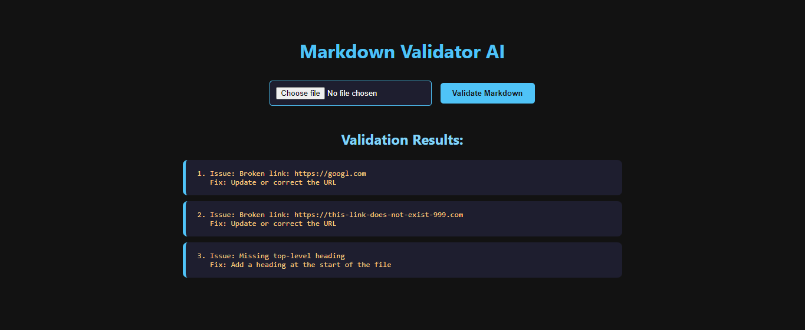
Output Screenshot:

