Slide 1
Azure Data Engineering
Ravi Kumar

Slide 2
Types of Subscriptions
Free Trial: Offers limited free access to a variety of Azure services for a specified period (typically 30 days) with some free credits to start with.
Pay-As-You-Go: Charges you only for the resources you use without any upfront commitment.
Enterprise Agreement (EA): Designed for larger organizations with discounted rates based on usage commitments.
Cloud Solution Provider (CSP): Managed by Microsoft partners, providing flexible solutions and support for businesses.
Visual Studio (MSDN) Subscription: Offers monthly Azure credits as part of Visual Studio subscription benefits, ideal for developers.
Student Subscription: Provides free credits and access to Azure services for students to support learning and development.
Management Group
Subscription
Subscription
Resource Group
Resource Group
Resource Group
Resource Group
Resource1
Resource2
Resource3
Resource4
Resource5
Resource6

Slide 3
Resource Group
Key Points
Logical Grouping: Resource groups help organize and manage all the resources (like virtual machines, databases, and more) that make up an application or service. Think of it as a folder on your computer where you keep all related files together.
Unified Management: You can manage and deploy multiple resources together. For example, if you have a web app, a database, and storage, you can manage them all within one resource group.
Lifecycle Management: Resources in the same group can be managed and deleted as a single entity. This simplifies the lifecycle management of your applications.
Access Control: You can apply role-based access control (RBAC) to the resource group, making it easier to manage who has permissions to create, manage, or delete resources within that group.
Billing and Monitoring: Resource groups provide a way to view billing and monitor the usage of the resources within the group. This helps in tracking costs and usage patterns effectively
A Resource Group in Azure is a logical container that holds related resources for an Azure solution.

Slide 4
Linked Services
Key Points
Connection Information:
A linked service contains connection strings, authentication credentials, and other configuration settings necessary to connect to your data sources or compute environments.
Types of Data Stores:
Storage Services: Connect to Azure Blob Storage, Azure Data Lake Storage, and others.
Databases: Connect to SQL Server, Azure SQL Database, PostgreSQL, MySQL, etc.
Compute Services: Connect to Azure HDInsight, Azure Databricks, and more.
Configuration:
Each linked service is configured based on the type of service it connects to. For example, an Azure Blob Storage linked service will require an account name and key, while a SQL Database linked service will need a connection string and credentials.
Security:
Linked services securely store credentials in Azure Key Vault or directly in the Data Factory configuration, ensuring that sensitive information is protected.
Reusability:
Linked services can be reused across multiple pipelines, activities, and datasets within Azure Data Factory, promoting efficient management and consistency.
In Azure Data Factory, a Linked Service is a connection string that defines the connection information needed for Data Factory to connect to external data sources. Think of it as a bridge that allows Azure Data Factory to interact with your various data stores, compute services, or other resources. Here are some key aspects of Linked Services

Slide 5
Integration Runtime (IR)
An Integration Runtime (IR) in Azure Data Factory is the compute infrastructure used by Data Factory to provide data integration capabilities across different network environments. It acts as a bridge for data movement, transformation, and activity dispatching.
Key Functionalities
Data Movement: Moves data between different data stores, which can be on-premises or in the cloud.
Data Transformation: Performs data transformations and processes data flows, leveraging Azure Data Factory's capabilities or custom transformations.
Activity Dispatch: Executes activities within a pipeline, such as data copying, transformations, and control flow operations.
Key Types of Integration Runtime
Azure Integration Runtime:
Fully Managed: Hosted by Azure, this IR automatically scales out to meet your data integration needs.
Cloud-to-Cloud: Ideal for cloud-to-cloud data movement and transformation scenarios.
No Setup: Minimal configuration required, as Azure manages the resources.
Self-Hosted Integration Runtime:
User Managed: Installed on a virtual machine or an on-premises server.
Hybrid Connectivity: Enables data movement between on-premises and cloud sources.
Control: Provides more control over the environment and network configurations.
Azure SSIS Integration Runtime:
For SSIS Packages: Specifically designed to run SQL Server Integration Services (SSIS) packages in a managed environment.
Hybrid Scenarios: Supports both on-premises and cloud data integration using SSIS.
Choosing the Right Integration Runtime
Azure IR: Best for cloud-native, scalable, and fully managed data integration scenarios.
Self-Hosted IR: Suitable for hybrid scenarios requiring secure data movement between on-premises and cloud environments.
Azure SSIS IR: Ideal for organizations looking to lift and shift SSIS packages to the cloud without rewriting them.

Slide 6
Integration Runtime (IR)
Azure Integration Runtime (Azure-IR)
Overview
Azure-IR is a fully managed, cloud-based integration runtime provided by Microsoft. It is suitable for data integration tasks that don't require access to on-premises data sources. This IR handles data movement, data transformation, and dispatching activities in the cloud.
Features
Fully Managed: No infrastructure management required; Microsoft handles the provisioning, scaling, and maintenance.
Data Movement: Efficiently moves data between different cloud data stores.
Data Transformation: Supports data transformation activities using Mapping Data Flows.
Activity Dispatch: Orchestrates activities on various compute services such as Azure Databricks, Azure HDInsight, and more.
Use Cases
Copying data between cloud-based data stores.
Executing data transformation activities in the cloud.
Orchestrating data workflows involving cloud services.
Self-Hosted Integration Runtime (SH-IR)
Overview
SH-IR is installed on a local machine or virtual machine within your private network. It facilitates data integration tasks that require access to on-premises data sources or resources in a private network.
Features
Customer-Managed: Requires you to install, configure, and maintain the runtime on your infrastructure.
Hybrid Connectivity: Supports data movement between on-premises data sources and cloud data stores.
Secure Data Transfer: Ensures secure data transfer using encrypted channels.
Custom Execution: Can execute custom activities, run SSIS packages, and connect to private network resources.
Use Cases
Copying data from on-premises SQL Server to Azure Blob Storage.
Moving data between on-premises systems and cloud-based data stores.
Orchestrating hybrid data workflows involving both on-premises and cloud services.
Azure-SSIS Integration Runtime (Azure-SSIS-IR)
Overview
Azure-SSIS-IR is specifically designed for executing SQL Server Integration Services (SSIS) packages in a managed Azure compute environment. This IR allows you to lift and shift your existing SSIS packages to Azure with minimal changes.
Features
Managed SSIS Execution: Provides a fully managed environment for running SSIS packages in Azure.
Integration with Azure Services: Allows seamless integration with other Azure services such as Azure SQL Database, Azure Data Lake Storage, and more.
Custom Package Execution: Supports executing custom SSIS packages, leveraging existing on-premises investments.
Scalability: Automatically scales based on the demands of your SSIS workloads.
Use Cases
Migrating on-premises SSIS packages to Azure.
Running SSIS packages to perform ETL (Extract, Transform, Load) operations in the cloud.
Integrating SSIS packages with other Azure services for enhanced data workflows.

Slide 7
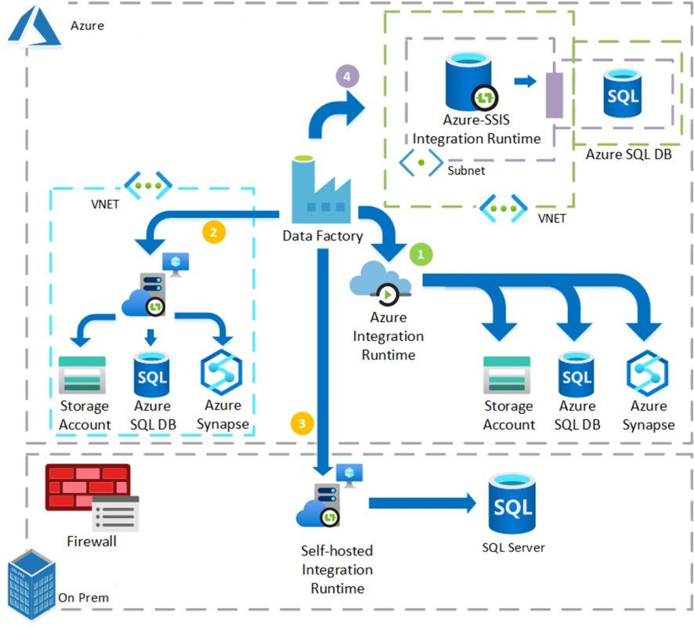

Slide 8
Dataset
In Azure Data Factory, a Dataset represents the data structure within your data stores that is used in activities like copying or transforming data. It’s essentially a reference to the data you want to process, including its schema, location, and format
Key Points
Representation of Data:
A dataset provides the schema and metadata of the data. For example, it can represent a table in a database, a file in a storage account, or a directory containing multiple files.
Types of Datasets:
Tabular Dataset: Represents data structures like tables, files, or any source that can be structured in a tabular format.
Binary Dataset: Represents binary data, typically used for file formats like images, videos, and compressed files.
Connection to Linked Services:
A dataset is associated with a linked service, which provides the connection information to the data store where the data resides.
Schema and Properties:
Datasets define the structure of the data, including columns, data types, and any additional metadata required to understand and process the data.
Data Location and Format:
Specifies the path to the data (e.g., file path, table name) and its format (e.g., CSV, JSON, Parquet).
Use Cases
Copy Activity: Define source and destination datasets for data copying.
Mapping Data Flow: Use datasets to define input and output data for transformations.
Lookup Activity: Retrieve data from a dataset to be used in subsequent activities.

Slide 9
storage account
Cntd..
It is a service provided by Microsoft Azure that is designed for storing large amounts of unstructured data. "Blob" stands for "Binary Large Object." It is highly scalable, cost-effective, and optimized for a wide range of data storage scenarios
Key Points
Initial Creation: When you create a new storage account and select Azure Data Lake Storage Gen2, you have the option to enable the hierarchical namespace. This decision needs to be made at the time of creation.
Post-Creation Limitation: If the storage account was initially created without hierarchical namespace enabled, you cannot enable it afterward. The hierarchical namespace feature is a fundamental property that must be set during the creation of the storage account.
Key Features of Azure Blob Storage
Block Blobs: Ideal for storing text or binary data, such as documents and media files. These blobs are made up of blocks, and you can manage individual blocks, making them suitable for uploading large files efficiently.
Append Blobs: Designed for append-only operations, making them perfect for logging data where new data needs to be appended.
Page Blobs: Used for scenarios requiring frequent read/write operations, such as virtual hard drives and Azure VMs.
Scalability and Performance:
High Scalability: Can store petabytes of data and handle millions of requests per second.
Performance: Low latency and high throughput, making it suitable for high-demand applications.
Storage Tiers
Hot Tier: Optimized for data that is accessed frequently.
Cool Tier: Suitable for data that is infrequently accessed and stored for at least 30 days.
Archive Tier: Best for data that is rarely accessed and can tolerate high retrieval latency, typically for long-term storage.
Integration
Integration with Other Services: Seamlessly integrates with services like Azure Data Factory, Azure Machine Learning, and Azure Synapse Analytics.
APIs and SDKs: Supports a wide range of APIs and SDKs for various programming languages, making it easy to incorporate into your applications
Security:
Encryption: Data is encrypted both at rest and in transit.
Access Control: Role-based access control (RBAC), shared access signatures (SAS), and other access management features ensure data security.
Data Management:
Lifecycle Management: Policies can be set to automatically move data between different tiers based on usage.
Soft Delete: Allows you to recover blobs that were accidentally deleted within a specified retention period

Slide 10
storage account
Advanced tab..
Example Use Cases
Backup and Restore: Store backups of your databases and applications.
Big Data and Analytics: Store large datasets for processing and analysis.
Content Distribution: Efficiently deliver images, videos, and other media content.
Logging and Monitoring: Collect and archive logs from various services and applications.
Requiring secure transfer for REST API operations : Azure Blob Storage is an important security measure to ensure that all data transmitted to and from the storage account is encrypted in transit. This can prevent data from being intercepted by unauthorized parties.
Enabling public access on a container: in Azure Blob Storage can be useful for several reasons, especially when you need to share data widely without the need for authentication. By enabling public access, you can efficiently share data with a broad audience while simplifying the access process. However, it's essential to balance the need for accessibility with appropriate security measures to protect sensitive information.
Enable storage account key access in Azure, you can manage the access keys of your storage account to allow applications to access your Azure Storage resources.
Default to Azure Active Directory (AAD) authorization in the Azure Portal: Benefits of Defaulting to AAD Authorization
Enhanced Security: Using AAD for authorization provides better security compared to using access keys.
Simplified Access Management: Easier to manage permissions and access control using Azure RBAC (Role-Based Access Control).
Compliance: Helps meet regulatory and compliance requirements by using modern authentication methods.
By enabling this setting, you ensure that all data access operations in the Azure Portal default to using AAD, enhancing security and simplifying access management.
The Permitted Scope for Copy Operations feature in Azure Blob Storage allows you to restrict the source accounts from which data can be copied to your destination account.
Allowed Copy Scope Options
(null) (default): Allows copying from any storage account to the destination account.
Microsoft Entra ID: Permits copying only from accounts within the same Microsoft Entra tenant as the destination account.
PrivateLink: Permits copying only from storage accounts that have private links to the same virtual network as the destination account.
Enable cross-tenant replication: Create Replication Policy:
Click on Create replication rules.
Select the destination subscription and destination storage account.
In the Container pair details section, select a source container from the source account and a destination container from the destination account.
Configure Replication Rules: Specify the rules for replication, such as which block blobs in the source container will be replicated to the destination container.
Save: Click on Save to apply the replication policy
Steps to Recover a Soft-Deleted Blob
Enable Soft Delete:
Make sure soft delete is enabled for your storage account. You can enable it through the Azure portal, PowerShell, or Azure CLI1.
View Soft-Deleted Blobs:
Navigate to the Azure portal and go to your storage account.
Go to the Blob service section and select the container where the blob was deleted.
Toggle the Show deleted blobs option to view the list of soft-deleted blobs.
Restore the Blob:
Select the soft-deleted blob from the list.
Click on the Undelete button to restore the blob.

Slide 11
storage account
Data protection tab..
Example Use Cases
Backup and Restore: Store backups of your databases and applications.
Big Data and Analytics: Store large datasets for processing and analysis.
Content Distribution: Efficiently deliver images, videos, and other media content.
Logging and Monitoring: Collect and archive logs from various services and applications.
Requiring secure transfer for REST API operations : Azure Blob Storage is an important security measure to ensure that all data transmitted to and from the storage account is encrypted in transit. This can prevent data from being intercepted by unauthorized parties.
Enabling public access on a container: in Azure Blob Storage can be useful for several reasons, especially when you need to share data widely without the need for authentication. By enabling public access, you can efficiently share data with a broad audience while simplifying the access process. However, it's essential to balance the need for accessibility with appropriate security measures to protect sensitive information.
Enable storage account key access in Azure, you can manage the access keys of your storage account to allow applications to access your Azure Storage resources.
Default to Azure Active Directory (AAD) authorization in the Azure Portal: Benefits of Defaulting to AAD Authorization
Enhanced Security: Using AAD for authorization provides better security compared to using access keys.
Simplified Access Management: Easier to manage permissions and access control using Azure RBAC (Role-Based Access Control).
Compliance: Helps meet regulatory and compliance requirements by using modern authentication methods.
By enabling this setting, you ensure that all data access operations in the Azure Portal default to using AAD, enhancing security and simplifying access management.
The Permitted Scope for Copy Operations feature in Azure Blob Storage allows you to restrict the source accounts from which data can be copied to your destination account.
Allowed Copy Scope Options
(null) (default): Allows copying from any storage account to the destination account.
Microsoft Entra ID: Permits copying only from accounts within the same Microsoft Entra tenant as the destination account.
PrivateLink: Permits copying only from storage accounts that have private links to the same virtual network as the destination account.
Enable cross-tenant replication: Create Replication Policy:
Click on Create replication rules.
Select the destination subscription and destination storage account.
In the Container pair details section, select a source container from the source account and a destination container from the destination account.
Configure Replication Rules: Specify the rules for replication, such as which block blobs in the source container will be replicated to the destination container.
Save: Click on Save to apply the replication policy
Steps to Recover a Soft-Deleted Blob
Enable Soft Delete:
Make sure soft delete is enabled for your storage account. You can enable it through the Azure portal, PowerShell, or Azure CLI1.
View Soft-Deleted Blobs:
Navigate to the Azure portal and go to your storage account.
Go to the Blob service section and select the container where the blob was deleted.
Toggle the Show deleted blobs option to view the list of soft-deleted blobs.
Restore the Blob:
Select the soft-deleted blob from the list.
Click on the Undelete button to restore the blob.

Slide 12
storage account
Data protection
Enabling Point-in-Time Restore : Point-in-time restore for Azure Blob Storage containers allows you to restore a container to a previous state at a specific point in time.
Prerequisites
Blob Versioning: Ensure blob versioning is enabled on your storage account.
Change Feed: Ensure the change feed is enabled on your storage account.
Soft Delete: It is recommended to have soft delete enabled for additional protection.
Enabling soft delete for blobs in Azure Blob Storage is a great way to protect your data from accidental deletions. Soft delete preserves your deleted data for a specified retention period, allowing you to restore it if needed.
Enabling soft delete for containers in Azure Blob Storage is a powerful feature that protects entire containers and their contents from accidental or malicious deletions.
Enable soft delete for file shares.

Slide 13
Pipeline
In the context of Azure Data Factory (ADF) and other data integration platforms, a pipeline is a logical grouping of activities
Key Components of a Pipeline
Activities:
Definition: Each activity represents a step in the process. Activities can include data movement (copy data), data transformation (data flow), control flow (if/else logic, loops), and more. Examples: Copy Activity, Data Flow Activity, Execute Stored Procedure Activity.
Triggers:
Definition: Triggers determine when a pipeline execution starts. They can be scheduled, triggered by events, or manual.
Types: Schedule triggers, tumbling window triggers, event-based triggers, and on-demand triggers.
Data Flows:
Definition: Define how data should be transformed during the pipeline execution. They can include operations like joins, aggregations, sorting, and more.
Examples: Mapping Data Flow, Wrangling Data Flow.
Linked Services:
Definition: Linked services define the connection information for data sources and destinations. They specify how to connect to external services like Azure Blob Storage, SQL databases, and more. Examples: Azure Blob Storage Linked Service, Azure SQL Database Linked Service.
Datasets:
Definition: Datasets represent data structures within the data stores that are referenced by activities. They define the schema, location, and format of the data.
Examples: CSV dataset, SQL table dataset.
Control Flow:
Definition: Pipelines can include control flow activities that allow for conditional logic, looping, and error handling. Examples: For Each Activity, If Condition Activity, Until Activity.
Benefits of Pipelines
Automation:
Automate complex data workflows and eliminate manual tasks.
Scheduling:
Execute tasks on a defined schedule without human intervention.
Scalability:
Handle large volumes of data with ease.
Orchestration:
Coordinate different tasks and processes in a unified way.

Slide 14
Set Variable
Purpose of Set Variable Activity
The Set Variable activity allows you to assign a value to a pipeline variable. It’s useful for storing intermediate results, parameters, or temporary data that other activities in your pipeline can use.
Example Scenario
Imagine you have a pipeline that needs to process different files. You can use the Set Variable activity to dynamically set the file name:
Define Variable:
Name: FileName
Type: String
Set Variable Activity:
Variable name: FileName
Value: "sample.csv" (for a static value) or @concat('file_', pipeline().parameters.date, '.csv') (for a dynamic value).
Using the Variable
Once you’ve set the variable, you can reference it in other activities using the syntax @variables('VariableName').
Add 2 numbers:
Formula :@add(int(variable(‘variablename1’)),int(variable(‘variablename’)))
To convert into string : {@add(int(variable(‘variablename1’)),int(variable(‘variablename’)))}
Parameters: defined at the pipeline level, can’t be modified.
Pipeline level, LinkedList level, Dataset level these 3 levels only we can create parameters.
Key Components
Variables:
Definition: Variables in ADF are placeholders for values that you can use and update during the execution of a pipeline.
Types: Supported types include Integer, String, Boolean, and Array.
Dynamic Content:
Expressions: You can use ADF expressions to dynamically set the value of the variable based on the pipeline parameters, system variables, or output from previous activities.

Slide 15
Copy Activity
Purpose of Set Variable Activity
The Set Variable activity allows you to assign a value to a pipeline variable. It’s useful for storing intermediate results, parameters, or temporary data that other activities in your pipeline can use.
Example Scenario
Imagine you have a pipeline that needs to process different files. You can use the Set Variable activity to dynamically set the file name:
Define Variable:
Name: FileName
Type: String
Set Variable Activity:
Variable name: FileName
Value: "sample.csv" (for a static value) or @concat('file_', pipeline().parameters.date, '.csv') (for a dynamic value).
Using the Variable
Once you’ve set the variable, you can reference it in other activities using the syntax @variables('VariableName').
Add 2 numbers:
Formula :@add(int(variable(‘variablename1’)),int(variable(‘variablename’)))
To convert into string : {@add(int(variable(‘variablename1’)),int(variable(‘variablename’)))}
Parameters: defined at the pipeline level, can’t be modified.
Pipeline level, LinkedList level, Dataset level these 3 levels only we can create parameters.
Key Components
Variables:
Definition: Variables in ADF are placeholders for values that you can use and update during the execution of a pipeline.
Types: Supported types include Integer, String, Boolean, and Array.
Dynamic Content:
Expressions: You can use ADF expressions to dynamically set the value of the variable based on the pipeline parameters, system variables, or output from previous activities.

