Slide 1
Unsupervised Learning
Unsupervised machine learning is the machine learning task of inferring a function to describe hidden structure from "unlabeled" data
a classification or categorization is not included in the observations.
Since the examples given to the learner are unlabeled, there is no evaluation of the accuracy of the structure that is output by the relevant algorithm
which is one way of distinguishing unsupervised learning from supervised

Slide 2
Unsupervised Learning
Here we will discuss a class of unsupervised machine learning models:
clustering algorithms.
Clustering algorithms seek to learn an optimal division or discrete labeling of groups of points solely from the properties of the data,.
Perhaps the most popular clustering algorithm is the k-means algorithm.

Slide 3
The k-Means Algorithm
The k-means algorithm searches for a pre-determined number of clusters within an unlabeled multidimensional dataset.
It accomplishes this using a simple conception of what the optimal clustering looks like:
The "cluster center" is the arithmetic mean of all the points belonging to the cluster.
Each point is closer to its own cluster center than to other cluster centers.
Those two assumptions are the basis of the k-means model.
https://en.wikipedia.org/wiki/K-means_clustering

Slide 4
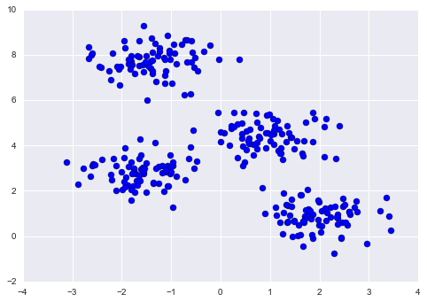
The k-Means Algorithm
from sklearn.datasets.samples_generator import make_blobs
X, _ = make_blobs(n_samples=300, centers=4,
cluster_std=0.60, random_state=0)
plt.scatter(X[:, 0], X[:, 1], s=50);

Slide 5
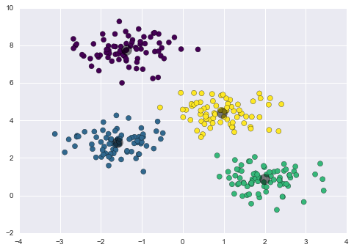
The k-Means Algorithm
from sklearn.cluster import KMeans
kmeans = KMeans(n_clusters=4)
kmeans.fit(X)
y_kmeans = kmeans.predict(X)
plt.scatter(X[:, 0], X[:, 1], c=y_kmeans, s=50, cmap='viridis') centers = kmeans.cluster_centers_ plt.scatter(centers[:, 0], centers[:, 1], c='black', s=200, alpha=0.5);

Slide 6
k-Means Algorithm: Expectation Maximization
The expectation–maximization approach here consists of the following procedure:
Guess some cluster centers
Repeat until converged
E-Step: assign points to the nearest cluster center
M-Step: set the cluster centers to the mean
Here the "E-step" or "Expectation step" is so-named because it involves updating our expectation of which cluster each point belongs to - in this context expectation is just a fancy word of mean/average.
The "M-step" or "Maximization step" is so-named because it involves maximizing the mean of the data in each cluster.

Slide 7
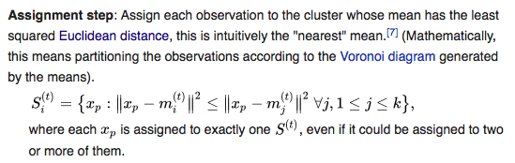

k-Means

Slide 8
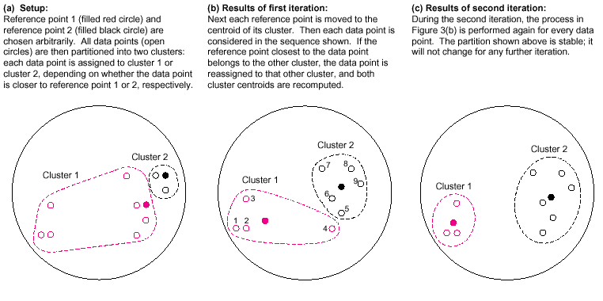
The k-Means Algorithm
Iterations of the k-means algorithm with k = 2.

Slide 9
Visualizing the k-Means Algorithm
http://stanford.edu/class/ee103/visualizations/kmeans/kmeans.html

Slide 10
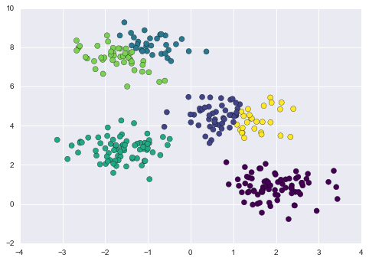
k-Means: selection of k
The selection of k can have a serious effect on the quality of your clusters.
import matplotlib.pyplot as plt from sklearn.cluster import KMeans
labels = KMeans(6, random_state=0).fit_predict(X) plt.scatter(X[:, 0], X[:, 1], c=labels, s=50, cmap='viridis')
plt.show()

Slide 11
K-Means: The Elbow method
The elbow method looks at the percentage of variance explained as a function of the number of clusters:
One should choose a number of clusters so that adding another cluster doesn't give much better modeling of the data.
More precisely, if one plots the percentage of variance explained by the clusters against the number of clusters, the first clusters will add much information (explain a lot of variance), but at some point the marginal gain will drop, giving an angle in the graph. The number of clusters is chosen at this point, hence the "elbow criterion".
https://en.wikipedia.org/wiki/Elbow_method_(clustering)

Slide 12
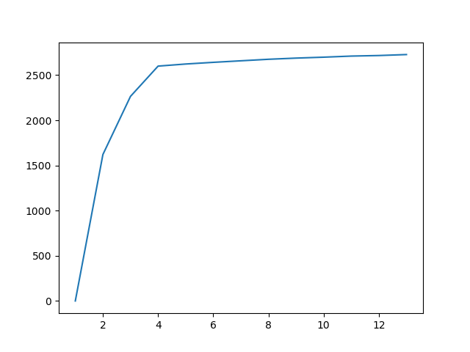
k-Means: The Elbow method
Looking for the ‘elbow’ in the variance plot

Slide 13
k-Means: The Elbow method
def elbow(df, n): import matplotlib.pyplot as plt from sklearn.cluster import KMeans import numpy as np from scipy.spatial.distance import cdist, pdist # kmeans models for each k kMeansVar = [KMeans(n_clusters=k).fit(df.values) for k in range(1, n)] # get the centroids of the models centroids = [X.cluster_centers_ for X in kMeansVar] # find the distances of the values to the centroids k_euclid = [cdist(df.values, cent) for cent in centroids] # find the distance of each point to its cluster center dist = [np.min(ke, axis=1) for ke in k_euclid] # total within cluster sum of squares wcss = [sum(d**2) for d in dist] # total sum of squares tss = sum(pdist(df.values)**2)/df.values.shape[0] # between clusters sum of squares bss = tss - wcss plt.plot(list(range(1,n)),bss) plt.show()
Demo elbow

Slide 14
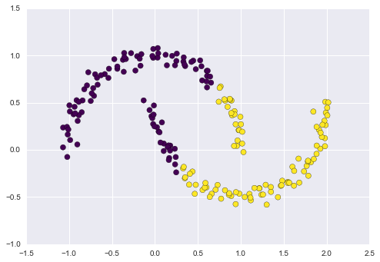
k-Means: non-linear boundaries
import matplotlib.pyplot as plt
from sklearn.cluster import KMeans
from sklearn.datasets import make_moons
X, y = make_moons(200, noise=.05, random_state=0) labels = KMeans(2, random_state=0).fit_predict(X) plt.scatter(X[:, 0], X[:, 1], c=labels, s=50, cmap='viridis');

Slide 15
The k-Means Algorithm
Pros:
Fast convergence
Conceptually simple
Cons:
Very sensitive to the choice of numbers of clusters k
Only considers convex cluster boundaries

Slide 16
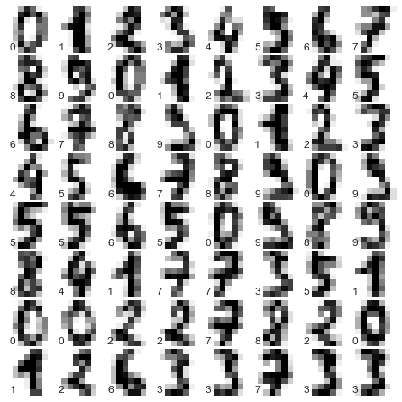
Example: Clustering Digits
The digits data set consists of 1,797 samples each consisting of an 8 × 8 grid of pixels (64 features) representing a handwritten digits between 0 and 9.
Here are a few samples from this data set.
from sklearn.datasets import load_digits digits = load_digits()
Question: can we use k-means to cluster in this data set and retrieve the digits?

Slide 17
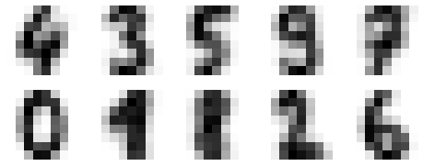
Example: Clustering Digits
The idea is to set up 10 clusters and then each cluster should contain all the rows representing one of the digits.
The result is 10 clusters in 64 dimensions. Notice that the cluster centers themselves are 64-dimensional points, and can themselves be interpreted as the "typical" digit within the cluster.
kmeans = KMeans(n_clusters=10, random_state=0)
kmeans.fit(digits.data)
fig, ax = plt.subplots(2, 5, figsize=(8, 3)) centers = kmeans.cluster_centers_.reshape(10, 8, 8) for axi, center in zip(ax.flat, centers): axi.set(xticks=[], yticks=[]) axi.imshow(center, interpolation='nearest', cmap=plt.cm.binary)
We see that even without the labels, KMeans is able to find clusters whose centers are recognizable digits, with perhaps the exception of 1 and 8.

Slide 18
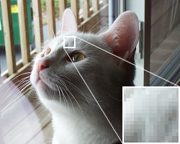
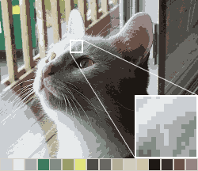
Example: Color Quantization
In computer graphics, color quantization or color image quantization is a process that reduces the number of distinct colors used in an image, usually with the intention that the new image should be as visually similar as possible to the original image.
An example image in 24-bit RGB color
The same image reduced to a palette of 16 colors specifically chosen to best represent the image; the selected palette is shown by the squares above
Source: Wikipedia

Slide 19
Example: Color Quantization
Most standard techniques treat color quantization as a problem of clustering points in three-dimensional space, where the points represent colors found in the original image and the three axes represent the three color channels.
Almost any three-dimensional clustering algorithm can be applied to color quantization, including k-Means.
After the clusters are located, typically the points in each cluster are averaged to obtain the representative color that all colors in that cluster are mapped to.
The three color channels are usually red, green, and blue.

Slide 20
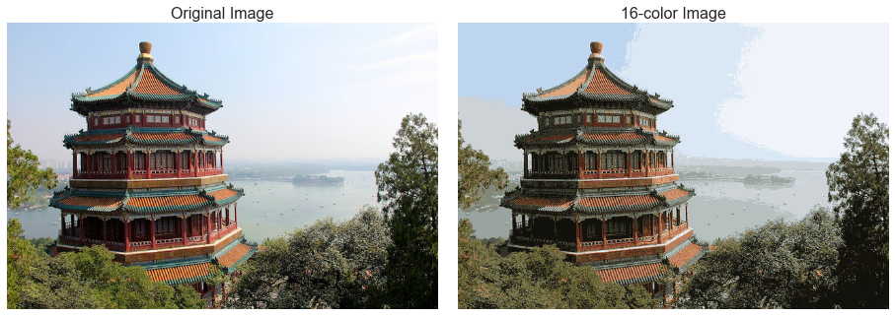
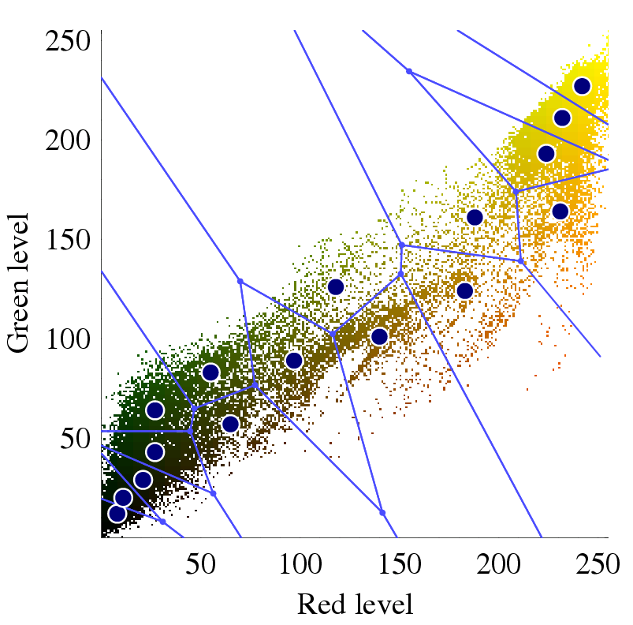
Example: Color Quantization
>>> data = china / 255.0 # use 0...1 scale >>> data = data.reshape(427 * 640, 3) >>> data.shape (273280, 3)
Let’s apply k-Means as a color quantizer.

Slide 21
Example: Color Quantization
k-Means cluster partition space into a Voronoi diagram.
All the points in a particular Voronoi diagram partition will be coded with the average color for that partition.
Compressing millions of colors into 16 colors.
from sklearn.cluster import MiniBatchKMeans kmeans = MiniBatchKMeans(16) kmeans.fit(data) new_colors = kmeans.cluster_centers_[kmeans.predict(data)]

Slide 22
Single-Link(age) Clustering
This is also called hierarchical clustering
The algorithm builds a hierarchy of clusters.

Slide 23
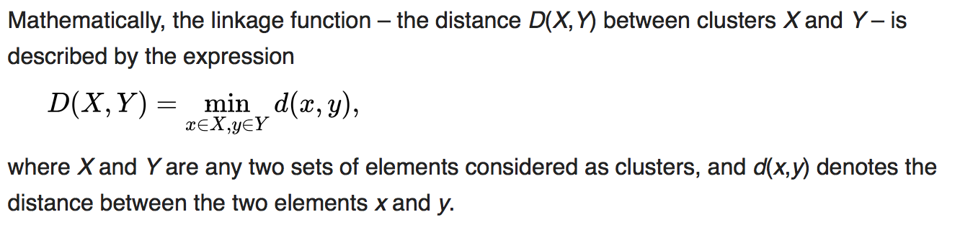
Single-Link(age) Clustering
Algorithm:
Start with each point of the dataset as a cluster by itself.
Merge two clusters with the smallest gap
distance between the closest points
Keep merging until you’ve reached K clusters
K is user defined just like in k-means
https://en.wikipedia.org/wiki/Single-linkage_clustering

Slide 24
Single-Link(age) Clustering
Distance Matrix
Hierarchical Cluster Representation
https://onlinecourses.science.psu.edu/stat555/node/86

Slide 25
Single-Link(age) Clustering
Determining clusters: One of the problems with hierarchical clustering is
that there is no objective way to say how many clusters there are.
K = 1
K=2
K=3

Slide 26
Single-Link(age) Clustering
Demo https://www.youtube.com/watch?v=XJ3194AmH40

Slide 27
Single-Link Clustering
Pros:
Fast
can find clusters of any shape
Cons:
no notion of compactness
no notion of balance

Slide 28
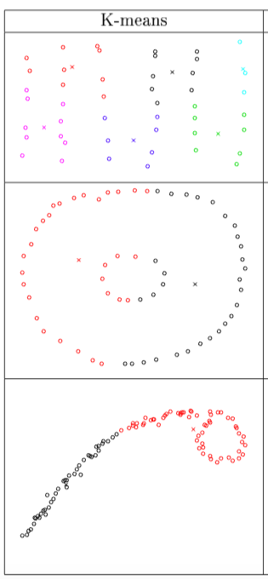
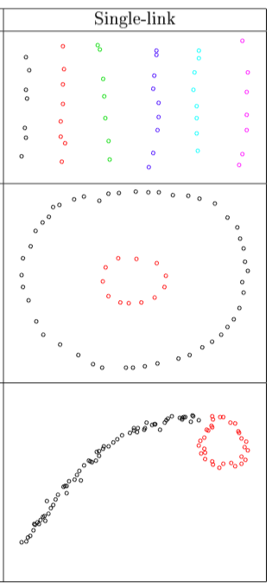
Comparison
http://www.stat.cmu.edu/~cshalizi/350-2006/

