Slide 1
Decision Trees
Learn from labeled observations - supervised learning
Represent the knowledge learned in form of a tree
Example: learning when to play tennis.
Examples/observations are days with their observed characteristics and whether we played tennis or not
Notes:
1

Slide 2
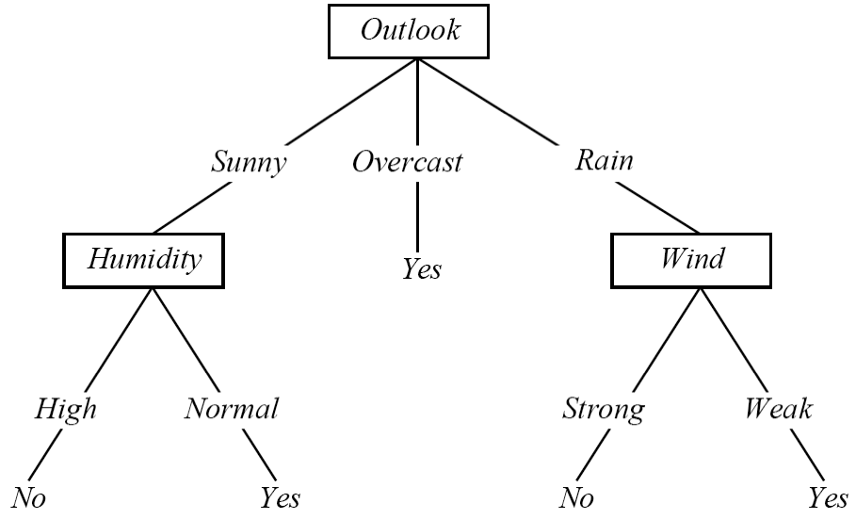
Play Tennis Example
Outlook | Temperature | Humidity | Windy | PlayTennis
Sunny | Hot | High | False | No
Sunny | Hot | High | True | No
Overcast | Hot | High | False | Yes
Rainy | Mild | High | False | Yes
Rainy | Cool | Normal | False | Yes
Rainy | Cool | Normal | True | No
Overcast | Cool | Normal | True | Yes
Sunny | Mild | High | False | No
Sunny | Cool | Normal | False | Yes
Rainy | Mild | Normal | False | Yes
Sunny | Mild | Normal | True | Yes
Overcast | Mild | High | True | Yes
Overcast | Hot | Normal | False | Yes
Rainy | Mild | High | True | No
Notes:
2

Slide 3
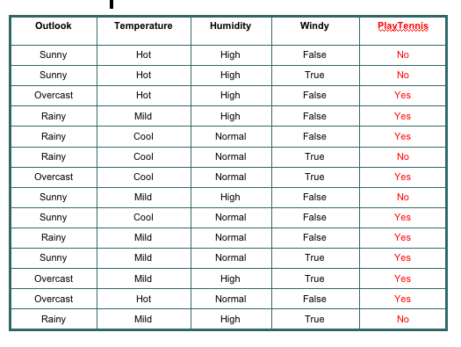
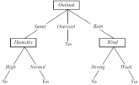
Decision Tree Learning
Induction
Facts or Observations
Theory
Notes:
3

Slide 4

Interpreting a DT
DT ≡ Decision Tree
A DT uses the features of an observation table as nodes and the feature values as links.
All feature values of a particular feature need to be represented as links.
The target feature is special - its values show up as leaf nodes in the DT.
Notes:
4

Slide 5
Interpreting a DT
Each path from the root of
the DT to a leaf can be
interpreted as a decision rule.
IF Outlook = Sunny AND Humidity = Normal THEN Playtennis = Yes
IF Outlook = Overcast THEN Playtennis =Yes
IF Outlook = Rain AND Wind = Strong THEN Playtennis = No
Notes:
5

Slide 6
DT: Explanation & Prediction
Explanation: the DT summarizes (explains) all the observations in the table perfectly ⇒ 100% Accuracy
Prediction: once we have a DT (or model) we can use it to make predictions on observations that are not in the original training table, consider:
Outlook = Sunny, Temperature = Mild, Humidity = Normal, Windy = False, Playtennis = ?
Notes:
6

Slide 7
Constructing DTs
How do we choose the attributes and the order in which they appear in a DT?
Recursive partitioning of the original data table
Heuristic - each generated partition has to be “less random” (entropy reduction) than previously generated partitions
Notes:
7

Slide 8
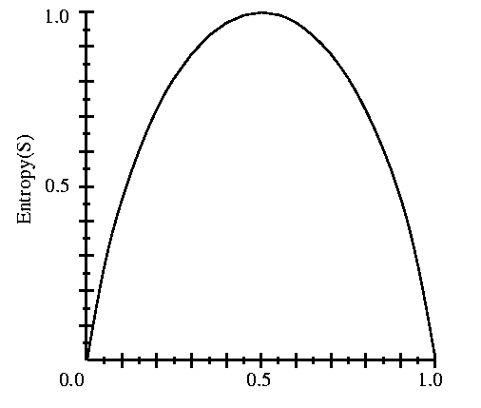
Entropy
S is a sample of training examples
p⁺ is the proportion of positive examples in S
p⁻ is the proportion of negative examples in S
Entropy measures the impurity (randomness) of S
S
p⁺
Entropy(S) ≡ - p⁺ log₂ p⁺ - p⁻ log₂ p⁻
Entropy(S) = Entropy([9+,5-]) = .94
Notes:
8

Slide 9
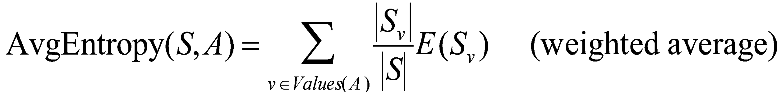
Partitioning the Data Set
Outlook | Temperature | Humidity | Windy | PlayTennis
Sunny | Hot | High | False | No
Sunny | Hot | High | True | No
Sunny | Mild | High | False | No
Sunny | Cool | Normal | False | Yes
Sunny | Mild | Normal | True | Yes
E = .97
Sunny
Outlook | Temperature | Humidity | Windy | PlayTennis
Overcast | Hot | High | False | Yes
Overcast | Cool | Normal | True | Yes
Overcast | Mild | High | True | Yes
Overcast | Hot | Normal | False | Yes
Outlook
Overcast
Average
Entropy = .64
(weighted .69)
E = 0
Rainy
Outlook | Temperature | Humidity | Windy | PlayTennis
Rainy | Mild | High | False | Yes
Rainy | Cool | Normal | False | Yes
Rainy | Cool | Normal | True | No
Rainy | Mild | Normal | False | Yes
Rainy | Mild | High | True | No
E = .97
Notes:
9

Slide 10
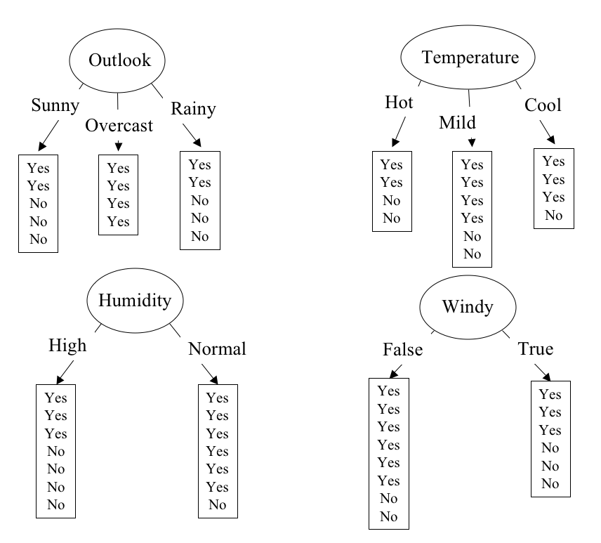
Partitioning in Action
E = .640
E = .789
E = .892
E = .911
Notes:
10

Slide 11
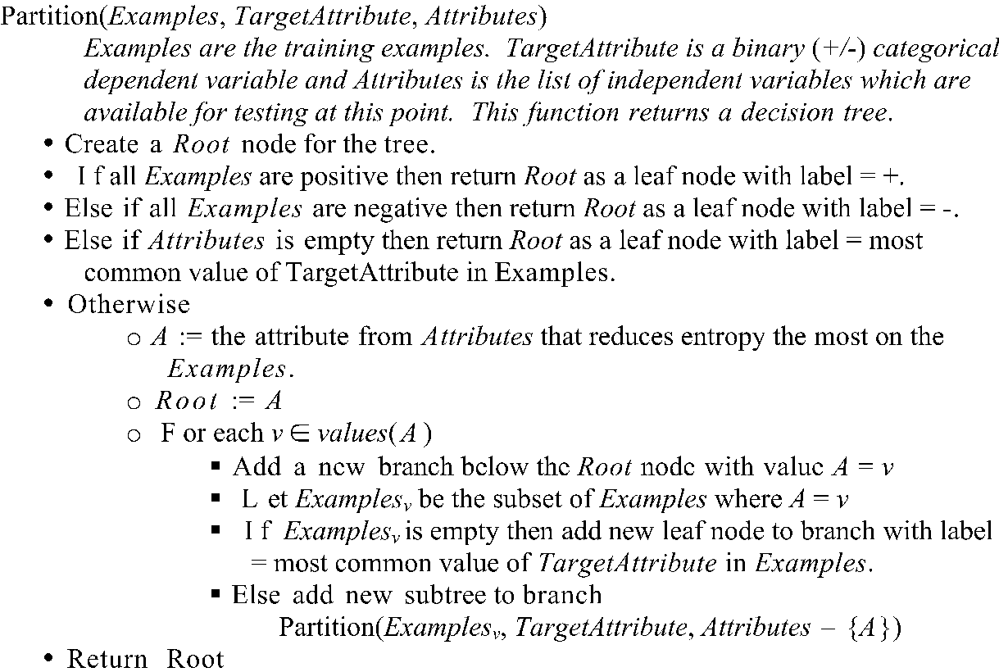
Recursive Partitioning
Based on material from the book: "Machine Learning", Tom M. Mitchell. McGraw-Hill, 1997.

Slide 12
Recursive Partitioning
Our data set:
Outlook | Temperature | Humidity | Windy | PlayTennis
Sunny | Hot | High | False | No
Sunny | Hot | High | True | No
Overcast | Hot | High | False | Yes
Rainy | Mild | High | False | Yes
Rainy | Cool | Normal | False | Yes
Rainy | Cool | Normal | True | No
Overcast | Cool | Normal | True | Yes
Sunny | Mild | High | False | No
Sunny | Cool | Normal | False | Yes
Rainy | Mild | Normal | False | Yes
Sunny | Mild | Normal | True | Yes
Overcast | Mild | High | True | Yes
Overcast | Hot | Normal | False | Yes
Rainy | Mild | High | True | No
Notes:
12

Slide 13
Recursive Partitioning
Sunny | Hot | High | False | No
Sunny | Hot | High | True | No
Overcast | Hot | High | False | Yes
Rainy | Mild | High | False | Yes
Rainy | Cool | Normal | False | Yes
Rainy | Cool | Normal | True | No
Overcast | Cool | Normal | True | Yes
Sunny | Mild | High | False | No
Sunny | Cool | Normal | False | Yes
Rainy | Mild | Normal | False | Yes
Sunny | Mild | Normal | True | Yes
Overcast | Mild | High | True | Yes
Overcast | Hot | Normal | False | Yes
Rainy | Mild | High | True | No
Outlook
Sunny | Hot | High | False | No
Sunny | Hot | High | True | No
Sunny | Mild | High | False | No
Sunny | Cool | Normal | False | Yes
Sunny | Mild | Normal | True | Yes
Rainy | Mild | High | False | Yes
Rainy | Cool | Normal | False | Yes
Rainy | Cool | Normal | True | No
Rainy | Mild | Normal | False | Yes
Rainy | Mild | High | True | No
Overcast | Hot | High | False | Yes
Overcast | Cool | Normal | True | Yes
Overcast | Mild | High | True | Yes
Overcast | Hot | Normal | False | Yes
Notes:
13

Slide 14
Recursive Partitioning
Outlook
Sunny | Hot | High | False | No
Sunny | Hot | High | True | No
Sunny | Mild | High | False | No
Sunny | Cool | Normal | False | Yes
Sunny | Mild | Normal | True | Yes
Rainy | Mild | High | False | Yes
Rainy | Cool | Normal | False | Yes
Rainy | Cool | Normal | True | No
Rainy | Mild | Normal | False | Yes
Rainy | Mild | High | True | No
Overcast | Hot | High | False | Yes
Overcast | Cool | Normal | True | Yes
Overcast | Mild | High | True | Yes
Overcast | Hot | Normal | False | Yes
Notes:
14

Slide 15
Recursive Partitioning
Outlook
Sunny | Hot | High | False | No
Sunny | Hot | High | True | No
Sunny | Mild | High | False | No
Sunny | Cool | Normal | False | Yes
Sunny | Mild | Normal | True | Yes
Rainy | Mild | High | False | Yes
Rainy | Cool | Normal | False | Yes
Rainy | Cool | Normal | True | No
Rainy | Mild | Normal | False | Yes
Rainy | Mild | High | True | No
Overcast | Hot | High | False | Yes
Overcast | Cool | Normal | True | Yes
Overcast | Mild | High | True | Yes
Overcast | Hot | Normal | False | Yes
Humidity
Sunny | Cool | Normal | False | Yes
Sunny | Mild | Normal | True | Yes
Sunny | Hot | High | False | No
Sunny | Hot | High | True | No
Sunny | Mild | High | False | No
Notes:
15

Slide 16
Recursive Partitioning
Outlook
Sunny | Hot | High | False | No
Sunny | Hot | High | True | No
Sunny | Mild | High | False | No
Sunny | Cool | Normal | False | Yes
Sunny | Mild | Normal | True | Yes
Rainy | Mild | High | False | Yes
Rainy | Cool | Normal | False | Yes
Rainy | Cool | Normal | True | No
Rainy | Mild | Normal | False | Yes
Rainy | Mild | High | True | No
Overcast | Hot | High | False | Yes
Overcast | Cool | Normal | True | Yes
Overcast | Mild | High | True | Yes
Overcast | Hot | Normal | False | Yes
Humidity
Windy
Sunny | Cool | Normal | False | Yes
Sunny | Mild | Normal | True | Yes
Sunny | Hot | High | False | No
Sunny | Hot | High | True | No
Sunny | Mild | High | False | No
Rainy | Mild | High | False | Yes
Rainy | Cool | Normal | False | Yes
Rainy | Mild | Normal | False | Yes
Rainy | Cool | Normal | True | No
Rainy | Mild | High | True | No
Notes:
16

Slide 17

Continuous-Valued Attributes
Sort instances according to the attribute values
Find “Splits” where the classes change
Select the split that gives you the highest gain
Consider:
(48+60)/2
= 54
(80+90)/2
= 85
Highest Gain: Temperature > 54

Slide 18
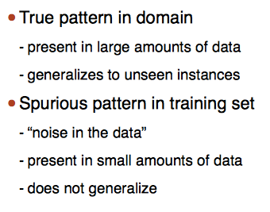
Decision Trees & Patterns in Data

Slide 19
Overfitting – Also True for Trees!
Tree Depth!

Slide 20
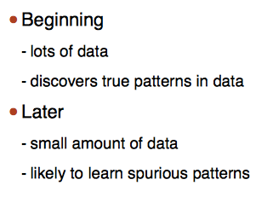
Tree Learning Process
Control the Tree Complexity - Pruning

Slide 21
Pruning
One of two ways:
Prevent the tree from overfitting – limit the tree depth.
Build the whole tree and then remove subtrees and replaces with suitable leaves.

Slide 22
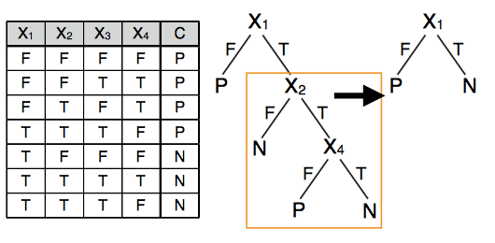
Pruning Example

Slide 23
Subtree Pruning with Deviation
At each split ask:
Is the pattern found in the data after splitting statistically significant?
Prune if deviation is small – that is, prune if no significant information gain.

Slide 24
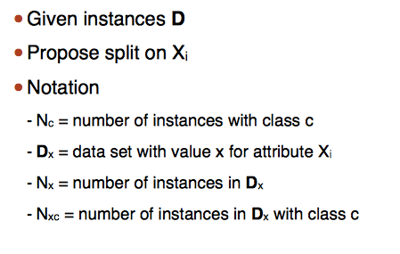
Given Split

Slide 25
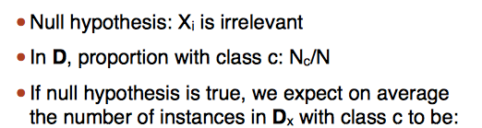

Absence of Pattern
$${\hat{N}}_{XC}=\frac{\left|D_{x}\right|}{N}N_{c}$$

Slide 26
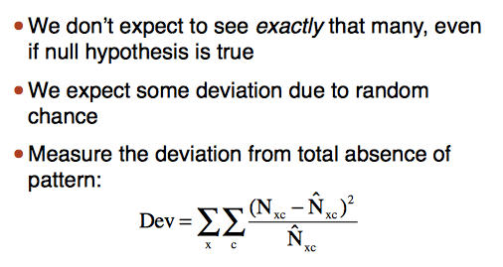
Deviation
➔ Delete split if Dev is small

