Slide 1
Ensemble Methods
In statistics and machine learning, ensemble methods use multiple learning algorithms to obtain better predictive performance than could be obtained from any of the constituent learning algorithms.
Ensemble methods construct a set of classifiers and then classify new data points by taking a weighted vote of their predictions.
sources: https://en.wikipedia.org/wiki/Ensemble_learning and Ensemble Methods in Machine Learning by Thomas G􏰡 Dietterich

Slide 2
Ensemble Methods
Supervised learning algorithms are commonly described as performing the task of searching through a hypothesis space to find a suitable hypothesis that will make good predictions with a particular problem.
Even if the hypothesis space contains hypotheses that are very well-suited for a particular problem, it may be very difficult to find (a good) one,
  local minima in ANN’s
  too expensive to fit a decision surface in a highly non-linear situation (SVM) – fitting an SVM with large values of C

Slide 3
Ensemble Methods
Ensembles combine multiple hypotheses to form a (hopefully) better hypothesis.
The term ensemble is usually reserved for methods that generate multiple hypotheses using the same base learner, i.e. decision tree
Note: The broader term of multiple classifier systems also covers hybridization of hypotheses that are not induced
by the same base learner.

Slide 4
Ensemble Methods
Evaluating the prediction of an ensemble typically requires more computation than evaluating the prediction of a single model
Ensembles may be thought of as a way to compensate for poor learning algorithms by performing a lot of extra computation.

Slide 5
Ensemble Methods
An ensemble is itself a supervised learning algorithm
  it is trained on labeled data and then used to make predictions on unseen data points
A trained ensemble represents a single hypothesis,
  This hypothesis, however, is not necessarily contained within the hypothesis space of the models from which it is built.
  Thus, ensembles can be shown to have more flexibility in the functions they can represent – we will see that with Random Forrests

Slide 6
Ensemble Techniques
Bagged Trees
  Bootstrap AGGregatED decision Trees
  Leo Breiman ‘94
Random Decision Forests
  Decision trees constructed on random subspaces
  Tin Kam Ho ‘95
Random Forests
  Decision trees built on bootstrap samples using random subspaces
  Leo Breiman ‘01

Slide 7
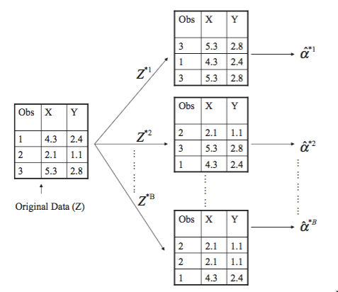

Bagged Trees
Recall the bootstrap
  resample with replacement – B bootstrap samples - Z^{*k}
Build B decision trees on the bootstrap samples -
Given a point have each tree vote on the prediction,
  The prediction with the most votes is the prediction of the ensemble.

Slide 8
Bagged Trees
Notice that due to the resampling with replacement each bootstrap sample represents the input domain slightly differently.
This means that bootstrapping might eliminate some irregularities from the original data that a single tree might have a difficult time learning/representing.

Slide 9
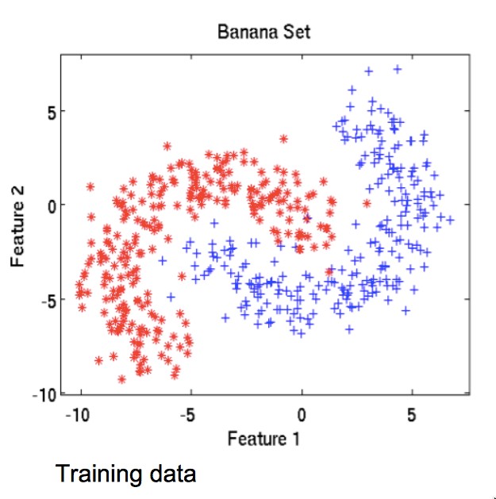
Bagged Trees
source: https://www.cs.rit.edu/~rlaz/prec20092/slides/Bagging_and_Boosting.pdf

Slide 10
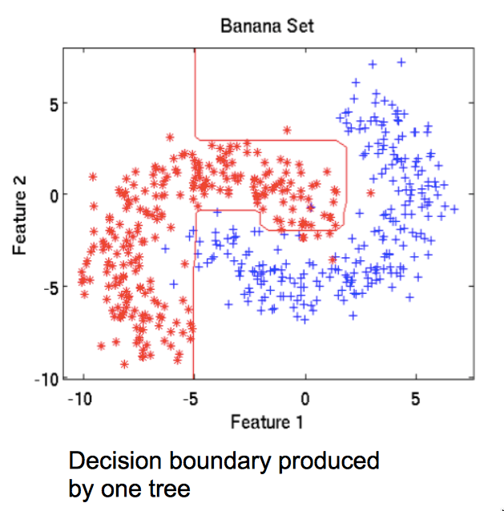
Bagged Trees

Slide 11
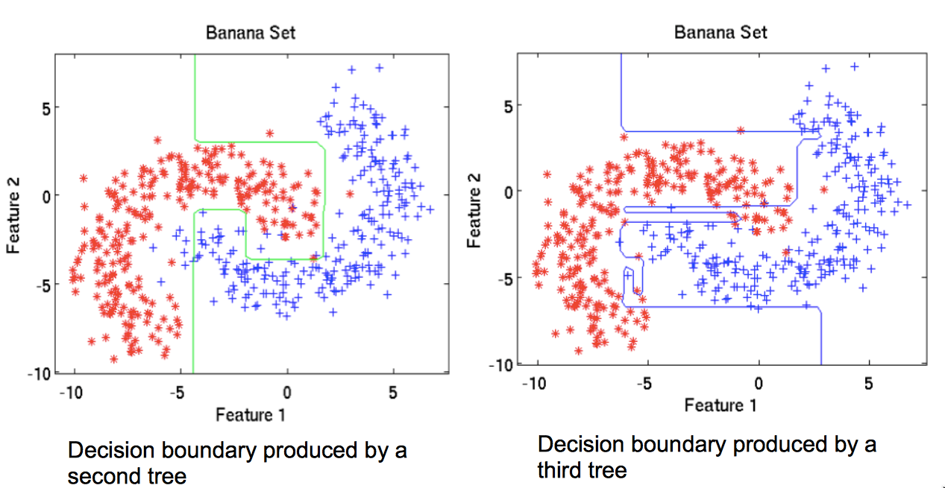
Bagged Trees

Slide 12
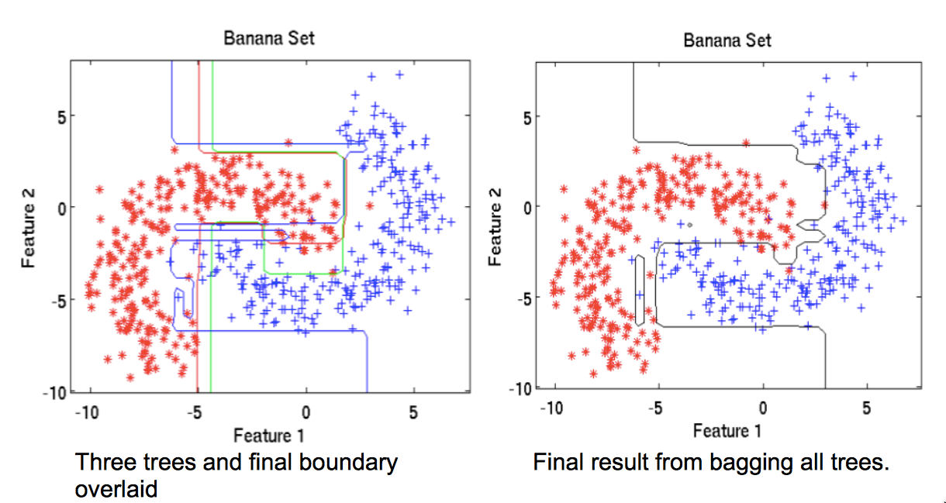
Bagged Trees

Slide 13
Random Subspace Method
The random subspace method is similar to bagging except that the features ("attributes", "predictors", "independent variables") are randomly sampled, with replacement, for each learner.
Informally, this causes individual learners to not over-focus on features that appear highly predictive/descriptive in the training set, but fail to be as predictive for points outside that set.
For this reason, random subspaces are an attractive choice for problems where the number of features is much larger than the number of training points

Slide 14
Random Subspace Method
An ensemble of models employing the random subspace method can be constructed using the following algorithm:
  Let the number of training points be N and the number of features in the training data be D.
  Choose L to be the number of individual models in the ensemble.
  For each individual model M, choose d_{M} (d_{M} < D) to be the number of input variables for M. It is common to have only one value of d_{M} for all the individual models.
  For each individual model M, create a training set by choosing d_{M} features from D with replacement and train the model.
Now, to apply the ensemble model to an unseen point, combine the outputs of the L individual models by majority voting.
Applying the above algorithm to decision trees gives us Random Decision Forests
https://en.wikipedia.org/wiki/Random_subspace_method

Slide 15
Random Forests
Random Forests combine Bagged Trees and Random Decision Forests.

Slide 16
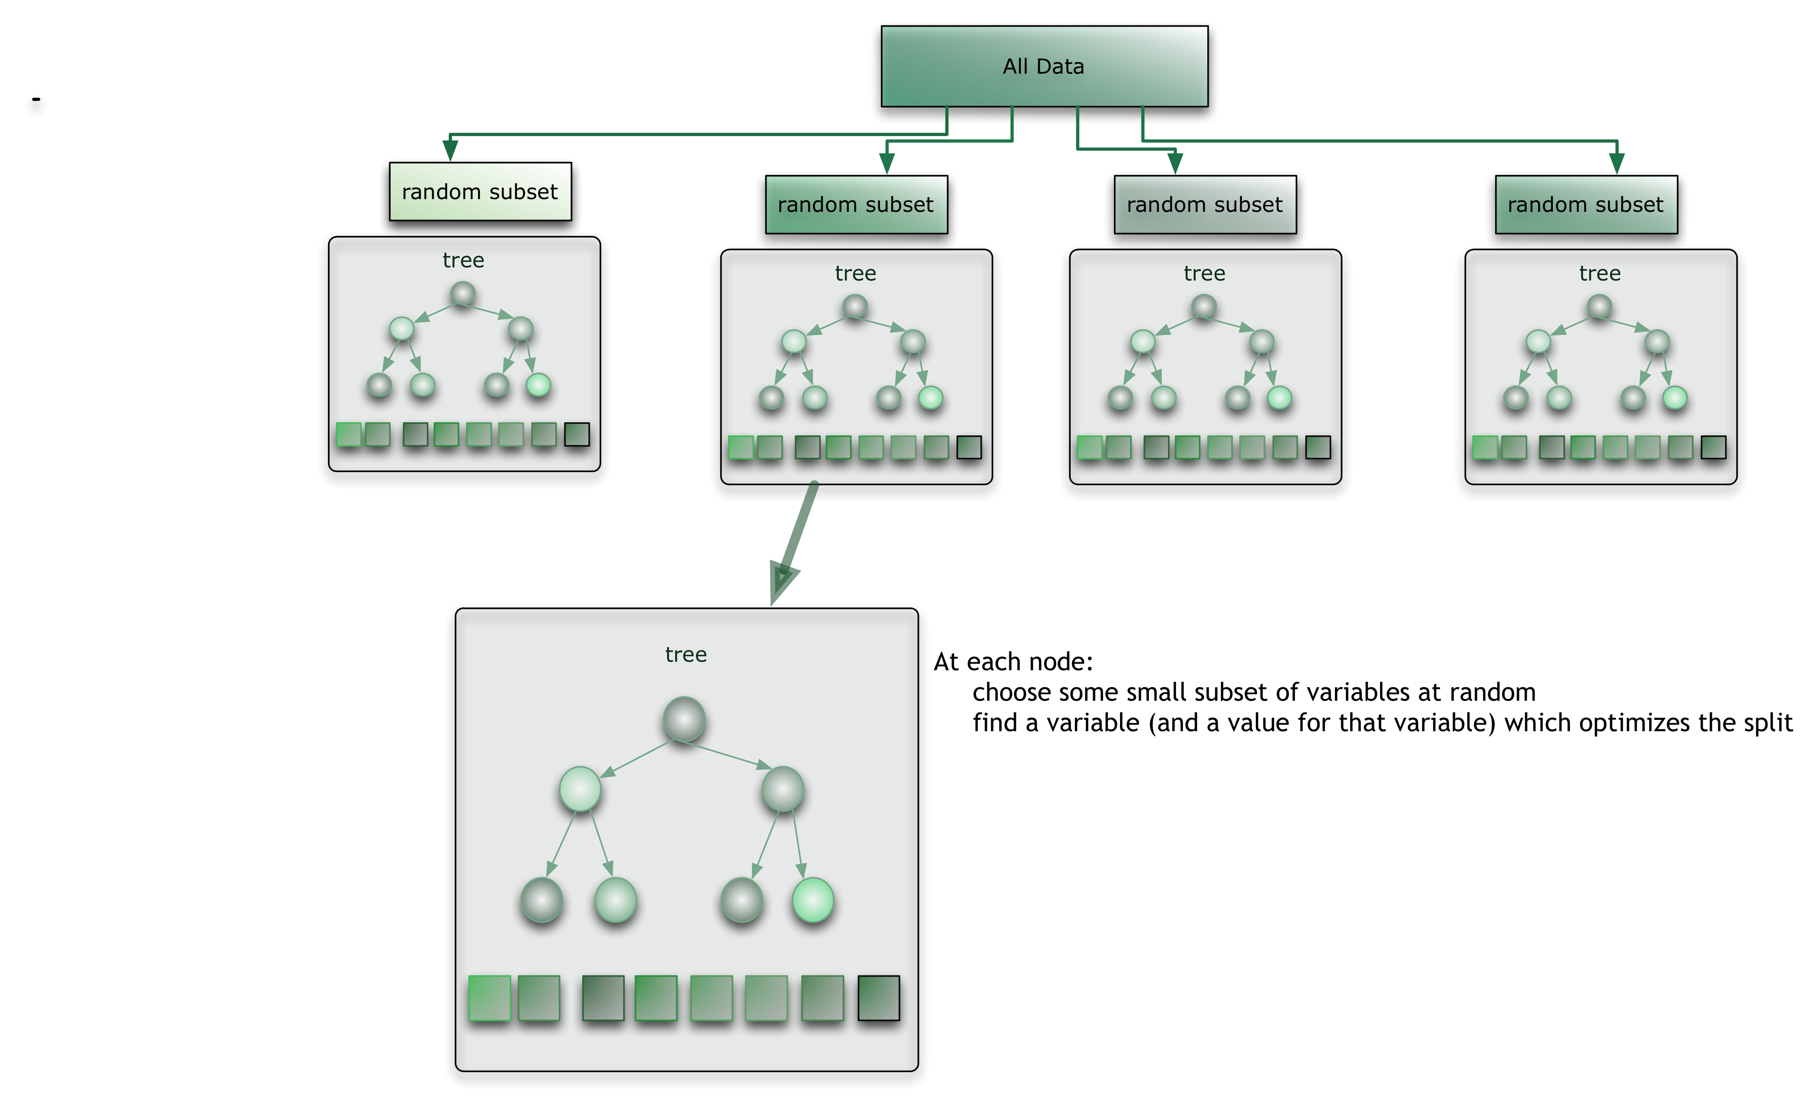
Random Forests
source: https://citizennet.com/blog/2012/11/10/random-forests-ensembles-and-performance-metrics/

Slide 17
Random Forests
Each tree is grown as follows:
Create a bootstrap sample from the original data. This sample will be the training set for growing the tree.
For M input variables/attribute, choose a number m<<M,
  at each node, m variables are selected at random out of the M and the best split on these m is used to split the node. The value of m is held constant during the forest growing.
Each tree is grown to the largest extent possible. There is no pruning.

Slide 18
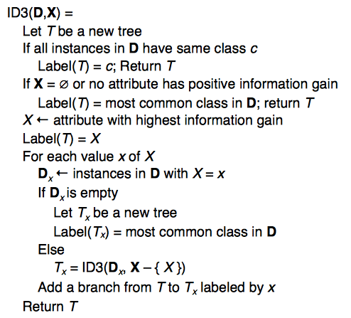
Random Forests
from m randomly selected attributes from X
At top level generate bootstrap
samples D
After trees have been grown
combine in a majority voting
scheme

