Slide 1
Regression Trees
Same as classification trees except we predict a numeric value
Slight complication with the entropy calculation for the splits

Slide 2
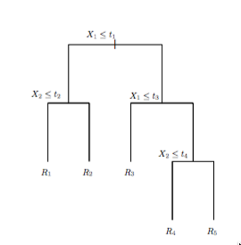
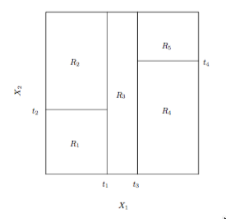
Regression Trees
Consider a data set with X1 and X2 as independent variables and Y as dependent variable with values R1, R2, R3, R4, and R5.
The right figure represents a partitioning of the space according to the induced tree.

Slide 3
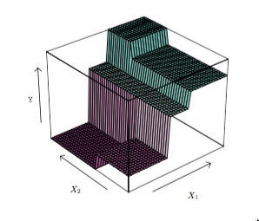
Regression Trees

Slide 4
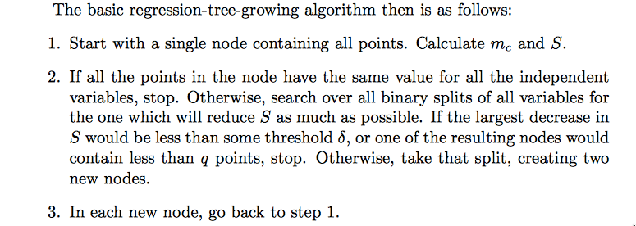

Regression Trees
with

Slide 5
Regression Trees
Note: We do not use entropy but minimize the sum squared error at the leaves!

Slide 6
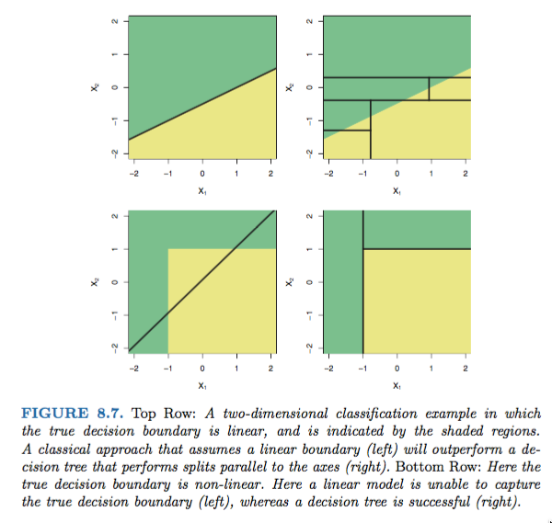

Slide 7
The End

