Slide 1
Sms Olvasás Androidon
CodeRaptor

Slide 2

Milyen osztályokra lesz szükségünk?
Data Class:
Adapter:
Activity
data class Data(val name: String, val age: Int){}
class ListAdapter(val context: Context,
val list: ArrayList<>): BaseAdapter(){}
class MainActivity : AppCompatActivity(){}

Slide 3
Kotlin data class vs Java
Kotlin:
data class Data(val name: String, val age: Int){}
Java:
public class Data{
private String name;
private Integer age;
public Data(){}
public String getName(){
return name;
}
public void setName(String name){ this.name = name; }
public Integer getAge(){ return age; }
public void setAge(Integer age){
this.age = age;
}
}

Slide 4
A fontosabb lépések / függvények
Jogosultáság engedélyezése:
<manifest>
<uses-permission android:name="android.permission.READ_SMS"/>
</manifest>
Engedély kérés kódban:
private fun askPermission(): Boolean {
return if (!hasPermission(this, Manifest.permission.READ_SMS)) {
Toast.makeText(this, "Megtagadva!", Toast.LENGTH_LONG).show()
false
}else {
Toast.makeText(this, "Engedélyezve!", Toast.LENGTH_LONG).show()
ActivityCompat.requestPermissions(this,
arrayOf(Manifest.permission.READ_SMS), PERMISSION_CODE)
true
}
}
Adapter inicializálása:
private fun setupAdapter(smsList: ArrayList<SmsData>, selection: String) {
val adapter = ListAdapter(this, smsList, selection)
sms_list_view.adapter = adapter
}

Slide 5
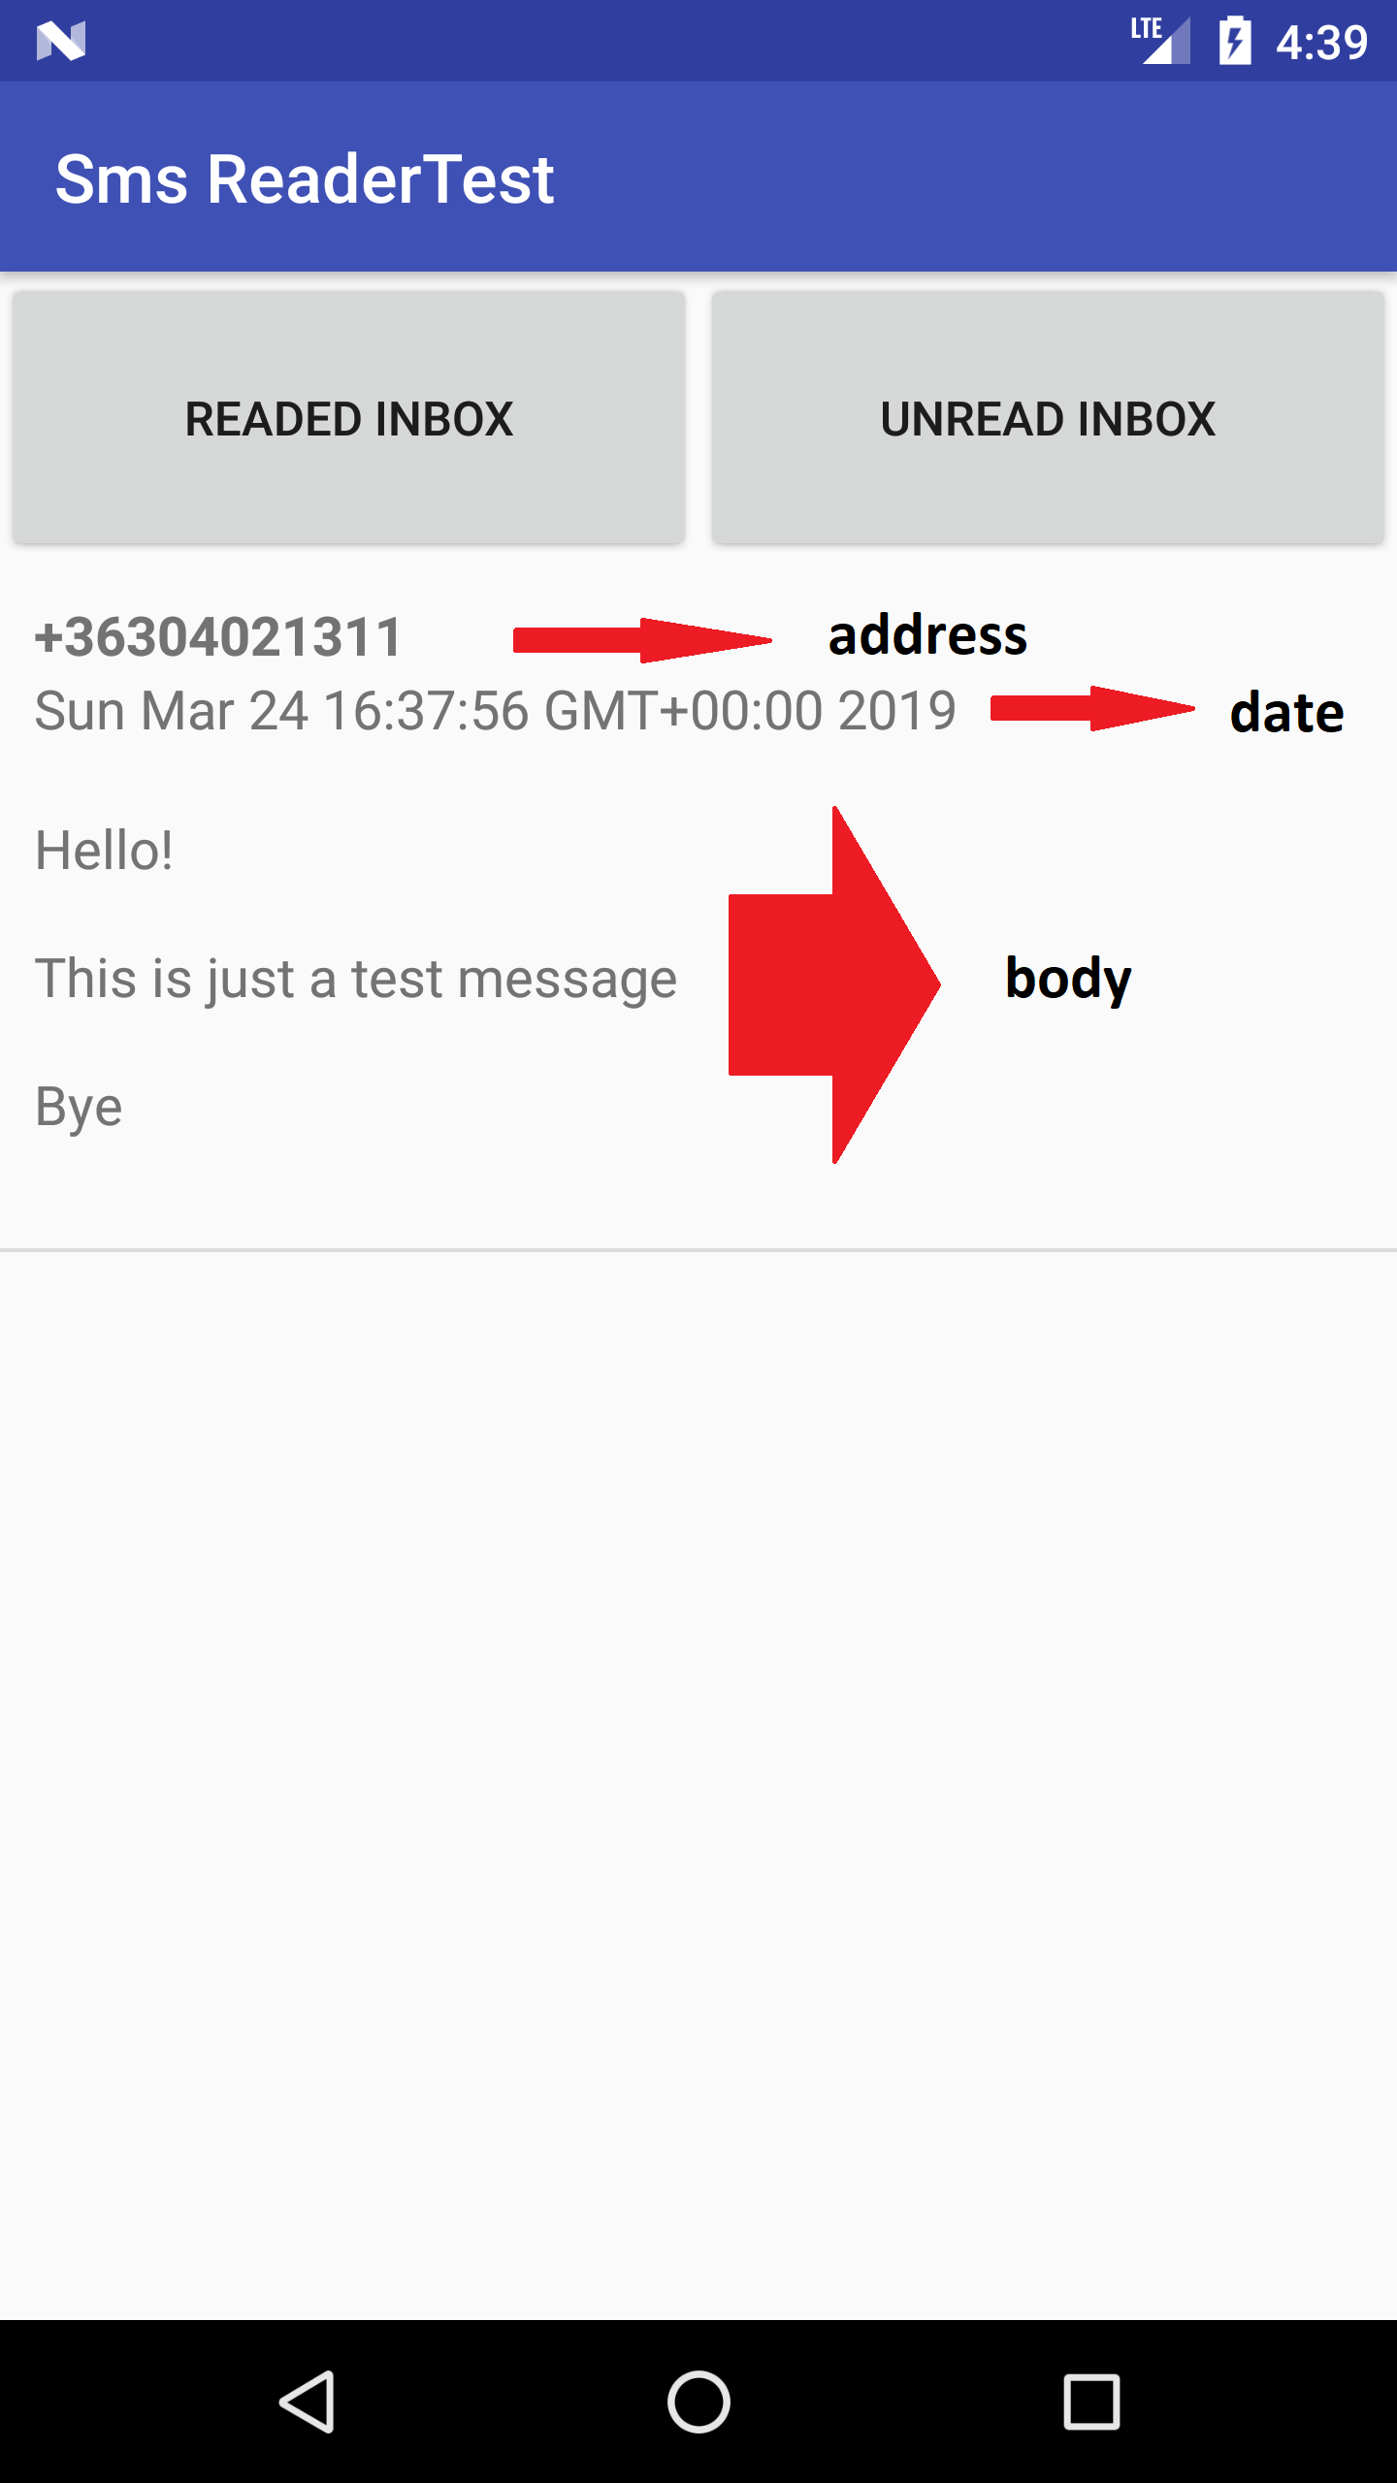

Sms olvasás háttere
Az sms-ket a rendszer Sqlite adatbázisban tárolja
Pár fontosabb attribútum:
_id
address
read
date
body

Slide 6
Sms-ek feldolgozása
//uriString = inbox, selection = read=0/1
private fun getSmsMessages(uriString: String, selection: String) {
val smsList = ArrayList<SmsData>()
val cursor: Cursor = contentResolver.query(
Uri.parse("content://sms/$uriString"),
null,selection,null,"date DESC")
if (cursor.moveToFirst()) {
val nameID = cursor.getColumnIndex("address")
val messageID = cursor.getColumnIndex("body")
val dateID = cursor.getColumnIndex("date")
do {
val dateString = cursor.getString(dateID)
smsList.add(SmsData(cursor.getString(nameID),
Date(dateString.toLong()),
cursor.getString(messageID)))
} while(cursor.moveToNext())
}
cursor.close()
setupAdapter(smsList, selection)
}

Slide 7
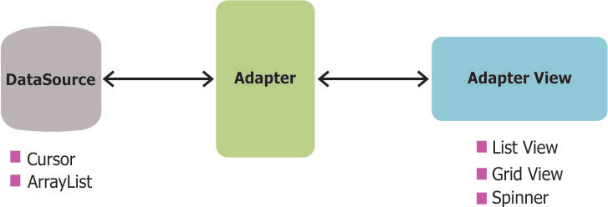
Adapter
4 kötelező függvénye:
getItem(position: Int): Any
getItemId(position: Int): Long
getCount(): Int
getView(): View

Slide 8
Adapter getView()
override fun getView(position: Int, convertView: View?,
parent: ViewGroup?): View {
val view = LayoutInflater.from(context)
.inflate(R.layout.row_layout, parent, false)
if (selection == MainActivity.UNREAD) {
view.sms_sender.setTypeface(null, Typeface.BOLD)
}
view.sms_sender.text = list[position].senderName
view.sms_message.text = list[position].message
view.sms_date.text = "${list[position].date} \n"
return view
}

Slide 9

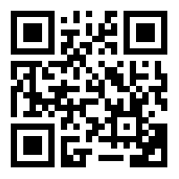
Tesztre fel!
A teljes forráskód githubon: https://goo.gl/K6AXCr
Vagy:
CodeRaptor

Slide 10


Teszthez Töltsétek le a Kahoot-ot!
Felhasználóneved legyen a neptun kódod!
PlayStrore:
iTunes:
PC:
kahoot.it

