Slide 1
CN Lab

Slide 2
OSPF-Configure OSPF routing protocol
Routers connect networks using the Internet Protocol (IP)
OSPF (Open Shortest Path First) is a router protocol used to find the best path for packets as they pass through a set of connected networks.

Slide 3
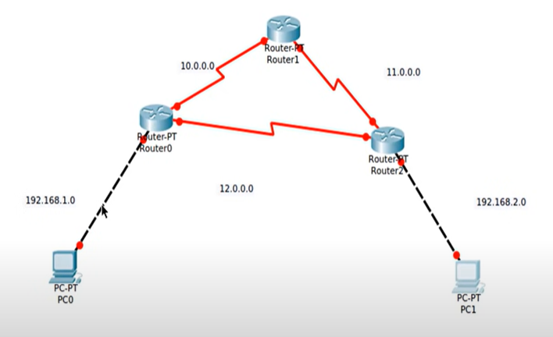
1.

Slide 4
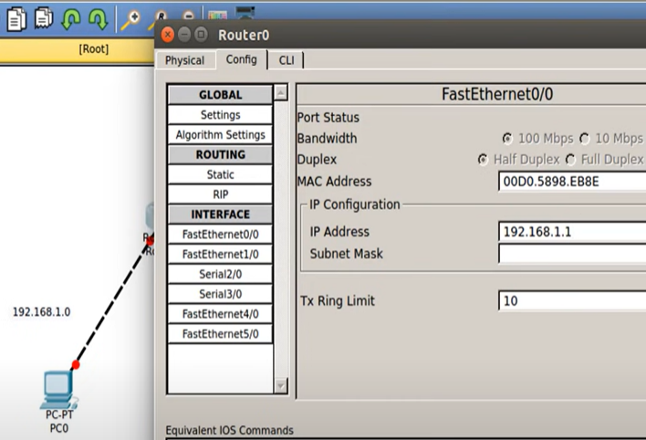
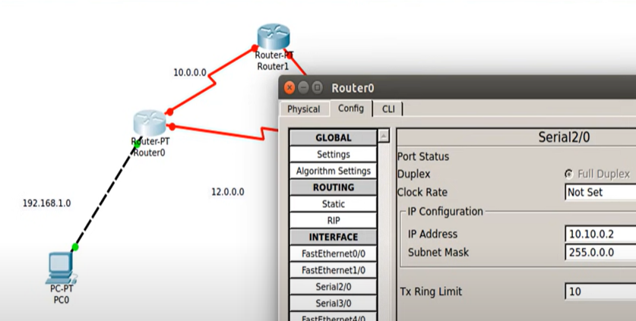
2.
Configure IP for PCs
Configure Gateway

Slide 5
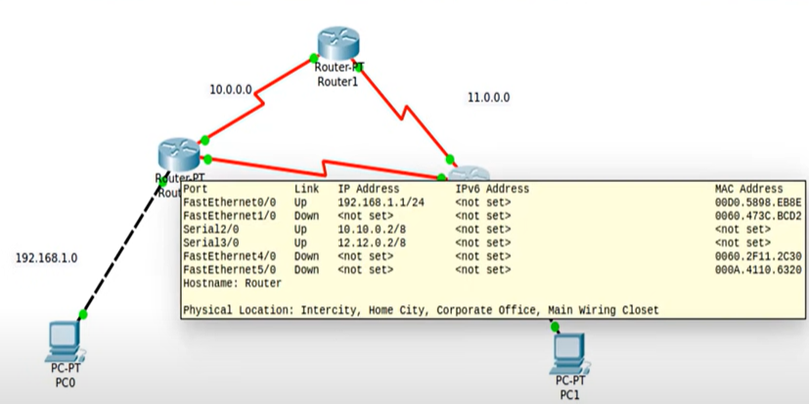

Slide 6
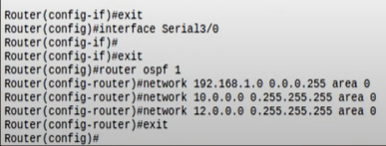



Slide 7
Go to edit filters next to auto captureplay

Slide 8
OSPF- using Area

Slide 9
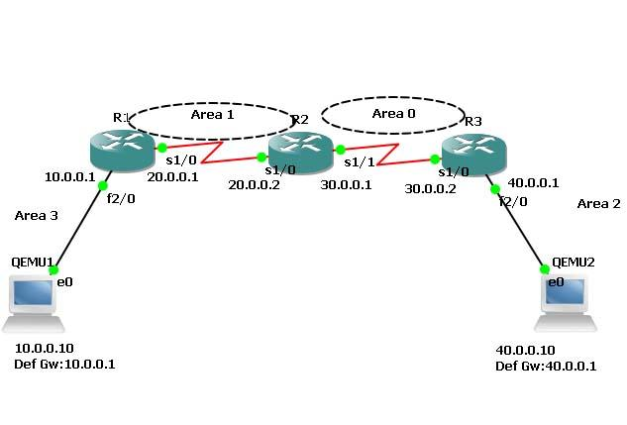

Slide 10
ARP
To construct simple LAN and understand the concept
and operation of Address Resolution Protocol (ARP)

Slide 11
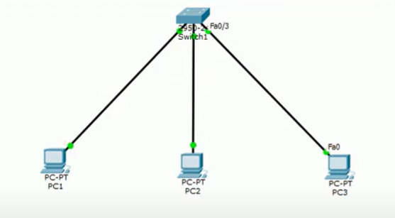
Address Resolution Protocol (ARP) is a protocol or procedure that connects an ever-changing Internet Protocol (IP) address to a fixed physical machine address, also known as a media access control (MAC) address, in a local-area network (LAN).

Slide 12
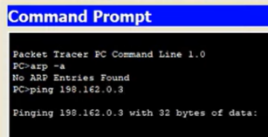
STEPS
Topology
IP address + subnet mask in each PC
Commands used:
arp -a → to check arp table( from PC command prompt)
arp -d → to clear arp
Click Capture/Forward

Slide 13
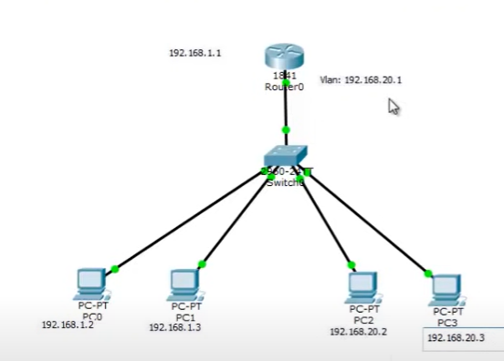
Prog: VLAN

Slide 14
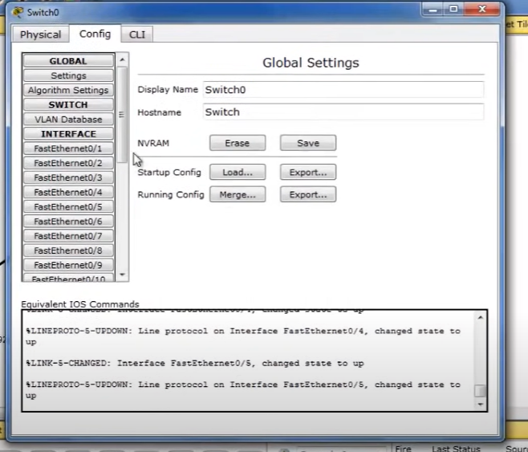
SWITCH

Slide 15
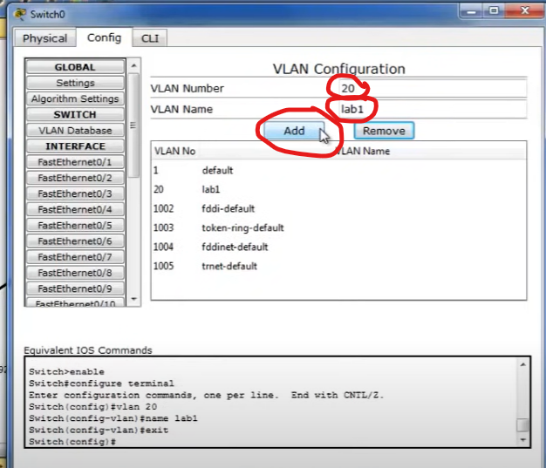

Slide 16
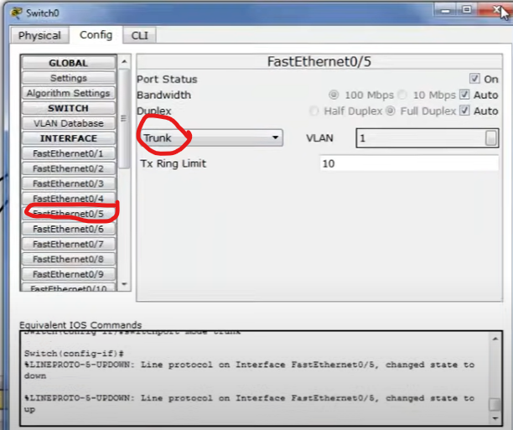
Set Trunk: here its FastEthernet 0/5

Slide 17
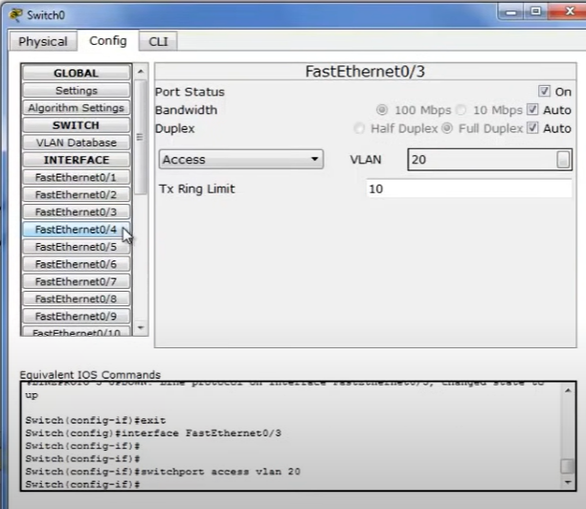
Now:
The right side systems connected to switch FE 3 and 4 have to be assigned VLAN 20
(Select from drop down box)

Slide 18
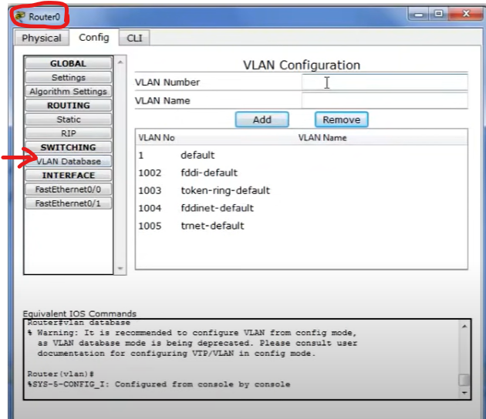
Here Add VLAN Details:
Ex: 20 and lab1
Notes:
https://www.youtube.com/watch?v=WMbXgtxTrBY

Slide 19
Commands in the router-CLI of router
Router#] Config Terminal
Router(config)#interface fastEthernet 0/0.1
Router(config-subif)#
Router(config-subif)#encapsulation dot1q 20
Router(config-subif)#ip address 192.168.20.1 255.255.255.0
Router(config-subif)#no shut
Router(config-subif)#exit
Router(config)#exit

Slide 20
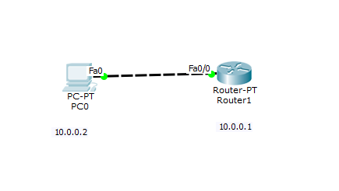
TELNET

Slide 21
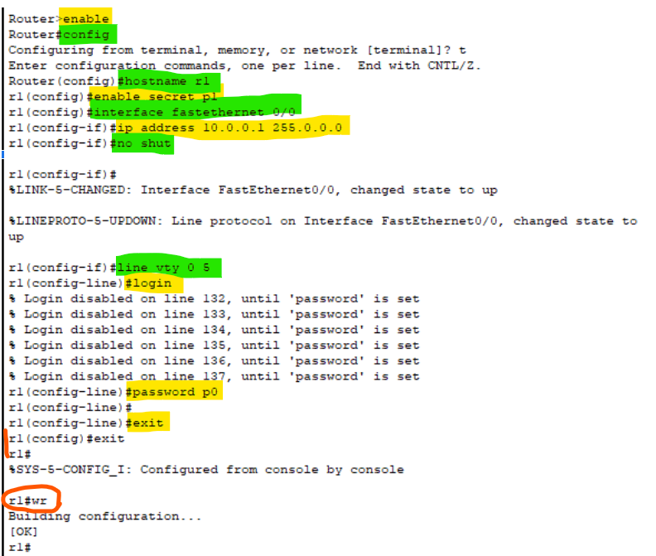
enable
config t
hostname R1
enable secret p1
interface fastethernet 0/0
ip address 10.0.0.1 255.0.0.0
no shut
line vty 0 5 --to allow virtual terminal access for 6 users
login
password p0
exit
exit
wr – to save changes in router
Router-0:

Slide 22
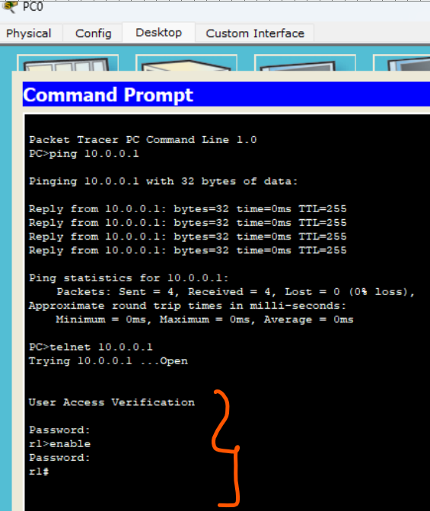
Commands in PC
In command prompt,
Ping 10.0.0.1
Password for User Access Verification is p0
Password for enable is p1
Accessing router CLI from PC

Slide 23
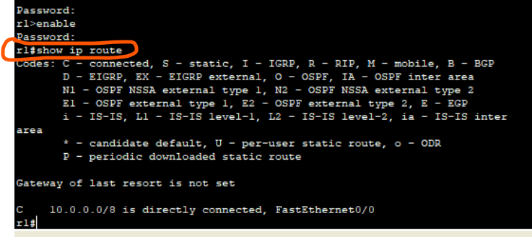
The admin in PC is able to run commands as run in router CLI and see the result from P

Slide 24
Write a program for error detecting code using CRC-CCITT (16-bits).
Algorithm
Start
Enter the message to be transmitted
Append the message with 16(since it is 16-bit CRC) 0`s (i.e. if you input 5 digit message, the appeneded message should be 21-bits.)
XOR appended message and transmit it.(Here, you compare with an already exisitng string such as 10001000000100001 and replace the bits the same way XOR operation works)
Verify the message that is received is the same as the one sent.
End

Slide 25
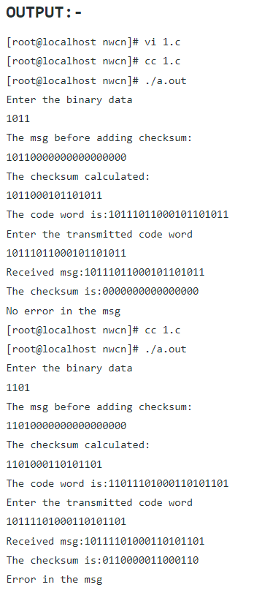

Slide 26
Write a program for congestion control using Leaky bucket algorithm.
Algorithm:
Start
Set the bucket size or the buffer size.
Set the output rate.
Transmit the packets such that there is no overflow.
Repeat the process of transmission until all packets are transmitted. (Reject packets where its size is greater than the bucket size)
Stop
Each host is connected to the network by an interface containing a leaky bucket, that is, a finite internal queue.
If a packet arrives at the queue when it is full, the packet is discarded.
In other words, if one or more process are already queued, the new packet is unceremoniously discarded.
This arrangement can be built into the hardware interface or simulated by the host operating system.
The host is allowed to put one packet per clock tick onto the network.
This mechanism turns an uneven flow of packet from the user process inside the host into an even flow of packet onto the network, smoothing out bursts and greatly reducing the chances of congestion.

