Slide 1

DATA STRUCTURES
UNIT-3
Part 2-Queues
Dr. Nagarathna N
PROFESSOR
B.M.S. COLLEGE OF ENGINEERING

Slide 2
UNIT 3
Stacks: Operations, array representations of stacks, stack applications - infix to postfix conversion, postfix expression evaluation, and function call tracing, recursion.
Queues: Introduction, Basic concept, linear queue operations, circular queue, priority queues, double ended queues. Applications of Queues.
Stack and queue implementation using linked lists

Slide 3
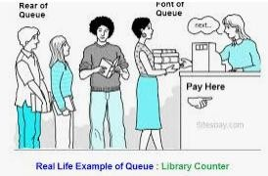
QUEUE -ADT
Queue: A list or a collection with the restrictions that insertion can be performed at one end (the rear or tail of the queue) and deletion can be performed at other end (the front or head of the queue).
A queue is a FIFO(first in, first out) data structure
Any waiting line is a queue:
The check-out line at a grocery store
The cars at a stop light
Ticket counter

Slide 4
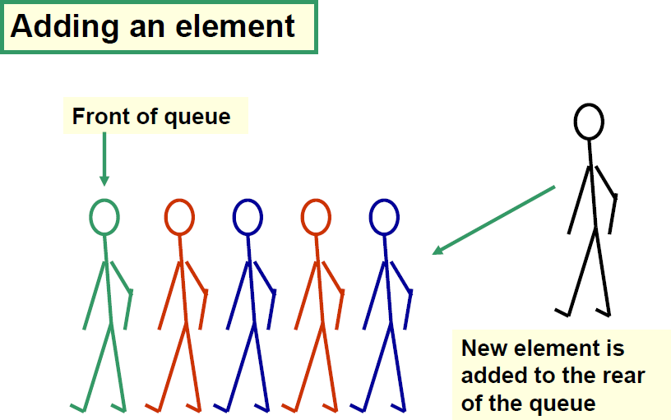
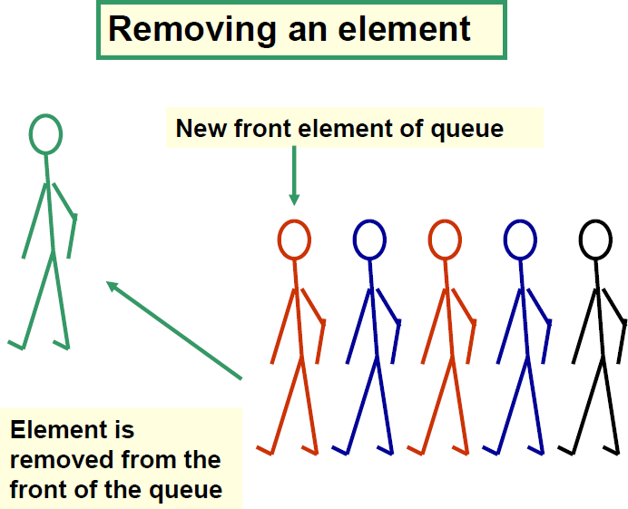
Conceptual view of a Queue

Slide 5
Uses of Queue in computing
For any kind of problem involving FIFO data.
Printer Queue
Keyboard Input buffer
GUI Event Queue
Web browser request Queue

Slide 6
Uses of Queues in computing
In simulation studies, where the goal is to reduce waiting times:
Optimize the flow of traffic at a traffic light
Determine the number of cashiers to have on duty at a grocery store at different times of day
Process Scheduling
Printer Queues in Network

Slide 7
Queue Operations
Enqueue(x) or push(x): add an element to the tail of a queue.
Dequeue() or pop(): remove an element from the head of a queue.
Front() or peek(): examine the element at the head of the queue.
QEmpty() or IsEmpty()
QFull() or IsFull()
It is not legal to access the elements in the middle of the queue!

Slide 8
Implementation of Queues
Array
Linked List

Slide 9
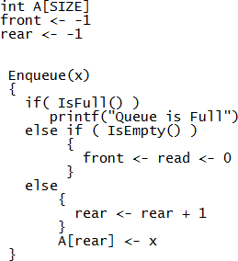
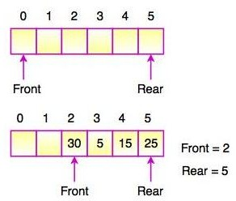
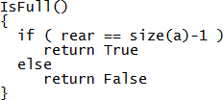
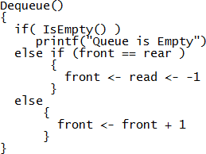
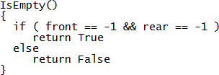
Array Implementation

Slide 10
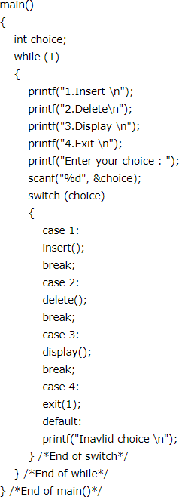
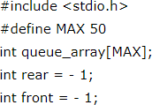
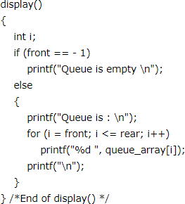

Slide 11
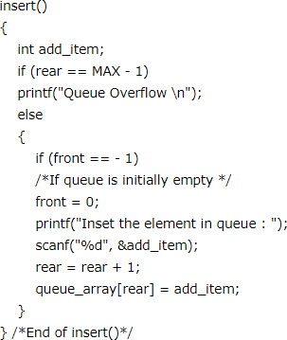
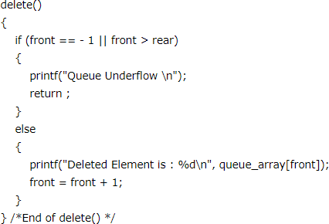

Slide 12
Lab Program 7
7. Write a program to simulate the working of a queue of integers using an array. Provide the following operations:
a) Insert b) Delete c) Display
The program should print appropriate messages for queue empty and queue overflow conditions.

Slide 13
Lab Program 9
9. Write a program to implement Stack & Queues using Linked Representation.

Slide 14
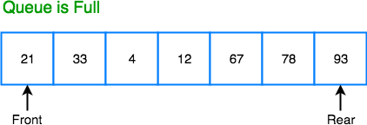
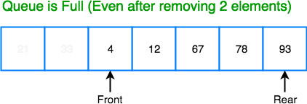
Circular Queue
Why we need a circular queue, when we already have linear queue data structure?

Slide 15
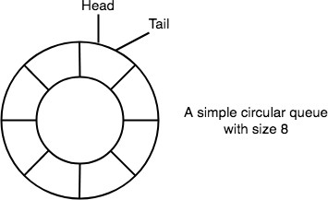
Circular Queue
Circular Queue is also a linear data structure, which follows the principle of FIFO(First In First Out), but instead of ending the queue at the last position, it again starts from the first position after the last, hence making the queue behave like a circular data structure.

Slide 16
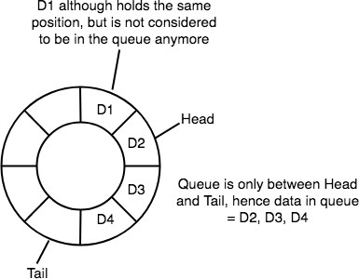
Circular Queue
In a circular queue, data is not actually removed from the queue. Only the head pointer is incremented by one position when dequeue is executed.
As the queue data is only the data between head and tail, hence the data left outside is not a part of the queue anymore, hence removed.

Slide 17
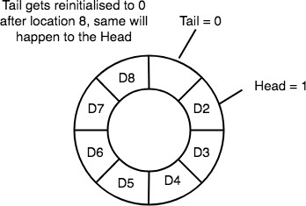
Circular Queue
The head and the tail pointer will get reinitialised to 0 every time they reach the end of the queue.
Current Position = i
Next Position = (i+1)% N
Previous Position = (i+N-1)%N

Slide 18
Application of Circular Queue
Some common real-world examples where circular queues are used:
Computer controlled Traffic Signal System uses circular queue.
CPU scheduling and Memory management.

Slide 19
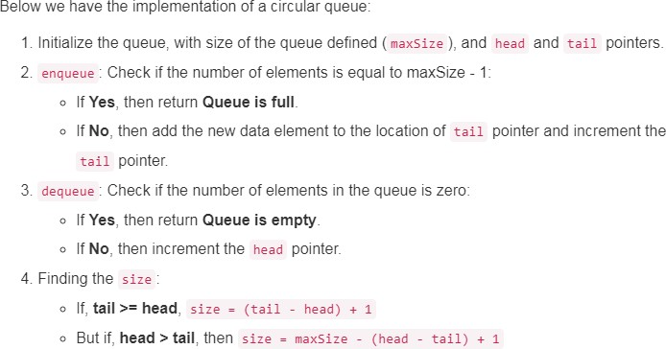
Implementation of Circular Queue

Slide 20
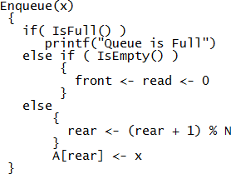

Implementation of Circular Queue

Slide 21
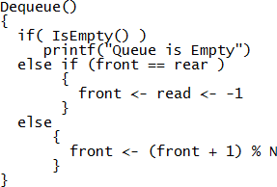
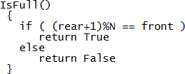

Slide 22
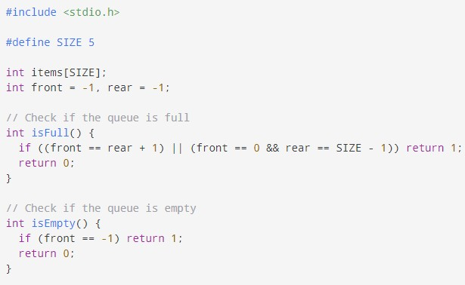
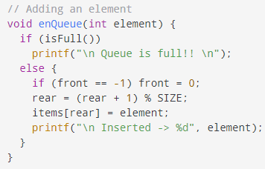

Slide 23
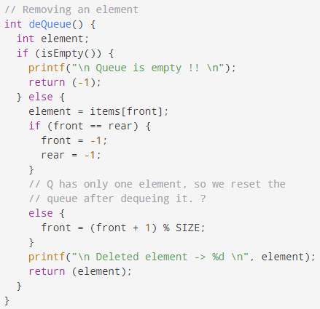
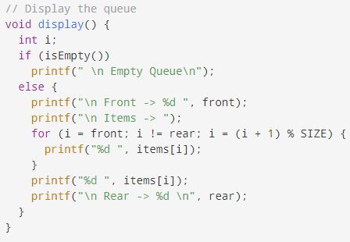

Slide 24
Lab Program 8
8. Write a program to simulate the working of a circular queue of integers using an array. Provide the following operations.:
a) Insert b) Delete c) Display
The program should print appropriate messages for queue empty and queue overflow conditions.
.

Slide 25

Double ended Queue
Deque or Double Ended Queue is a type of queue in which insertion and removal of elements can be performed from either from the front or rear. Thus, it does not follow FIFO rule (First In First Out).
Types of Deque
Input Restricted Deque
In this deque, input is restricted at a single end but allows deletion at both the ends.
Output Restricted Deque
In this deque, output is restricted at a single end but allows insertion at
both the ends.

Slide 26
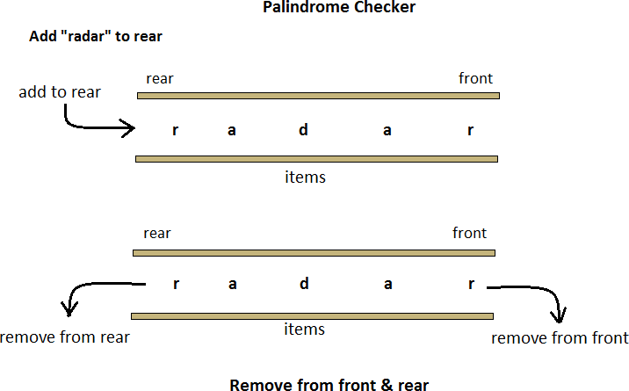
Applications

Slide 27

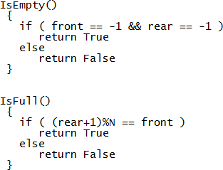
Algorithm

Slide 28
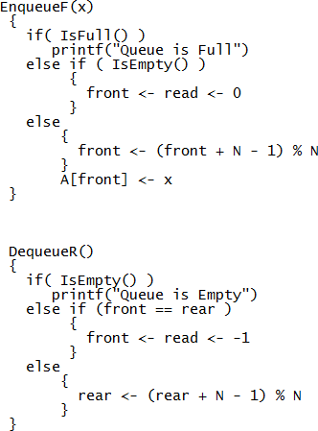
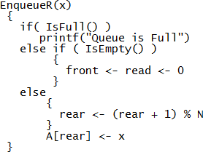
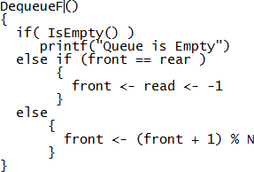

Slide 29
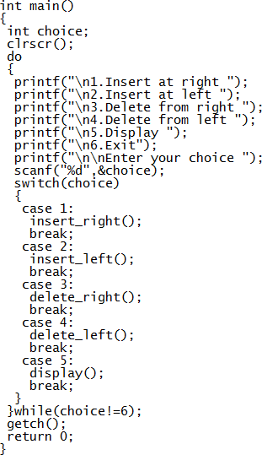
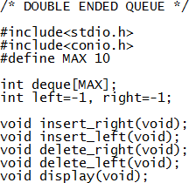

Slide 30
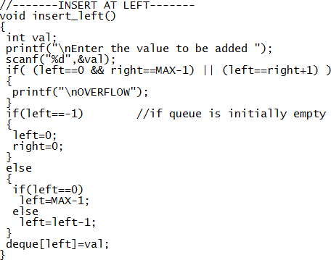
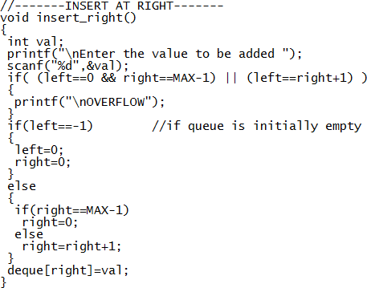

Slide 31
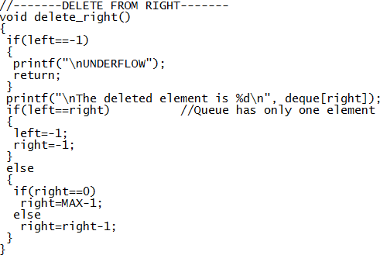
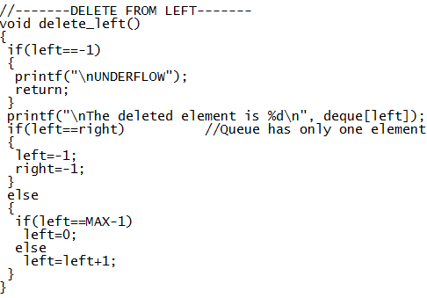

Slide 32
Priority Queue
Priority Queue is an extension of queue with following properties:
Every item has a priority associated with it.
An element with high priority is dequeued before an element with low priority.
If two elements have the same priority, they are served according to their order in the queue.

Slide 33
Priority Queue
In a queue, the first-in-first-out rule is implemented whereas, in a priority queue, the values are removed on the basis of priority. The element with the highest priority is removed first.

Slide 34
Types of Priority Queue
Min Priority Queue: In min priority Queue minimum number of value gets the highest priority and lowest number of element gets the highest priority.
Max Priority Queue: Max priority Queue is the opposite of min priority Queue in it maximum number value gets the highest priority and minimum number of value gets the minimum priority.

Slide 35
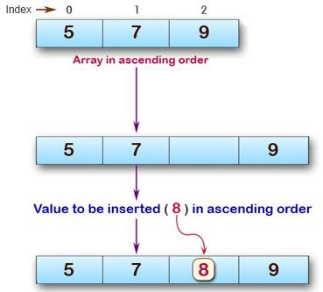
Solution

Slide 36
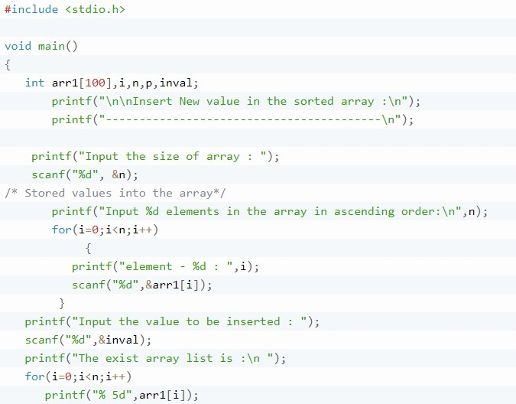

Slide 37
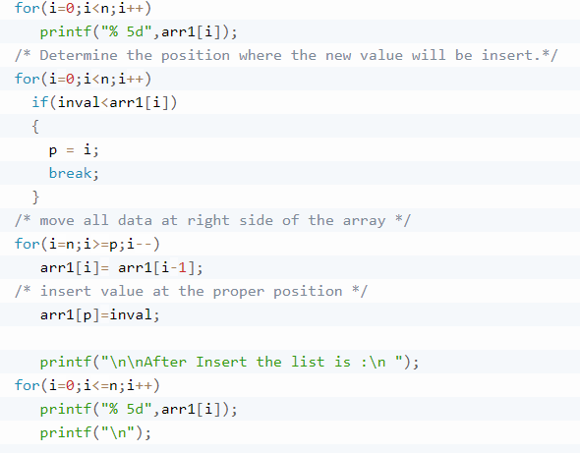

Slide 38
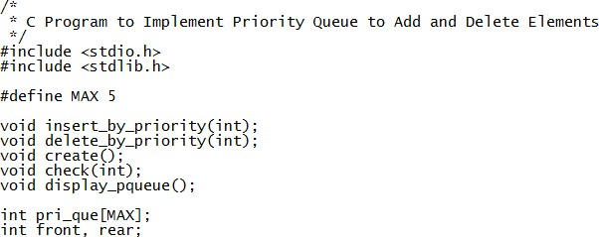
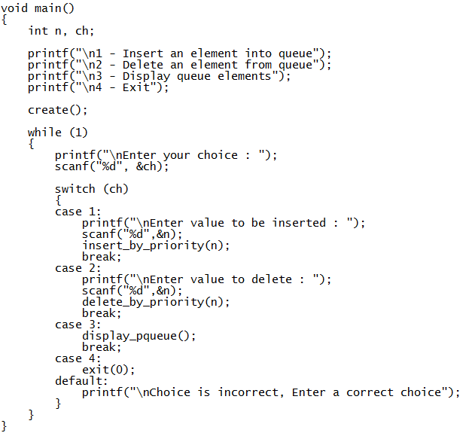

Slide 39
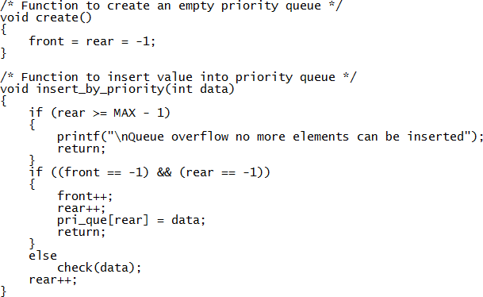
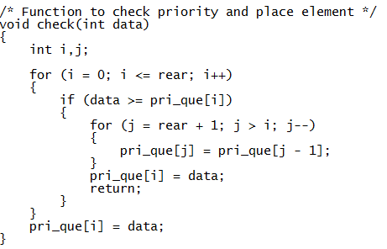

Slide 40
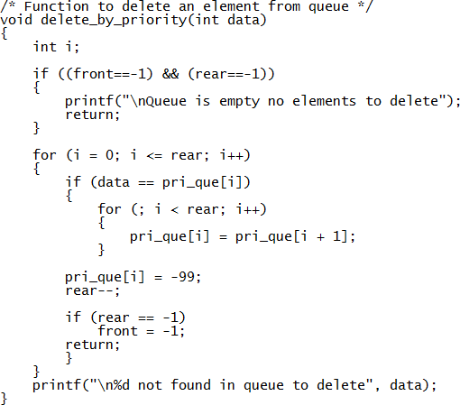
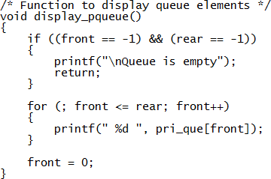

Slide 41
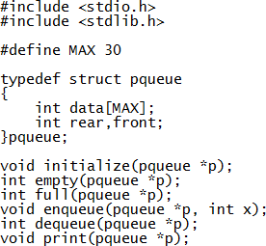
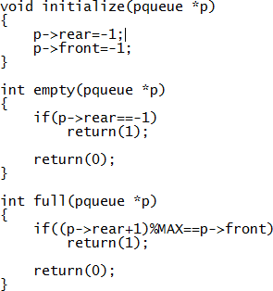
Priority Queue (Circular Q concept)

Slide 42
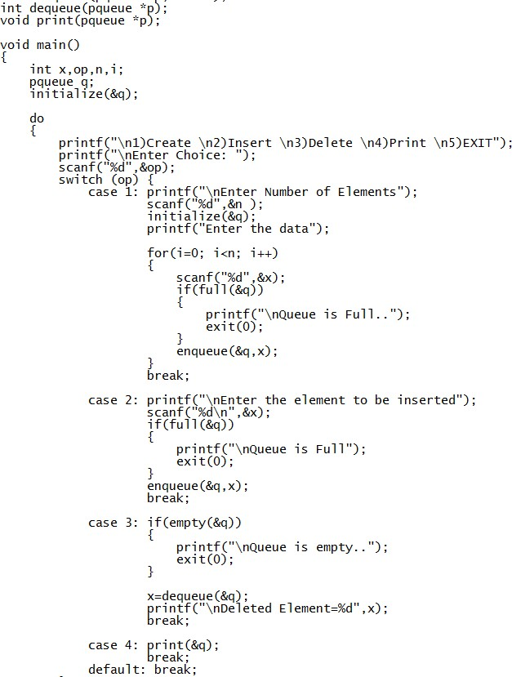

Priority Queue (Circular Q concept)

Slide 43
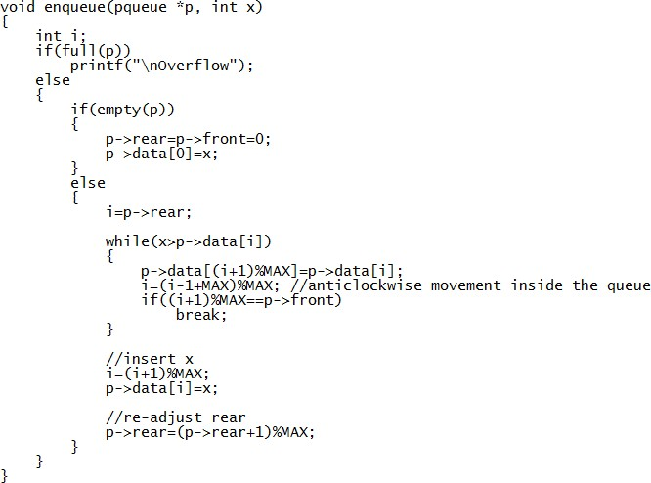

Slide 44



