Slide 1

Chapter 5
Introduction to
Modern Symmetric-key
Ciphers
5.<number>
Copyright © The McGraw-Hill Companies, Inc. Permission required for reproduction or display.

Slide 2
Chapter 5
Objectives
❏ To distinguish between traditional and modern
symmetric-key ciphers.
❏ To introduce modern block ciphers and discuss
their characteristics.
❏ To explain why modern block ciphers need to be
designed as substitution ciphers.
❏ To introduce components of block ciphers such as
P-boxes and S-boxes.
5.<number>

Slide 3
Chapter 5
Objectives (Continued)
❏ To discuss product ciphers and distinguish
between two classes of product ciphers: Feistel
and non-Feistel ciphers.
❏ To discuss two kinds of attacks particularly
designed for modern block ciphers: differential
and linear cryptanalysis.
❏ To introduce stream ciphers and to distinguish
between synchronous and nonsynchronous stream
ciphers.
❏ To discuss linear and nonlinear feedback shift
registers for implementing stream ciphers.
5.<number>

Slide 4
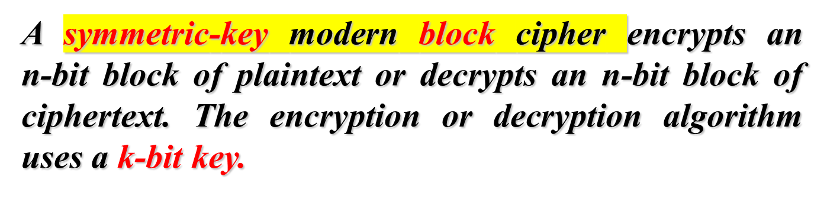
5-1 MODERN BLOCK CIPHERS
Topics discussed in this section:
5.1.1 Substitution or Transposition
5.1.2 Block Ciphers as Permutation Groups
5.1.3 Components of a Modern Block Cipher
5.1.4 Product Ciphers
5.1.5 Two Classes of Product Ciphers
5.1.6 Attacks on Block Ciphers
5.<number>

Slide 5
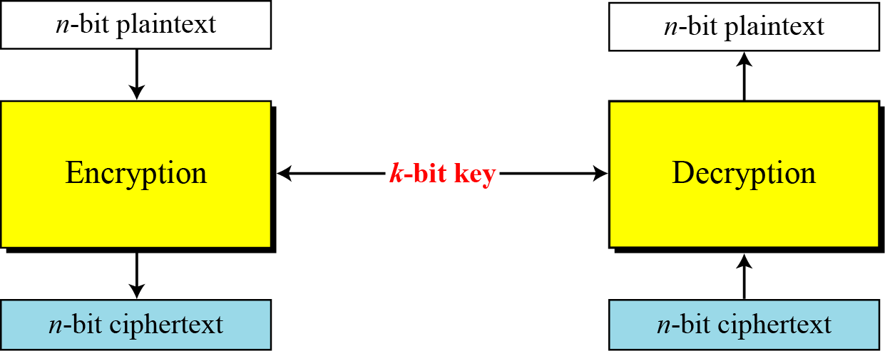
5.1 Continued
Figure 5.1 A modern block cipher
5.<number>

Slide 6



5.1 Continued
Example 5.1
How many padding bits must be added to a message of 100 characters if 8-bit ASCII is used for encoding and the block cipher accepts blocks of 64 bits?
Solution
Encoding 100 characters using 8-bit ASCII results in an 800-bit message. The plaintext must be divisible by 64. If | M | and |Pad| are the length of the message and the length of the padding,
5.<number>

Slide 7
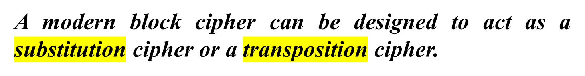

5.1.1 Substitution or Transposition
Note
To be resistant to exhaustive-search attack,
a modern block cipher needs to be
designed as a substitution cipher.
5.<number>

Slide 8


5.1.1 Continued
Example 5.2
Suppose that we have a block cipher where n = 64. If there are 10 1’s in the ciphertext, how many trial-and-error tests does Eve need to do to recover the plaintext from the intercepted ciphertext in each of the following cases?
a. The cipher is designed as a substitution cipher.
b. The cipher is designed as a transposition cipher.
Solution
In the first case, Eve has no idea how many 1’s are in the plaintext. Eve needs to try all possible 264 64-bit blocks to find one that makes sense.
In the second case, Eve knows that there are exactly 10 1’s in the plaintext. Eve can launch an exhaustive-search attack using only those 64-bit blocks that have exactly 10 1’s.
5.<number>

Slide 9
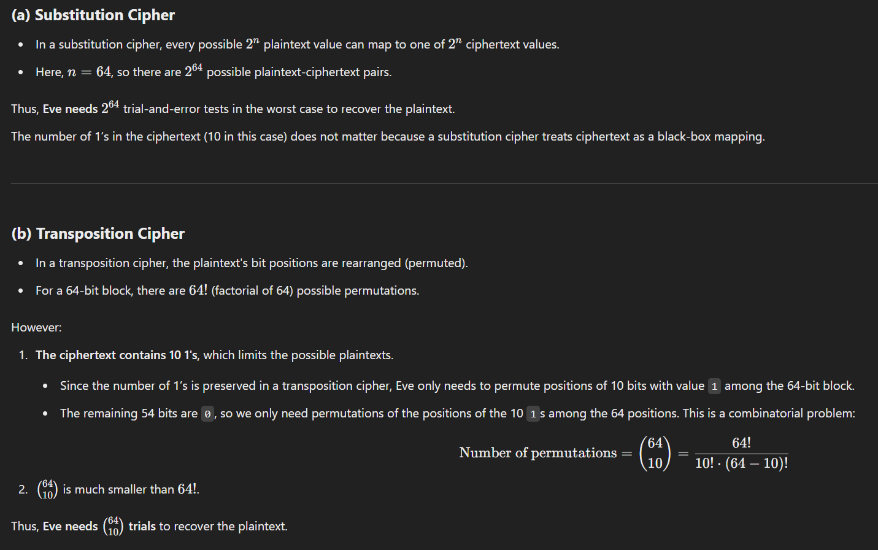
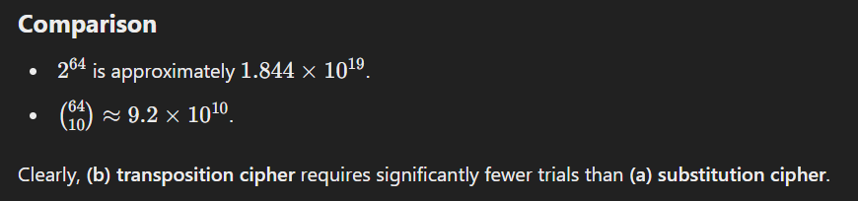
5.<number>

Slide 10
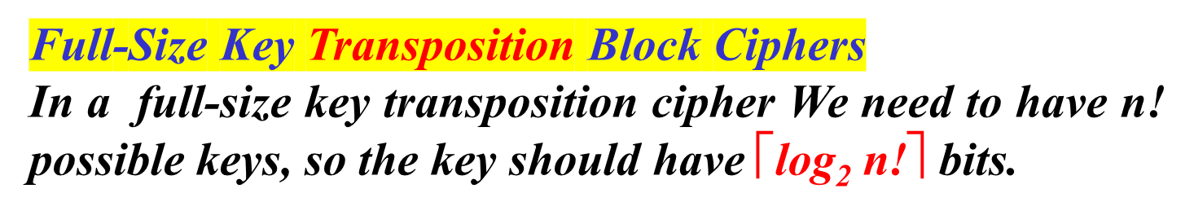
5.1.2 Block Ciphers as Permutation Groups
Is a modern block cipher a group?
Example 5.3
Show the model and the set of permutation tables for a 3-bit block transposition cipher where the block size is 3 bits.
Solution
The set of permutation tables has 3! = 6 elements, as shown in Figure 5.2.
5.<number>

Slide 11
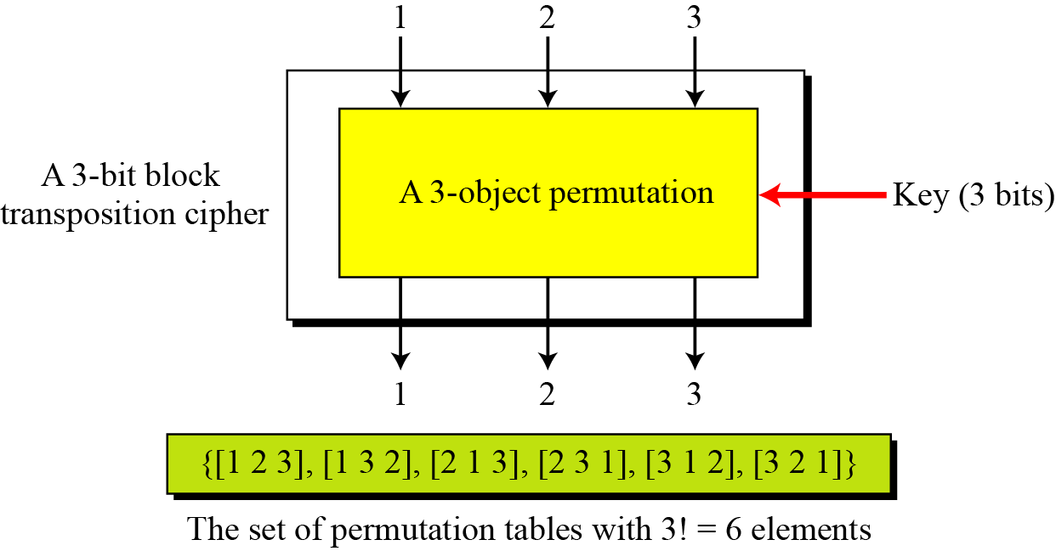
5.1.2 Continued
Figure 5.2 A transposition block cipher modeled as a permutation
5.<number>

Slide 12
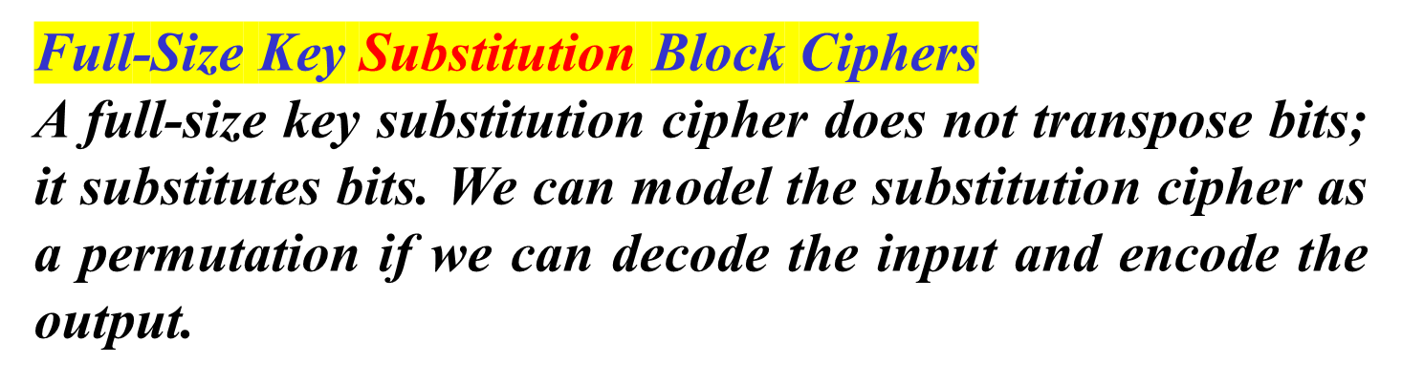
5.1.2 Continued
Example 5.4
Show the model and the set of permutation tables for a 3-bit block substitution cipher.
Solution
Figure 5.3 shows the model and the set of permutation tables. The key is also much longer, ⎡log₂40,320 = 16 bits.
5.<number>

Slide 13
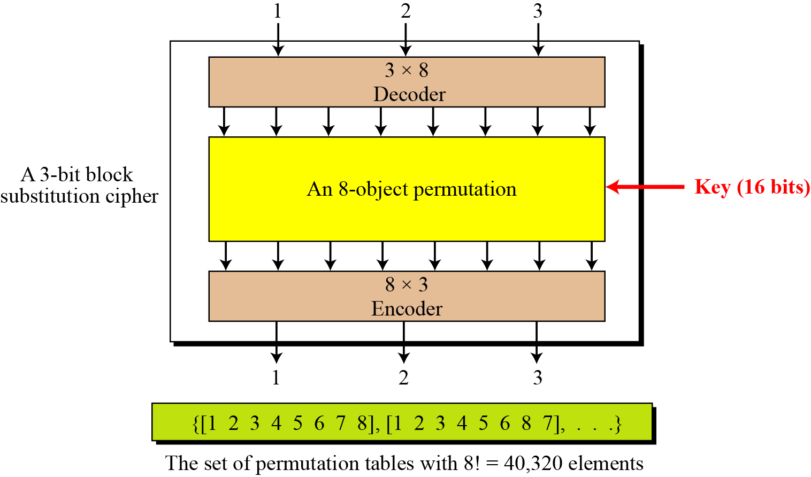
5.1.2 Continued
Figure 5.3 A substitution block cipher model as a permutation
5.<number>

Slide 14
5.1.2 Continued
Note
A full-size key n-bit transposition cipher or a substitution block cipher can be modeled
as a permutation, but their key sizes are different:
Transposition: the key is ⎡log₂n! bits long.
Substitution: the key is ⎡log₂(2n)! bits long.
Note
A partial-key cipher is a group under the composition operation if it is a subgroup
of the corresponding full-size key cipher.
5.<number>

Slide 15
5.1.3 Components of a Modern Block Cipher
Modern block ciphers normally are keyed substitution ciphers in which the key allows only partial mappings from the possible inputs to the possible outputs.
P-Boxes
A P-box (permutation box) parallels the traditional transposition cipher for characters. It transposes bits.
5.<number>

Slide 16

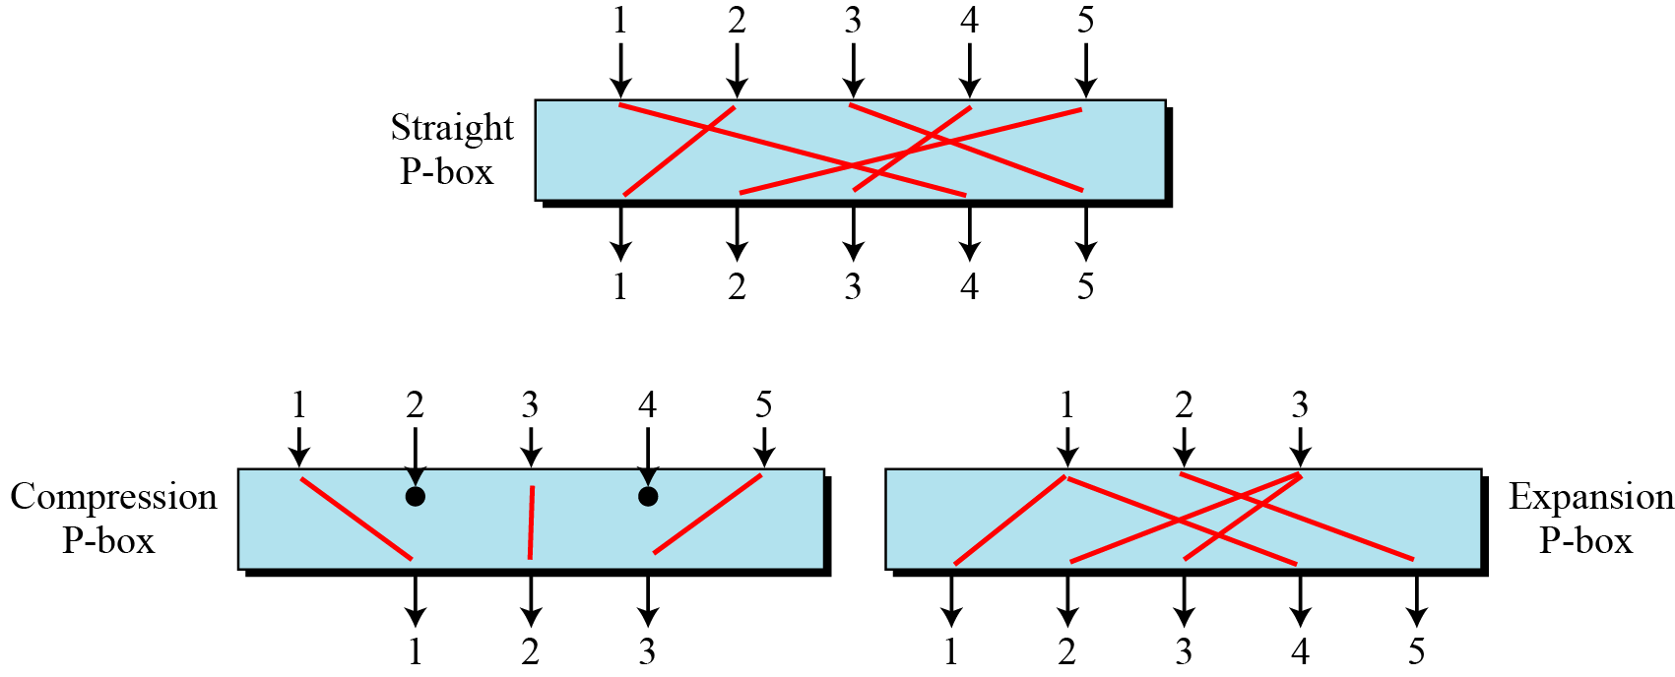




5.1.3 Continued
Figure 5.4 Three types of P-boxes
5.<number>

Slide 17
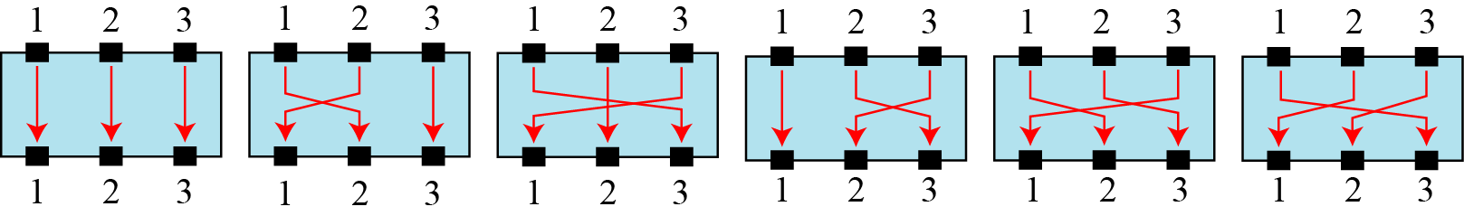
5.1.3 Continued
Example 5.5
Figure 5.5 shows all 6 possible mappings of a 3 × 3 P-box.
Figure 5.5 The possible mappings of a 3 × 3 P-box
5.<number>

Slide 18

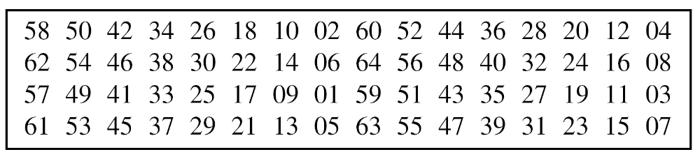
5.1.3 Continued
Table 5.1 Example of a permutation table for a straight P-box
Table 5.1 has 64 entries, corresponding to the 64 inputs
5.<number>

Slide 19


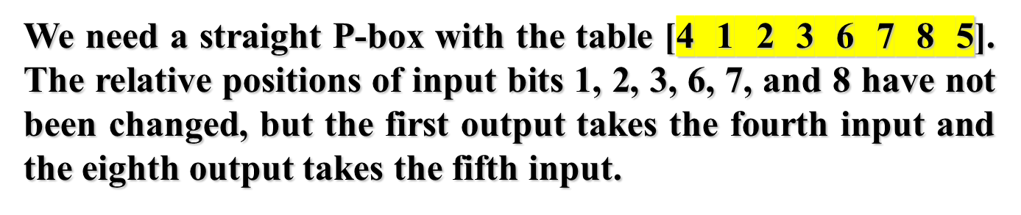
5.1.2 Continued
Example 5.6
Design an 8 × 8 permutation table for a straight P-box that moves the two middle bits (bits 4 and 5) in the input word to the two ends (bits 1 and 8) in the output words. Relative positions of other bits should not be changed.
Solution
5.<number>

Slide 20

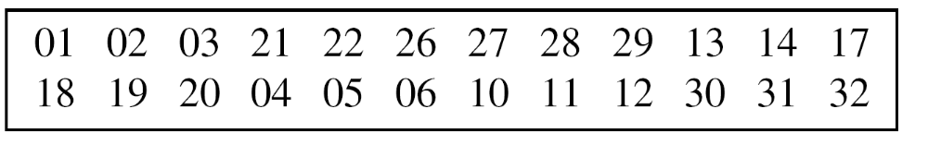
5.1.3 Continued
A compression P-box is a P-box with n inputs and m outputs where m < n.
Table 5.2 Example of a 32 × 24 permutation table
5.<number>

Slide 21
5.1.3 Continued
Compression P-Box
Table 5.2 Example of a 32 × 24 permutation table
5.<number>

Slide 22
5.1.3 Continued
Expansion P-Boxes
An expansion P-box is a P-box with n inputs and m outputs where m > n.
Table 5.3 Example of a 12 × 16 permutation table
5.<number>

Slide 23



5.1.3 Continued
Note
A straight P-box is invertible, but compression and expansion P-boxes are not.
5.<number>

Slide 24
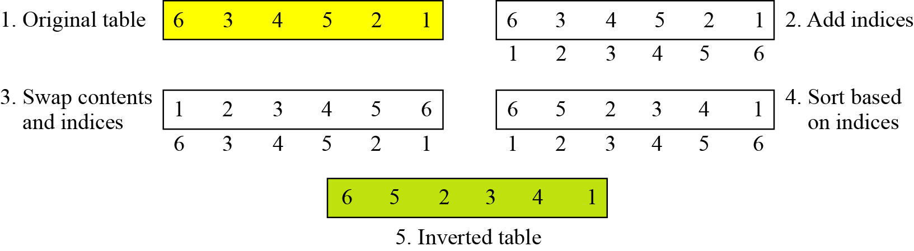
5.1.3 Continued
Example 5.7
Figure 5.6 shows how to invert a permutation table represented as a one-dimensional table.
Figure 5.6 Inverting a permutation table
5.<number>

Slide 25
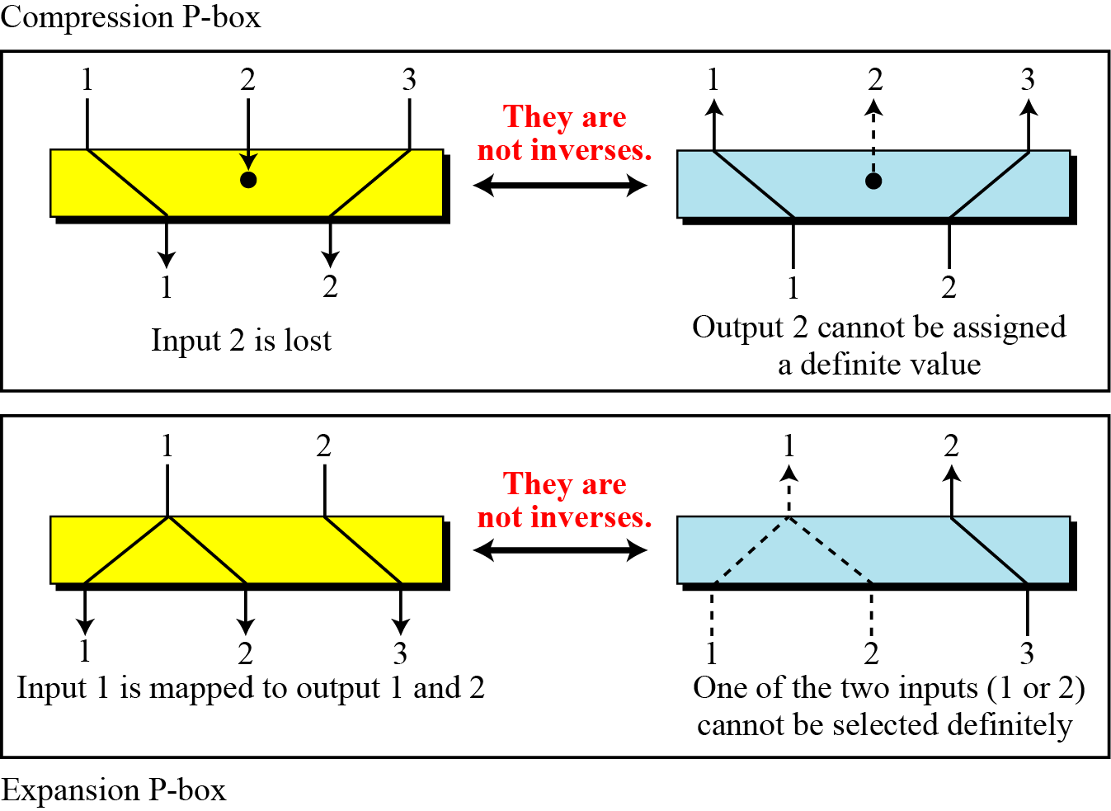
5.1.3 Continued
Figure 5.7 Compression and expansion P-boxes are non-invertible
5.<number>

Slide 26
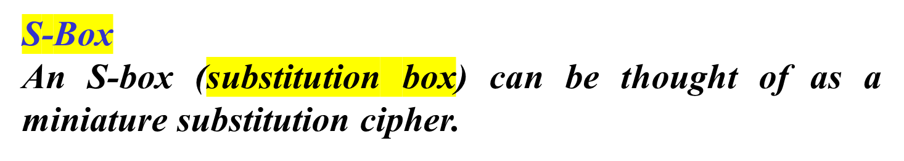
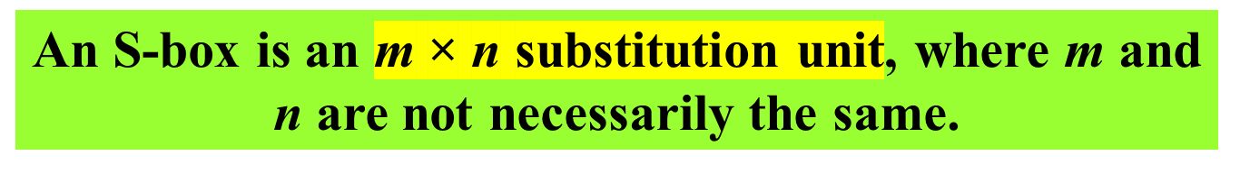
5.1.3 Continued
Note
5.<number>

Slide 27




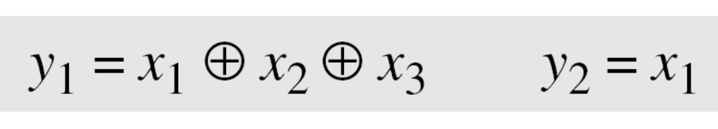

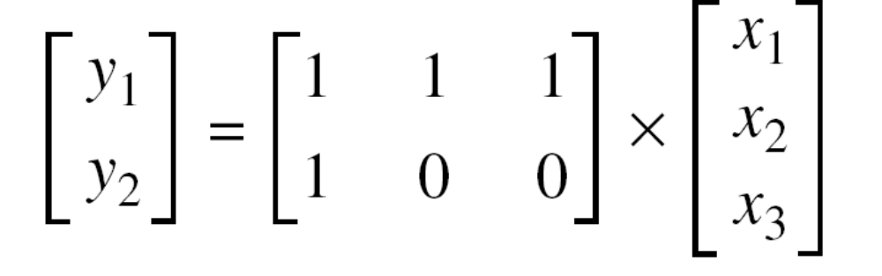
5.1.3 Continued
Example 5.8
In an S-box with three inputs and two outputs, we have
The S-box is linear because a_{1,1} = a_{1,2} = a_{1,3} = a_{2,1} = 1 and
a_{2,2} = a_{2,3} = 0. The relationship can be represented by matrices, as shown below:
5.<number>

Slide 28
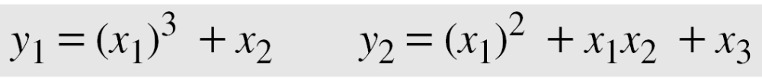
5.1.3 Continued
Example 5.9
In an S-box with three inputs and two outputs, we have
where multiplication and addition is in GF(2). The S-box is nonlinear because there is no linear relationship between the inputs and the outputs.
5.<number>

Slide 29
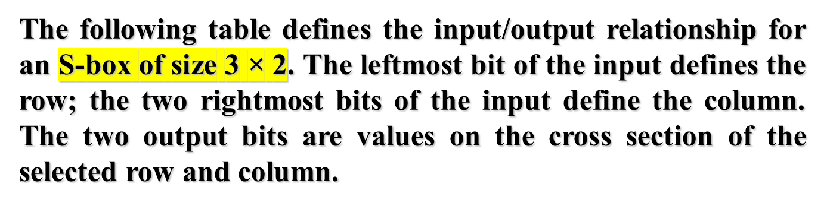

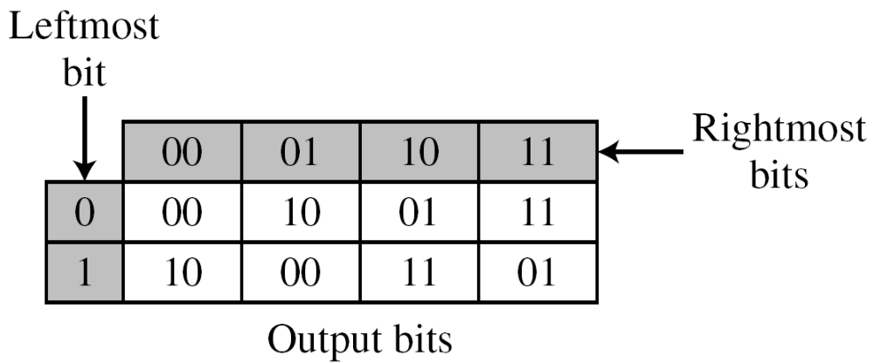

5.1.3 Continued
Example 5.10
Based on the table, an input of 010 yields the output 01. An input of 101 yields the output of 00.
5.<number>

Slide 30

5.1.3 Continued
An S-box may or may not be invertible. In an invertible
S-box, the number of input bits should be the same as the number of output bits.
5.<number>

Slide 31
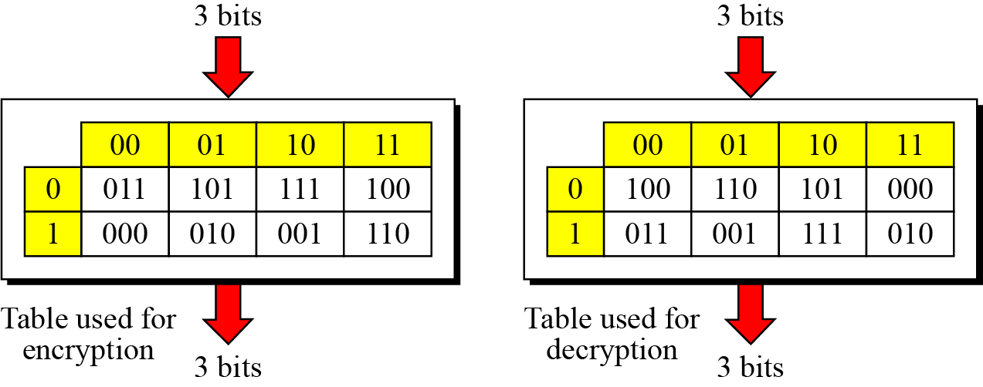
5.1.3 Continued
Example 5.11
Figure 5.8 shows an example of an invertible S-box. For example, if the input to the left box is 001, the output is 101. The input 101 in the right table creates the output 001, which shows that the two tables are inverses of each other.
Figure 5.8 S-box tables for Example 5.11
5.<number>

Slide 32




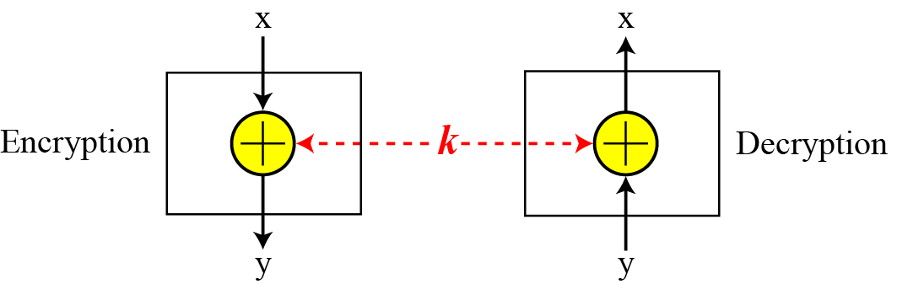
5.1.3 Continued
Exclusive-Or
An important component in most block ciphers is the exclusive-or operation.
5.<number>

Slide 33
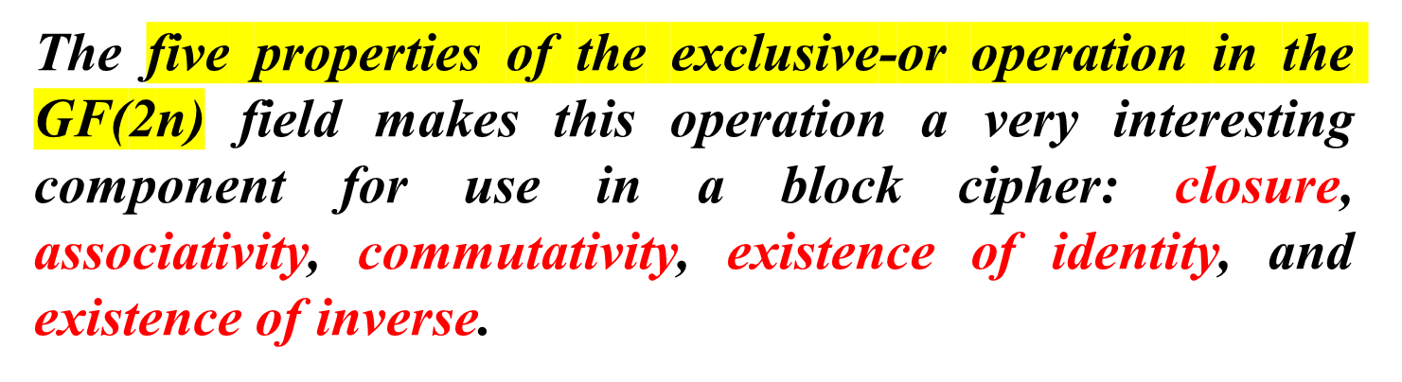
5.1.3 Continued
Exclusive-Or (Continued)
An important component in most block ciphers is the exclusive-or operation. As we discussed in Chapter 4, addition and subtraction operations in the GF(2n) field are performed by a single operation called the exclusive-or (XOR).
5.<number>

Slide 34
5.1.3 Continued
Exclusive-Or (Continued)
The inverse of a component in a cipher makes sense if the component represents a unary operation (one input and one output). For example, a keyless P-box or a keyless S-box can be made invertible because they have one input and one output. An exclusive operation is a binary operation. The inverse of an exclusive-or operation can
make sense only if one of the inputs is fixed (is the same in encryption and decryption). For example, if one of the inputs is the key, which normally is the same in encryption and decryption, then an exclusive-or operation is self-invertible, as shown in Figure 5.9.
5.<number>

Slide 35
5.1.1 Continued
Figure 5.9 Invertibility of the exclusive-or operation
5.<number>

Slide 36

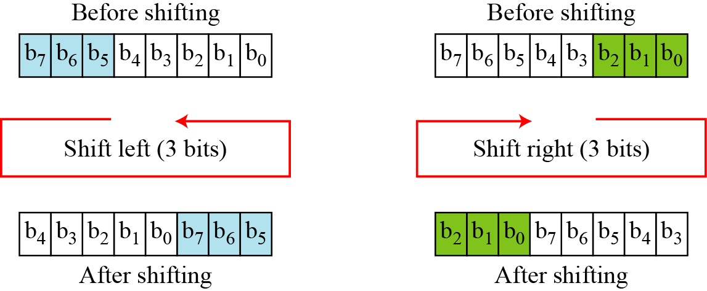
5.1.3 Continued
Another component found in some modern block ciphers is the circular shift operation.
Figure 5.10 Circular shifting an 8-bit word to the left or right
5.<number>

Slide 37
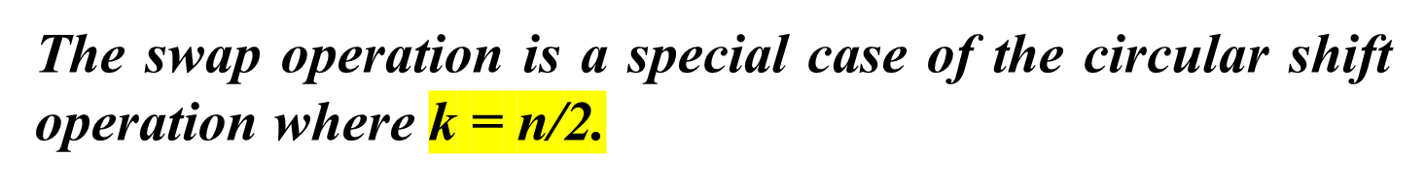

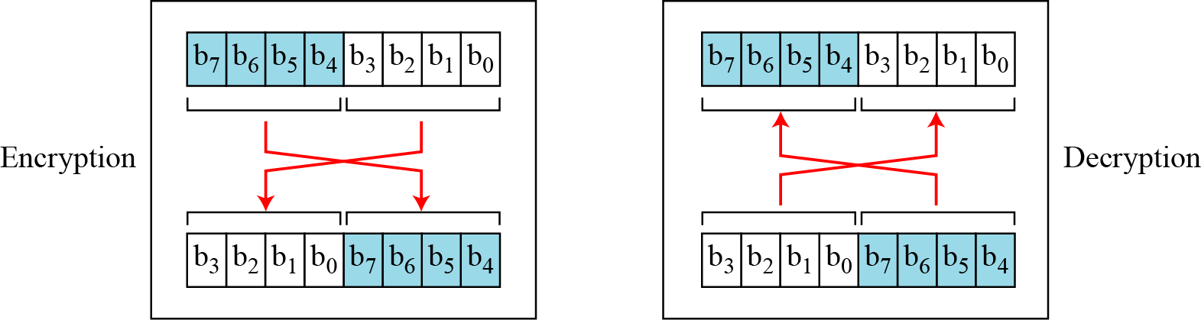
5.1.3 Continued
Swap
Figure 5.11 Swap operation on an 8-bit word
5.<number>

Slide 38

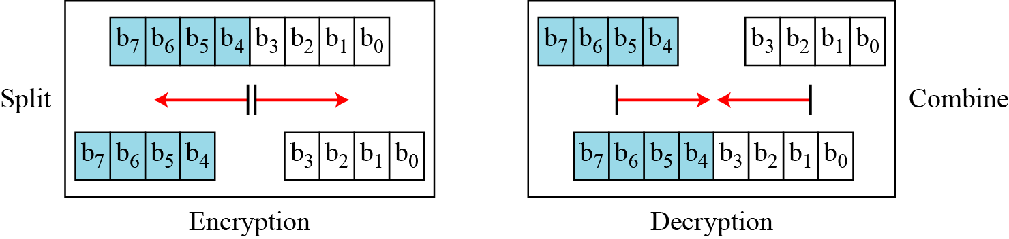
5.1.3 Continued
Two other operations found in some block ciphers are split and combine.
Figure 5.12 Split and combine operations on an 8-bit word
5.<number>

Slide 39
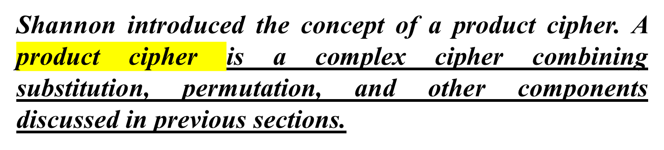
5.1.4 Product Ciphers
5.<number>

Slide 40
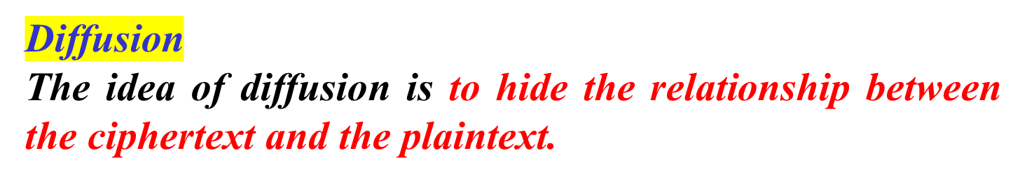
5.1.4 Continued
Note
Diffusion hides the relationship between the ciphertext and the plaintext.
5.<number>

Slide 41
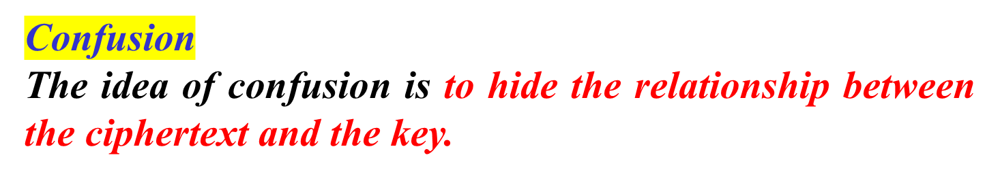
5.1.4 Continued
Note
Confusion hides the relationship between the ciphertext and the key.
5.<number>

Slide 42
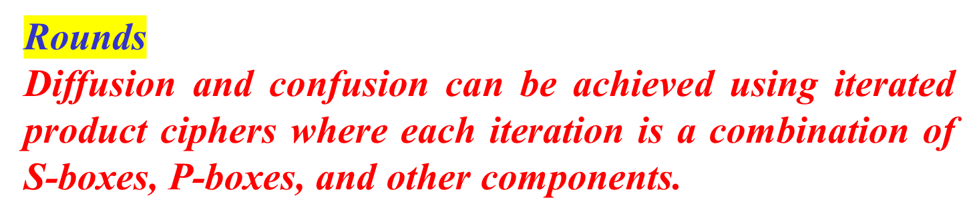
5.1.4 Continued
5.<number>

Slide 43
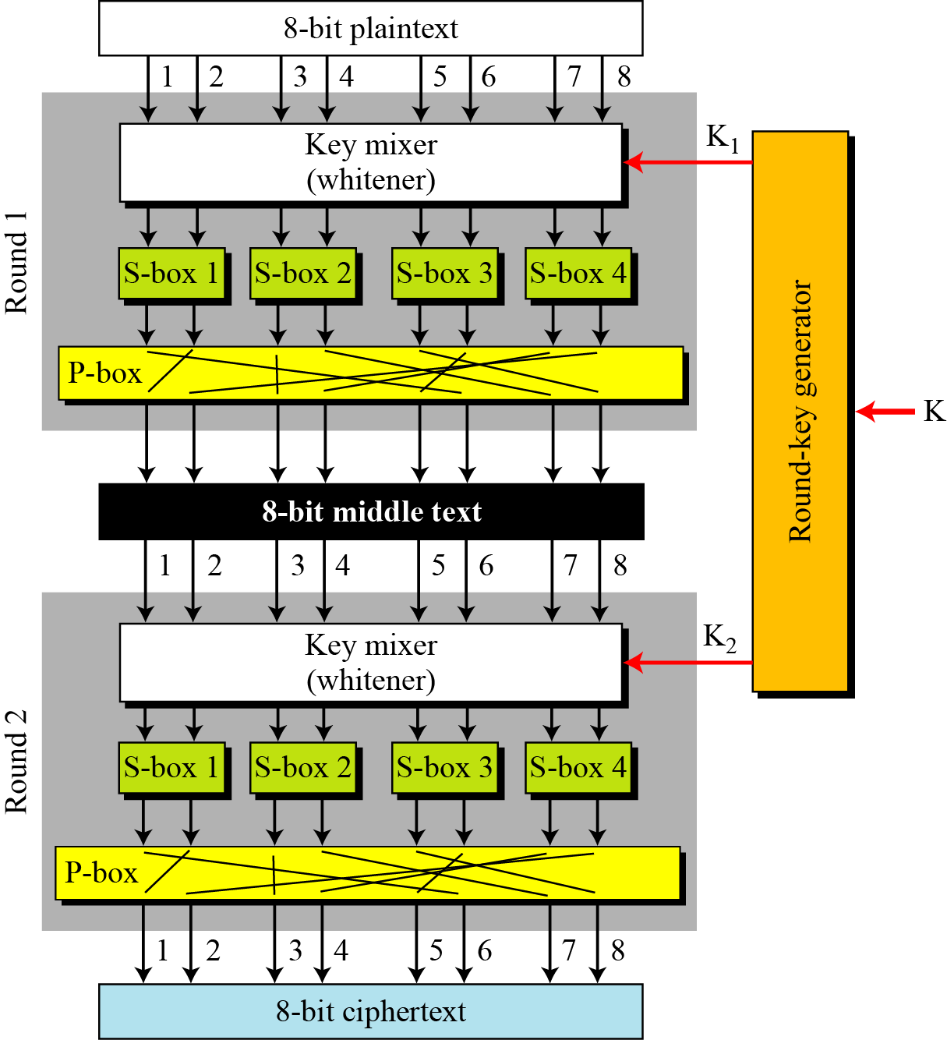


5.1.4 Continued
Figure 5.13 A product cipher made of two rounds
5.<number>

Slide 44
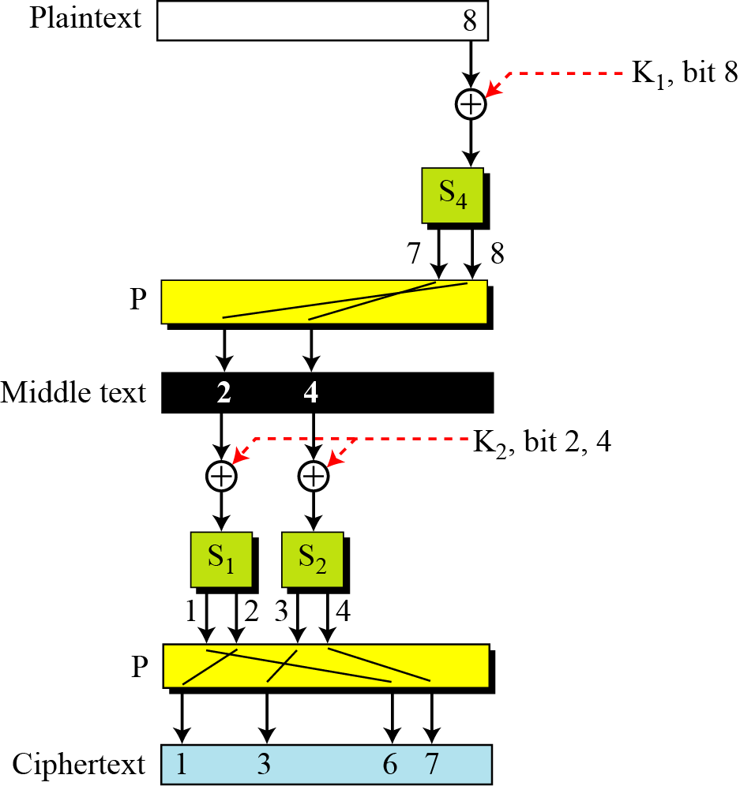
5.1.4 Continued
Figure 5.14 Diffusion and confusion in a block cipher
5.<number>

Slide 45
5.1.5 Two Classes of Product Ciphers
Modern block ciphers are all product ciphers, but they are divided into two classes.
1. Feistel ciphers
2. Non-Feistel ciphers
5.<number>

Slide 46
5.1.5 Continued
Feistel Ciphers
Feistel designed a very intelligent and interesting cipher that has been used for decades. A Feistel cipher can have three types of components: self-invertible, invertible, and
noninvertible.
5.<number>

Slide 47
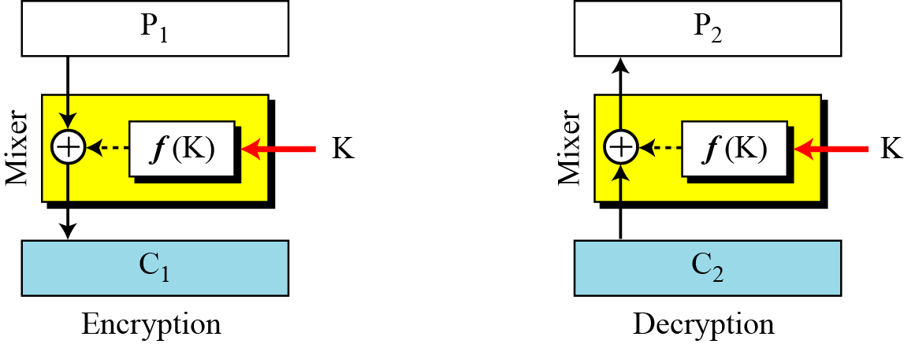


5.1.5 Continued
Figure 5.15 The first thought in Feistel cipher design
Note
Diffusion hides the relationship between the ciphertext and the plaintext.
5.<number>

Slide 48

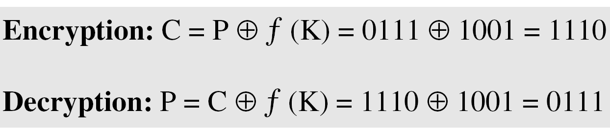

5.1.3 Continued
Example 5.12
This is a trivial example. The plaintext and ciphertext are each 4 bits long and the key is 3 bits long. Assume that the function takes the first and third bits of the key, interprets these two bits as a decimal number, squares the number, and interprets the result as a 4-bit binary pattern. Show the results of encryption and decryption if the original plaintext is 0111 and the key is 101.
Solution
The function extracts the first and second bits to get 11 in binary or 3 in decimal. The result of squaring is 9, which is 1001 in binary.
5.<number>

Slide 49
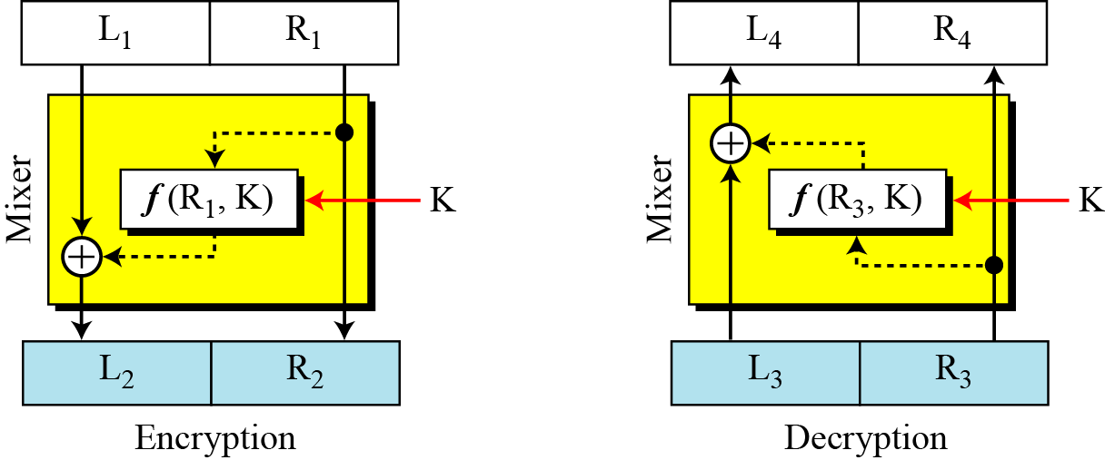


5.1.5 Continued
Figure 5.16 Improvement of the previous Feistel design
5.<number>

Slide 50
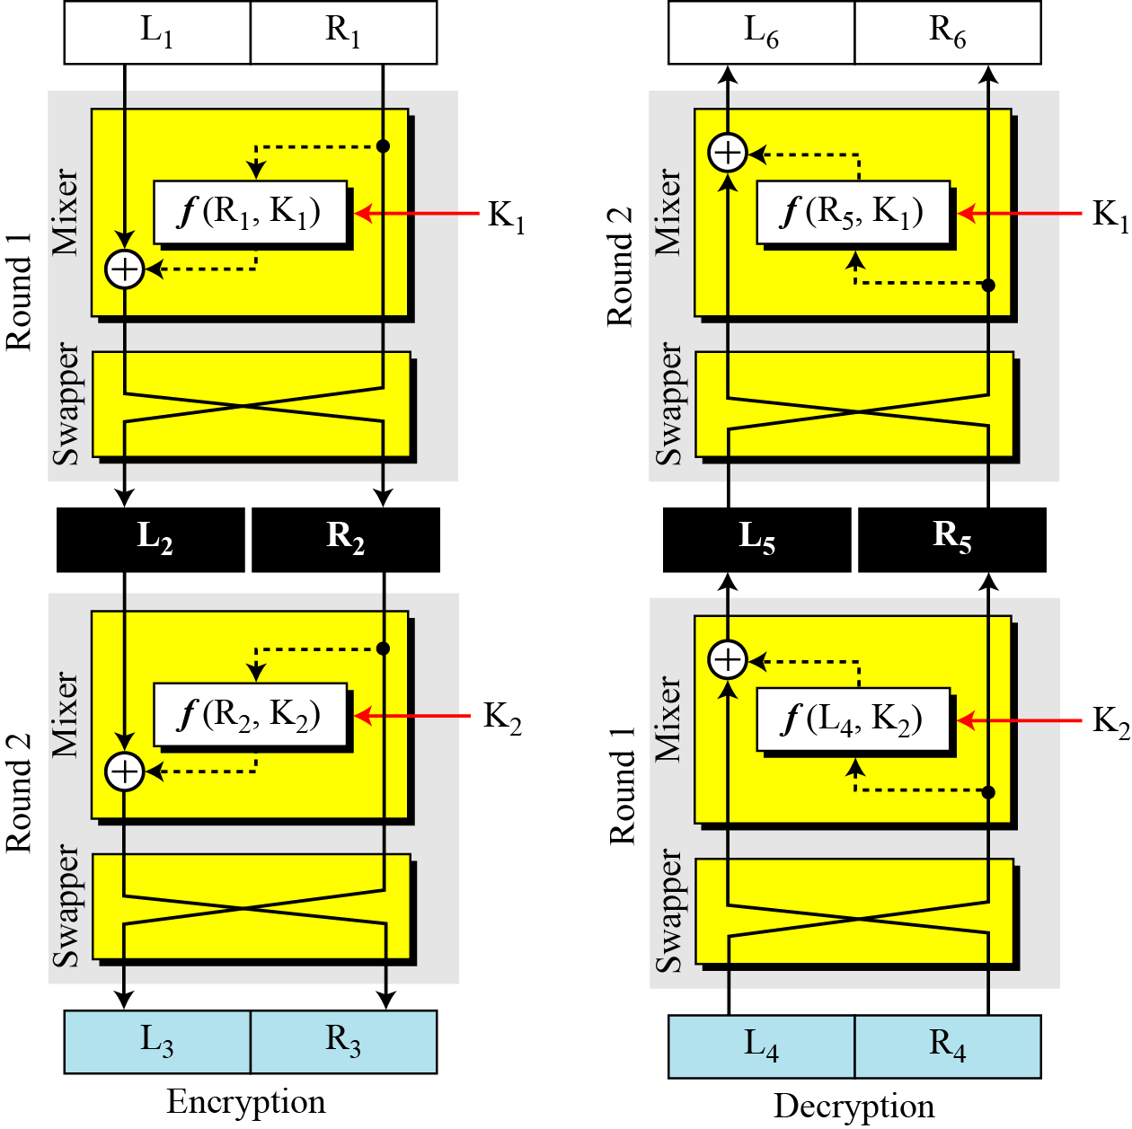



5.1.5 Continued
Figure 5.17 Final design of a Feistel cipher with two rounds
5.<number>

Slide 51
5.1.5 Continued
Non-Feistel Ciphers
A non-Feistel cipher uses only invertible components. A component in the encryption cipher has the corresponding component in the decryption cipher.
5.<number>

Slide 52
5.1.6 Attacks on Block Ciphers
Attacks on traditional ciphers can also be used on modern block ciphers, but today’s block ciphers resist most of the attacks discussed in Chapter 3.
5.<number>

Slide 53
5.1.5 Continued
Differential Cryptanalysis
Eli Biham and Adi Shamir introduced the idea of differential cryptanalysis. This is a chosen-plaintext attack.
5.<number>

Slide 54
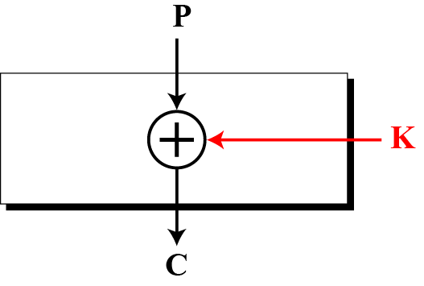
5.1.6 Continued
Example 5.13
Assume that the cipher is made only of one exclusive-or operation, as shown in Figure 5.18. Without knowing the value of the key, Eve can easily find the relationship between plaintext differences and ciphertext differences if by plaintext difference we mean P1 ⊕ P2 and by ciphertext difference, we mean C1⊕ C2. The following proves that C1 ⊕ C2 = P1 ⊕ P2:
Figure 5.18 Diagram for Example 5.13
5.<number>

Slide 55
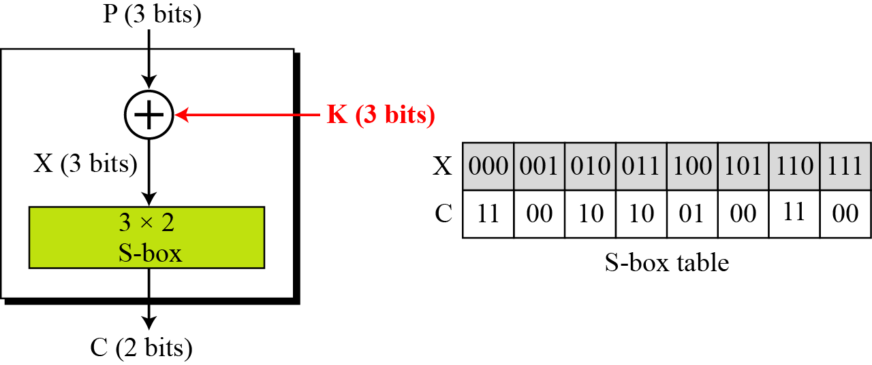
5.1.6 Continued
Example 5.14
We add one S-box to Example 5.13, as shown in Figure 5.19.
Figure 5.19 Diagram for Example 5.14
5.<number>

Slide 56
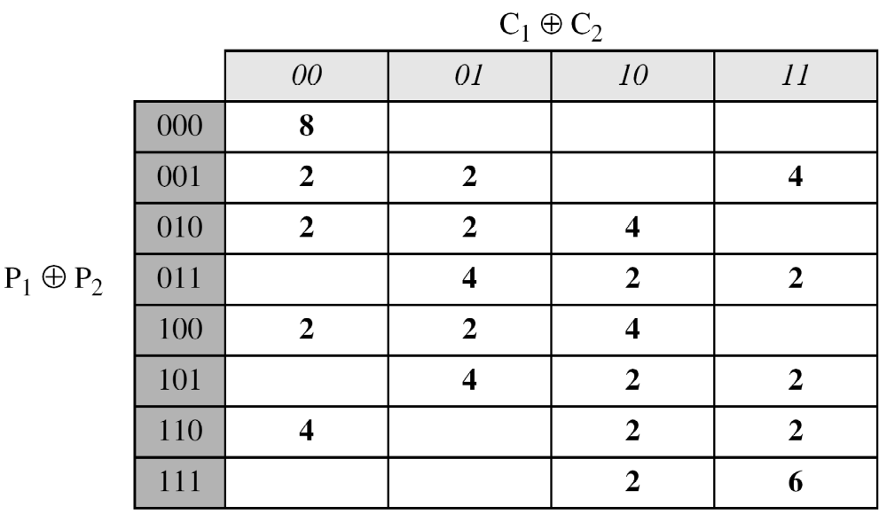
5.1.6 Continued
Example 5.14 Continued
Eve now can create a probabilistic relationship as shone in Table 5.4.
Table 5.4 Differential input/output
5.<number>

Slide 57
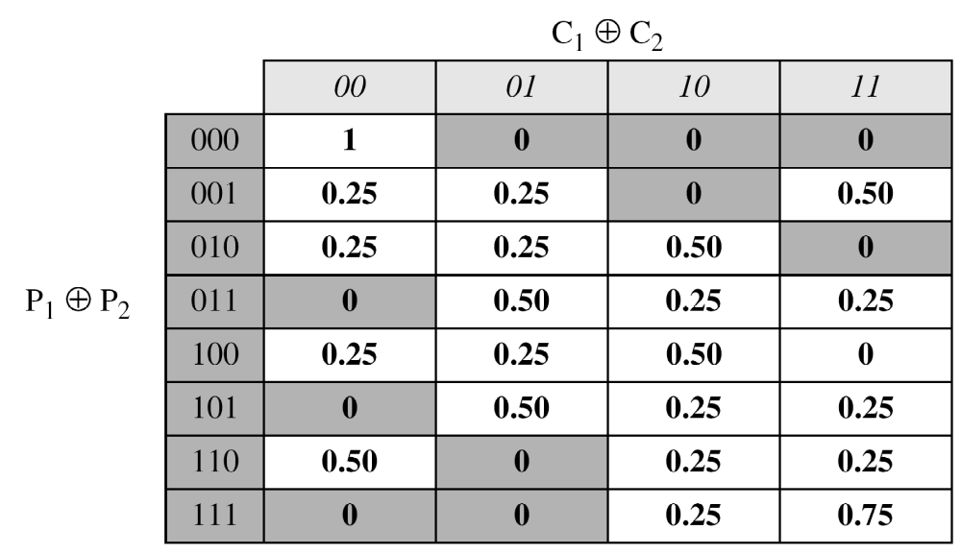
5.1.6 Continued
Example 5.15
The heuristic result of Example 5.14 can create probabilistic information for Eve as shown in Table 5.5.
Table 5.5 Differential distribution table
5.<number>

Slide 58
5.1.6 Continued
Example 5.16
Looking at Table 5.5, Eve knows that if P₁ ⊕ P₂ = 001, then C₁ ⊕ C₂ = 11 with the probability of 0.50 (50 percent). She tries C₁ = 00 and gets P₁ = 010 (chosen-ciphertext attack). She also tries C₂ = 11 and gets P₂ = 011 (another chosen-ciphertext attack). Now she tries to work backward, based on the first pair, P₁ and C₁,
The two tests confirm that K = 011 or K =101.
5.<number>

Slide 59
5.1.6 Continued
Note
Differential cryptanalysis is based on a nonuniform differential distribution table of the S-boxes in a block cipher.
Note
A more detailed differential cryptanalysis is given in Appendix N.
5.<number>

Slide 60
5.1.6 Continued
Linear Cryptanalysis
Linear cryptanalysis was presented by Mitsuru Matsui in 1993. The analysis uses known plaintext attacks.
5.<number>

Slide 61
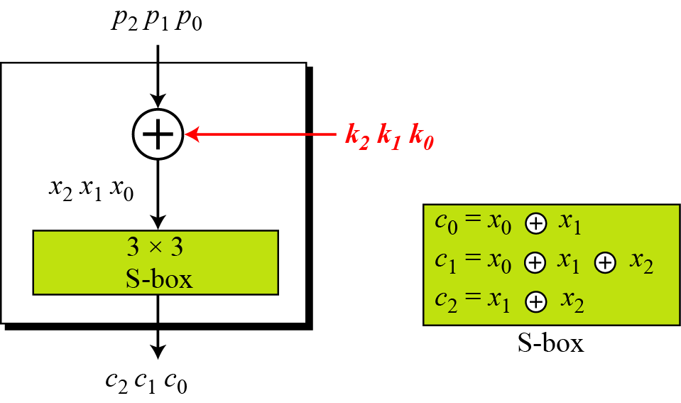
5.1.6 Continued
Figure 5.20 A simple cipher with a linear S-box
5.<number>

Slide 62
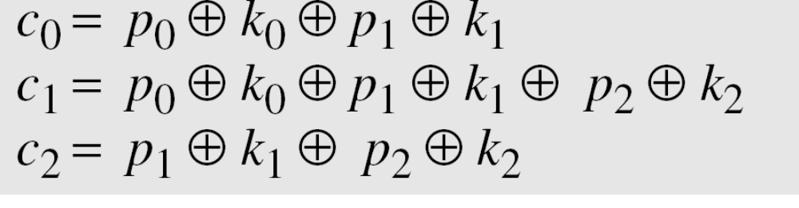
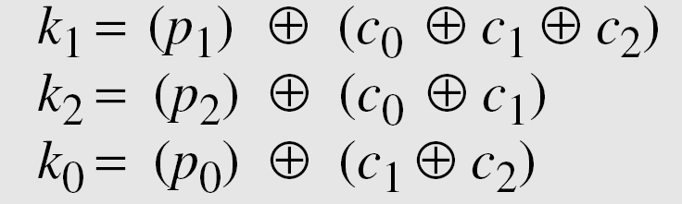
5.1.6 Continued
Solving for three unknowns, we get.
This means that three known-plaintext attacks can find the values of k₀, k₁, and k₂ .
5.<number>

Slide 63
5.1.6 Continued
In some modern block ciphers, it may happen that some
S-boxes are not totally nonlinear; they can be approximated, probabilistically, by some linear functions.
where 1 ≤ x ≤ m, 1 ≤ y ≤ n, and 1 ≤ z ≤ n.
Note
A more detailed linear cryptanalysis is given in Appendix N.
5.<number>

Slide 64
5-2 MODERN STREAM CIPHERS
In a modern stream cipher, encryption and decryption
are done r bits at a time. We have a plaintext bit stream P = p_{n}…p₂ p₁, a ciphertext bit stream
C = c_{n}…c₂ c₁, and a key bit stream K = k_{n}…k₂ k₁, in which p_{i} , c_{i} , and k_{i} are r-bit words.
Topics discussed in this section:
5.2.1 Synchronous Stream Ciphers
5.2.2 Nonsynchronous Stream Ciphers
5.<number>

Slide 65
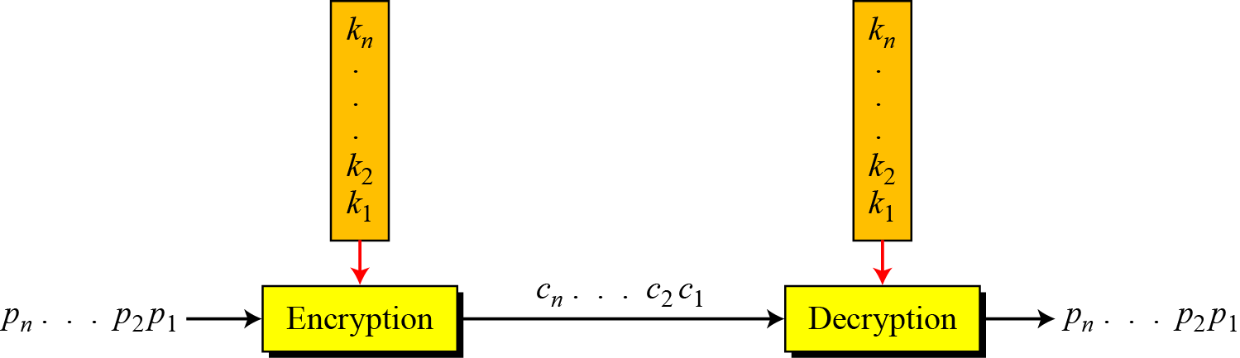
5.2 Continued
Figure 5.20 Stream cipher
Note
In a modern stream cipher, each r-bit word in the plaintext stream is enciphered using an r-bit word in the key stream to create the corresponding r-bit
word in the ciphertext stream.
5.<number>

Slide 66
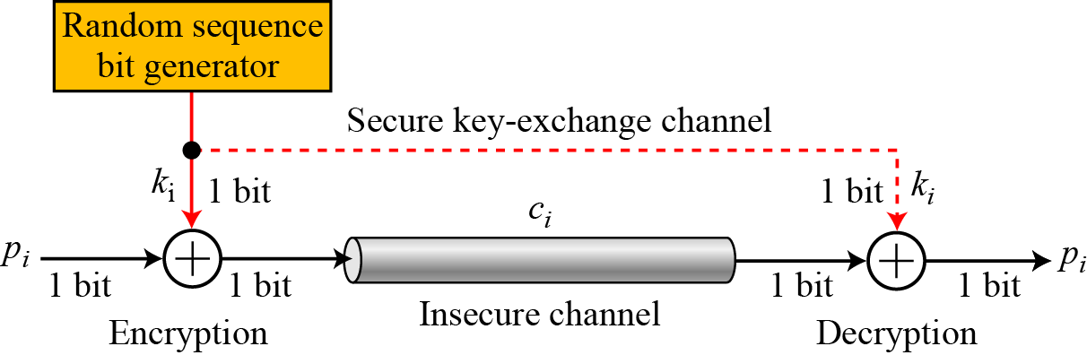
5.2.1 Synchronous Stream Ciphers
Note
In a synchronous stream cipher the key is independent of the plaintext or ciphertext.
Figure 5.22 One-time pad
5.<number>

Slide 67
5.2.1 Continued
Example 5.17
What is the pattern in the ciphertext of a one-time pad cipher in each of the following cases?
a. The plaintext is made of n 0’s.
b. The plaintext is made of n 1’s.
c. The plaintext is made of alternating 0’s and 1’s.
d. The plaintext is a random string of bits.
Solution
Because 0 ⊕ k_{i} = k_{i} , the ciphertext stream is the same as the key stream. If the key stream is random, the ciphertext is also random. The patterns in the plaintext are not preserved in the ciphertext.
5.<number>

Slide 68
5.2.1 Continued
Example 5.7
(Continued)
Because 1 ⊕ k_{i} = k_{i} where k_{i} is the complement of k_{i} , the ciphertext stream is the complement of the key stream. If the key stream is random, the ciphertext is also random. Again the patterns in the plaintext are not preserved in the ciphertext.
In this case, each bit in the ciphertext stream is either the same as the corresponding bit in the key stream or the complement of it. Therefore, the result is also a random string if the key stream is random.
In this case, the ciphertext is definitely random because the exclusive-or of two random bits results in a random bit.
5.<number>

Slide 69
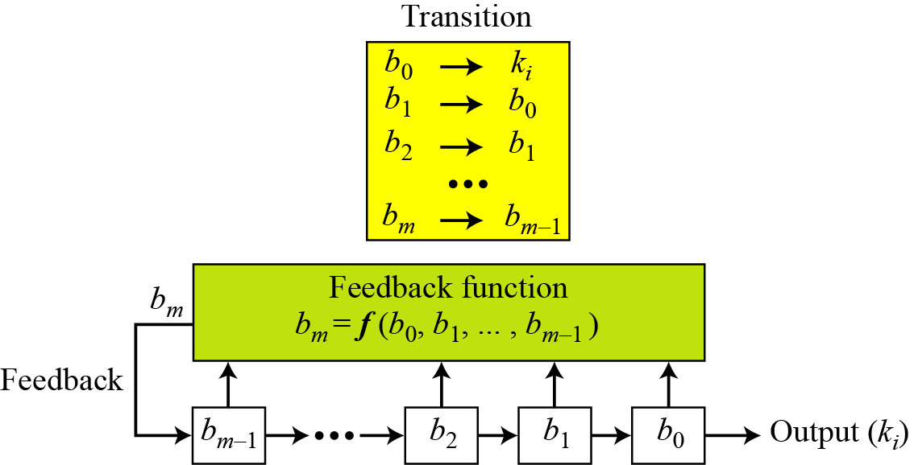
5.2.1 Continued
Figure 5.23 Feedback shift register (FSR)
5.<number>

Slide 70
5.2.1 Continued
Example 5.18
Create a linear feedback shift register with 5 cells in which
b₅ = b₄ ⊕ b₂ ⊕ b₀ .
Solution
If c_{i} = 0, b_{i} has no role in calculation of b_{m}. This means that b_{i} is not connected to the feedback function. If c_{i} = 1, b_{i} is involved in calculation of bm. In this example, c1 and c3 are 0’s, which means that we have only three connections. Figure 5.24 shows the design.
5.<number>

Slide 71

5.2.1 Confidentiality
Figure 5.24 LSFR for Example 5.18
5.<number>

Slide 72

5.2.1 Continued
Example 5.19
Create a linear feedback shift register with 4 cells in which
b₄ = b₁ ⊕ b₀. Show the value of output for 20 transitions (shifts) if the seed is (0001)₂.
Solution
Figure 5.25 LFSR for Example 5.19
5.<number>

Slide 73
5.2.1 Continued
Example 5.19
(Continued)
Table 4.6 Cell values and key sequence for Example 5.19
5.<number>

Slide 74

5.2.1 Continued
Example 5.19
(Continued)
Table 4.6 Continued
5.<number>

Slide 75
5.2.1 Continued
Example 5.19
(Continued)
Note that the key stream is 100010011010111 10001…. This looks like a random sequence at first glance, but if we go through more transitions, we see that the sequence is periodic. It is a repetition of 15 bits as shown below:
The key stream generated from a LFSR is a pseudorandom sequence in which the the sequence is repeated after N bits.
Note
The maximum period of an LFSR is to 2m − 1.
5.<number>

Slide 76
5.2.1 Continued
Example 5.20
The characteristic polynomial for the LFSR in Example 5.19 is (x4 + x + 1), which is a primitive polynomial. Table 4.4 (Chapter 4) shows that it is an irreducible polynomial. This polynomial also divides (x7 + 1) = (x4 + x + 1) (x3 + 1), which means e = 23 − 1 = 7.
5.<number>

Slide 77
5.2.2 Nonsynchronous Stream Ciphers
In a nonsynchronous stream cipher, each key in the key stream depends on previous plaintext or ciphertext.
Note
In a nonsynchronous stream cipher, the key depends on either the plaintext or ciphertext.
5.<number>

