Slide 1
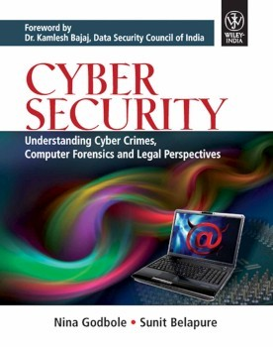
Chapter 1
Introduction to Cybercrime

Slide 2
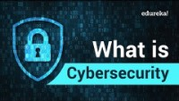
Cybersecurity

Slide 3

Introduction
Internet has undeniably opened a new way of exploitation known as cybercrime involving the use of computers, the Internet, cyberspace and the worldwide web (WWW). https://financesonline.com/cybercrime-trends/
Statistics for Cyber Crime in India
https://www.statista.com/topics/5054/cyber-crime-in-india/

Slide 4
Cybercrime: Definition and Origins of the Word
The definitions of computer crime:
1. Any illegal act where a special knowledge of computer technology is essential for its perpetration, investigation or prosecution.
2. Any traditional crime that has acquired a new dimension or order of magnitude through the aid of a computer, and abuses that have come into being because of computers.
3. Any financial dishonesty that takes place in a computer environment.
4. Any threats to the computer itself, such as theft of hardware or software, sabotage and demands for ransom.
The term “cybercrime” relates to a number of other terms such as:
Computer-related crime
Computer crime
Internet crime
E-crime
High-tech crime

Slide 5
Two types of attack are prevalent in cybercrimes:
1. Techno-crime: A premeditated act against a system or systems, with the intent to copy, steal, prevent access, corrupt or otherwise deface or damage parts of or the complete computer system.
2. Techno-vandalism: These acts of “brainless” defacement of websites and/or other activities, such as copying files and publicizing their contents publicly, are usually opportunistic in nature.
Cybercrimes differ from most terrestrial crimes in four ways:
how to commit them is easier to learn
they require few resources relative to the potential damage caused
they can be committed in a jurisdiction without being physically present in it
they are often not clearly illegal.
Cyberterrorism is defined as “any person, group or organization who, with terrorist intent, utilizes accesses or aids in accessing a computer or computer network or electronic system or electronic device by any available means, and thereby knowingly engages in or attempts to engage in a terrorist act commits the offence of cyberterrorism.”

Slide 6
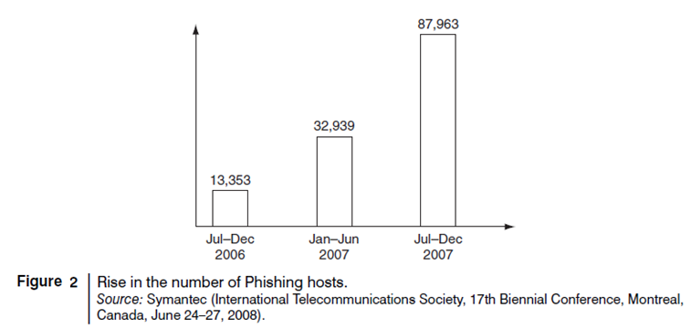
How cybercrimes are planned and how they actually take place
Cyberterrorists usually use computer as a tool, target or both for their unlawful act to gain information.
Internet is one of the means by which the offenders can gain priced sensitive information of companies, firms, individuals, banks and can lead to intellectual property (IP), selling illegal articles, pornography/child pornography, etc. This is done using:
Phishing, Spoofing, Pharming, Internet Phishing, wire transfer, etc.
Cyber Security by Nina Godbole/Sunit Belapure
Copyright © 2011 Wiley India Pvt. Ltd. All rights reserved.

Slide 7
Cybercrime and Information Security
Indian Information Technology Act (ITA 2008) provides a new focus on “Information Security in India.”
“Cybersecurity” means protecting information, equipment, devices, computer, computer resource, communication device and information stored therein from unauthorized access.
Where financial losses to the organization due to insider crimes are concerned, difficulty is faced in estimating the losses because the financial impacts may not be detected by the victimized organization and no direct costs may be associated with the data theft.
For anyone trying to compile data on business impact of cybercrime, there are number of challenges.
Organizations do not explicitly incorporate the cost of the vast majority of computer security incidents into their accounting.
There is always a difficulty in attaching a quantifiable monetary value to the corporate data and yet corporate data get stolen/lost.
Most organizations abstain from revealing facts and figures about “security incidents” including cybercrime.
Organizations perception about “insider attacks” seems to be different than that made out by security solution vendor.
Awareness about “data privacy” too tends to be low in most organizations.

Slide 8
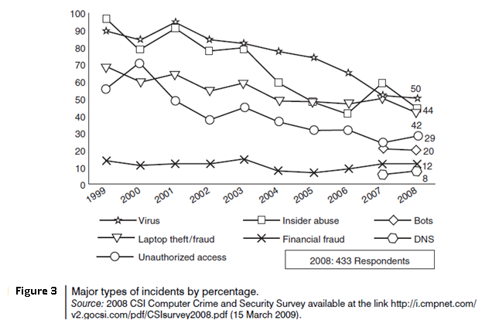
Figure 3 shows several categories of incidences – viruses, insider abuse, laptop theft and unauthorized access to systems.
Typical network misuses are for:
Internet radio
streaming audio
streaming video
file sharing
instant messaging
Online gaming
Online gambling
Cyber Security by Nina Godbole/Sunit Belapure
Copyright © 2011 Wiley India Pvt. Ltd. All rights reserved.

Slide 9
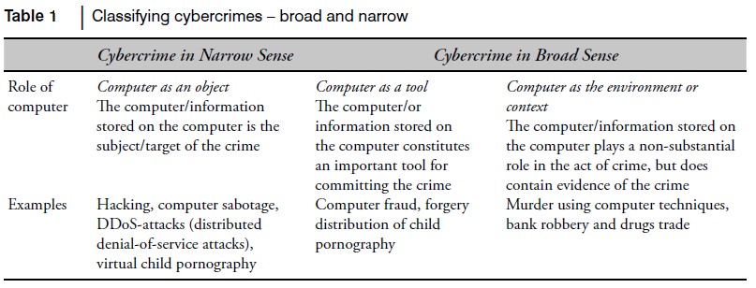
Who are Cybercriminals?
Cybercriminals are those who conduct activities such as child pornography; credit card fraud; cyberstalking; defaming another online; gaining unauthorized access to computer systems; ignoring copyright, software licensing and trademark protection; overriding encryption to make illegal copies; software piracy and stealing another’s identity to perform criminal acts.
1. Type I: Cybercriminals – hungry for recognition
2. Type II: Cybercriminals – not interested in recognition
3. Type III: Cybercriminals – the insiders
Classifications of Cybercrimes
Cyber Security by Nina Godbole/Sunit Belapure
Copyright © 2011 Wiley India Pvt. Ltd. All rights reserved.

Slide 10
Cybercrimes are classified as follows:
Cybercrime against individual
2. Cybercrime against property
3. Cybercrime against organization
4. Cybercrime against Society
5. Crimes emanating from Usenet newsgroup:
E-Mail Spoofing
A spoofed E-Mail is one that appears to originate from one source but actually has been sent from another source.
Spamming
People who create electronic Spam are called spammers.
Spam is the abuse of electronic messaging systems to send unsolicited bulk messages indiscriminately.
Spamming is widely detested, and has been the subject of legislation in many jurisdictions – for example, the CAN-SPAM Act of 2003.
Cyber Security by Nina Godbole/Sunit Belapure
Copyright © 2011 Wiley India Pvt. Ltd. All rights reserved.

Slide 11
Search engine spamming
Spamming is alteration or creation of a document with the intent to deceive an electronic catalog or a fi ling system.
Some web authors use “subversive techniques” to ensure that their site appears more frequently or higher number in returned search results.
Cyberdefamation
“Cyberdefamation” occurs when defamation takes place with the help of computers and/or the According to the IPC Section 499:
1. It may amount to defamation to impute anything to a deceased person, if the imputation would harm the reputation of that person if living, and is intended to be hurtful to the feelings of his family or other near relatives.
2. It may amount to defamation to make an imputation concerning a company or an association or collection of persons as such.
3. An imputation in the form of an alternative or expressed ironically, may amount to defamation.
4. No imputation is said to harm a person’s reputation unless that imputation directly or indirectly, in the estimation of others, lowers the moral or intellectual character of that person, or lowers the character of that person in respect of his caste or of his calling, or lowers the credit of that person, or causes it to be believed that the body of that person is in a loathsome state or in a state generally considered as disgraceful.
The law on defamation attempts to create a workable balance between two equally important human rights
The right to an unimpaired reputation
The right to freedom of expression
Cyber Security by Nina Godbole/Sunit Belapure
Copyright © 2011 Wiley India Pvt. Ltd. All rights reserved.

Slide 12
Internet Time Theft
Internet time theft occurs when an unauthorized person uses the Internet hours paid for by another person.
It comes under hacking because the person gets access to someone else’s ISP user ID and password, either by hacking or by gaining access to it by illegal means
Salami Attack/Salami Technique
These attacks are used for committing financial crimes.
No account holder will probably notice this unauthorized debit, but the bank employee will make a sizable amount every month.
Data Diddling
A data diddling attack involves altering raw data just before it is processed by a computer and then changing it back after the processing is completed.
Electricity Boards in India have been victims to data diddling programs inserted when private parties computerize their systems.
Cyber Security by Nina Godbole/Sunit Belapure
Copyright © 2011 Wiley India Pvt. Ltd. All rights reserved.

Slide 13
Forgery
Forging counterfeit currency notes, postage and revenue stamps, marksheets, etc. using sophisticated computers, printers and scanners.
Web Jacking
Web jacking occurs when someone forcefully takes control of a website (by cracking the password and later changing it).
Newsgroup Spam/Crimes Emanating from Usenet Newsgroup
The advent of Google Groups, and its large Usenet archive, has made Usenet more attractive to spammers than ever.
Spamming of Usenet newsgroups actually predates E-Mail Spam.
Industrial Spying/Industrial Espionage
“Spies” can get information about product finances, research and development and marketing strategies, an activity known as “industrial spying.”
“Targeted Attacks” - applies very well to organizations that are victim of focused attacks aiming at stealing corporate data, Intellectual Property or whatever else that may yield a competitive advantage for a rival company.
There are two distinct business models for cybercrime applied to industrial spying
Selling Trojan-ware
Selling Stolen Intellectual Property.
Cyber Security by Nina Godbole/Sunit Belapure
Copyright © 2011 Wiley India Pvt. Ltd. All rights reserved.

Slide 14
Hacking
Hackers, crackers and phrackers are some of the oft-heard terms. The original meaning of the word “hack” meaning an elegant, witty or inspired way of doing almost anything originated at MIT.
Hackers write or use ready-made computer programs to attack the target computer.
They possess the desire to destruct and they get enjoyment out of such destruction.
Some hackers hack for personal monetary gains, such as stealing credit card information, transferring money from various bank accounts to their own account followed by withdrawal of money.
Online Frauds
Types of crimes under the category of hacking
Spoofing website and E-Mail security alerts
Hoax mails about virus threats
lottery frauds
Spoofing.
Spoofing websites and E-Mail security threats
Fraudsters create authentic looking websites that are actually nothing but a spoof.
The purpose of these websites is to make the user enter personal information which is then used to access business and bank accounts
This kind of online fraud is common in banking and financial sector.
It is strongly recommended not to input any sensitive information that might help criminals to gain access to sensitive information, such as bank account details, even if the page appears legitimate.
Cyber Security by Nina Godbole/Sunit Belapure
Copyright © 2011 Wiley India Pvt. Ltd. All rights reserved.

Slide 15
Virus hoax E-Mails
The warnings may be genuine, so there is always a dilemma whether to take them lightly or seriously.
A wise action is to first confirm by visiting an antivirus site such as McAfee, Sophos or Symantec before taking any action, such as forwarding them to friends and colleagues.
Lottery frauds
Typically letters or E-Mails that inform the recipient that he/she has won a prize in a lottery.
To get the money, the recipient has to reply, after which another mail is received asking for bank details so that the money can be directly transferred.
Spoofing
A hacker logs-in to a computer illegally, using a different identity than his own.
He creates a new identity by fooling the computer into thinking that the hacker is the genuine system operator and then hacker then takes control of the system.
Pornographic Offenses
“Child pornography” includes:
1. Any photograph that can be considered obscene and/or unsuitable for the age of child viewer;
2. film, video, picture;
3. computer-generated image or picture of sexually explicit conduct where the production of such visual depiction involves the use of a minor engaging in sexually explicit conduct.
As the broad-band connections get into the reach of more and more homes, larger child population will be using the Internet and therefore greater would be the chances of falling victim to the aggression of pedophiles.
Cyber Security by Nina Godbole/Sunit Belapure
Copyright © 2011 Wiley India Pvt. Ltd. All rights reserved.

Slide 16
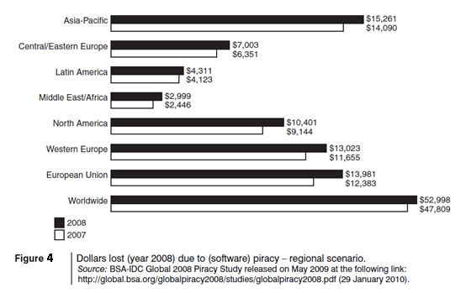
Software Piracy
Theft of software through the illegal copying of genuine programs or the counterfeiting and distribution of products intended to pass for the original.
Those who buy pirated software have a lot to lose:
getting untested software that may have been copied thousands of times over
the software, if pirated, may potentially contain hard-drive-infecting viruses
there is no technical support in the case of software failure, that is, lack of technical product support available to properly licensed users
there is no warranty protection,
there is no legal right to use the product, etc.
Economic impact of software piracy is grave (see Fig. 4).
Cyber Security by Nina Godbole/Sunit Belapure
Copyright © 2011 Wiley India Pvt. Ltd. All rights reserved.

Slide 17
Computer Sabotage
It is the use of the Internet to hinder the normal functioning of a computer system through the introduction of worms, viruses or logic bombs. It can be used to gain economic advantage over a competitor, to promote the illegal activities of terrorists or to steal data or programs for extortion purposes. Logic bombs are event-dependent programs created to do something only when a certain event (known as a trigger event) occurs. Some viruses may be termed as logic bombs.
E-Mail Bombing/Mail Bombs
It refers to sending a large number of E-Mails to the victim to crash victim’s E-Mail account or to make victim’s mail servers crash (in the case of a company or an E-Mail service provider).
Computer program can be written to instruct a computer to do such tasks on a repeated basis.
Usenet Newsgroup as the Source of Cybercrimes
Usenet is a popular means of sharing and distributing information on the Web with respect to specific topic or subjects. It is a mechanism that allows sharing information in a many-to-many manner. The newsgroups are spread across 30,000 different topics.
Cyber Security by Nina Godbole/Sunit Belapure
Copyright © 2011 Wiley India Pvt. Ltd. All rights reserved.

Slide 18
Computer Network Intrusions
Computer Networks pose a problem by way of security threat because people can get into them from anywhere.
The cracker can bypass existing password protection by creating a program to capture logon IDs and passwords.
The practice of “strong password” is therefore important.
Password Sniffing
Password Sniffers are programs that monitor and record the name and password of network users as they login, jeopardizing security at a site.
Whoever installs the Sniffer can then impersonate an authorized user and login to access restricted documents.
Credit Card Frauds
Millions of dollars may be lost annually by consumers who have credit card and calling card numbers stolen from online databases.
Bulletin boards and other online services are frequent targets for hackers who want to access large databases of credit card information.
Identity Theft
Identity theft is a fraud involving another person’s identity for an illicit purpose.
This occurs when a criminal uses someone else’s identity for his/her own illegal purposes.
The cyberimpersonator can steal unlimited funds in the victim’s name without the victim even knowing about it for months, sometimes even for years!
Cyber Security by Nina Godbole/Sunit Belapure
Copyright © 2011 Wiley India Pvt. Ltd. All rights reserved.

Slide 19
Cybercrime: The Legal Perspectives
Computer Crime: Criminal Justice Resource Manual (1979)
The first comprehensive presentation of computer crime
computer-related crime was defined in the broader meaning as: any illegal act for which knowledge of computer technology is essential for a successful prosecution.
Cybercrime:
outcome of “globalization.”
Globalized information systems accommodate an increasing number of transnational offenses.
This problem can be resolved in two ways:
1. Divide information systems into segments bordered by state boundaries
2. Incorporate the legal system into an integrated entity obliterating these state boundaries
Cybercrimes: An Indian Perspective
India has the fourth highest number of Internet users in the world.
there are 45 million Internet users in India
37% - from cybercafes
57% of users are between 18 and 35 years.
A point to note is that the majority of off enders were under 30 years.
About 46% cybercrime cases were related to incidents of cyberpornography
In over 60% of these cases, off enders were between 18 and 30 years.
Cybercrime and the Indian ITA 2000
The first step toward the Law relating to E-Commerce at international level to regulate an alternative form of commerce and to give legal status in the area of E-Commerce.
Cyber Security by Nina Godbole/Sunit Belapure
Copyright © 2011 Wiley India Pvt. Ltd. All rights reserved.

Slide 20
Hacking and the Indian Law(s)
Cybercrimes are punishable under two categories: the ITA 2000 and the IPC.
A total of 207 cases of cybercrime were registered under the IT Act in 2007 compared to 142 cases registered in 2006.
Under the IPC too, 339 cases were recorded in 2007 compared to 311 cases in 2006.
A Global Perspective on Cybercrimes
In Australia, cybercrime has a narrow statutory meaning as used in the Cyber Crime Act 2001, which details offenses against computer data and systems.
In the Council of Europe’s (CoE’s) Cyber Crime Treaty, cybercrime is used as an umbrella term to refer to an array of criminal activity including offenses against computer data and systems, computer-related offenses, content offenses and copyright offenses.
Recently, there have been a number of significant developments such as
1. August 4, 2006 Announcement: The US Senate ratifies CoE Convention on Cyber Crime.
2. In August 18, 2006, there was a news article published “ISPs Wary About ‘Drastic Obligations’ on Web Site Blocking.”
3. CoE Cyber Crime Convention (1997–2001) was the first international treaty seeking to address Internet crimes by harmonizing national laws, improving investigative techniques and increasing cooperation among nations.
Cybercrime and the Extended Enterprise
It is the responsibility of each user to become aware of the threats as well as the opportunities that “connectivity” and “mobility” presents them with.
Extended enterprise - represents the concept that a company is made up not just of its employees, its board members and executives, but also its business partners, its suppliers and even its customers (Fig. 5).
Cyber Security by Nina Godbole/Sunit Belapure
Copyright © 2011 Wiley India Pvt. Ltd. All rights reserved.

Slide 21
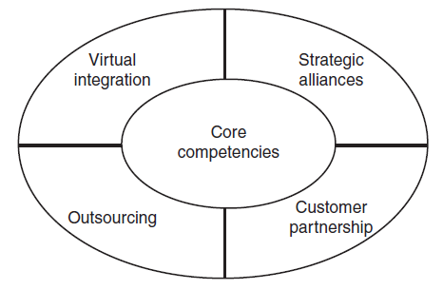
Cybercrime Era: Survival Mantra for the Netizens
Netizen
Netizen is someone who spends considerable time online and also has a considerable presence online (through websites about the person, through his/her active blog contribution and/or also his/her participation in the online chat rooms).
The 5P Netizen mantra for online security is: (a) Precaution, (b) prevention, (c) Protection, (d) Preservation and (e) Perseverance.
For ensuring cybersafety, the motto for the “Netizen” should be “Stranger is Danger!”
Cyber Security by Nina Godbole/Sunit Belapure
Copyright © 2011 Wiley India Pvt. Ltd. All rights reserved.

Slide 22
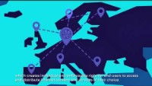
Internet Governance

