Slide 1

Unix Shell Programming
Unit-1: Overview of Unix
Notes:
1

Slide 2

Introduction
UNIX is an operating system.
An operating system is a set of programs that act as a link between the computer and the user.
The operating system (OS) manages the resources of a computer.
Examples of computer resources are: CPU, RAM, disk memory, printers, displays, keyboard, etc
Notes:
2

Slide 3
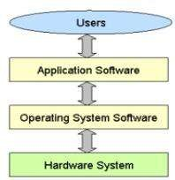


- The interface provided by the OS can either be a Graphical User Interface- GUI or a Command Line Interface- CLI.

Slide 4
Unix OS
Unix was originally developed in 1969 by a group of AT&T employees Ken Thompson, Dennis Ritchie, Douglas McIlroy, and Joe Ossanna at Bell Labs.
There are various Unix variants available in the market.
Solaris Unix, AIX, HP Unix and BSD are a few examples.
Linux is also a flavor of Unix which is freely available.

Slide 5
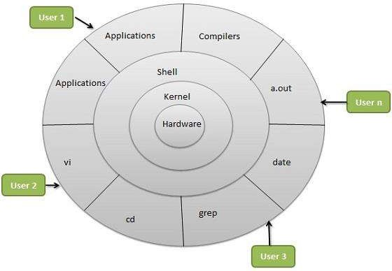



Unix Architecture

Slide 6



Unix follows a modular architecture, in which, the functionalities are divided between the two modules: Kernel and Shell. This is division of labour.
The kernel interacts with the machine hardware and the shell interacts with the user.
Kernel: It is a collection of functions written in C language. It is loaded into the memory when the system is booted.
It performs memory management, process management and file management.

Slide 7


Shell: The shell is the command interpreter.
It takes the commands given by the user, interprets them and directs them to the kernel for further processing.
There are different types of shell-
Bourne shell (sh),
C shell (csh),
Korn shell (ksh),
Bourne Again Shell (bash)

Slide 8


Shell Types:
In Unix, there are two major types of shells −
Bourne shell − the $ character is the default prompt.\
usually installed as /bin/sh
C shell − the % character is the default prompt.
The Bourne Shell has the following subcategories −
Bourne shell (sh)
Korn shell (ksh)
Bourne Again shell (bash)
POSIX shell (sh)
The different C-type shells follow −
C shell (csh)
TENEX/TOPS C shell (tcsh)
The original Unix shell was written in the mid-1970s by Stephen R. Bourne while he was at the AT&T Bell Labs in New Jersey.
Bourne shell was the first shell to appear on Unix systems, thus it is referred to as "the shell".
In this chapter, we are going to cover most of the Shell concepts that are based on the Borne Shell.

Slide 9
Features of Unix
1) Multiuser
- Multiple users can access the system by connecting to points known as terminals.
- Several users can run multiple programs simultaneously on one system.
2) Multitasking
The kernel is designed to handle a user's multiple needs.
In a multitasking environment, a user sees one job running in the foreground; the rest run in the background.

Slide 10


Pattern Matching
UNIX has very sophisticated pattern matching features.
Regular Expressions describe a pattern to match, a sequence of characters, not words, within a line of text.
4) Portable
UNIX can be installed on many hardware platforms.
Unix operating system is written in C language, hence it is more portable than other operating systems.

Slide 11
5) UNIX Toolkit
UNIX offers facility to add and remove many applications as and when required.
Tools include
→ general purpose tools
→ text manipulation tools
→ compilers/interpreters
→ networked applications and
→ system administration tools

Slide 12
6) Programming Facility
The UNIX shell is also a programming language; it was designed for programmer, not for end user.
It has all the necessary ingredients, like control structures, loops and variables, that establish powerful programming language.
This features are used to design shell scripts – programs that can also invoke UNIX commands.
Many of the system's functions can be controlled and automated by using these shell scripts.

Slide 13
7) Documentation
The principal on-line help facility available is the man command, which remains the most important references for commands and their configuration files.
Apart from the man documentation, there's a vast ocean of UNIX resources available on the Internet.

Slide 14
Command Structure
UNIX commands take the following general form:
verb [options] [arguments]
where verb is the command name that can take a set of optional options and one or more optional arguments.
Commands, options and arguments have to be separated by spaces or tabs to enable the shell to interpret them as words.
The shell compresses multiple occurrences of whitespace into a single whitespace.

Slide 15
General Purpose Utilities
cal
date
echo
bc
ps
passwd
PATH
who
tput clear
ls (ls>list)
wc(wc|list)
uname
Pwd
tty
mkdir, cd, rmdir

Slide 16

Internal and External Commands
Some commands are implemented as part of the shell itself rather than separate executable files. Such commands that are built-in are called internal commands.
If the command (file) has an independence existence in the /bin directory (i.e. has separate executable files), it is called external command.

Slide 17

Important Environment Variables
HOME - your home directory.
USER and LOGNAME - your login ID.
HOSTNAME - the name of the host computer.
PWD - the current working directory.
PATH - a list of directories in which to look for executable commands.
Certain applications and commands may communicate with the shell and reference the environment variables that it maintains.
For example, it seems that frm and nfrm seem not to work if $MAIL is not defined. frm and nfrm are commands to list the contents of your inbox without logging into pine.
Notes:
17

Slide 18



The File System
Ordinary File
Directory File
Device File

Slide 19
/
├── bin
│ ├── bash
│ ├── ls
│ └── cp
├── boot
│ └── vmlinuz
├── etc
│ ├── passwd
│ ├── fstab
│ └── hosts
├── home
│ ├── user1
│ │ ├── documents
│ │ └── pictures
│ └── user2
│ ├── downloads
│ └── music
├── lib
│ ├── libc.so
│ └── libm.so
├── tmp
├── usr
│ ├── bin
│ ├── lib
│ └── share
├── var
│ ├── log
│ └── mail
└── sbin
└── shutdown

Slide 20
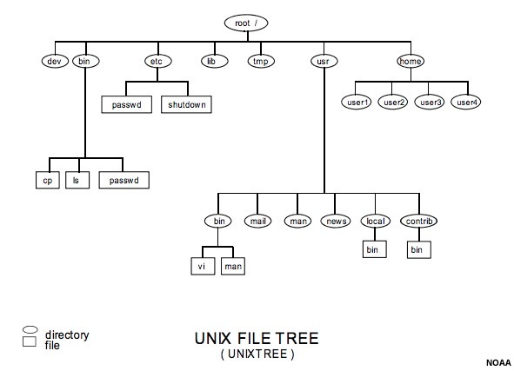

Slide 21
/ (Root Directory): The starting point of the file system.
/bin: Contains essential binaries (commands) required for system operation.
/etc: Configuration files for the system.
/home: User home directories where personal files are stored.
/lib: Shared libraries used by executable files.
/tmp: Temporary files created by applications.
/dev: contains all device files.

Slide 22
mkdir
rmdir
cd
pwd

Slide 23
Absoulte Pathname:
Full path starting from the root ( / ) Example: /home/user/documents/file.txt
Relative Pathname:
Path relative to the current directory. Example: documents/file.txt

Slide 24
Basic File attributes
dr-xr-xr-x 2 kumar metal 128 jun 18 22:41 note
-r-xr-xr-x 2 kumar metal 128 jun 18 22:41 progs
Chmod: changing File permissions:
Relative permission: chmod category operation permission filename
Absolute Permission: r=4, w=2,x=1

Slide 25
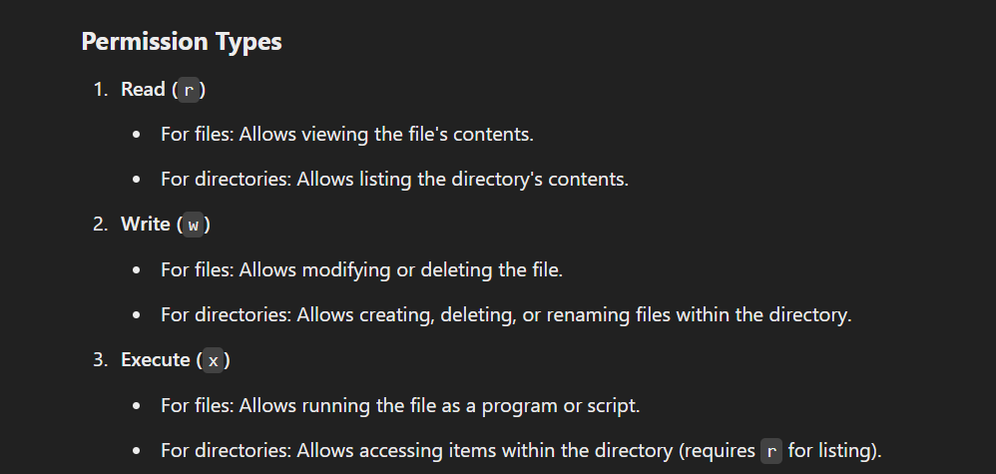
File and Directory Permissions

Slide 26
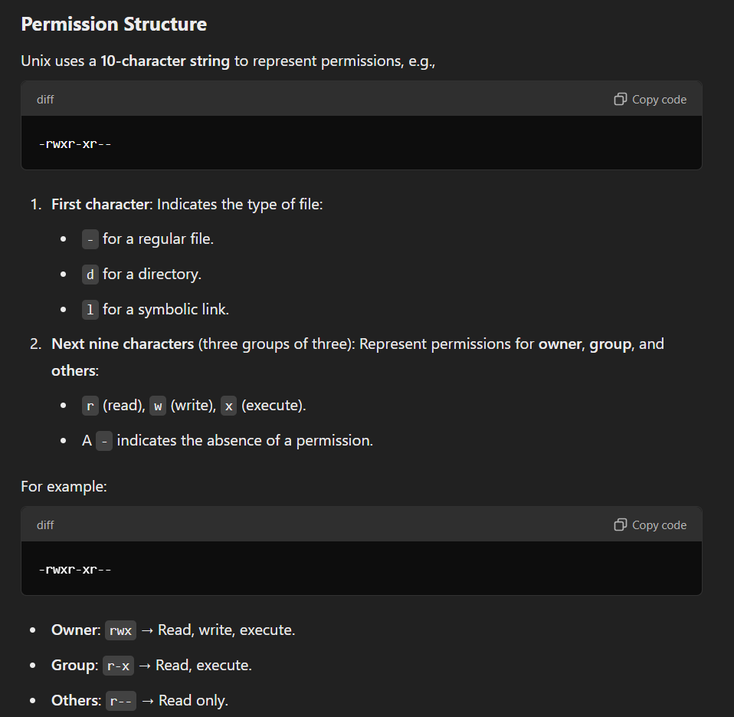



Slide 27
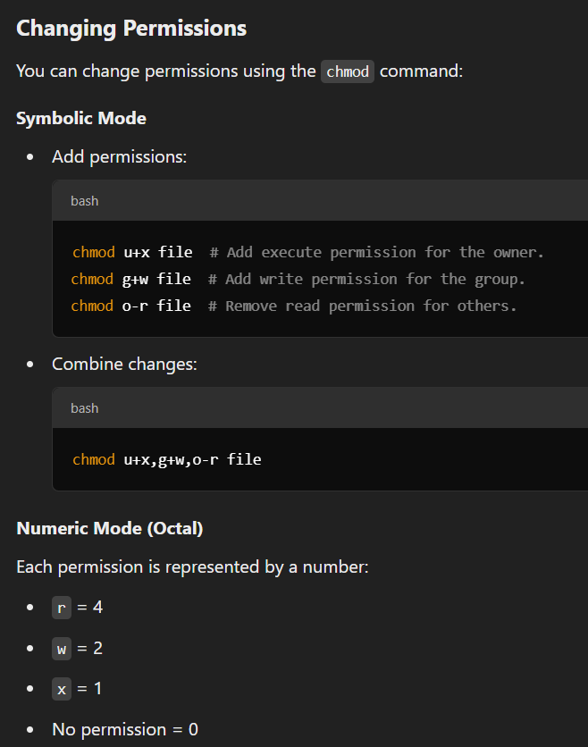
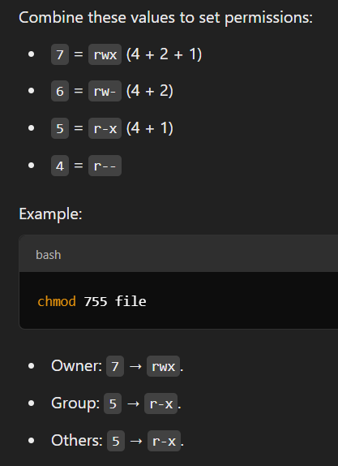






Slide 28
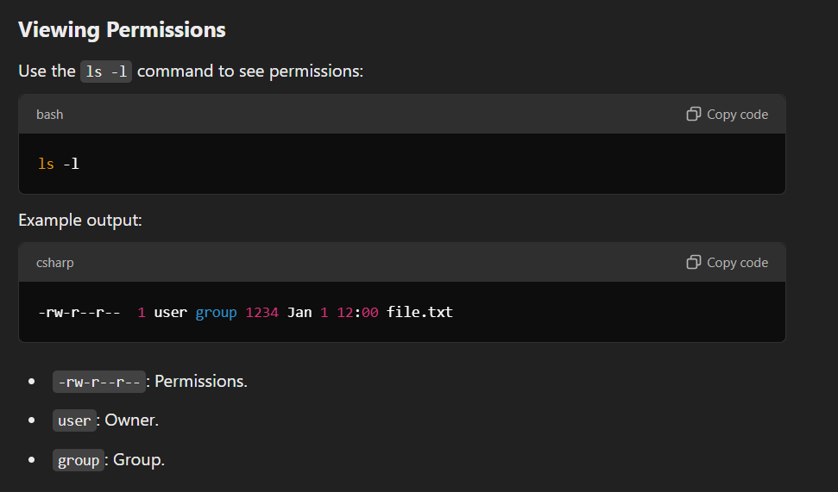


Slide 29
Chown
→ to change the ownership of a file or directory. Syntax:
chown owner filename
owner: The new owner of the file.
filename: The file or directory whose ownership you want to change.
Example:
chown alice file.txt
This changes the owner of file.txt to the user alice.

Slide 30
Chgrp
→ to change the group ownership of a file or directory. Syntax:
chgrp group filename
group: The new group for the file.
filename: The file or directory whose group ownership you want to change.
Example:
chgrp developers file.txt
This changes the group of file.txt to developers.

Slide 31


The vi Editor
The default editor that comes with the UNIX operating system is called vi (visual editor). Using vi editor, we can edit an existing file or create a new file from scratch. we can also use this editor to just read a text file.
Open vi editor
vi file_name

Slide 32
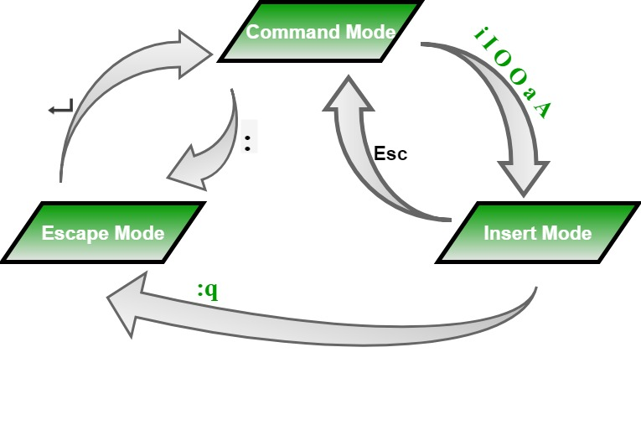




vi: Modes

Slide 33




Pattern Matching
The meta characters that are used to construct patterns are called wild cards.
* : any no of characters including none
?: single character
??: two characters
[ijk]: single character either i j or k
[x-z]: single character in the range x to z
[!x-z]:single character not in the range x to z

Slide 34
Shell scripts
A shell script contains a list of commands which have to be executed regularly.
Shell script is also known as shell program.
The user can execute the shell script itself to execute commands in it.
The extension is -- .sh
To execute use the command:
sh filename.sh

Slide 35
Before you add anything else to your script, you need to alert the system that a shell script is being started. This is done using the shebang construct.
#!/bin/sh
This tells the system that the commands that follow are to be executed by the Bourne shell.
It's called a shebang because the # symbol is called a hash, and the ! symbol is called a bang.

Slide 36

Sample scripts
#! /bin/sh
echo “Welcome to Shell Programming”
echo “Today’s date : `date`”
echo “My Shell :$SHELL”

Slide 37




Shell script to add 2 numbers
#!/bin/bash
# Prompt the user for the first number
echo "Enter the first number: "
read num1
# Prompt the user for the second number
echo "Enter the second number: "
read num2
# Perform the addition
sum=$((num1 + num2))
# Display the result
echo "The sum of $num1 and $num2 is: $sum“
Shell script to display the current working directory
Shell script to change the password

