Slide 1
usp

Slide 2
A process in an operating system (OS) is a program in execution.
It is an instance of a program that is being executed by one or more threads. In simpler terms, a process is the unit of work in a system.
It consists of the program code (also known as text section), data, and resources that the program uses during its execution.
In Unix-like operating systems, processes are managed by the kernel, which is the core part of the OS responsible for controlling hardware resources and providing basic services for software.

Slide 3
Key Concepts Related to Processes in Unix
Process Control Block (PCB):
Each process is represented by a process control block (PCB), which stores information about the process such as:
Process ID (PID)
Parent Process ID (PPID)
CPU state (registers, program counter)
Memory state (base and limit registers)
Process state (running, waiting, etc.)
I/O resources and files used by the process
The PCB helps the operating system manage and schedule processes effectively.

Slide 4
Process States
Process States: A process in Unix can be in one of several states during its lifecycle:
New: The process is being created.
Ready: The process is ready to execute and waiting for CPU time.
Running: The process is currently executing on the CPU.
Waiting (Blocked): The process is waiting for some event to occur, such as I/O completion or waiting for a resource (like a semaphore or lock).
Terminated (Zombie): The process has finished execution, but its exit status is still pending for the parent process to collect.
Stopped: The process has been stopped, typically due to a signal.

Slide 5
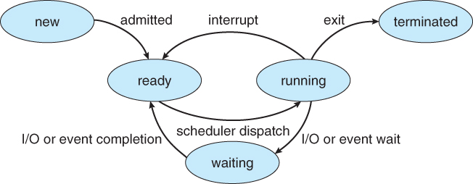

Slide 6
Process Lifecycle
Process Lifecycle: A process goes through several stages during its lifecycle. These stages are:
Creation: The process is created when a program is executed. A new process can be created using the fork() system call in Unix, which creates a copy of the parent process.
Execution: The process executes instructions from the program.
Termination: The process terminates when its execution completes, either successfully or due to an error. The exit status is returned to the parent process.
When a process finishes execution, its PCB is cleaned up, but if the parent does not collect the exit status, the process becomes a zombie process.

Slide 7
Process Control in Unix:
Process Control in Unix: Unix provides several system calls to control processes, such as:
fork(): Used to create a new process by duplicating the calling process. The new process is called the child process, and the
original process is called the parent process.
Syntax: pid_t fork(void);
Return Value: The return value of fork() is 0 in the child process and the PID of the child in the parent process.
exec(): Used to replace the current process image with a new one. This allows a process to execute a different program. Syntax: int execvp(const char *file, char *const argv[]);
The exec() function does not return if it is successful, as the current process is replaced with the new program.
wait(): The parent process can use wait() to wait for the child process to terminate. This allows the parent process to collect the
exit status of the child process.
Syntax: pid_t wait(int *status);
Return Value: Returns the PID of the terminated child process.
exit(): This function is used to terminate a process, returning an exit status to the parent process.
Syntax: void exit(int status);
Status: The exit status is an integer code that indicates the success or failure of the process.
kill(): This is used to send signals to processes, such as terminating a process or pausing it.
Syntax: int kill(pid_t pid, int sig);
It can be used to send termination signals like SIGTERM or SIGKILL to a process.

Slide 8
Parent and Child Processes
Parent and Child Processes:In Unix, processes can create child processes through fork().
A parent process can communicate with its child processes, but they run independently.
The PID (Process ID) is used to identify each process, and the PPID (Parent Process ID) is used to track the parent process.
Zombie Processes: When a child process terminates, it sends an exit status to the parent.
If the parent doesn't read the status (via wait()), the child process remains in the process table as a zombie. The process is terminated, but its PCB remains until the parent calls wait() to collect the status
Orphan Processes: If a parent process terminates before its child process, the child becomes an orphan process.
In this case, the init process (PID 1) becomes the new parent of the orphan process and will clean up its resources when it terminates.

Slide 9
Process ID (PID) and Parent Process ID (PPID)
Process ID (PID) and Parent Process ID (PPID)PID: Each process in Unix has a unique identifier called Process ID (PID).
It is used by the kernel to track and manage processes.
PPID: Each process has a Parent Process ID (PPID), which identifies the parent process that created it.
The init process (PID 1) is the ancestor of all processes.

Slide 10
Signals in Unix and Process Management
Signals in Unix and Process Management : Unix processes can send and receive signals.
Signals are a form of inter-process communication (IPC) used to notify a process that a specific event has occurred.
Examples of signals include:
SIGKILL: Used to forcefully terminate a process.
SIGTERM: Requests that a process terminate gracefully.
SIGSTOP: Suspends the process temporarily (can be resumed later).
SIGCONT: Resumes a stopped process.
A process can handle signals by using signal handlers, and processes can ignore certain signals.

Slide 11
Process Scheduling and Multi-tasking
Scheduling: The kernel is responsible for scheduling processes to run on the CPU.
It uses various scheduling algorithms to decide which process should run next. Common scheduling algorithms include Round-Robin, First-Come-First-Serve (FCFS), and Shortest Job First (SJF).
Time-sharing: In Unix, processes are usually scheduled based on time-sharing, meaning each process gets a small slice of CPU time (called a time quantum).
If a process doesn't finish within its time slice, it is preempted and placed back into the ready queue for later execution.

Slide 12
Process Example:
Consider the following simple example in Unix where a process forks a child process, the child process executes a program, and the parent waits for the child to finish:
Parent Process calls fork().Child Process (created by fork()) calls exec() to replace its image with a new program (e.g., ls).
Parent Process waits for the child to terminate using wait().
The child terminates, and the parent collects the exit status.

Slide 13
#include <stdio.h>
#include <unistd.h>
#include <sys/types.h>
int main() {
pid_t pid = fork(); // Create a new process
if (pid == -1) {
// If fork() fails
perror("Fork failed");
return 1;
}
if (pid == 0) {
// This block is executed by the child process
printf("I am the child process, my PID is %d, and my parent's PID is %d\n", getpid(), getppid());
} else {
// This block is executed by the parent process
printf("I am the parent process, my PID is %d, and my child's PID is %d\n", getpid(), pid);
}
return 0;
}

Slide 14
#include <stdio.h>
#include <stdlib.h>
#include <unistd.h>
int main() {
pid_t pid = fork(); // Create a new process
if (pid == 0) {
// This is the child process
printf("Child process: Executing 'ls' command\n");
execlp("ls", "ls", NULL); // Replace the child process with 'ls'
} else if (pid > 0) {
// This is the parent process
wait(NULL); // Wait for the child to terminate
printf("Parent process: Child terminated\n");
} else {
// Error handling
perror("fork");
exit(1);
}
return 0;
}

Slide 15
execlp("ls", "ls", NULL):
First parameter (file): "ls" — the name of the program to execute.
Second parameter (arg): "ls" — the first argument to the program (by convention, this is the program name itself).
hird parameter (NULL): Marks the end of the argument list.
The execlp() function will search for the executable ls in the system's PATH, replace the current process with ls, and pass "ls" as the first argument to ls (which is the standard convention).
The program ls will then execute and show the contents of the directory (or the standard output depending on how it is called).
If execlp() fails (e.g., if the program ls is not found), it returns -1, and an error message can be retrieved using perror().

Slide 16
A process in Unix can be in one of several states at any given time, and these states are typically represented as part of a process state diagram. The common process states in Unix are:
New (or Created): The process is being created. This is the state immediately after the process has been created by the operating system, but before it begins execution.
Ready: The process is ready to run and is waiting for the CPU to be assigned to it. It’s in a queue (called the ready queue), and the operating system will schedule it for execution
as soon as it gets CPU time.
Running: The process is currently being executed by the CPU. This state can be interrupted or preempted, especially in multitasking systems, where the CPU may be switched
between different processes.
Waiting (or Blocked): The process is waiting for an event to occur (like I/O completion or a signal). During this time, it is not ready to run and is blocked until the event it is waiting
for happens.
Terminated (or Zombie): The process has finished executing but is still in the system because its parent process has not yet read its exit status. The process is technically finished
but still occupies a small amount of system resources (like process ID) until the parent calls wait() to retrieve its exit status.
Suspended (or Stopped): This state occurs when a process has been paused or suspended. This could be due to signals like SIGSTOP or a manual suspension
(e.g., using the kill command to stop a process).

Slide 17
In a Unix-like operating system, a parent process is a process that creates one or more child processes.
The relationship between parent and child processes is a fundamental concept in process management.
Key Characteristics of Parent ProcessesProcess Creation:A parent process creates child processes through system calls like fork() or clone().
The fork() system call is the most common method for creating a new process in Unix-like systems. When a process calls fork(), it creates an almost identical copy of itself, known as a child process.
Parent-Child Relationship:Every process in a Unix-like system has a parent process except for the initial process (usually the init process with PID 1).
The child process inherits certain properties from the parent process, such as the environment, open file descriptors, and resource limits.
The child can run independently of the parent once created.
Process ID (PID) and Parent Process ID (PPID):Every process in a Unix-like system has a unique identifier called a PID (Process ID).
Each process also has a Parent Process ID (PPID) that identifies its parent process.
The PPID of a process is the PID of the process that created it.You can view the PID and PPID of processes using the ps or top commands in Unix/Linux systems.

Slide 18
Parent Process Responsibilities:
Monitoring Child Processes: The parent process may need to monitor the execution of its child processes, either by waiting for them to finish or periodically checking their status.
Resource Management: The parent is responsible for reclaiming resources associated with its child processes once they finish execution. This happens through a system call called wait() or waitpid(), which allows the parent to collect the exit status of the child.
Zombie Processes: If a child process terminates and the parent fails to read the child's exit status, the child remains in a zombie state. The parent is expected to call wait() to clean up the child process and remove it from the process table.
Termination:
When the parent process terminates, the system reassigns its child processes to a new parent, usually the init process (PID 1), in Unix-like systems.This is done to ensure that orphaned child processes are properly managed.

Slide 19
In this example:The parent process calls fork(), which creates a child process.
The child process receives a return value of 0 from fork(), while the parent process receives the PID of the child.
Each process prints its PID and the PPID (Parent Process ID).
Parent Process Termination and Orphan Processes
If the parent process terminates before the child process, the child becomes an orphan.
In Unix-like systems, orphaned processes are adopted by the init process (with PID 1), which ensures they are properly cleaned up once they terminate.
System Calls Involving Parent Processes
fork(): Creates a new process (child) by duplicating the parent process.
wait(): The parent process waits for the child process to finish and retrieves its exit status.
waitpid(): Allows a parent process to wait for a specific child process by specifying its PID.
exit():Terminates a process and passes an exit status to its parent.

Slide 20
Parent Process: A process that creates one or more child processes using system calls like fork().
Child Process: A process created by the parent, inheriting resources and properties from it.
Parent Process ID (PPID): Identifies the parent of a process, enabling communication and management between parent and child.
Zombie Process: A child process that has finished execution but hasn’t been cleaned up by the parent.
Orphan Process: A child process whose parent has terminated, typically adopted by the init process.

Slide 21
Zombie Process
A Zombie process occurs when a child process terminates, but the parent process hasn't yet read its exit status using wait() or waitpid(). This leaves the child in the zombie state, occupying a process entry in the process table until the parent retrieves the exit status.
Zombie Process Program Example
In this example, we create a zombie process by having the parent process not call wait() after the child process terminates.

Slide 22
#include <stdio.h>
#include <unistd.h>
#include <sys/types.h>
#include <sys/wait.h>
int main() {
pid_t pid = fork();
if (pid == -1) {
// Fork failed
perror("Fork failed");
return 1;
}
if (pid == 0) {
// Child process
printf("Child process: PID = %d\n", getpid());
// Child terminates without the parent calling wait() yet
_exit(0);
} else {
// Parent process
printf("Parent process: PID = %d, waiting for child to terminate...\n", getpid());
// Parent does NOT call wait(), so the child becomes a zombie// The process table will still hold an entry for the child until parent does wait()
while (1) {
// Infinite loop to keep the parent running // The child will remain in the zombie state
}
}
return 0;
}

Slide 23
Introduction to sockets
A socket is one endpoint of a two way communication link between two programs running on the network.
The socket mechanism provides a means of inter-process communication (IPC) by establishing named contact points between which the communication take place.
Like ‘Pipe’ is used to create pipes and sockets is created using ‘socket’ system call.
The socket provides bidirectional FIFO Communication facility over the network. A socket connecting to the network is created at each end of the communication.
Each socket has a specific address.
This address is composed of an IP address and a port number.
Socket are generally employed in client server applications.
The server creates a socket, attaches it to a network port addresses then waits for the client to contact it. The client creates a socket and then attempts to connect to the server socket.
When the connection is established, transfer of data takes place.

Slide 24
A socket is an endpoint for sending and receiving data in a network, used in both TCP and UDP communication
Types of Sockets : There are two types of Sockets: the datagram socket and the stream socket.
Datagram Socket : This is a type of network which has connection less point for sending and receiving packets. It is similar to mailbox.
The letters (data) posted into the box are collected and delivered (transmitted) to a letterbox (receiving socket).
Stream Socket In Computer operating system, a stream socket is type of interprocess communications socket or network socket which provides a connection-oriented, sequenced, and unique flow of data without record boundaries with well defined mechanisms for creating and destroying connections and for detecting errors.
It is similar to phone. A connection is established between the phones (two ends) and a conversation (transfer of data) takes place.

Slide 25
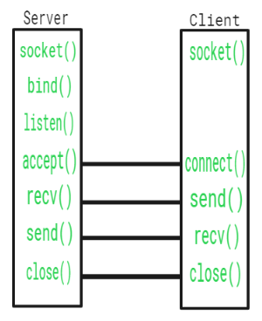

Slide 26
Function Call | Description
Socket() | To create a socket
Bind() | It’s a socket identification like a telephone number to contact
Listen() | Ready to receive a connection
Connect() | Ready to act as a sender
Accept() | Confirmation, it is like accepting to receive a call from a sender
Write() | To send data
Read() | To receive data
Close() | To close a connection

Slide 27
Introduction to I/O Multiplexing
I/O Multiplexing refers to the technique used in computer systems to efficiently manage multiple input/output (I/O) operations on various devices or streams, such as files, sockets, or pipes, without requiring multiple threads or processes.
It allows a single process to handle multiple I/O operations concurrently by monitoring several I/O streams and performing operations when they are ready, making it an essential concept in systems programming and networking.
I/O multiplexing is widely used in applications where a single process needs to interact with multiple I/O sources simultaneously, such as network servers handling multiple client connections or applications that interact with many files or sockets.

Slide 28
Blocking System call
A blocking system call is a system call that blocks the process execution until the requested operation is completed.
The blocking system call can be used in synchronous I/O or asynchronous I/O.
Synchronous (blocking) input
and output methods: read(), write()
Asynchronous input and output methods:
select(), poll()

Slide 29
The following example shows how to use the read() system call.
The read() function returns the number of bytes actually read, which may be less than the number of bytes requested. The difference between the two is not always returned as an error condition.
The following example shows how to use the write() system call.
The write() function writes up to count bytes from the buffer pointed to by buf to file descriptor fd.
It returns the number of bytes written, which may be less than the count if a write error occurs. The following example shows how to use the select() system call.
The select() function blocks until input or output become possible for any of a set of open files. The descriptors will be updated with information about whether I/O is possible for them or not.
The following example shows how to use poll() system call.
The poll() function returns the number of file descriptors that are ready for reading (0) and writing (1), respectively. It returns -1 on failure with errno set appropriately.

Slide 30
Non-Blocking System Call
A non-blocking system call is a system call that does not block. The calling process can continue execution while the operation is in progress and returns immediately when it’s complete.
The most important difference between blocking and non-blocking IO is how code behaves during the I/O operation:
with a blocking IO, users must wait until data has been received before continuing execution; with a non-blocking IO, users don’t have to wait for anything at all!
The main advantage of non-blocking IO is that it allows users to continue with other tasks while waiting for the I/O operation to complete.
This can be especially useful when writing concurrent programs, where there are many things happening at once (like multiple threads).
Non-blocking IO is a bit harder to write than blocking IO, but it’s also much more powerful and flexible. This is because non-blocking IO allows users to perform multiple I/O operations at once, in any order.

Slide 31
Asynchronous I/O
Asynchronous I/O is a technique to handle I/O operations without blocking the process. In other words, asynchronous I/O performs an operation on some data or resource and returns immediately without waiting for a response from another system.
It’s used when the user wants to perform an operation that does not need constant interaction with your application, but the user still wants it done as soon as possible (e.g., printing something out).
This approach allows more flexibility in program flow since it allows users to work with multiple threads at once and avoid deadlocks between them.
Asynchronous I/O can also be used for network communication since it provides better performance than synchronous IO (blocking IO), but there are some restrictions on how this needs to be implemented:
Users cannot use asynchronous reads or write if any other part of your application depends on them having completed before moving on to another task; otherwise, this could cause issues later down the line when running under load conditions!

Slide 32
Synchronous I/O
Synchronous I/O is a mechanism in which the process is blocked until the I/O operation is completed. This can happen when there is no way for processes to continue until their scheduled event has finished. In this case, synchronous I/O needs to wait patiently till it has been given permission by its supervisor program to proceed with further processing.
Asynchronous I/O, or nonblocking I/O (NBIO), is a mechanism in which the process continues its execution without waiting for the I/O operation to complete. For example: if the user wants to read data from disk and then write that data back onto disk later on – then asynchronous IO would suit this scenario perfectly well because it means that your program will continue running even after completing its task of writing new records onto disk or reading existing ones off.

Slide 33
Difference Between Blocking and Non-Blocking I/O
Blocking I/O Non-Blocking I/O
Blocking I/O is when a process is waiting for an I/O operation to complete.
Non-blocking I/O means that when user call GetData().
For example, if users are trying to write data from your application into a file on disk, then if another process wants access too at that same time then they would have their own read or write operations started at the same time as yours.
This can cause problems because there’s no guarantee that they’ll finish before the user does.
In our example above, it returns immediately without waiting until all the requested data has been transferred over (and returned).
The result here could be different depending on how busy those other processes were when calling GetData(), So this doesn’t really matter much here; just know that what we’re doing now won’t block any other programs from getting their jobs done either since everything happens on its own schedule – even though it might seem like nothing else was happening while waiting around forever.

Slide 34
Key Concepts of I/O Multiplexing:
Non-blocking I/O:
In traditional blocking I/O operations, a process waits (or "blocks") for an I/O operation to complete before it can continue. This can be inefficient, especially when dealing with multiple I/O streams.
Non-blocking I/O allows the process to continue executing without waiting for the I/O operation to complete. If the I/O operation is not ready (e.g., data is not available), the process can continue performing other tasks.
Event-driven Programming:
I/O multiplexing is closely associated with event-driven programming, where a process listens for events (such as data being ready to read from a socket) and responds when the event occurs, without continuously polling.
Efficiency:
Instead of dedicating a separate thread or process for each I/O operation (which can be expensive in terms of memory and CPU), I/O multiplexing allows a single process to efficiently handle many I/O operations.

Slide 35
How I/O Multiplexing Works:
The main idea behind I/O multiplexing is to use a mechanism that allows a process to check multiple I/O streams to see if they are ready for reading or writing, and then perform the operation when appropriate.
This typically involves:
Monitoring multiple file descriptors (or I/O streams).
Waiting for events that signal when a stream is ready for a read/write operation.
Handling the event once the I/O stream is ready.
I/O multiplexing generally uses an event loop where the process waits for I/O events and handles them accordingly.

Slide 36
Techniques for I/O Multiplexing:In Unix-like systems (Linux, macOS), the most commonly used techniques for I/O multiplexing are:
select():The select() system call allows a process to monitor multiple file descriptors for readiness (e.g., whether data is available to read, or whether a file descriptor is ready to accept data).
It works by providing a list of file descriptors, and the system call blocks until one or more of them is ready for I/O.
How select() works:
You specify a set of file descriptors (sockets, files, etc.) you want to monitor for I/O readiness.The process is blocked until at least one of the file descriptors is ready (or a timeout occurs).
After select() returns, you can check which file descriptors are ready for reading or writing and take appropriate actions.

Slide 37
poll():Similar to select(), poll() allows you to monitor multiple file descriptors, but it provides more flexibility.
Unlike select(), poll() doesn't have a fixed limit on the number of file descriptors that can be monitored.
poll() uses a polling-based approach and is more scalable than select() for large numbers of file descriptors.
It works by maintaining a list of file descriptors and checking which ones are ready for I/O.

Slide 38
Advantages of I/O Multiplexing:
Efficiency: I/O multiplexing allows a single process or thread to handle multiple I/O streams concurrently without spawning a separate thread for each stream. This reduces overhead and improves resource utilization.
Scalability: Mechanisms like epoll() and kqueue() can efficiently scale to handle thousands of file descriptors, making them ideal for high-performance servers and applications
.Concurrency: It enables non-blocking, event-driven concurrency, allowing the system to handle multiple I/O operations at once, which is particularly useful in network servers or any application where multiple I/O sources need to be managed.
Reduced Context Switching: By avoiding multiple threads for each I/O stream, the system reduces the context switching overhead that can occur in a multithreaded environment.

Slide 39
Disadvantages of I/O Multiplexing:
Complexity: The use of I/O multiplexing often requires a more complex event-driven programming model.
Managing the event loop and handling different types of events (read/write, timeout, error) can be tricky.
Blocking Behavior: While I/O multiplexing reduces blocking, some methods (e.g., select()) still block the process until an event occurs. This can lead to some latency in handling certain events.
Platform Limitations: While techniques like select() are widely available, more advanced methods like epoll() and kqueue() are platform-specific (Linux and BSD/macOS, respectively).

Slide 40
Use Cases for I/O Multiplexing:
Network Servers: I/O multiplexing is often used in servers that need to handle many client connections simultaneously, such as web servers, database servers, and proxy servers.
Real-time Applications: Applications that require real-time data processing (such as streaming or gaming) can benefit from I/O multiplexing to efficiently handle multiple I/O streams.
File Systems: I/O multiplexing is useful for file systems that need to monitor multiple files for reading or writing concurrently.

Slide 41
Pipes and FIFO
Conceptually, a pipe is a connection between two processes, such that the standard output from one process becomes the standard input of the other process.
In the UNIX Operating System, Pipes are useful for communication between related processes(inter-process communication).
The pipe is a one-way communication only i.e. we can use a pipe such that One process writes to the pipe, and the other process reads from the pipe.
It opens a pipe, which is an area of main memory that is treated as a “virtual file”.
The pipe can be used by the creating process, as well as all its child processes, for reading and writing. One process can write to this “virtual file” or pipe and another related process can read from it.
If a process tries to read before something is written to the pipe, the process is suspended until something is written.
The pipe system call finds the first two available positions in the process’s open file table and allocates them for the read and write ends of the pipe.

Slide 42
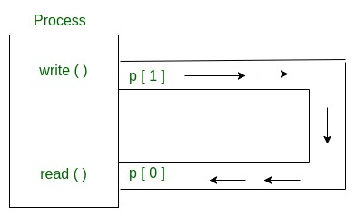
Pipes behave FIFO(First in First out), Pipe behave like a queue data structure. Size of read and write don’t have to match here. We can write 512 bytes at a time but we can read only 1 byte at a time in a pipe.

Slide 43
// C program to illustrate
// pipe system call in C
#include <stdio.h> // For printf()
#include <stdlib.h> // For exit()
#include <unistd.h> // For pipe(), read(), write()
#define MSGSIZE 16
char* msg1 = "hello, world #1";
char* msg2 = "hello, world #2";
char* msg3 = "hello, world #3";
int main() {
char inbuf[MSGSIZE];
int p[2], i;
// Create a pipe and check for errors
if (pipe(p) < 0) {
perror("pipe");
exit(1);
}

Slide 44
// Write to the pipe
write(p[1], msg1, MSGSIZE);
write(p[1], msg2, MSGSIZE);
write(p[1], msg3, MSGSIZE);
// Read from the pipe
for (i = 0; i < 3; i++) {
read(p[0], inbuf, MSGSIZE);
printf("%s\n", inbuf);
}
// Close file descriptors
close(p[0]);
close(p[1]);
return 0;
}

Slide 45
Here, In this code After finishing reading/writing, both parent and child block instead of terminating the process and that’s why program hangs.
This happens because read system call gets as much data it requests or as much data as the pipe has, whichever is less.
If pipe is empty and we call read system call then Reads on the pipe will return EOF (return value 0) if no process has the write end open.
If some other process has the pipe open for writing, read will block in anticipation of new data so this code output hangs because here write ends parent process and also child process doesn’t close.

Slide 46
Key Concepts of Pipes
Data Stream: A pipe enables the flow of data in a continuous stream between processes, without having to write and read data to and from disk files.
This makes pipes an efficient way to handle data in real-time.
Unidirectional Communication: Typically, a pipe supports unidirectional communication. Data flows in one direction—from the producer to the consumer.
In some cases, bidirectional pipes can be used, but this is less common.Standard Input and Output (stdin, stdout): Pipes are often used with standard input (stdin) and standard output (stdout).
A process can send output to a pipe, and another process can read from it.
Named and Anonymous Pipes:Anonymous Pipes: These are used for communication between related processes, such as a parent and child process.
They are temporary and do not have a name.Named Pipes (FIFOs): These are persistent pipes that are given a name and can be used for communication between unrelated processes or processes that do not have a parent-child relationship.

Slide 47
How Pipes Work:
Creating a Pipe: A pipe is typically created using system calls in an operating system.
On Unix-like systems, the pipe() system call creates a pair of file descriptors (read and write ends).
Writing to the Pipe: The producer process writes data to the pipe’s write end.
This data is buffered until the consumer process reads it.
Reading from the Pipe: The consumer process reads the data from the pipe’s read end.
The pipe maintains a buffer to temporarily hold the data while waiting for the consumer to process it.
Closing the Pipe: Once the communication is complete, the pipe is closed, and any remaining data is discarded. The pipe's file descriptors are also closed by the processes.

Slide 48
Use Cases for Pipes:
Inter-Process Communication (IPC): Pipes are used for communication between processes in many operating systems, such as Linux, Windows, and macOS.
They provide a way for one process to send data to another, facilitating complex operations that require collaboration between programs.
Data Streaming: Pipes can be used for streaming data from one program to another without writing the data to disk. For example, a video processing application might pipe video data to a compression utility for real-time compression.

Slide 49
Types of Pipes:
Anonymous Pipes:These are used for communication between related processes (like parent-child processes). They are usually temporary and disappear once the processes terminate.
Example: In a shell, | is used to create an anonymous pipe.
Named Pipes (FIFOs):These pipes are used to communicate between processes that are not necessarily related (i.e., not parent-child processes).
They persist even after the processes end and are given a name within the filesystem.
Example: In Unix-like systems, mkfifo is used to create a named pipe.
Windows Named Pipes: On Windows systems, named pipes can be used for communication between different processes or even between processes on different computers across a network.

Slide 50
Limitations of Pipes:
Unidirectional: Standard pipes typically allow only one-way communication.
To achieve two-way communication, two pipes are often required.
Buffering: Pipes use buffering, so if the consumer is slow in reading data, the buffer may fill up and block the producer, causing delays or deadlocks in some cases.
Limited to Local Communication: Although named pipes can sometimes be used for communication over a network, pipes are generally intended for local inter-process communication within the same machine.

Slide 51
Full-Duplex Pipes:A full-duplex pipe is a type of communication channel that allows data to flow in both directions between two processes simultaneously.
Unlike a half-duplex pipe, where data can only flow in one direction at a time (one process sends data, and the other receives), full-duplex communication enables both processes to send and receive data at the same time.
Key Concepts of Full-Duplex Pipes:
Two-Way Communication: In a full-duplex pipe, both the sender and receiver can transmit data simultaneously.
This is similar to a telephone conversation where both parties can speak and listen at the same time.
Bidirectional Data Flow: Full-duplex pipes allow data to flow both ways in parallel, ensuring that two-way communication between processes happens seamlessly without waiting for one direction to complete before starting the other.
Requires Two Channels: Typically, full-duplex communication needs two channels:
One for sending data from process A to process B.One for sending data from process B to process A.
This is often achieved by using two separate pipes or a more advanced communication mechanism, such as a socket or message queue, depending on the operating system or framework.

Slide 52
How Full-Duplex Communication Works:
Implementation: In typical systems like Unix, full-duplex communication can be achieved by creating two unidirectional pipes (or one bidirectional pipe in some specialized systems), one for each direction of communication.
For example, in a two-way communication scenario:Pipe 1 handles data from Process A to Process B.
Pipe 2 handles data from Process B to Process A.
Both pipes can be used concurrently to allow for continuous data exchange between the two processes.
Buffering: Each pipe has its own buffer to temporarily store the data while it is being transmitted. Full-duplex communication requires careful management of these buffers to ensure that data isn't lost or delayed.

Slide 53
FIFO (First In, First Out)A FIFO (also known as a named pipe) is a special type of pipe that appears as a file in the filesystem.
It follows the First In, First Out (FIFO) principle, meaning that the first data written to the FIFO will be the first data read by the consumer.
Key Characteristics of FIFO:Named: Unlike anonymous pipes, FIFOs have a name in the filesystem, allowing unrelated processes to communicate.
FIFOs are created using the mkfifo command in Unix-like systems.
Unidirectional or Bidirectional: Typically, FIFOs are unidirectional (one-way), but they can be used in pairs to achieve bidirectional communication.
Persistent: Unlike anonymous pipes, which are temporary and only exist during the life of the communicating processes, FIFOs persist on the filesystem until explicitly deleted.
They can exist across different sessions.

Slide 54
Working of FIFO
How FIFO Works:Creating a FIFO:
A FIFO is created using the mkfifo command in Unix-like systems:
Bash
Copy codemkfifo /tmp/myfifo
Writing to the FIFO: One process can write data to the FIFO.
The data is then available for reading by another process.
Reading from the FIFO: Another process can read the data from the FIFO.
If the FIFO is empty, the reader process will block until data becomes available.
Closing the FIFO: After communication, the processes close the FIFO.
If it's a named FIFO, the FIFO file remains in the filesystem until explicitly deleted.

Slide 55
Example of using a FIFO in a Unix shell:
mkfifo /tmp/myfifo # Create a FIFO named "myfifo"
echo "Hello from process A" > /tmp/myfifo
cat /tmp/myfifo
Process B will output Hello from process A when it reads from the FIFO.
FIFO vs Pipe:
Pipes are typically used for communication between related processes and are temporary.
FIFOs are named pipes that can be used for communication between unrelated processes. They persist as files in the filesystem until deleted, which allows for more flexible, long-term inter-process communication.

Slide 56
Differences Between Pipes and FIFOs
Feature | Pipe | FIFO (Named Pipe)
Name | Anonymous (no name) | Named (exists as a file in the filesystem)
Communication | Typically for related processes (parent-child) | Can be used between unrelated processes
Persistence | Temporary, exists only while processes are running | Persistent, remains until explicitly deleted
Direction | Unidirectional (one-way) | Unidirectional, but can be used in pairs for bidirectional communication
System Call to Create | pipe() | mkfifo()

Slide 57
Introduction to Remote procedure calls
Remote Procedure Call (RPC) is a powerful technique for constructing distributed, client-server based applications.
It is based on extending the conventional local procedure calling so that the called procedure need not exist in the same address space as the calling procedure.
The two processes may be on the same system, or they may be on different systems with a network connecting them.

Slide 58
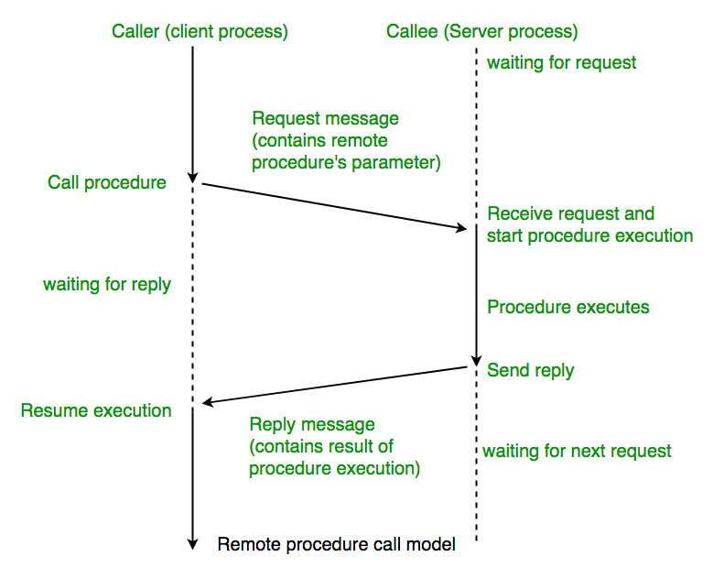

Slide 59
The calling environment is suspended, procedure parameters are transferred across the network to the environment where the procedure is to execute, and the procedure is executed there.
When the procedure finishes and produces its results, its results are transferred back to the calling environment, where execution resumes as if returning from a regular procedure call.
Note : RPC is especially well suited for client-server (e.g. query-response) interaction in which the flow of control alternates between the caller and callee.
Conceptually, the client and server do not both execute at the same time. Instead, the thread of execution jumps from the caller to the callee and then back again.

Slide 60
Types of RPC
Callback RPC
Callback RPC allows processes to act as both clients and servers. It helps with remote processing of interactive applications. The server gets a handle to the client, and the client waits during the callback. This type of RPC manages callback deadlocks and enables peer-to-peer communication between processes.
Broadcast RPC
In Broadcast RPC, a client’s request is sent to all servers on the network that can handle it. This type of RPC lets you specify that a client’s message should be broadcast. You can set up special broadcast ports. Broadcast RPC helps reduce the load on the network.
Batch-mode RPC
Batch-mode RPC collects multiple RPC requests on the client side and sends them to the server in one batch. This reduces the overhead of sending many separate requests. Batch-mode RPC works best for applications that don’t need to make calls very often. It requires a reliable way to send data.

Slide 61
What Does RPC do?
RPC stands for Remote Procedure Call. It lets a program on one computer use code on another computer as if it were on the same computer.
When a program with RPC is made ready to run, it includes a helper part called a stub. This stub acts like the remote code.
When the program runs and tries to use the remote code, the stub gets this request. It then sends it to another helper program on the same computer.
The first time this happens, the helper program asks a special computer where to find the remote code.
The helper program then sends a message over the internet to the other computer, asking it to run the remote code. The other computer also has helper programs that work with the remote code.
When the remote code is done, it sends the results back the same way.
This whole process makes it seem like the remote code is running on the local computer, even though it’s actually running somewhere else.

Slide 62
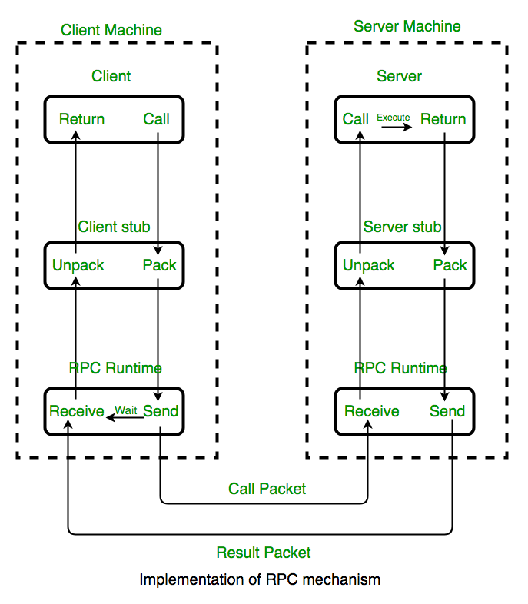

Slide 63
A client invokes a client stub procedure, passing parameters in the usual way. The client stub resides within the client’s own address space.
2. The client stub marshalls(pack) the parameters into a message. Marshalling includes converting the representation of the parameters into a standard format, and copying each parameter into the message.
3. The client stub passes the message to the transport layer, which sends it to the remote server machine. On the server, the transport layer passes the message to a server stub, which demarshalls(unpack) the parameters and calls the desired server routine using the regular procedure call mechanism.
4. When the server procedure completes, it returns to the server stub (e.g., via a normal procedure call return), which marshalls the return values into a message.
5. The server stub then hands the message to the transport layer. The transport layer sends the result message back to the client transport layer, which hands the message back to the client stub.
6. The client stub demarshalls the return parameters and execution returns to the caller.

Slide 64
Issues of the RPC
RPC Runtime
RPC run-time system is a library of routines and a set of services that handle the network communications that underlie the RPC mechanism. In the course of an RPC call, client-side and server-side run-time systems’ code handle binding, establish communications over an appropriate protocol, pass call data between the client and server, and handle communications errors.
Stub
The function of the stub is to provide transparency to the programmer-written application code. On the client side, the stub handles the interface between the client’s local procedure call and the run-time system, marshalling and unmarshalling data, invoking the RPC run-time protocol, and if requested, carrying out some of the binding steps.
On the server side, the stub provides a similar interface between the run-time system and the local manager procedures that are executed by the server.
Binding
The most flexible solution is to use dynamic binding and find the server at run time when the RPC is first made. The first time the client stub is invoked, it contacts a name server to determine the transport address at which the server resides. Binding consists of two parts
Naming: A Server having a service to offer exports an interface for it. Exporting an interface registers it with the system so that clients can use it.
Locating: A Client must import an (exported) interface before communication can begin.

Slide 65
The call semantics associated with RPC
Retry Request Message: Whether to retry sending a request message when a server has failed or the receiver didn’t receive the message.
Duplicate Filtering: Remove the duplicate server requests.
Retransmission of Results: To resend lost messages without re-executing the operations at the server side.

Slide 66
Advantages
Easy Communication: RPC lets clients talk to servers using normal procedure calls in high-level programming languages. This makes it simple for programmers to work with.
Hidden Complexity: RPC hides the details of how messages are sent between computers. This means programmers don’t need to worry about the underlying network communication.
Flexibility: RPC can be used in both local and distributed environments. This makes it versatile for different types of applications.
Disadvantages
Limited Parameter Passing: RPC can only pass parameters by value. It can’t pass pointers, which limits what can be sent between computers.
Slower Than Local Calls: Remote procedure calls take longer than local procedure calls because they involve network communication.
Vulnerable to Failures: RPC depends on network connections, other machines, and separate processes. This makes it more likely to fail than local procedure calls.

