Slide 1

How to design a Webpage
A get to start approach for creating a simple webpage.
01

Slide 2

Basic structure of a webpage
Webpages are comprised of 2 major regions of development,
1. Front-end
2. Back-end
Front-end :
Front-end is nothing but the part of the webpage, which user visually sees and interact with. Most home pages you visit comes under this region of development.
Back-end :
All the data fetching (getting information) and database workflows comes under Back-end region of development.
02

Slide 3
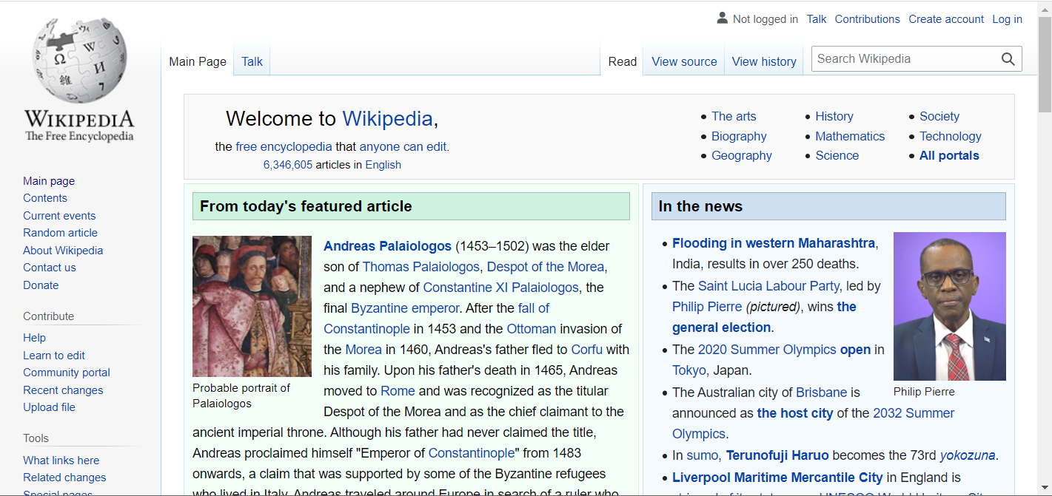
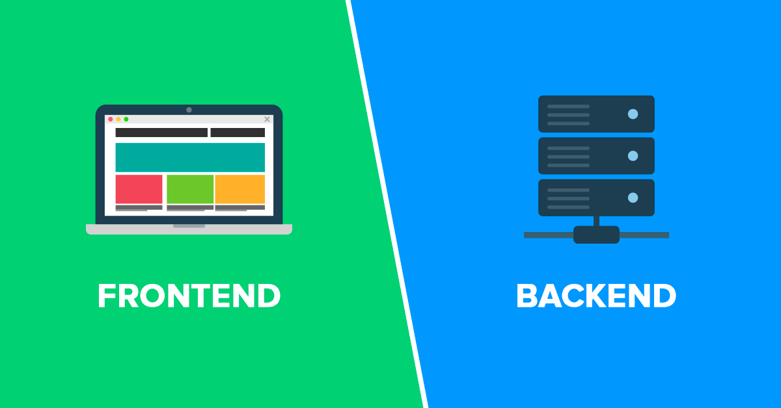
Example
What if we don’t know something, or want to learn more about? We use Wikipedia and search for the desired article, and in turn Wikipedia, gives us nicely presented result. Let’s take this use-case and separate the two regions of development.
Front-end:
The input search bar you use to search for an article ,the whole homepage containing contents like “Today’s featured article” and all visual contents, comes under Front-end region.
Back-end:
When we enter the keyword in the search bar, Wikipedia just traverses it’s database and present us the relevant content. This part of database operation is not visually seen and hidden from the user. This comes under the Back-end region.
03

Slide 4

Connecting regions.
So how do we connect the Front-end with Back-end? We use the power of scripting languages and manipulate the web-content from Front-end to Back-end vice-versa. Scripting languages provide a way for data transfer between Front-end and back-end.
So when next time, when your search query fetches you the desired result, Thank the middleman (Scripting language) for taking your query from the front-end to the database in backend.
04

Slide 5
So, how exactly can we create a Front-end, Back-end and connect them?
Front-end:
We use Markup Languages to structure and use Stylesheets to style our webpage to make it more appealing to the user. There are many Markup Languages available like , XML, HTML, SGML and XHTML. HTML being a popular choice. We use CSS3 to style the webpage and JavaScript in client-side to make webpages more dynamic and interactive.
Backend:
Back-end has many options to choose from ranging from PHP, Java, Ruby to Python and JavaScript. The most popular ones being, Python and JavaScript in recent times. We use databases like MYSQL, MongoDB and PostgreSQL.
Connecting both:
As we discussed before, we use scripting languages like JavaScript, VBScript , with JavaScript being the most dominant one.
05

Slide 6

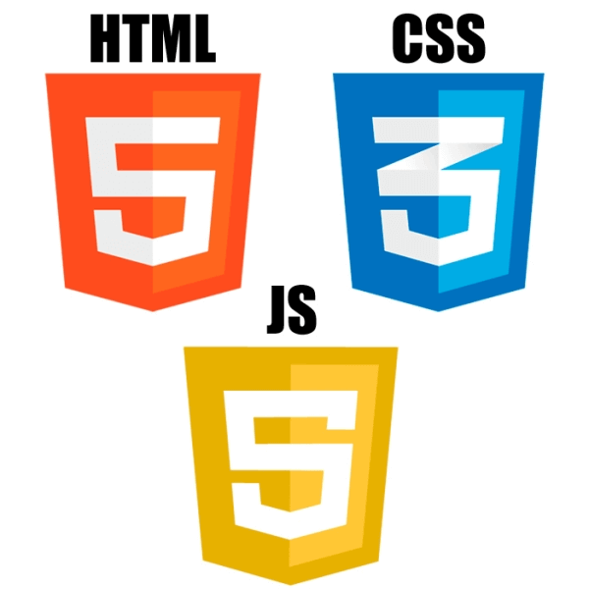
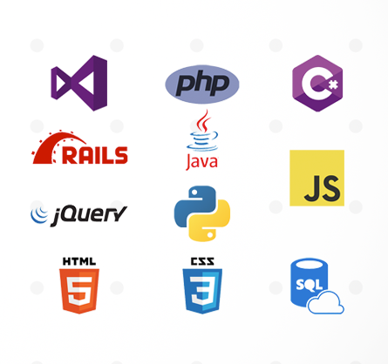

Scripting-Languages
Front-end
Back-end
06

Slide 7
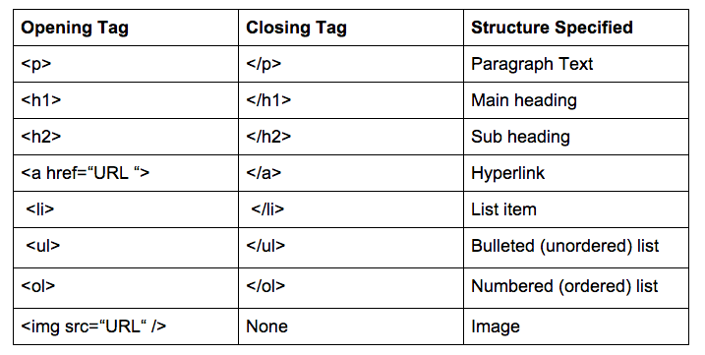
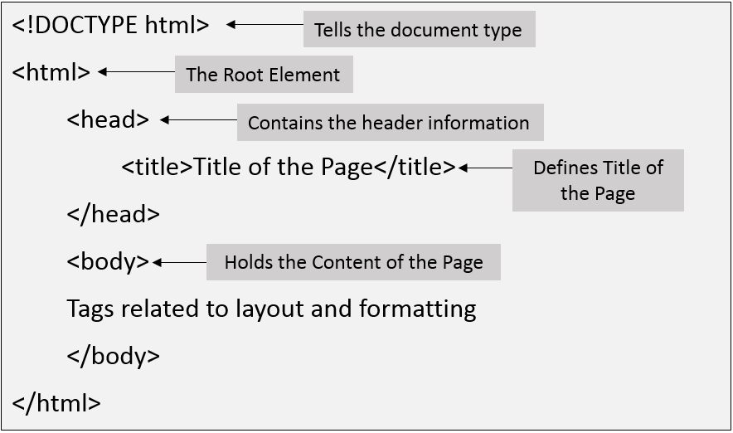
HTML
HTML structures the webpage in a tree like manner. It uses tags to create a basic layout and tags in turn uses attributes (properties) for additional features. A basic structure of HTML is given below,
Some commonly used tags and their uses are discussed below,
07

Slide 8
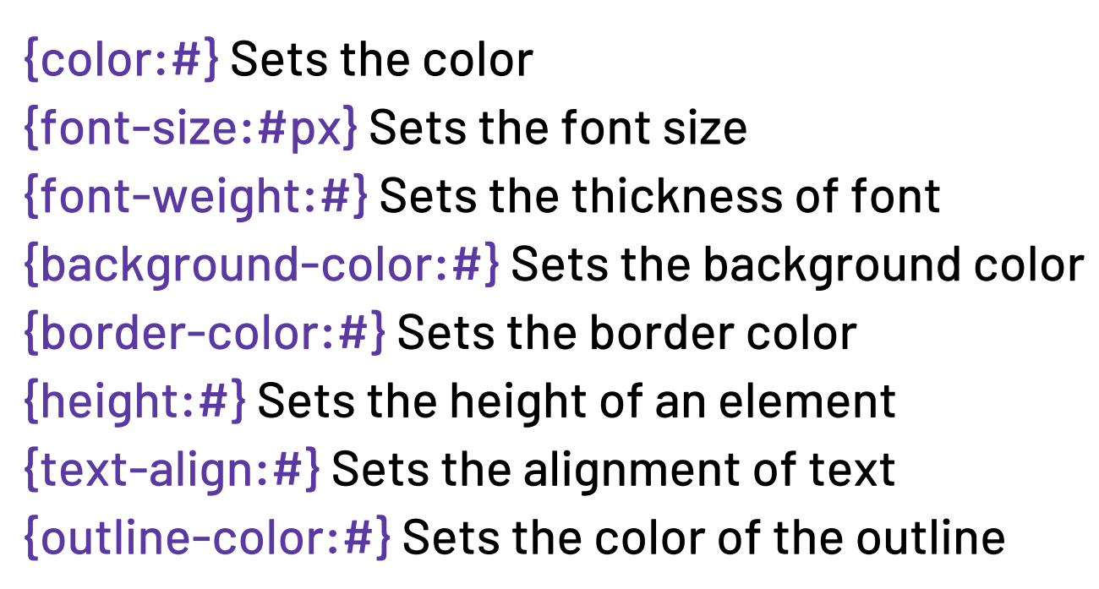
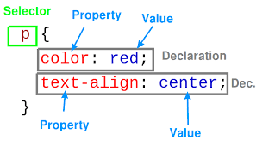
CSS
CSS uses selector rules, to target elements In the webpage and to make them more visually appealing by adding styling. Basic structure of CSS rules are given below,
Selectors – selects the element to apply styling.
Property – states, which property to change.
Value – states, how much that selected property should be changed. A combination of a property and a value is called Declaration.
Some commonly used tags and their uses are discussed below,
08

Slide 9
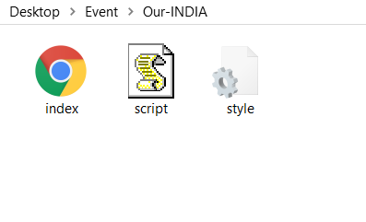
So, enough of theory, let’s get practical.
STEP 1 :
Let us create a new folder in our computer, inside which our project resides.
STEP 2 :
Create an index.html, style.css and script.js files inside that folder.
The objective of this event, is to get you started on Web-development.
We are going to create a simple static webpage. (Static means a webpage without any back-end and database). Let us make a website describing our country.
09

Slide 10

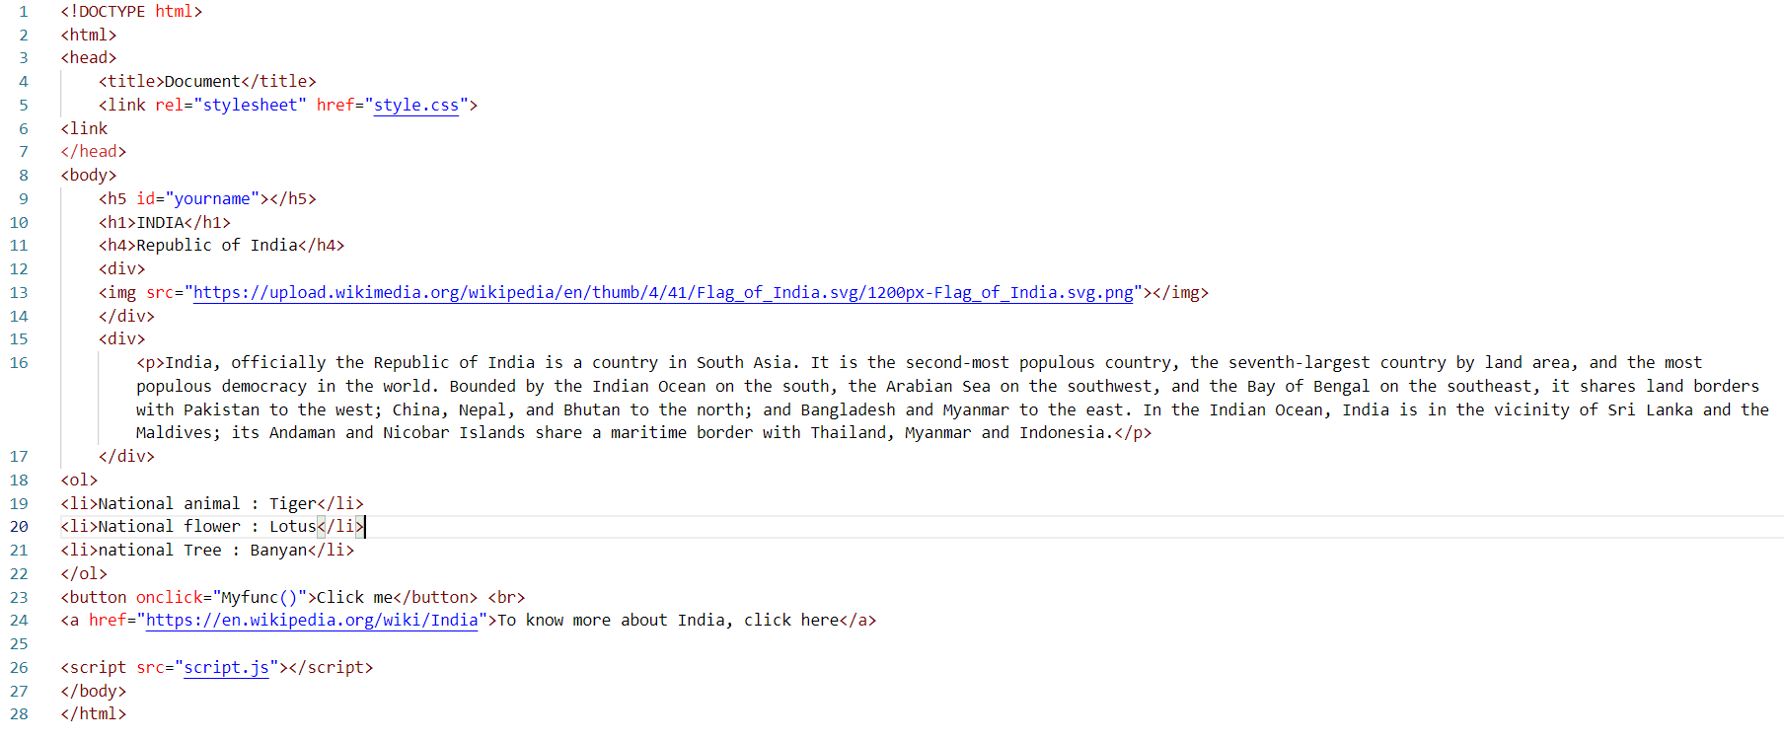
STEP 3 :
Open the index.html file and create a simple structure containing some images and text elements. We use <link> and <script> tag to link our CSS and JavaScript respectively.
10

Slide 11
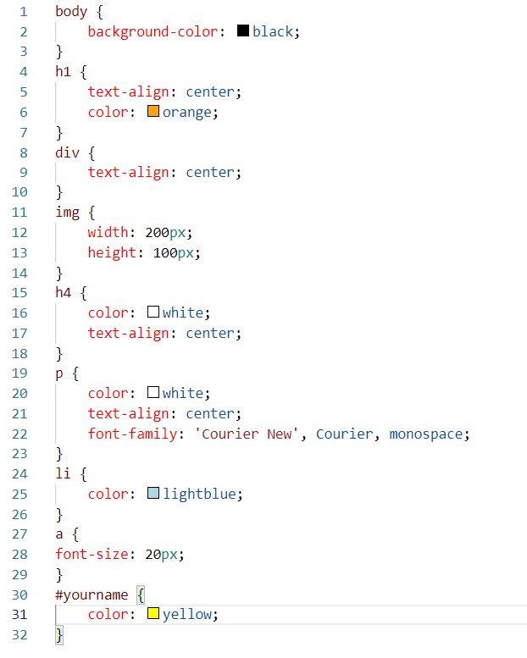
STEP 4 :
Now lets style our simple static page using CSS. We change background color, font color and alignments using CSS. We even use Width and Height to make our image smaller.
Font-family – Indicates which family of fonts to use.
Width & Height – Specifies the width and height of the image.
Font-size – It specifies the font size for the text.
11

Slide 12
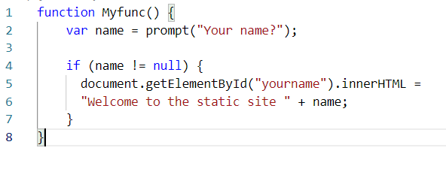
STEP 5 :
Lets do a small amount of JavaScript here, remember the button we’ve added in our HTML, and the empty h5 tags with id of “yourname”, we are going to trigger an function on clicking the button. We add the event listener “onclick” to the button, to wait for click events. If a click event is sensed , we run the “Myfunc” function.
Now on our script.js file, we use the prompt function to prompt the user for input and display it in the “yourname” tag.
We define a function called “Myfunc” which contains a variable “name” which stores the value entered in the prompt by the user.
We then do a simple “if” to determine, if the user entered value is not null, if it is not null, we proceed with grabbing the element with “id” of “yourname” and change it’s innerHTML value to the string followed by the entered value.
12

Slide 13
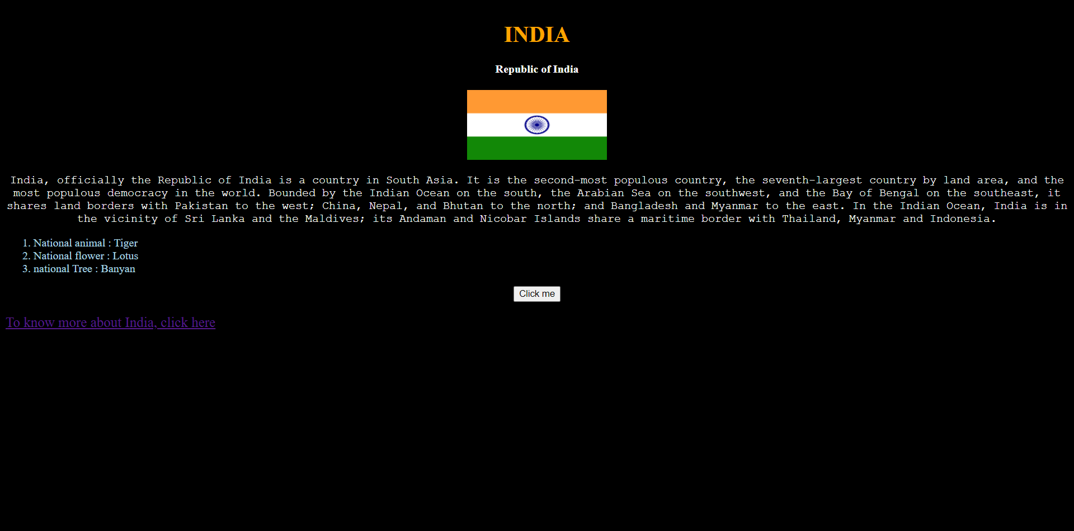
STEP 6 :
That’s it, Now let’s open the index.html page in browser, to see our webpage in action.
13

Slide 14
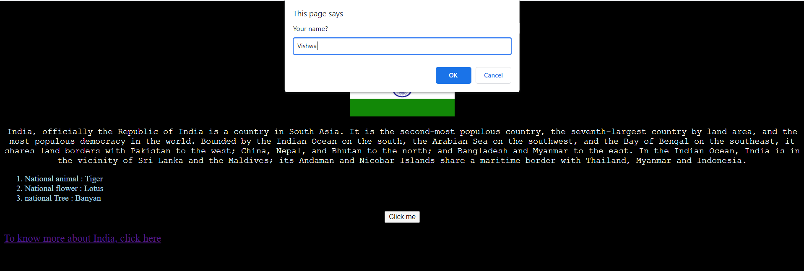
Now after we press the button, we get a prompt, to enter our name.
14

Slide 15
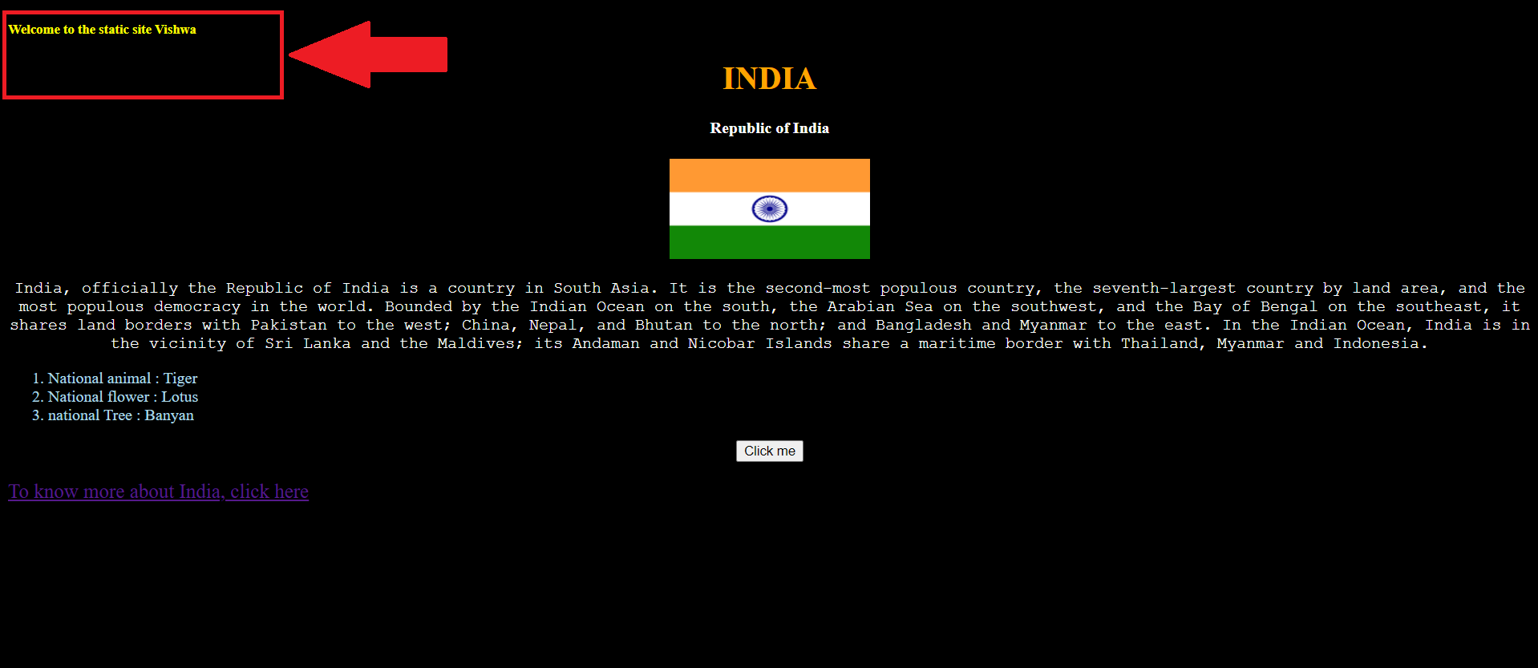
Note the name we’ve entered , is displayed on the top-left.
15

Slide 16
So now, we’ve created a static webpage
Thank You
16

Slide 17
Vishwa.R - LinkedIn
code-reaper08 - GitHub
17

