Slide 1
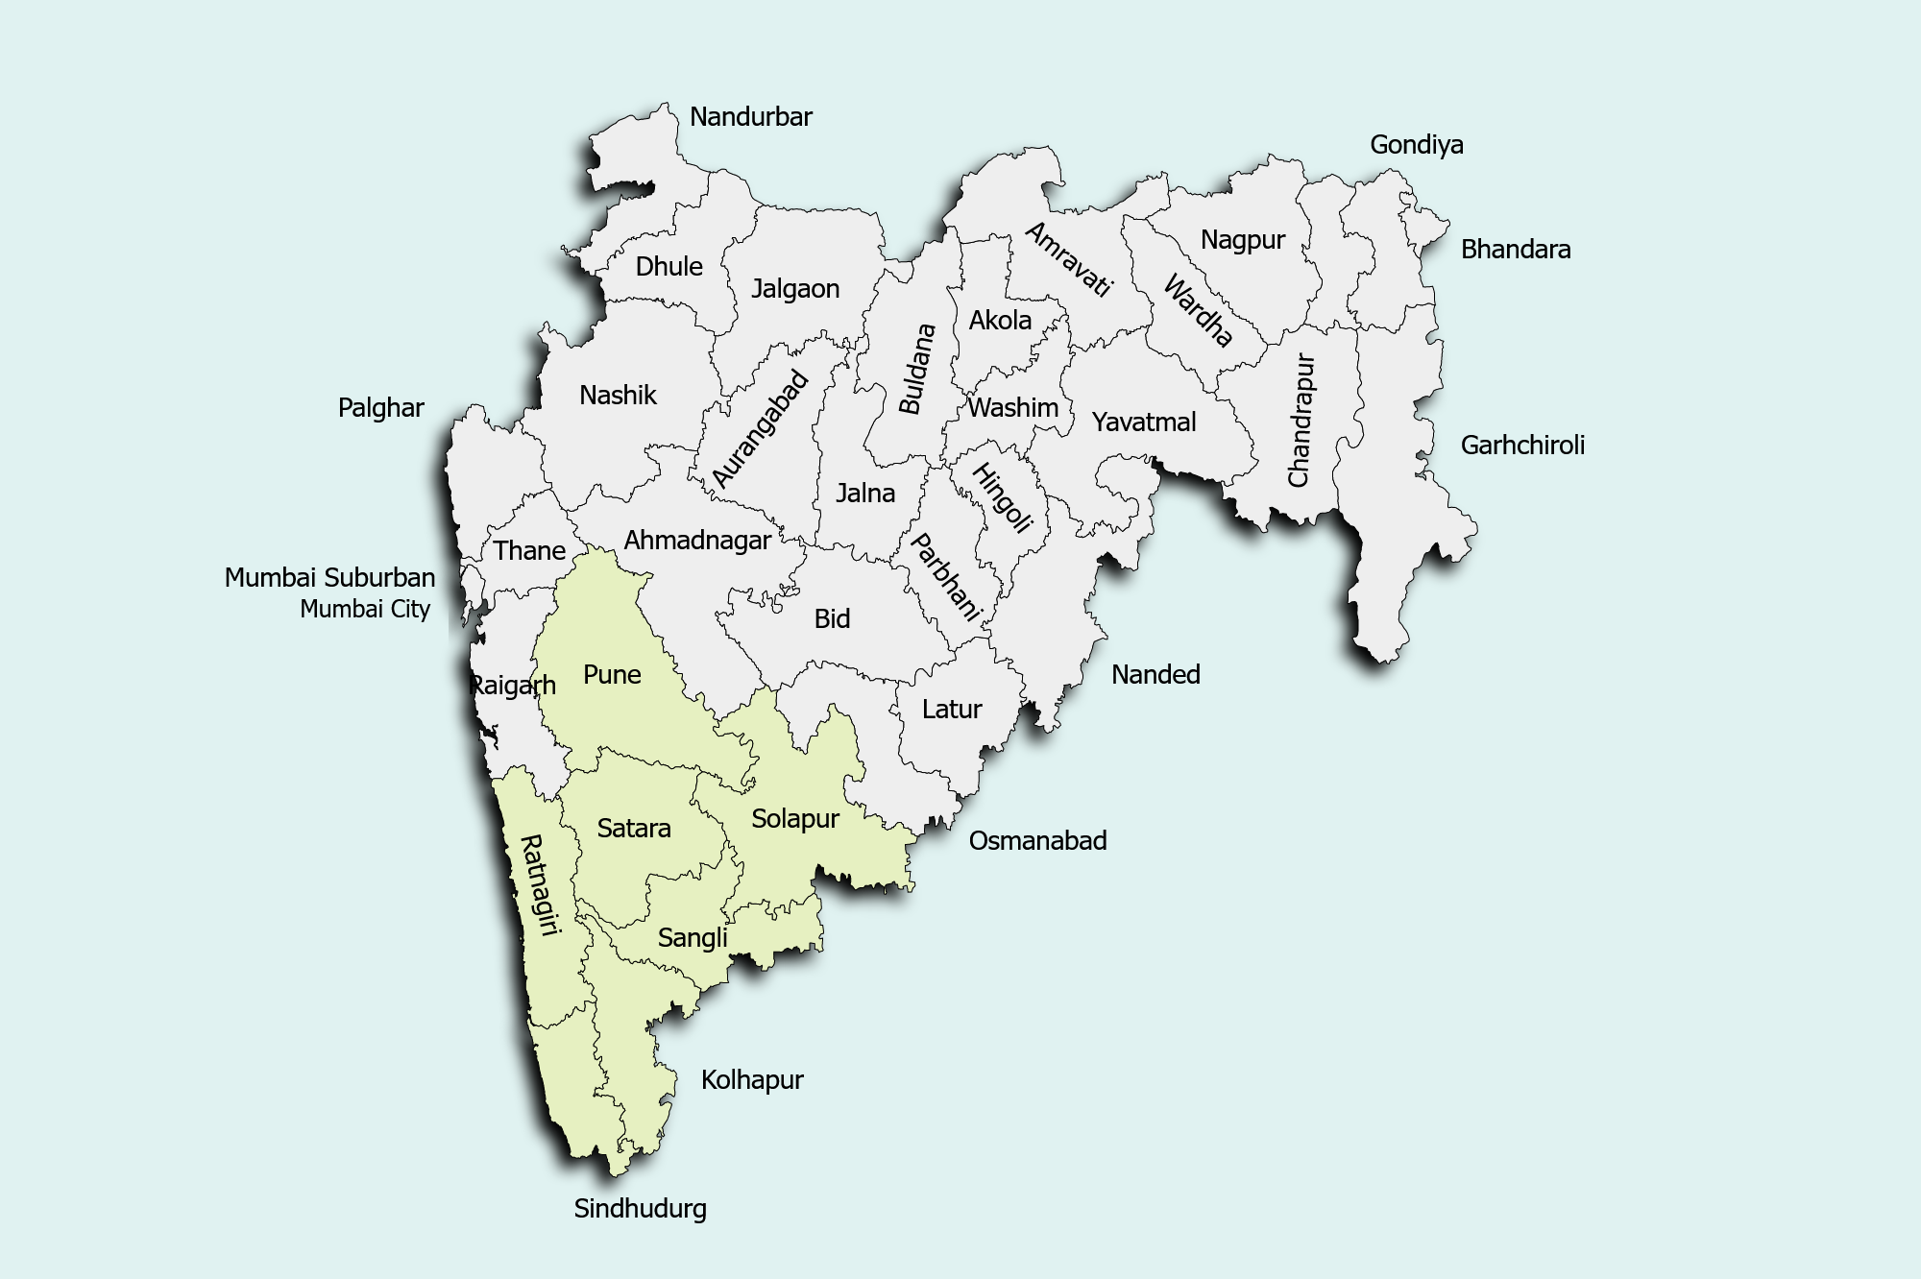
Jurisdiction of Pune Customs
Mumbai - Suburban
Talegaon
Bhamboli
Chinchwad
Pimpri
Dighi
Mumbai
Q
Airport & ACC
Pune HQ,
Pune CFD
Bankot
Dapoli Division HQ, CFD
Satara
Commissionerate HQ
Port
ICD
Airport & Air Cargo
Customs Division HQ (Preventive & CFD)
Customs Facilitation Range
Kelshi
Dabhol
Solapur
Chiplun
Q
Jaigad
Ratnagiri Divn HQ + CFD
Ranpar
Sangli
Kolhapur
Vijaydurg
Sindhudurg Divn HQ
+ CFR
Redi

