Slide 1

Code-RLadies
Getting R Installed & Working!
January Meeting
Jan 21, 2020

Slide 2
A Few Points of Business
We have RLadies Stickers!
We need a Sponsor (so we can keep having food provided)
We could also do brown-bag/ potluck
Double check communication channels
Where to go for everything
Who is taking control of specific outlets
Others?

Slide 3
Wifi and Password for the Hub
Wifi: apt112
Password: 124568909865421

Slide 4
LaTeX
Used to create R Markdown documents, the background typesetter
Must do this first (It will likely make you reinstall EVERYTHING if you wait)
https://www.latex-tutorial.com/installation/
Windows -- MikTex
Linux -- texlive package and pdflatex command to compile files
Mac -- MacTeX
Getting A Latex editor might not be a bad idea (Hope prefers TeXMaker)

Slide 5
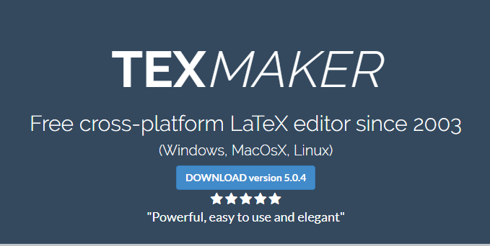
Windows
Search: miktek download
Website: https://miktex.org/download
Mac
Search: mactex download
Website : https://tug.org/mactex/mactex-download.html
Search: TeXMaker download
Website: https://www.xm1math.net/texmaker/download.html

Slide 6
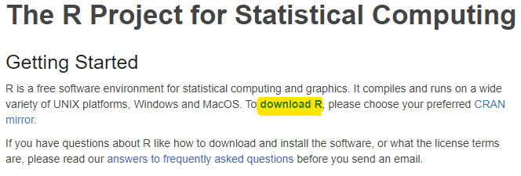
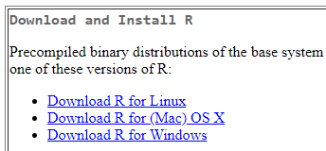
R
Search: r download
Website: https://www.r-project.org/
Click on the “download R” link under Getting Started
Choose a mirror; the cloud link will choose for you
Each OS has its own link
Current Version : 3.6.2 “Dark and Stormy Night”

Slide 7
RStudio
RStudio is an integrated development environment (IDE) for R. It makes using R easier because it includes features like a console and tools for plotting, history, debugging, and workspace management.
Google “Rstudio install” and select the first link (Download RStudio)
Click the download button for the free RStudio Desktop (option on the far left)
From here, you can install the correct file for your operating system
The current version of RStudio is RStudio-1.2.5033

Slide 8

GIT & GITHub
GIT & Github are great tools for version control. Version control
is necessary when coding so you don’t lose everything when a
system crashes.
GIT uses the command line, so it can be tricky to set up
Search and BOOKMARK: happyGITwithR
Website: https://happygitwithr.com/
A super detailed walkthrough of getting GIT to work with R that we will follow to install GIT

Slide 9
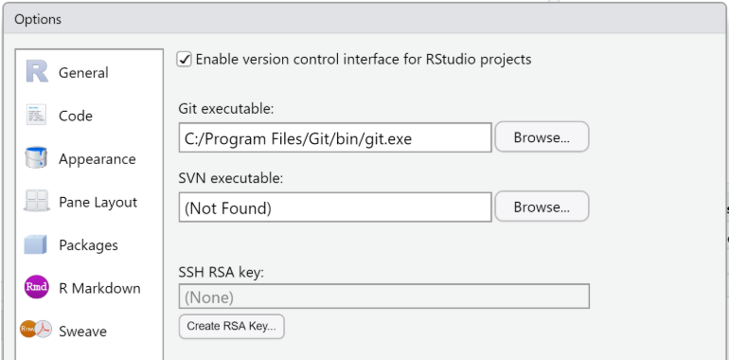
GIT & R
According to Jenny Bryan, you need a free GitHub account to connect with R and a repository. Luckily, we have one!
https://github.com/code-rladies/code-rladies-resources
To clone it from RStudio:
Tell R where the git.exe file is
Restart RStudio
Start a new project
Copy https from GITHub

Slide 10
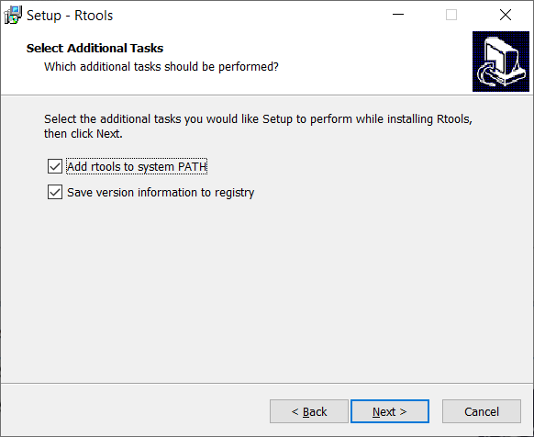
RTools, Xcode, & Other Development Tools
RTools is a collection of tools necessary for building R packages (you don’t need it for all packages, but there are some really cool ones you can only install if you have Rtools!)
For Windows:
Google “rtools install” and select “Rtools - CRAN - R” It should be the first option
Click on “RTools35.exe” This is the recommended option and will be the second on the list
When you go through the installer for Rtools, be sure to select “Add rtools to system PATH” on the Select Additional Tasks page

Slide 11
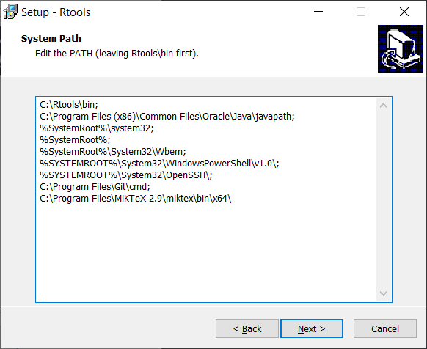
RTools, Xcode, & Other Development Tools
Put your cursor at the end of the first line of the system path and hit your enter key so you can start a new line
For the new line, type “C:\Rtools\mingw_32\bin;”
After you’ve added this additional line to the system path, hit next and continue with the installation
When it’s done installing, you can double check that the system path is correct by opening RStudio and typing “sys.getenv(“PATH”)” into the console and hitting enter. You should see “C:\\Rtools\\bin; C:\\Rtools\\mingw_32\\bin;” in the output
Notes:
If anyone forgets to add to their system path during the install, they can type “env” into their start search, select “Edit the system environment variables”, click “Environment Variables…” button under the “Advanced” tab, under “System Variables” section in the lower pane find and select the “Path” row and then click the edit button. From here, you can click the “New” button and type out the line mentioned in step 5, then click the “Move Up” button until this new line is right under the “C:\Rtools\bin;” line. Click OK to save the changes and everything should be good to go. You may need to restart apps like rstudio for the changes to be updated.

Slide 12
RTools, Xcode, & Other Development Tools
Xcode is an integrated development environment (IDE) for macOS containing a suite of software development tools
For mac:
Goodle “install xcode” and “go to download” for Xcode. This should be the first option
You should be able to install it from here like you would any other app

Slide 13
RTools, Xcode, & Other Development Tools
After installing Rtools or Xcode, install devtools.
Pull up RStudio and type the following into the console (lower left pane): install.packages("devtools")
Another option is to click on the “Packages” tab in the lower right pane, click on “Install”, type “devtools” into the box for packages, and click the install button

Slide 14
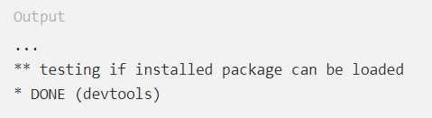
RTools, Xcode, & Other Development Tools
If you are using linux, you’ll have to install a compiler and various development libraries that very depending on what flavor of linux you use. The example is for ubuntu. If you are using a different flavor, let us know, and we’ll help you figure it out!
For ubuntu:
Install system dependencies for devtools: sudo apt install build-essential libcurl4-gnutls-dev libxml2-dev libssl-dev
Enter R’s shell as root to make devtools available system-wide: sudo -i R
Install devtools: install.packages('devtools')
When it’s finished, you should see:
Notes:
Source for installing devtools on ubuntu: https://www.digitalocean.com/community/tutorials/how-to-install-r-packages-using-devtools-on-ubuntu-18-04

Slide 15
RTools, Xcode, & Other Development Tools
Once you have all installed devtools on your respective operating systems, load the devtools library by typing and entering “library(devtools)” into your console
Windows people: After loading devtools, type “find_rtools()” into the console and it should return TRUE if your Rtools installation worked properly

Slide 16
FINALLY Done Installing!!!
Now to play around a little!
Change the color and window setup!
Tools → Global Options
Appearance and Pane Options
Let’s add a fun start up message!
You need the usethis package for easy access
All the shortcuts!
Press Alt + Shift + K

Slide 17
Website Collection
LaTeX: https://www.latex-tutorial.com/installation/; https://www.xm1math.net/texmaker/download.html
R: https://www.r-project.org/
RStudio: https://rstudio.com/products/rstudio/download/
Git: https://happygitwithr.com/; https://github.com/code-rladies/; https://github.com/code-rladies/code-rladies-resources
Rtools: https://cran.r-project.org/bin/windows/Rtools/; https://developer.apple.com/xcode/
Other help: https://github.com/Chris-Engelhardt/data_sci_guide; https://github.com/kristineccles/Introduction_to_R

