Slide 1


Case Study of airbnb
Presented by : Sarthak Omar
Omar

Slide 2

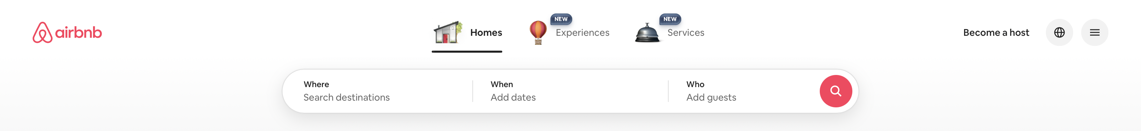

About the company
Airbnb is a global online platform launched in 2008 that connects hosts offering homes or spare rooms with travelers looking for short-term stays. Operating on a peer-to-peer model, it offers a wide range of accommodations—from private rooms to entire properties—along with user reviews, secure payments, and customer support. Airbnb earns through service fees charged to hosts and guests and has expanded into experiences and business travel. By prioritizing flexibility and personalized stays, it has reshaped how people think about accommodation and challenged the traditional hotel industry.

Slide 3
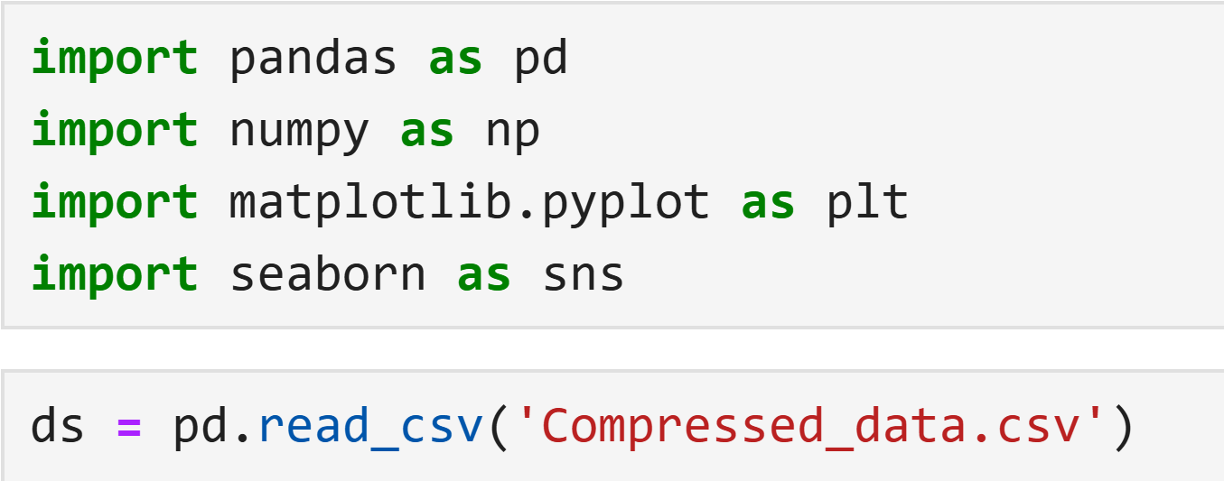
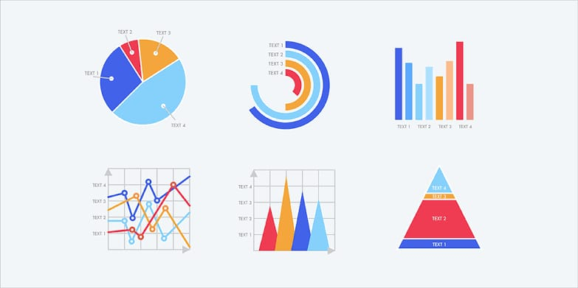
About The Dataset
The dataset contains 102599 rows and 26 Columns, where the Columns have null values. To deal with them, I used 2 libraries, NumPy & Pandas. I used NumPy for mathematical operations, Pandas for handling the Dataset, and Matplotlib-Pyplot and Seaborn for Data visualization.
Insights Delivered
What is the distribution of listing prices?
How are the different room types distributed?
How are listings distributed across different neighborhoods?
Relationship between price and room type

Slide 4
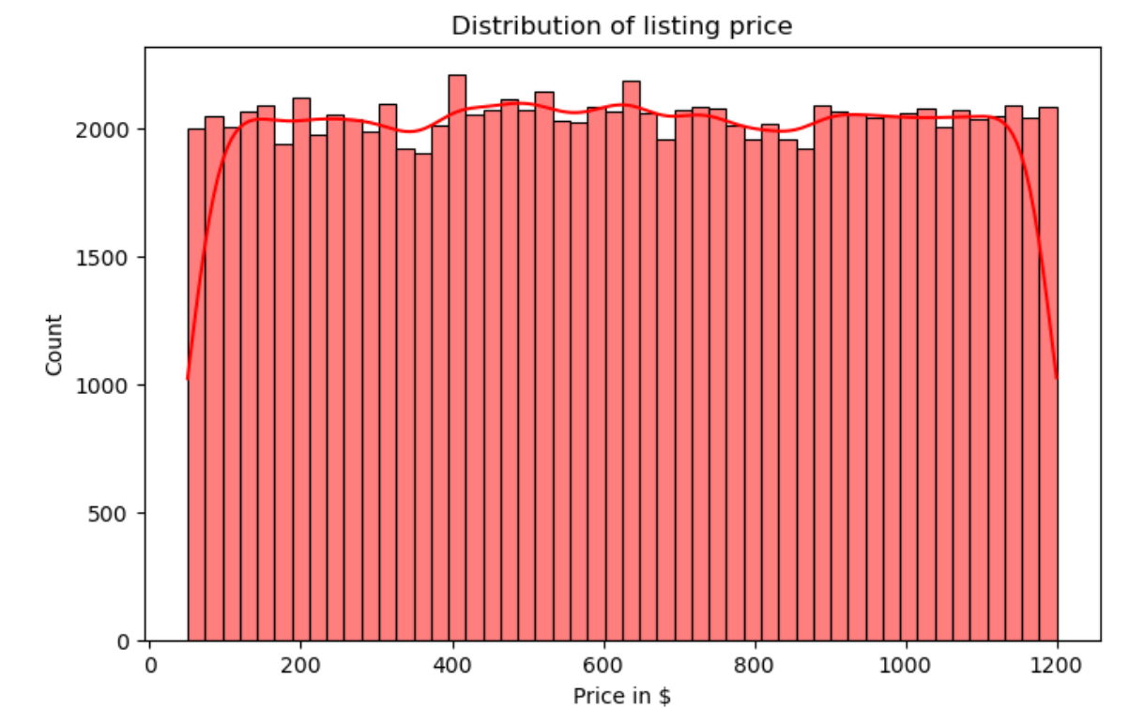
What is the distribution of listing prices?
The price histogram shows the even distribution of listing price ranges across different prices.
There is a specific consideration of listing price in any particular price range
The KDE line helps us to visualize the graph more effectively

Slide 5
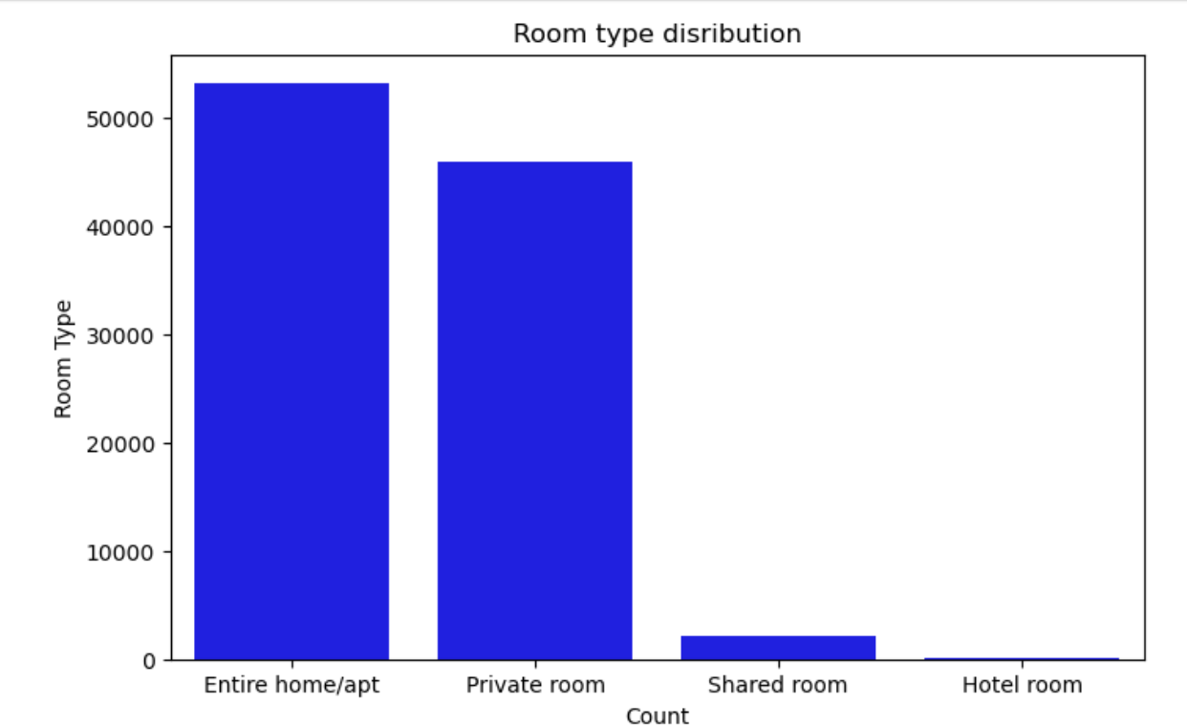
How are the different room types distributed?
According to the distribution, more people like to book an apartment room type.
And the second preference is a private room.
Shared rooms and hotel rooms are significantly less preferred.

Slide 6
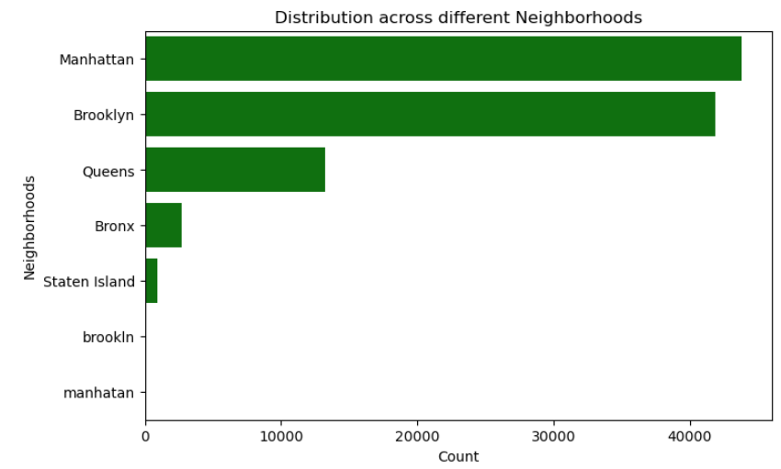
How are listings distributed across different neighborhoods?
This horizontal bar chart shows the number of entries (or items) distributed across different neighborhoods in a city. Each bar represents a neighborhood, and the length of the bar shows how many times that neighborhood appears in the dataset.

Slide 7
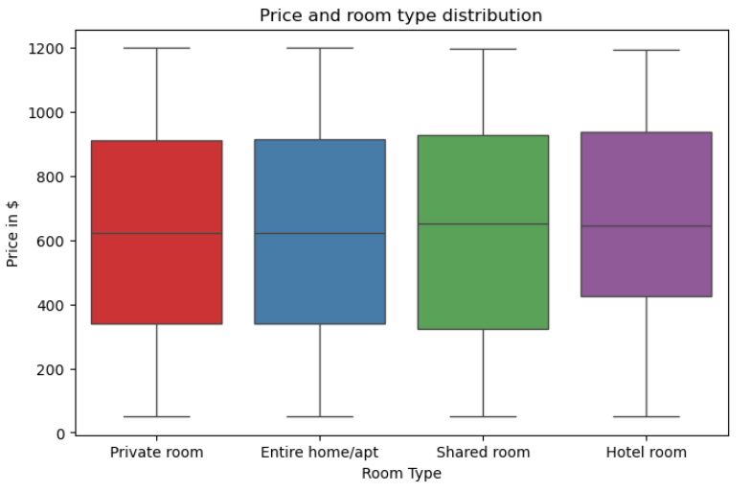
Relationship between price and room type?
All room types have a broad price distribution, roughly from $50 to $1200
The median price is around $620–650 for all room types.
Surprisingly, Shared rooms have similar price ranges and medians as Private rooms and even Entire apartments — this could suggest pricing inconsistencies or anomalies in the dataset.
Thank you For Exploring!!
Sign Out

